Slide 1
2026年销售报告
{{text:subtitle}}
{{text:report_date}}
{{image:product_image}}
{{text:company_name}}

Slide 2
Key Business Metrics
Report: 2026年销售报告
SALES
GROWTH
ORDERS
CUSTOMERS
1258万元
{{text:growth}}
{{text:orders}}
{{text:customers}}
Total reported sales: 1258万元 year to date.
Metric | Value A | Value B
Summary | 1258万元 | Growth {{text:growth}} YoY

Slide 3
Product Showcase
{{text:product_name}}
{{image:product_image}}
{{text:product_description}}
Price
{{text:product_price}}
Month-over-month growth
{{text:product_growth}}
2026年销售报告

Slide 4

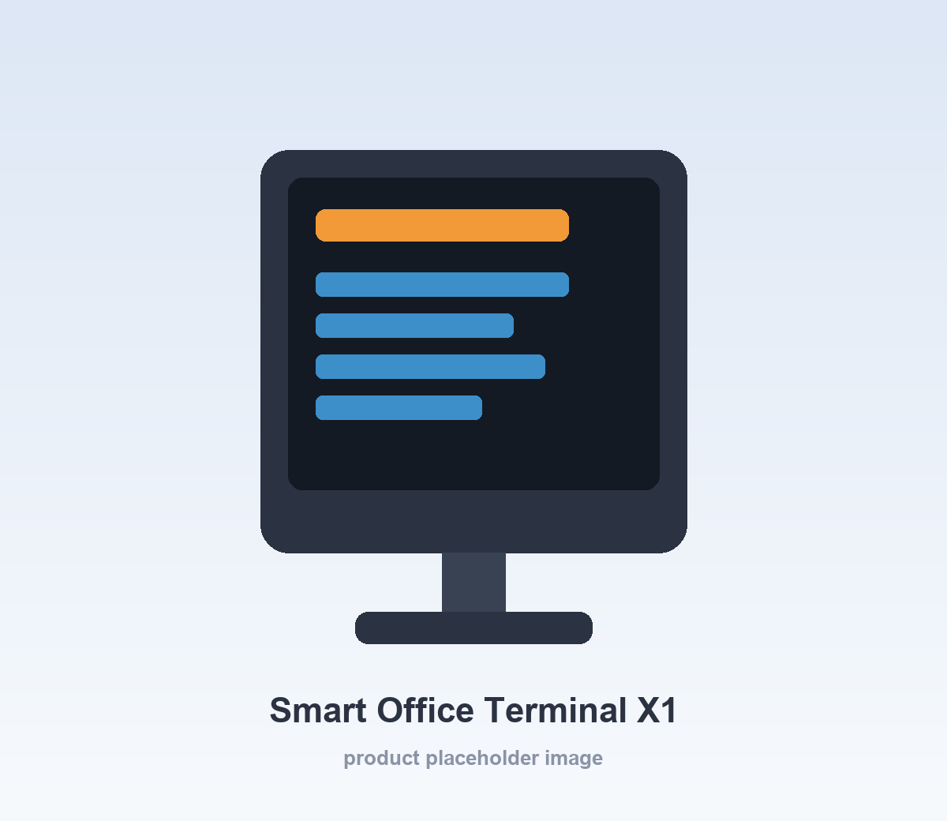
Workspace Asset Test
{{image:missing_image}}

