Slide 1
Java Web

Slide 2
servlet
用Java编写的服务器端程序
交互式地浏览和修改数据
生成动态Web内容

Slide 3
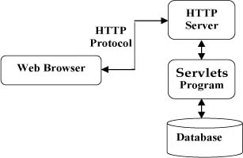

Slide 4
public class Demo extends HttpServlet {
@Override
protected void doGet(HttpServletRequest req, HttpServletResponse resp) throws ServletException, IOException {
resp.setContentType("text/html");
PrintWriter writer = resp.getWriter();
writer.print("<p>hello,world</p>");
writer.close();
}
}
before servlet3.0
xml配置
<servlet>
<servlet-name>index</servlet-name>
<servlet-class>org.zhy.Demo</servlet-class>
</servlet>
<servlet-mapping>
<servlet-name>index</servlet-name>
<url-pattern>/index</url-pattern>
</servlet-mapping>
after servlet3.0
@WebServlet(value = "/index")

Slide 5
jsp
全称JavaServer Pages）是由Sun Microsystems公司倡导和许多公司参与共同建立的一种使软件开发者可以响应客户端请求，而动态生成HTML、XML或其他格式文档的Web网页的技术标准。

Slide 6
<%@ page import="java.util.Date" %>
<%@ page contentType="text/html;charset=UTF-8" language="java" %>
<html>
<head>
<title>jspDemo</title>
</head>
<body>
<p>here is a jsp!</p>
<p><%= new Date() %></p>
</body>
</html>

Slide 7
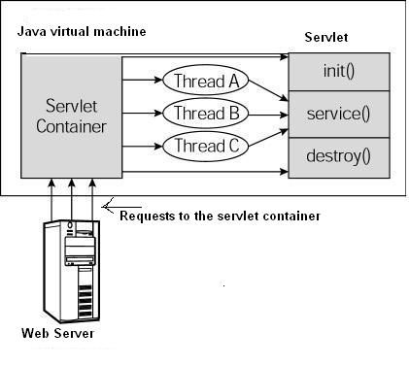
public interface Servlet {
void init(ServletConfig var1) throws ServletException;
ServletConfig getServletConfig();
void service(ServletRequest var1, ServletResponse var2);
String getServletInfo();
void destroy();
}

Slide 8
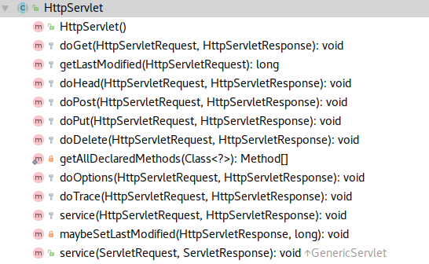

Slide 9
//简化的service源码
protected void service(HttpServletRequest req, HttpServletResponse resp) {
String method = req.getMethod();
if(method.equals("GET")) {
this.doGet(req, resp);
} else if(method.equals("HEAD")) {
this.doHead(req, resp);
} else if(method.equals("POST")) {
this.doPost(req, resp);
} else if(method.equals("PUT")) {
this.doPut(req, resp);
} else if(method.equals("DELETE")) {
this.doDelete(req, resp);
} else if(method.equals("OPTIONS")) {
this.doOptions(req, resp);
} else if(method.equals("TRACE")) {
this.doTrace(req, resp);
} else {
String errMsg1 = lStrings.getString("http.method_not_implemented");
Object[] errArgs = new Object[]{method};
errMsg1 = MessageFormat.format(errMsg1, errArgs);
resp.sendError(501, errMsg1);
}
}

Slide 10
doPost方法
<form action="/index" method="post">
name<input type="text" name="name"><br>
age<input type="text" name="age"><br>
<input type="submit">
</form>
@Override
protected void doPost(HttpServletRequest req, HttpServletResponse resp) throws ServletException, IOException {
String name = req.getParameter("name");
String age = req.getParameter("age");
PrintWriter writer = resp.getWriter();
writer.println("name = " + name);
writer.println("age = " + age);
writer.close();
}

