Slide 1
Chapter 10
Combinatorial designs

Slide 2
Summary
Modular arithmetic
Block designs
Steiner triple systems
Latin squares
Assignments

Slide 3
Modular arithmetic

Slide 4


Some notations
Z: the set of integers {… -2, -1 , 0, 1, 2, …}
Z_{n}: the set of non-negative integers {0, 1, 2, …, n-1} which are less than n.
If m is an integer, then there exist unique integers q (the quotient) and r (the remainder) such that m = q × n + r, 0 ≤ r ≤ n-1.
Addition mod n is the (unique) remainder when the ordinary sum a +b is divided by n
Multiplication mod n is the unique remainder when the ordinary product a × b is divided by n.

Slide 5

Example
The simplest case is n = 2. we have Z₂ = {0, 1}, and addition and multiplication mod 2 are given in the following tables:
⊕
0
1
0
1
0
0
1
0
0
0
1
1
0
1
0
1

Slide 6
Exercises
Construct the addition and multiplication tables for the integers mod 3 and integers modulo 4.

Slide 7


Inverse
An additive inverse (denote as – a) of an integer a in Z_{n} is an integer b such that
A multiplication inverse (denote as a⁻¹) of an integer a in Z_{n} is an integer b in Z_{n} such that

Slide 8
Example
In the integers modulo 10, the additive inverses are as follows:
-0 = 0, -1 = 9, -2 = 8, -3 = 7, -4 = 6
-5= 5 , -6 = 4, -7 = 3, -8 = 2, -9 = 1
The multiplication inverses are as follows:
1⁻¹ = 1, 3⁻¹ = 7, 7⁻¹ = 3, 9⁻¹ = 9, none of 0, 2, 4, 5, 6, and 8 has a multiplication inverse in Z₁₀.

Slide 9
Algorithm to compute the GCD
GCD (a, b):
Set A = a and B = b.
While A × B ≠ 0, do
if A ≥ B, then replace A by A – B.
else, replace B by B – A.
Set GCD = B.
Question: How to compute GCD(a₁, a₂, a₂ ,…, a_{n})?

Slide 10
Example
A
B
Compute GCD(48, 126).
By applying the algorithm, the results are displayed as shown in the table. We conclude that the GCD of 48 and 126 is the terminal value d = 6 of B.
48
126
48
78
48
30
18
30
18
12
6
12
6
6
0
6

Slide 11
Theorem 10.1.2
Let n be an integer with n ≥ 2 and let a be a non-zero integer in Z_{n} = {0, 1, 2, …, n-1}. Then a has a multiplicative inverse in Z_{n} iff the greatest common divisor (GCD) of a and n is 1. If a has a multiplicative inverse, then it is unique.

Slide 12
Corollary 10.1.3
Let n be a prime number. Then each non-zero integer in Z_{n} has a multiplicative inverse.
If GCD (a, b) = 1, then we call a and b relatively prime.

Slide 13
Calculate the inverse
Determine if 11 has a multiplicative inverse in Z₃₀ and, if so, calculate the multiplicative inverse.
By applying the algorithm, GCD(11, 30) = 1 and the results are displayed in the table. By theorem 10.1.2, 11 has a multiplicative inverse in Z₃₀. We use the equations in the table:
1= 3-1×2=3-1×(8-2×3) = 3×3 – 1×8
=3×(11-1×8) – 1 × 8 = 3×11 – 4×8
= 11×11 - 4×30 , hence, 11⁻¹ = 11 in Z₃₀.
A
B
30
11
30=2×11+8
8
11
11=1×8+3
8
3
8=2×3+2
2
3
3=1×2+1
2
1
2=2×1+0
0
1
d = 1

Slide 14
Exercise
Find the multiplicative inverse of 16 in Z_{45.}

Slide 15
Fields
For each prime p and each integer k ≥ 2, there exists a polynomial of degree k with coefficients in Z_{p} which does not have a non-trivial factorization.
Example: for Z₂, x³ + x + 1 =0 has no non-trivial factorization in Z₂.
The polynomial has a root denoted as i, i.e., i³ + i + 1 = 0.

Slide 16
Field
The p^{k} elements of the finite field is
{a +bi+ci²+…+di^{k-1}: a, b, c, and d in Z_{p}}, where i is a root of the polynomial.
i^{k} can be calculated by the polynomial.

Slide 17
Example
Construction of a field with 4 elements.
We start with Z₂ and the polynomial x²+x+1 with coefficients in Z₂ . The polynomial has no root in Z₂ and cannot be factored in any non-trivial way. We adjoin a root i of this polynomial to Z₂, getting i²+i+1 = 0, hence, i² = -i-1=i+1.
The four elements of the field is {a+bi: a, b in Z₂} = {0, 1, i, 1+i}. With addition table and multiplication table given in the next page.

Slide 18
Addition table and multiplication table of F₄
+
0
1
i
1+i
×
0
1
i
1+i
0
0
1
i
1+i
0
0
0
0
0
1
1
0
1+i
i
1
0
1
i
1+i
i
i
1+i
0
1
i
0
i
1+i
1
1+i
1+i
i
1
0
1+i
0
1+i
1
i
i² = 1 + i; i × (1 +i) = i + (1 + i) = 1+0×i = 1 ;
(1+i) ×(1+i) = i² +(1+1) ×i + 1 = (1+i) + 1 = i

Slide 19
Another example
Construction of a field of 3³ = 27 elements.
We start with Z₃ and the polynomial x³+2x+1 with coefficients in Z₃ . The polynomial has no root in Z₃ and cannot be factored in any non-trivial way. We adjoin a root i of this polynomial to Z₃, getting i³+2i+1 = 0, hence, i³ = -2i-1=i+2.
The field with 27 elements is {a+bi+ci²: a, b and c in Z₃}. The addition and multiplicative arithmetic satisfy the usual laws of mod 3 arithmetic.

Slide 20
Exercise
Start with Z₂ and show that x³ + x +1 cannot be factored in a non-trivial way, and then use this polynomial to construct a field with 2³ = 8 elements.
Continue to do the following computations: 1) (1+i) + (1+i+i²)
2) i² × (1+i+i²)
3) (1+i)⁻¹.

Slide 21
Block designs

Slide 22
An Example
suppose 7 varieties of products need to be tested by 7 consumers. Each consumer is asked to compare a certain 3 of the varieties. The test is to have a property that each pair of the 7 varieties is compared by exactly one person. Can such a testing experiment be designed?

Slide 23
Analysis for the example
We label the different varieties 0, 1, 2, 3, 4, 5, 6. There are C(7, 2) = 21 pairs of the 7 varieties. Each tester gets 3 varieties and thus makes C(3, 2) = 3 comparisons. Since each pair is to be compared exactly once, the number of testers must be 21/3=7. Thus in this case, the design is possible.

Slide 24
Block design for the example
For the above example, what we now seek is 7 subsets B₁, B₂,…, B₇ of the 7 varieties, which we shall call blocks, with the property that each pair of varieties is together in exactly one block. E.g., such a collection of 7 blocks is the following:
B₁ = {0,1,3}, B₂ = {1,2,4}, B₃ = {2,3,5}, B₄ = {3,4,6}, B₅ = {0,4,5}, B₆ = {1,5,6}, B₇ = {0,2,6}.

Slide 25



Terms
Let k, and v be positive integers with 2 ≤ k ≤ v.
Let X be any set of v elements, called varieties, and let B be a collection B₁, B₂, …, B_{b} of k element subsets of X called blocks. Then B is a balanced block design on X, provided each pair of elements of X occurs together in exactly blocks. The number is called the index of the design.
The assumption above that k is at least 2 is to prevent trivial solutions: if k = 1, then a block contains no pairs and = 0.

Slide 26
BIBD
If k = v, that is the complete set of varieties occurs in each block, then the design is called a complete block design. It corresponds to a testing experiment in which each individual compares each pair of varieties. From combinatorial point of view they are trivial, forming a collection of sets all equal to X.
If k < v, and B is balanced, then we have a balanced incomplete block design, or BIBD for short. We henceforth deal with BIBD.

Slide 27
Incidence matrix of B
Let B be a BIBD on X. we associate with B an incidence matrix (incidence array) A. The array A has b rows, each corresponding to each of the blocks B₁, B₂, …, B_{b}, and v columns, one corresponding to each of the varieties x₁, x₂, …, x_{v} in X. The entry a_{ij} at the intersection of row i and column j is 0 or 1:
a_{ij} = 1 if x_{j} is in B_{i},
a_{ij} = 0 if x_{j} is not in B_{i}.

Slide 28
Example
The incidence matrix for the previous example is as follows, where B = {B₁ = {0,1,3}, B₂ = {1,2,4}, B₃ = {2,3,5}, B₄ = {3,4,6}, B₅ = {0,4,5}, B₆ = {1,5,6}, B₇ = {0,2,6}}.
0
1
2
3
4
5
6
B₁
1
1
0
1
0
0
0
B₂
0
1
1
0
1
0
0
B₃
0
0
1
1
0
1
0
B₄
0
0
0
1
1
0
1
B₅
1
0
0
0
1
1
0
B₆
0
1
0
0
0
1
1
B₇
1
0
1
0
0
0
1

Slide 29
Parameters of the BIBD
b: the number of blocks;
v: the number of varieties;
k: the number of varieties in each block;
r: the number of blocks containing each variety
: the number of blocks containing each pair of varieties.
e.g., in the previous example, b = 7, v = 7, k = 3, r = 3, = 1.

Slide 30
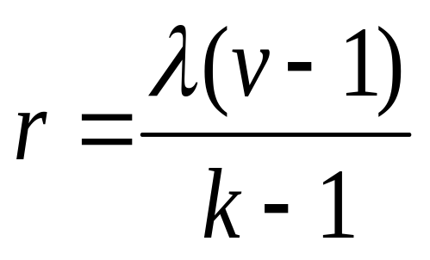
Conclusions concerning BIBD
In a BIBD,
1. each variety is contained in
blocks.
2. bk = vr
3. < r.
4. b ≥ v

Slide 31
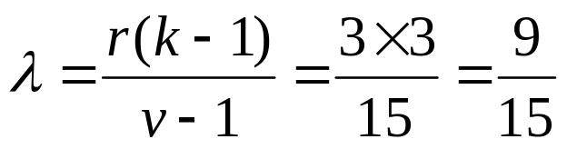
Example
Is there a BIBD with parameters b = 12, k = 4, v = 16, and r = 3?
  The equation bk = vr holds.
  If there is such a design, its index satisfies
  Since this is not an integer there can be no such design with four of its parameters as given.

Slide 32
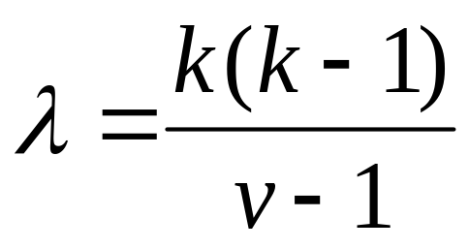
SBIBD
A BIBD for which b = v, that is for which the number b of block equals the number v of varieties, is called symmetric, and this is shortened to SBIBD.
Correspondingly, in a SBIBD:
b = v ➔ k = r.

Slide 33
Starter blocks and developed blocks
Let v ≥ 2 be an integer and consider the set of integers mod v: Z_{v} = {0, 1, 2, …, v-1}, whose addition and multiplication are denoted by the usual symbols + and ×.
Let B = {i₁, i₂, …, i_{k}} be a subset of Z_{v} consisting of k integers. For each integer j in Z_{v}, we define B+j = {i₁+j, i₂+j, …, i_{k}+j} to be the subset of Z_{v} by adding mod v the integer j to each of the integers in B.
The v sets B = B+ 0, B+1, B+ 2, …, B+ v-1 so obtained are called the blocks developed from the block B and B is called the starter block.

Slide 34
Example
Let b = 7 and consider Z₇ = { 0, 1, 2, 3, 4, 5, 6}, Consider the starter block B = {0, 1, 3}. Then we have
B+0 = {0, 1, 3}; B+1 = {1, 2, 4}; B+2 = {2, 3, 5}; B+3 = {3, 4, 6}; B+4 = {4, 5, 0}, B+5 = {5, 6 ,1}, B+6 = { 6, 0, 2}.
This is a BIBD, indeed the same one in the first example of this section. Since b = v, we have a SBIBD with b=v=7, k=r=3 and = 1.

Slide 35
Example
Let v = 7 as in the above example, but now let the starter block be B = {0, 1, 4}. Then we have
B+0 = {0, 1, 4}; B+1 = {1, 2, 5}; B+2 = {2, 3, 6}; B+3 = {3, 4, 0}; B+4 = {4, 5, 1}, B+5 = {5, 6, 2}, B+6 = { 6, 0, 3}.
In this case we not obtain a BIBD because, for instance, the varieties 1 and 2 occur together in one block, while the varieties 1 and 5 are together in two block.

Slide 36
Difference set mod v
Let B be a subset of k integers in Z_{v}. Then B is called a difference set mod v, provided each non-zero integer in Z_{v} occurs the same number of times among the k(k-1) differences among distinct elements of B (in both order): x – y (x, y in B; x ≠ y).
Since there are v-1 non-zero integers in Z_{v}, each non-zero integer in Z_{v} must occur
times as a difference in a difference set.

Slide 37
Example
Let v =7 and k = 3 and consider B = {0, 1, 3}. We compute the subtraction table for the integers in B, ignoring the 0’s in the diagonal positions:
Examining this table we see that each of the non-zero integers 1, 2, 3, 4, 5, 6 in Z₇ occurs exactly once in the off-diagonal positions and hence exactly once as a difference. Hence, B is a difference set mod 7.
-
0
1
3
0
0
6
4
1
1
0
5
3
3
2
0

Slide 38
Example
Let v =7 and k = 3 but now let B = {0, 1, 4}. We compute the subtraction table for the integers in B, and get the table as shown.
Examining this table we see that 1and 6 each occur once as a difference, 3 and 4 each occur twice, and 2 and 5 do not occur at all. Thus B is not a difference set in this case.
-
0
1
4
0
0
6
3
1
1
0
4
4
4
3
0

Slide 39
Theorem 10.2.5
Let B be a subset of k < v elements of Z_{v} which forms a difference set mod v. Then the blocks developed from B as a starter block form a SBIBD with index

Slide 40
Example
Find a difference set of size 5 in Z₁₁, and use it as a starter block in order to construct an SBIBD.
We show that B = {0, 2, 3, 4 ,8} is a difference set with = 2. we compute the subtraction table, and see that each non-zero integer in Z₁₁ occurs twice as a difference and hence B is a difference set.
-
0
2
3
4
8
0
0
9
8
7
3
2
2
0
10
9
5
3
3
1
0
10
6
4
4
2
1
0
7
8
8
6
5
4
0

Slide 41
Using B as a starter block we obtain the following blocks for a SBIBD with parameters b = v = 11, k = r = 5 and = 2.
B+0={0, 2, 3, 4, 8}; B+1={1, 3, 4, 5, 9};
B+2 = {2, 4, 5, 6, 10}; B + 3 = {0, 3, 5, 6, 7};
B+ 4 = {1, 4, 6, 7, 8}; B+5={2, 5, 7, 8, 9};
B+6={3, 6, 8, 9, 10}; B+7={0, 4, 7, 9 ,10}; B+8={0, 1, 5, 8, 10}; B+9={0, 1, 2, 6, 9}; B+10={1, 2, 3, 7, 10}.

Slide 42
Steiner triple systems

Slide 43
Review
BIBD is a partition of ?? objects to ?? blocks such that each block contain ?? objects and each object appear in ?? blocks, and each pair of objects appear in ?? blocks.

Slide 44
Steiner triple systems
Balanced block design with block size k = 3 are called Steiner triple systems.
BIBD’s with block size 2 are trivial. To get a BIBD with =2, simply take each of the blocks with = 1 twice. To get one with = 3, take each of the blocks three times.

Slide 45
Example
The following is an example of a Steiner triple system of index = 1 with 9 varieties:
{0, 1, 2} {3, 4, 5} {6, 7, 8}
{0, 3, 6} {1, 4, 7} {2, 5, 8}
{0, 4, 8} {2, 3, 7} {1, 5, 6}
{0, 5, 7} {1, 3, 8} {2, 4, 6}

Slide 46
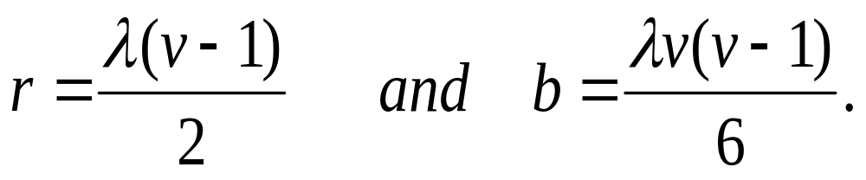
Parameters
Let B be a Steiner triple system with parameters b, v, k = 3, r, . Then
If the index is =1, then there is a non-negative integer n such that v = 6n+1 or v = 6n+3.

Slide 47
Construction of Steiner triple systems
If there are Steiner triple systems of index =1 with v and w varieties, respectively, then there is a Steiner triple system of index = 1 with vw varieties.

Slide 48
How to construct
Let B₁ be a Steiner triple system of index =1 with the v varieties a₁, a₂, …, a_{v} and let B₂ be a Steiner triple system of index =1 with the w varieties b₁, b₂,…, b_{w}. We consider a set X of vw varieties c_{ij}, ( i = 1, 2, …, v, j = 1, 2, …, w) which we may think of as the entries of a v-by-w array whose rows correspond to a_{i} and whose columns correspond to b_{j} as shown:

Slide 49
We define a set B of triples of the elements of X. Let {c_{ir}, c_{js}, c_{kt}} be a set of 3 elements of X. then {c_{ir}, c_{js}, c_{kt}} is a triple of B iff one of the following holds:
b₁
b₂
…
b_{w}
a₁
c₁₁
c₁₂
…
c_{1w}
a₂
c₂₁
c₂₂
…
c_{2w}
…
…
…
…
…
a_{v}
c_{v1}
c_{v2}
…
c_{vw}
r = s = t, and {a_{i}, a_{j}, a_{k}} is a triple of B₁. put another way, the elements {c_{ir}, c_{js}, c_{kt}} are in the same column of the array and the rows in which they lie correspond to a triple of B₁
i = j = k, and {b_{r}, b_{s}, b_{t}} is a triple of B₂. put another way, the elements {c_{ir}, c_{js}, c_{kt}} are in the same row of the array and the columns in which they lie correspond to a triple of B₂

Slide 50
b₁
b₂
…
b_{w}
a₁
c₁₁
c₁₂
…
c_{1w}
a₂
c₂₁
c₂₂
…
c_{2w}
…
…
…
…
…
a_{v}
c_{v1}
c_{v2}
…
c_{vw}
(iii) i, j and k are all different and {a_{i}, a_{j}, a_{k}} is a triple of B₁, and r, s and t are all different and {b_{r}, b_{s}, b_{t}} is a triple of B₂. put another way, c_{ir}, c_{js}, and c_{kt} are in 3 different rows and 3 different columns of the array, and the rows in which they lie correspond to a triple of B₁ and the columns in which they lie correspond to a triple of B₂.

Slide 51
Example and exercise
Construct a Steiner triple system with 21 varieties.
Hints:
1. construct two Steiner triple systems B₁ and B₂ with 3 and 7 varieties, respectively.
2. construct B based on B₁ and B₂.

Slide 52
Solution
a₀
a₁
a₂
Let X = {a₀, a₁, a₂} and Y = {b₀, b₁, b₂, b₃, b₄, b₅, b₆} be two sets of varieties. Let B₁ = {a₀, a₁, a₂} and B₂ = {{b₀, b₁, b₃}, {b₁, b₂, b₄}, {b₂, b₃, b₅} , {b₃, b₄, b₆}, {b₄, b₅, b₀}, {b₅, b₆, b₁}, {b₆, b₀, b₂} } be the Steiner triple systems of X and Y, respectively.
b₀
0
1
2
b₁
5
6
7
b₂
9
10
11
b₃
3
8
4
b₄
12
13
14
b₅
15
16
17
b₆
18
19
20

Slide 53
Exercise
Let B₁ = {a₁, a₂, a₃}and B₂ = {b₁, b₂, b₃} be two Steiner triple systems with 3 varieties. B is obtained from B₁ and B₂ as follows: The 3-by-3 array is shown (we represent the 9 varieties as 0, 1, 2, …, 8)
b₁
b₂
b₃
a₁
0
1
2
a₂
3
4
5
a₃
6
7
8

Slide 54
(i) the entries in each of the 3 rows: {0, 1, 2} {3, 4, 5} {6, 7, 8}.
(ii) the entries in each of the 3 columns: {0, 3, 6} {1, 4, 7} {2, 5, 8}
(iii) three entries, no two from the same row or column: {0, 4, 8} {1, 5, 6}, {2, 3, 7} {0, 5, 7} {1, 3 ,8} {2, 4 ,6}.
b₁
b₂
b₃
a₁
0
1
2
a₂
3
4
5
a₃
6
7
8

Slide 55
Resolvability class
If the triples of B can be partitioned into parts so that each variety occurs in exactly one triple in each part, then the Steiner triple system of index = 1 is called resolvable and each part is called a resolvability class.
Note that each resolvability class is a partition of the set of varieties into triples.

Slide 56
Example
In the above example, the Steiner triple system with 9 varieties can be partitioned into 4 parts
{0, 1, 2} {0, 3, 6} {0, 4, 8} {0, 5, 7}
{3, 4, 5} {1, 4, 7} {1, 5, 6} {1, 3 ,8}
{6, 7, 8} {2, 5, 8} {2, 3, 7} {2, 4 ,6}.
It is a resolvability class.

Slide 57
Parameters in resolvability class
v = 6n + 3
b = v(v-1)/6 = (2n+1)(3n+1)
k = 3
r = (v-1)/2=3n+1
= 1.
The number of triples in each resolvability class is
v/3 = 2n +1.

Slide 58
Latin Squares

Slide 59
Latin square of order n
Let n be a positive integer and let S be a set of n distinct elements. A Latin square of order n, based on the set S, is a n-by-n array each of whose entries is an element of S such that each of the n elements of S occurs once in each row and once in each column.
Each of the rows and each of the columns of a Latin square is a permutation of the elements of S.

Slide 60
Examples
0
1
2
3
0
1
2
0
1
1
2
3
0
1
2
0
1
0
2
3
0
1
2
0
1
3
0
1
2

Slide 61
Partitions in Latin squares
Consider a Latin square of order n based on Z_{n}, let k be any element of Z_{n}. The positions occupied by k’s are positions for n non-attacking rooks on an n-by-n board. Let A(k) be the set of positions occupied by k’s, then A(0), A(1), …, A(n-1) is a partition of the set of n² positions of the board. Each consisting of n positions for non-attacking rooks.

Slide 62
Example
For the 4-by-4 Latin square A. We have
A(0) = {(0,0),(1,3),(2,2),(3,1)}
A(1) = {(0,1),(1,0),(2,3), (3,2)}
A(2) = {(0,2),(1,1),(2,0),(3,3)}
A(3) = {(0,3),(1,2),(2,1),(3,0)}
0
1
2
3
1
2
3
0
2
3
0
1
3
0
1
2

Slide 63
Comments
We can exchange A(0), A(1), …, A(n-1) at will and the result will always be a latin square. There are n! latin squares which result in this way.
Using this idea of interchanging the positions occupied by the various elements 0, 1, …, n-1 we can always bring a latin square to standard form, whereby in row 0 the integers 0, 1, …, n-1 occur in their natural order.

Slide 64
Constructing Latin squares by addition mod n
Let n be a positive integer. Let A be the n-by-n array whose entry a_{ij} in row i and column j is
a_{ij} = i + j (addition mod n), (i, j = 0, 1, 2, …, n-1).
Then A is a Latin square of order n based on Z_{n}.

Slide 65
Example
The following Latin square of order 4 is constructed by addition mod 4.
a_{ij} = i + j (mod 4)
0
1
2
3
1
2
3
0
2
3
0
1
3
0
1
2

Slide 66
Constructing Latin squares by multiplicative inverses
Let n be a positive integer and let r be a non-zero integer in Z_{n} such that the GCD of r and n is 1. Let A be the n-by-n array whose entry a_{ij} in row i and column j is
a_{ij} = r × i + j (arithmetic mod n), (i, j = 0, 1, 2, …, n - 1). Then A is a Latin square of order n based on Z_{n}.
The Latin square A is denoted as L_{n}^{r}

Slide 67
Example
Consider Z₅, since GCD(3, 5) = 1, the following Latin square L₅³ of order 5 is constructed by
a_{ij} = 3 × i + j (mod 5)
0
1
2
3
4
0
0
1
2
3
4
1
3
4
0
1
2
2
1
2
3
4
0
3
4
0
1
2
3
4
2
3
4
0
1

Slide 68
Properties of Latin squares
Let R_{n} and S_{n} be as shown. Let A be any n-by-n array based on Z_{n}. Then A is a Latin square iff the following conditions hold:
Consider both R_{n} × A and S_{n} × A, the resulting set of ordered pairs thus obtained equals the set of all ordered pairs that can be formed using the elements of Z_{n}.
0
0
…
0
1
1
…
1
R_{n} =
…
…
…
…
n-1
n-1
…
n-1
0
1
…
n-1
0
1
…
n-1
S_{n} =
…
…
…
…
0
1
…
n-1

Slide 69
Example
In each of the two juxtaposed arrays, each ordered pair occurs exactly once.
0
0
0
0
1
2
(0,0)
(0,1)
(0,2)
1
1
1
1
2
0
(1,1)
(1,2)
(1,0)
2
2
2
2
0
1
(2,2)
(2,0)
(2,1)
0
1
2
0
1
2
(0,0)
(1,1)
(2,2)
0
1
2
1
2
0
(0,1)
(1,2)
(2,0)
0
1
2
2
0
1
(0,2)
(1,0)
(2,1)

Slide 70
Orthogonal
Let A and B be Latin squares on the integers in Z_{n}. Then A and B are called orthogonal, provided in the juxtaposed array A × B each of the ordered pairs (i, j) of integers in Z_{n} occurs exactly once.
There do not exist two orthogonal Latin squares of order 2.
Let A₁, A₂, …, A_{k} be Latin squares of order n. We say they are mutually orthogonal, provided each pair A_{i}, A_{j} (i ≠ j) of them is orthogonal. We refer to mutually orthogonal Latin squares as MOLS.

Slide 71
Example
The following two Latin squares of order 4 are orthogonal.
(0,0)
(1,1)
(2,2)
(3,3)
0
1
2
3
0
1
2
3
1
0
3
2
3
2
1
0
(1,3)
(0,2)
(3,1)
(2,0)
2
3
0
1
1
0
3
2
(2,1)
(3,0)
(0,3)
(1,2)
3
2
1
0
2
3
0
1
(3,2)
(2,3)
(1,0)
(0,1)

Slide 72
Theorem 10.4.3
Let n be a prime number. Then L_{n}¹, L_{n}², …, L_{n}^{n-1} are n-1 MOLS of order n.

Slide 73
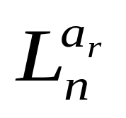
Construction of Latin squares by field arithmetic
Let F be a finite field with n = p^{k} elements for some prime p and positive integer k. Let a₀ = 0, a₁, a₂, …, a_{n-1} be the elements of F with a₀ the zero element of F. Consider any non-zero element a_{r} of F and define an n-by-n array A as follows:
The element a_{ij} in row i and column j of A is a_{ij} = a_{r} × a_{i} +a_{j}, (i, j = 0, 1, …, n-1).
The Latin square is denoted as

Slide 74
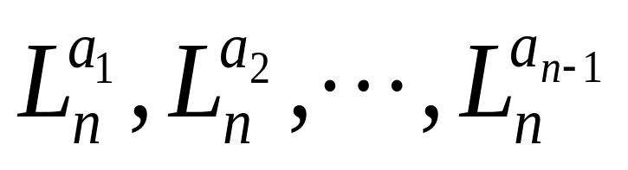
Theorem 10.4.4
Let n = p^{k} be an integer which is a power of a prime number p. Then
are n-1 MOLS of order n.

Slide 75
Example
Consider the 4-element field {a₀ = 0, a₁ = 1, a₂ = i, a₃ = 1+i}. We obtain the following Latin squares: (remind of that i² = i + 1)
Compute L₄^{1+i} by yourself
0
1
i
1+i
0
1
i
1+i
i
1+i
0
1
1
0
1+i
i
L₄^{i} =
L₄¹ =
1+i
i
1
0
i
1+i
0
1
1
0
1+i
i
1+i
i
1
0

Slide 76
Largest number of MOLS
Let n be a positive integer and let A₁, A₂, …, A_{k} be k MOLS of order n. Then k ≤ n-1; that is, the largest number N(n) of MOLS of order n is at most n-1.
N(n) ≥ 2 for each odd integer n.

Slide 77
Construction of larger Latin squares from smaller ones
If there is a pair of MOLS of order m and there is a pair of MOLS of order k, then there is a pair of MOLS of order mk. More generally,
N(mk) ≥ min{N(m), N(k)}.
Let n ≥ 2 be an integer and let
n = p₁^{e1} × p₂^{e2} × … × p_{k}^{ek}
be the factorization of n into distinct prime numbers p₁, p₂, …, p_{k}. Then N(n) ≥ min{p_{i}^{ei}-1: i = 1, 2, …, k}.

Slide 78
Example
Let A and B be two MOLS of order 3 and C, D be two MOLS of order 4. Construct two Latin squares of order 12.
0
2
1
0
1
2
B =
1
0
2
A =
1
2
0
2
1
0
2
0
1
0
1
2
3
0
1
2
3
1
0
3
2
2
3
0
1
C =
D =
2
3
0
1
3
2
1
0
3
2
1
0
1
0
3
2

Slide 79
Let (a_{ij}, C) replace a_{ij} in A, then a 12-by-12 array A × C (the elements are ordered pairs) is constructed. The following is an example of (a₁₂, C), where a₁₂ = 0 in A.
(0,0)
(0,1)
(0,2)
(0,3)
(a₁₂, C) =
(0,1)
(0,0)
(0,3)
(0,2)
(0,2)
(0,3)
(0,0)
(0,1)
(0,3)
(0,2)
(0,1)
(0,0)

Slide 80
At last, replace the ordered pairs in the array with the numbers in Z₁₂. e.g.,
(0,0)→0, (0,1)→1, (0,2)→2, (0,3)→3,
(1,0)→4, (1,1)→5, (1,2)→6, (1,3) →7,
(2,0)→8, (2,1) →9, (2,2)→10, (2,3) →11.
Note: there are exactly 12 different pairs in the array. Why?
Similarly, we can construct the 12-by-12 array B×D.
A×C and B×D are orthogonal.

Slide 81
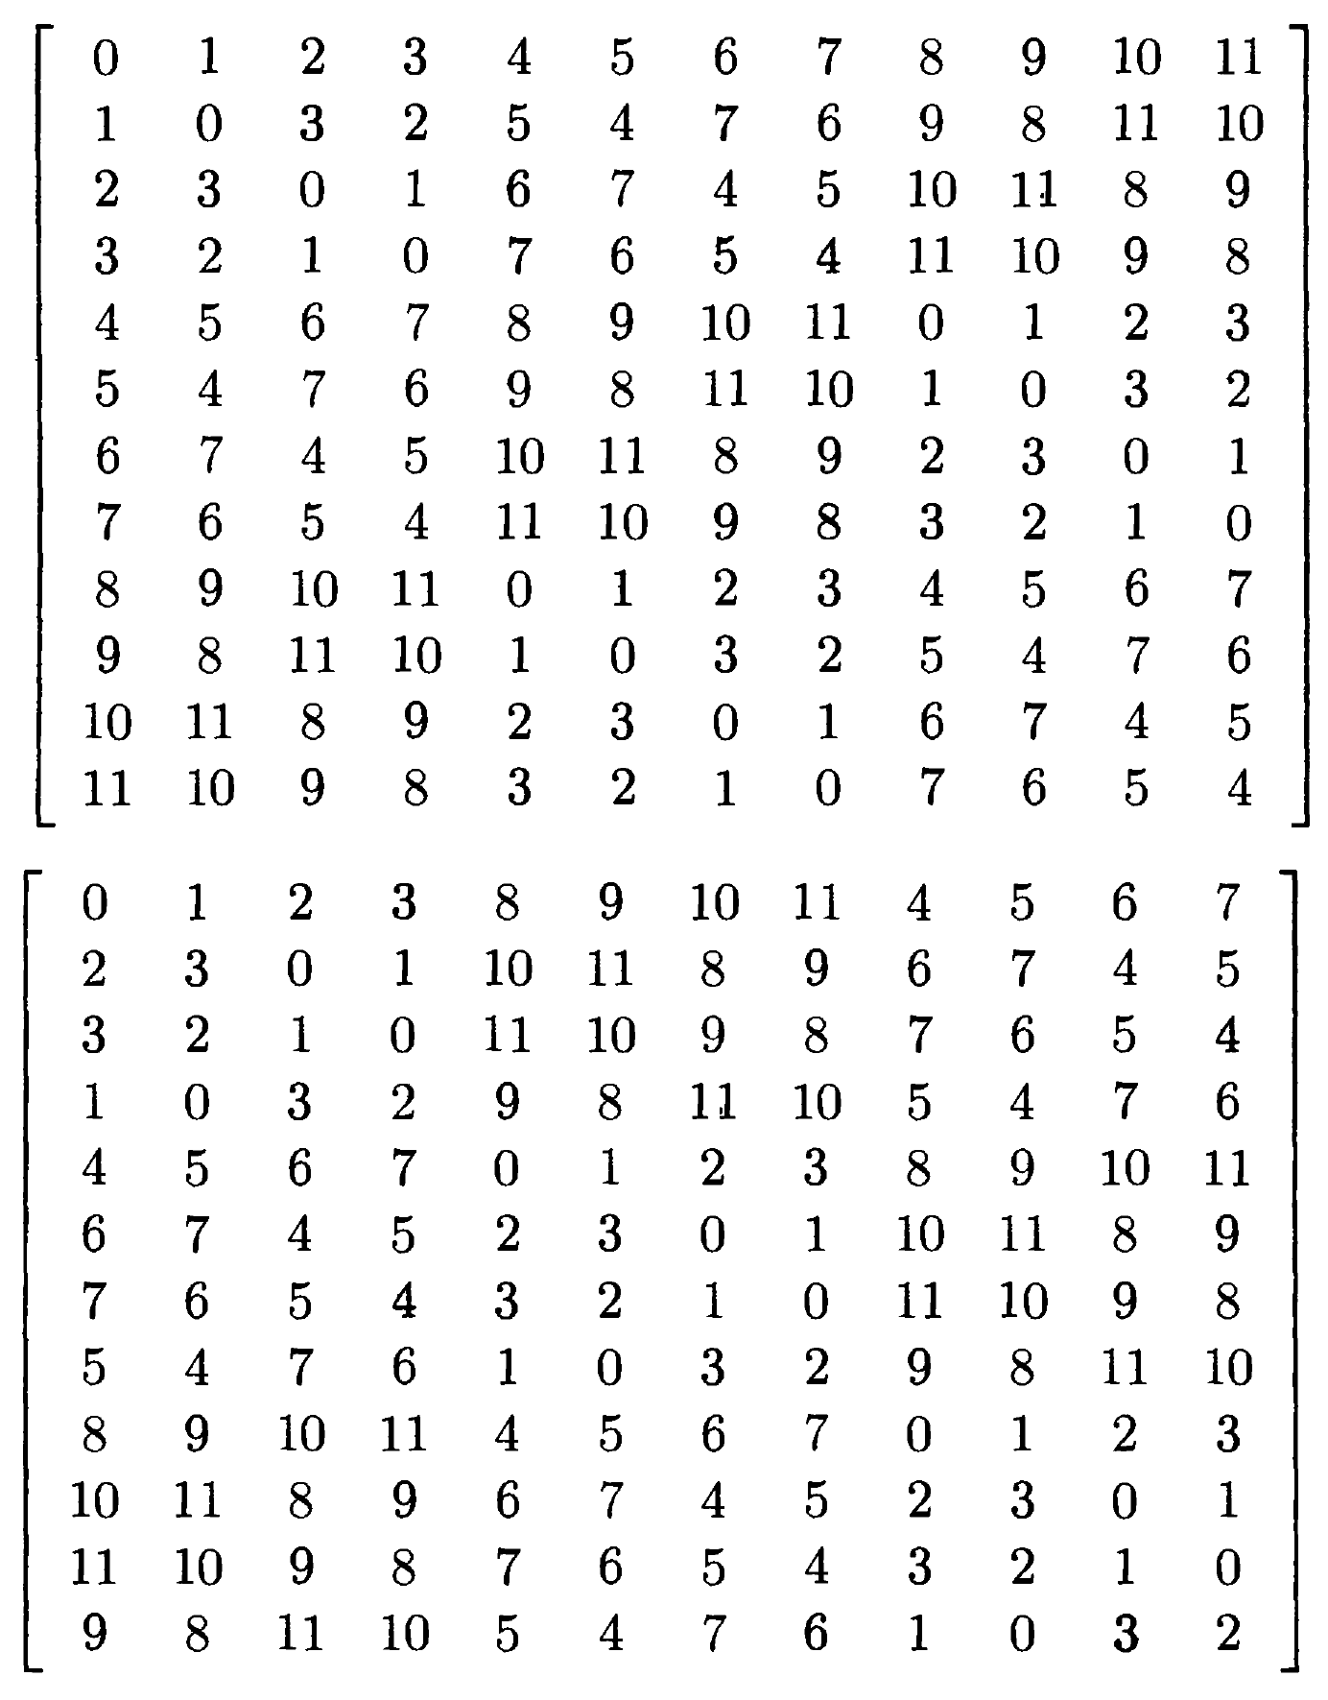

Slide 82
Corollary 10.4.9
Let n ≥2 be an integer which is not twice an odd number. Then there exists a pair of orthogonal Latin squares of order n.
It cannot guarantee the existence of a pair of MOLS of order n = 2, 6 ,10, 14, 18, …, 4k+ 2, …

Slide 83

MOLS and BIBD
Let n ≥ 2 be an integer. If there exist n-1 MOLS of order n, then there exists a resolvable BIBD with parameters
b = n²+n, v = n², k = n, r = n+1, = 1.
Conversely, if there exists a resolvable BIBD with above parameters , then there exist n-1 MOLS of order n.

Slide 84
Construction of BIBD with MOLS
Let A₁, A₂, …, A_{n-1} denote the n-1 MOLS of order n. We use the n+1 arrays
R_{n}, S_{n}, A₁, A₂, …, A_{n-1} where R_{n} and S_{n} are defined as in page 63 to construct a block design B with parameters
b = n²+n, v = n², k = n, r = n+1, = 1.
Review: A_{i}(k), R_{n}(k) and S_{n}(k).

Slide 85
We take the set X of varieties to be the set of v = n² positions of an n-by-n array; that is,
X = {(i, j): i = 0, 1, …, n-1; j = 0, 1, …, n-1}.
Each of the n+1 array determines n blocks:
R_{n}(0) R_{n}(1) …. R_{n}(n-1)
S_{n}(0) S_{n}(1) ….. S_{n}(n-1)
A₁(0) A₁(1) …. A₁(n-1)
…………………
A_{n-1}(0) A_{n-1}(1) …. A_{n-1}(n-1)
Thus, we have b = n × (n+1) = n² + n blocks, each containing k = n varieties. Let B denote this collection of blocks, then B is a BIBD with the specified parameters.

Slide 86
Example
We illustrate the construction above of a BIBD, using the two Latin squares of order 3：
0
2
1
0
1
2
B =
1
0
2
A =
1
2
0
2
1
0
2
0
1

Slide 87
The varieties are the 9 positions of a 3-by-3 array, and the blocks are pictured by resolvability classes as follows:
.
.
.
.
.
.
.
.
.
.
.
.
.
.
.
.
.
.
.
.
.
.
.
.
.
.
.
.
.
.
.
.
.
.
.
.
.
.
.
.
.
.
.
.
.
.
.
.
.
.
.
.
.
.
.
.
.
.
.
.
.
.
.
.
.
.
.
.
.
.
.
.
.
.
.
.
.
.
.
.
.
.
.
.
.
.
.
.
.
.
.
.
.
.
.
.
.
.
.
.
.
.
.
.
.
.
.
.

Slide 88
Exercises
Suppose 25 (16) varieties of products need to be tested by 30 (20) consumers. Each consumer is asked to compare a certain 5 (4) of the varieties. The test is to have a property that each pair of the 25 (16) varieties is compared by exactly one person and each one variety is tested by 6 (5) consumers . How to design the blocks?

Slide 89
Latin rectangle
Let m and n be integers with m ≤ n. An m-by-n Latin rectangle, based on the integers in Z_{n}, is an m-by-n array such that no integers is repeated in any row or in any column.
If m = n, the Latin rectangle is a Latin square.

Slide 90
Example
An example of a 3-by-5 Latin rectangle
0
1
2
3
4
3
4
0
1
2
1
2
3
4
0

Slide 91
Completion
We say that an m-by-n Latin rectangle L can be completed, provided it is possible to attach n-m rows to L and obtain a Latin square L* (called a completion of L) of order n.

Slide 92
Example
A completion of the Latin rectangle
0
1
2
3
4
0
1
2
3
4
3
4
0
1
2
3
4
0
1
2
1
2
3
4
0
1
2
3
4
0
4
0
1
2
3
2
3
4
0
1

Slide 93
Completion of Latin rectangle
Let L be an m-by-n Latin rectangle based on Z_{n} with m < n. Then L has a completion.
Construction method: define a bigraph G =(X, △, Y), X = {x₀, x₁, …, x_{n-1}} corresponds to columns 0, 1, …, n-1 of the rectangle L, Y = {0, 1, …, n-1} is the elements on which L is based. △ = {(x_{i}, j): j does not occur in column i of L}. G has a perfect matching. Suppose the edges of a perfect matching are{(x₀, i₀), (x₁, i₁), …., (x_{n-1}, i_{n-1})}. Then (m+1)-by-n array obtained by adjoining i₀, i₁, …,i_{n-1} as a new row is a Latin rectangle. Continue the process until the n-by-n Latin square is completed.

Slide 94
Example
0
1
2
3
4
x₀
0
x₁
1
3
4
0
1
2
x₂
2
1
2
3
4
0
3
x₃
4
0
1
2
3
4
x₄
G

Slide 95
Semi-Latin square
Consider an n-by-n array L in which some positions are unoccupied and other positions are occupied by one of the integers {0, 1, 2, …, n-1}. Suppose that if an integer k occurs in L, then it occurs n times and no two k’s belong to the same row or column. Then we call L a semi-Latin square.
If m different integers occur in L, then we say L has index m.

Slide 96
Example
A semi-Latin square of order 5 and index 3.
1
0
2
2
1
0
0
1
2
2
0
1
2
0
1

Slide 97
Completion of semi-Latin square
Let L be a semi-Latin square of order n and index m where m < n. Then L has a completion.
Construction method: define a bigraph G =(X, △, Y), X = {x₀, x₁, …, x_{n-1}} correspond to rows 0, 1, …, n-1 of the rectangle L, Y = {y₀, y₁, …, y_{n-1}} correspond to columns of L. △ = {(x_{i}, y_{j}): the position at row i column j is unoccupied. Then G is (n-m)-regular and has a perfect matching. This matching identifies the desired position for number m. Continue to place other numbers m+1, m+2…. until L is completed.

Slide 98
Example
1
3
0
2
x₀
y₀
2
1
3
0
x₁
y₁
0
1
3
2
x₂
y₂
y₃
2
0
1
3
x₃
y₄
3
2
0
1
x₄
G

Slide 99
Assignments
Ex 16; 21, 28; 32; 52, 56.

