Slide 1
Chapter 5
The Binomial Coefficients

Slide 2
Summary
Pascal’s formula
The binomial theorem
Identities
Unimodality of binomial coefficients
The multinomial theorem
Newton’s binomial theorem

Slide 3
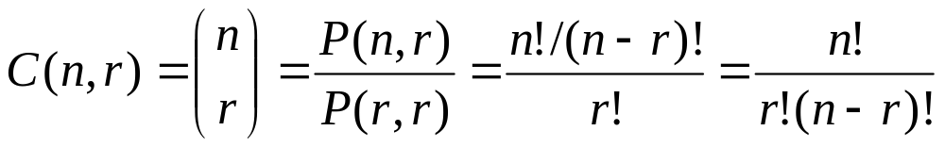
Review
If k > n, C(n,k) = 0, C(n, 0) =1; If n is positive and 1≤k ≤n, then
C(n,r) = C(n, n−r)

Slide 4
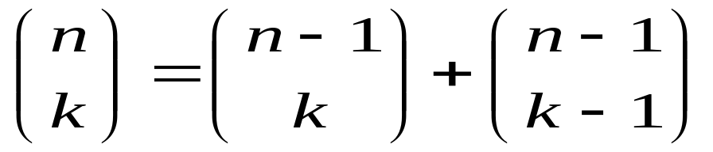
Pascal’s formula
For all integers n and k with 1≤k ≤n-1,
Hint: Let S be a set of n elements. We distinguish one of the elements of S and denote it by x. We then partition the set X of k-combinations of S into two parts , A and B such that all those k-combinations in A do not contain x while those in B contain x. Then
C(n, k) = |A| + |B| = C(n-1, k) + C(n-1, k-1).

Slide 5
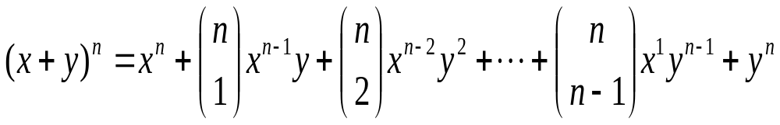
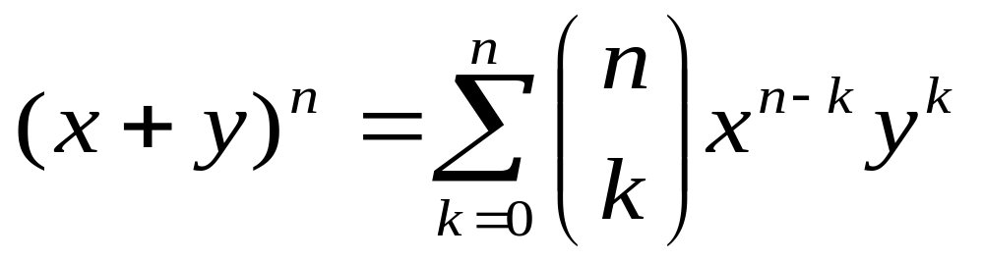
Binomial Theorem
Let n be a positive integer. Then for all x and y,
In summation notation,

Slide 6
Exercises
Expand (x+y)⁵ and (x+y)⁶, using the binomial theorem.
Expand (2x-y)⁷, using the binomial theorem.

Slide 7
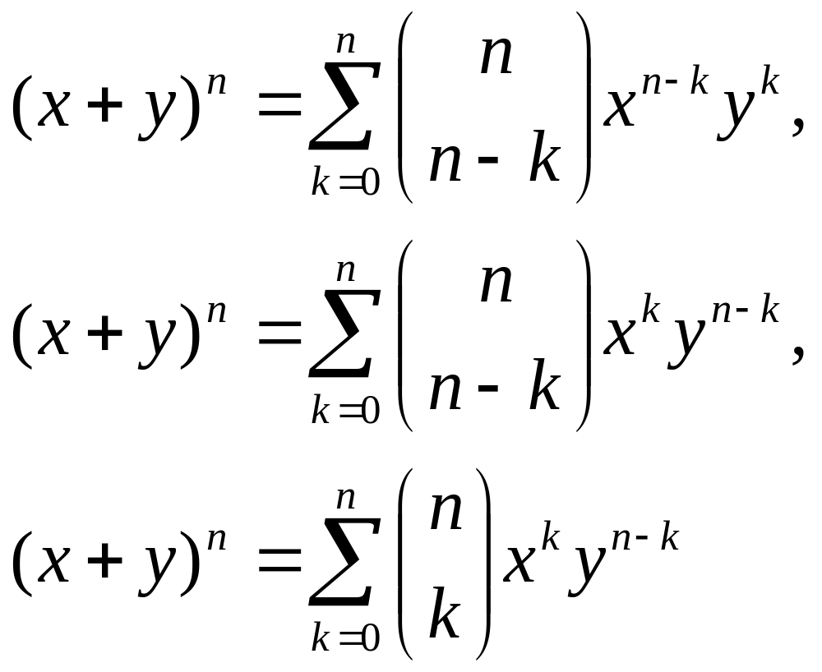
Equivalent forms

Slide 8
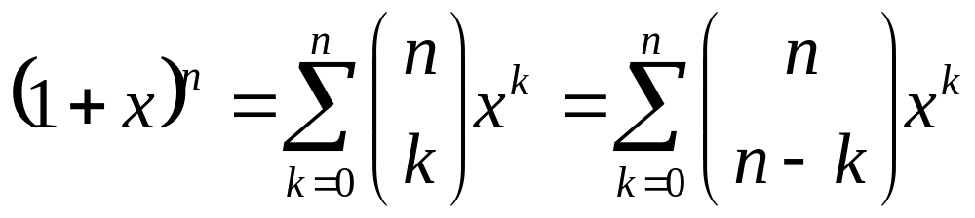
Special case
Let n be a positive number. Then for all x,

Slide 9
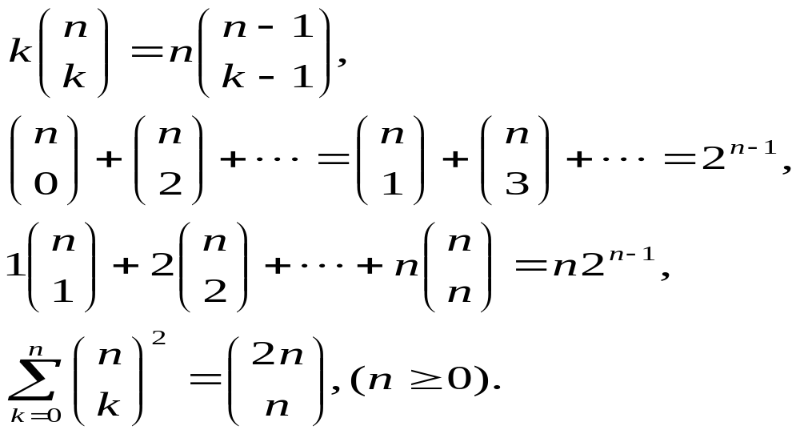
Identities
For positive integers n and k,

Slide 10
Hints for proof
Trivial ;
Set x=1 and y=-1 in the binomial theorem;
Differentiate both sides with respect to x for the special case of binomial theorem and then substituting x=1;
Counts the number of n-combinations of S (a set with 2n elements). Partition S into two subsets A and B. Each n-combination of S contains k elements of A and the remaining n-k elements in B. Note that C(n, k) = C(n, n-k).

Slide 11
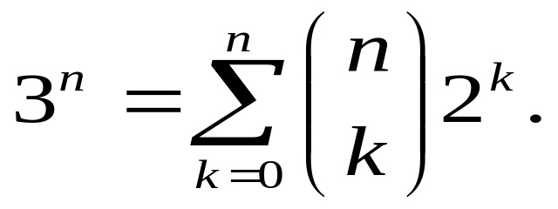
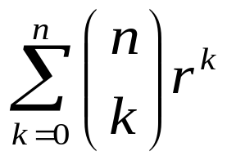
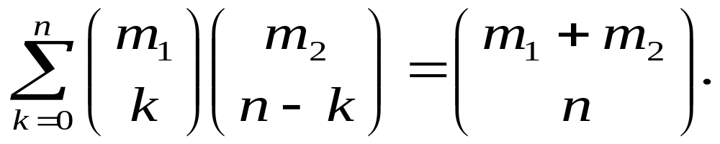
Exercises
Use the binomial theorem to prove that
Generalize to find the sum for any real number r.
Vandermonde convolution: for all positive integers m_{i}, m₂ and n,

Slide 12
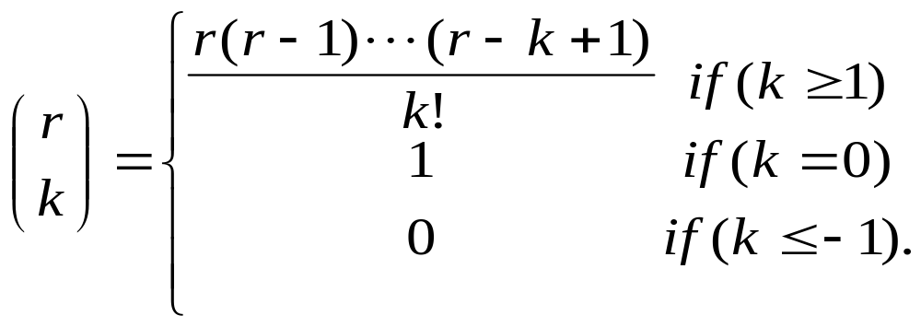
Generalization
Let r be any real number and k be any integer (positive, negative, or zero).

Slide 13
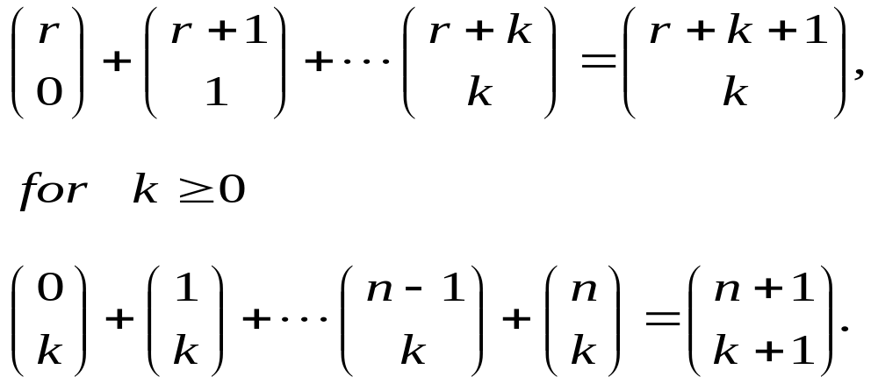
Identities
For any real number r and integer k,

Slide 14
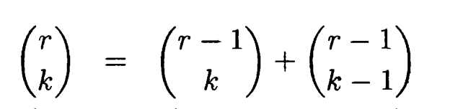
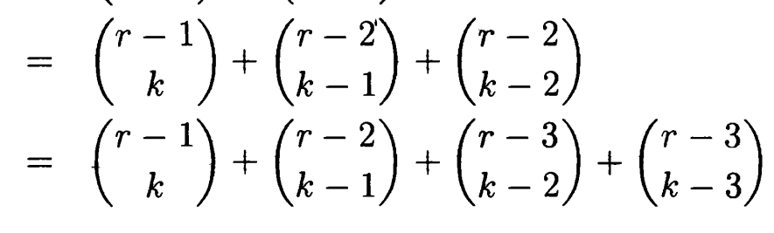
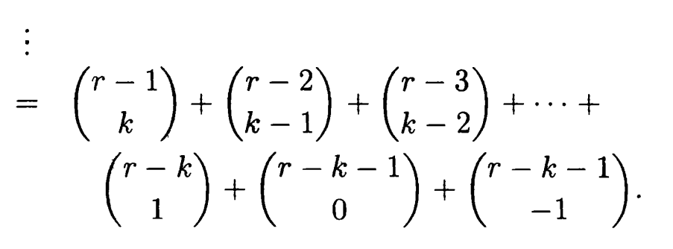
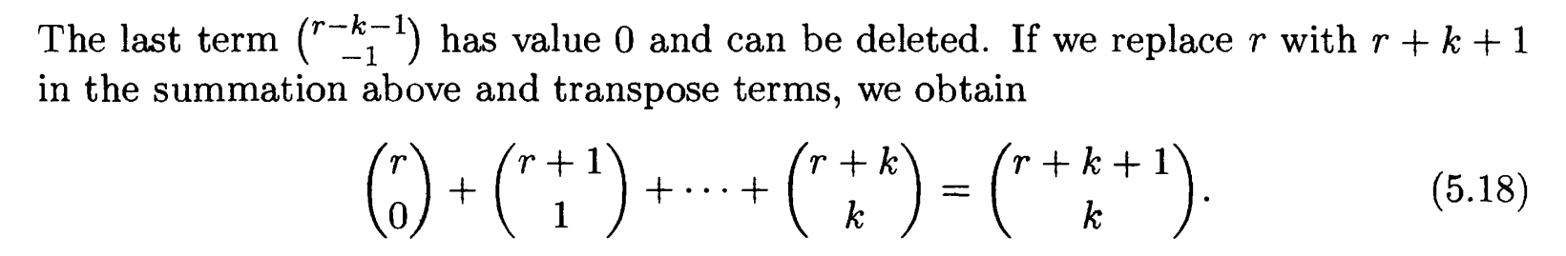
Proof

Slide 15
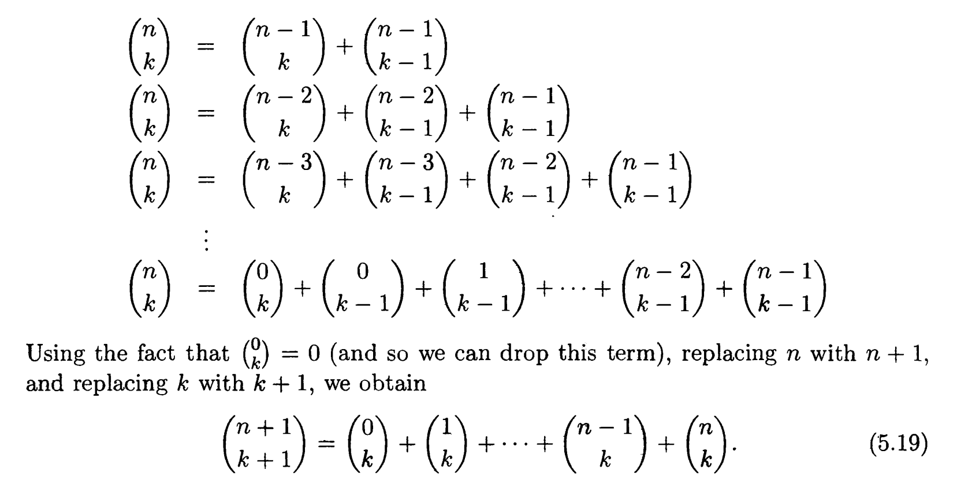

Slide 16
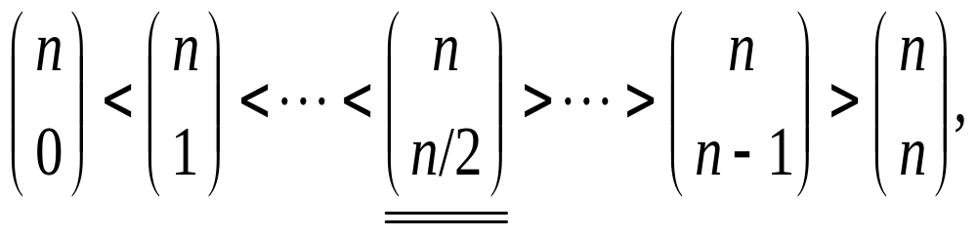
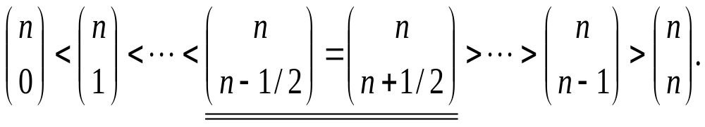
Unimodality of binomial coefficients
Let n be a positive integer. The sequence of binomial coefficients is a unimodal sequence. More precisely, if n is even,
and if n is odd,

Slide 17
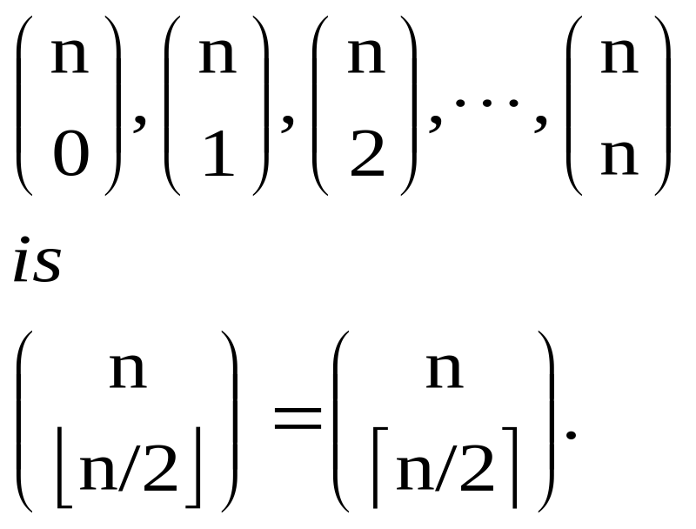
A corollary
For a positive integer n, the largest of the binomial coefficients

Slide 18
Clutter
Let S be a set of n elements. A Clutter of S is a collection C of combinations of S with the property that no combination in C is contained in another.
Example: if S ={a, b, c, d} then
C = {{a, b}, {b, c, d}, {a, d} , {a, c}} is a clutter.

Slide 19
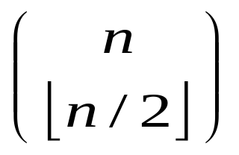
Sperner’s theorem
Let S be a set of n elements. Then a clutter on S contains at most sets.

Slide 20
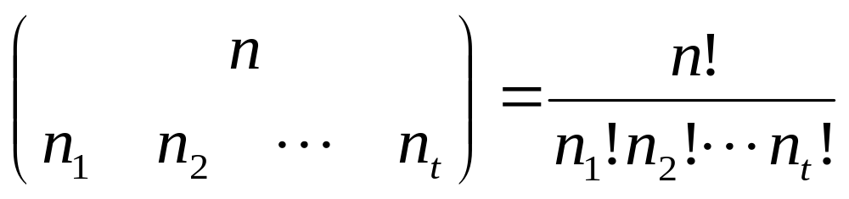
Multinomial coefficients
here n₁,n₂, …n_{t} are non-negative integers with n₁+n₂+ …+n_{t} = n.

Slide 21
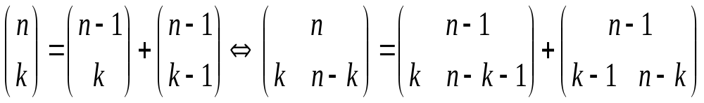
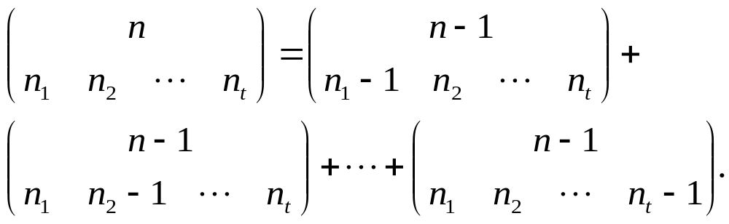
Pascal’s formula for the multinomial coefficients
Pascal’s formula for binomial coefficients:
Pascal’s formula for multinomial coefficients

Slide 22
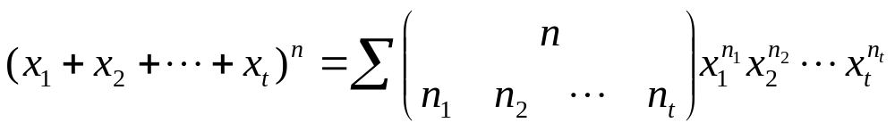
The multinomial theorem
Let n be a positive integer. For all x₁, x₂, …,x_{t},
where the summation extends over all non-negative integral solutions n₁, n₂, …,n_{t} of n₁+ n₂+ …+n_{t} = n.

Slide 23
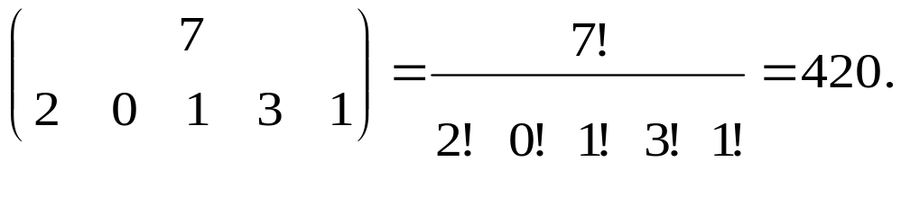
Example and exercise
When (x₁+ x₂+ …+x₅)⁷ is expanded, the coefficient of x₁²x₃x₄³x₅ equals
When (2x₁ ﹣3x₂+5x₃)⁶ is expanded, what the coefficient of x₁³x₂x₃² is?

Slide 24
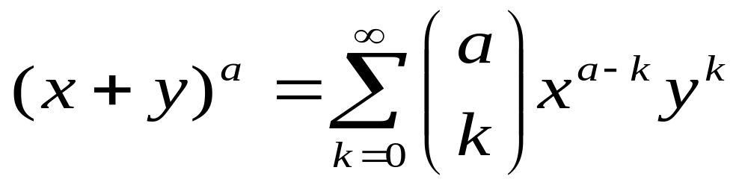
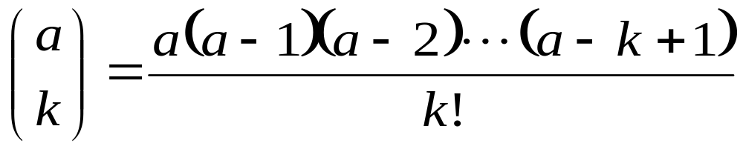
Newton’s Binomial Theorem
Let a be a real number . Then for all x and y with 0 ≤ |x| <|y|,
where

Slide 25
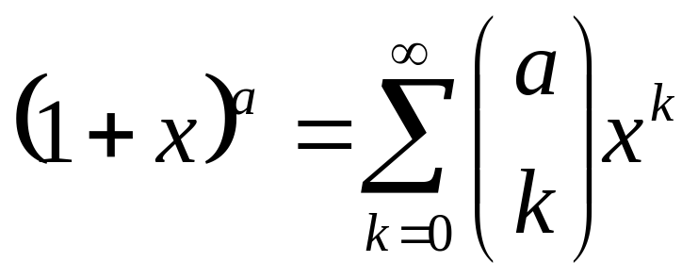
Special case
For any real number a,

Slide 26
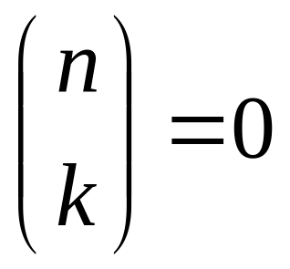

Correspondence
e.g. If a is a positive integer n, then when k>n
So

Slide 27
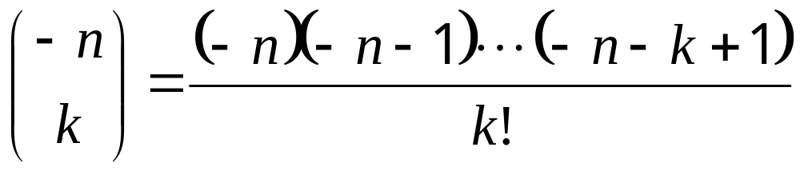
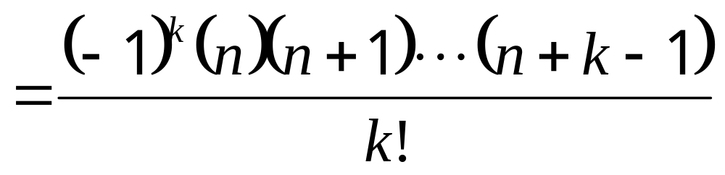
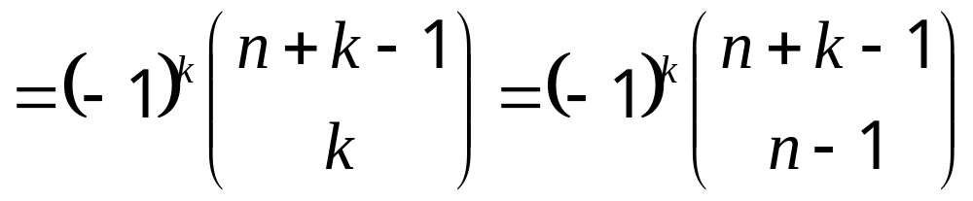
When a = -n
We can verify that

Slide 28
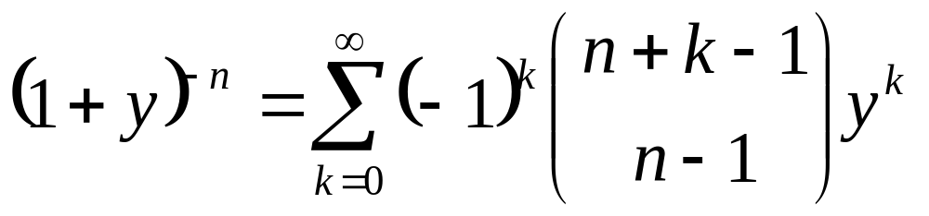
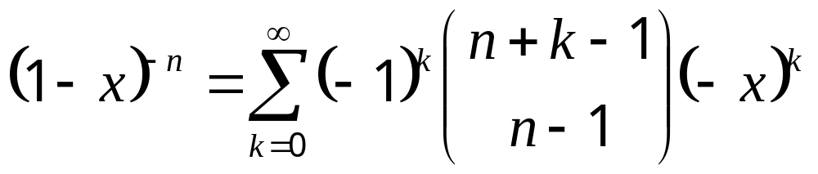
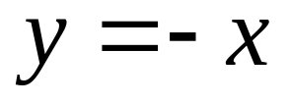
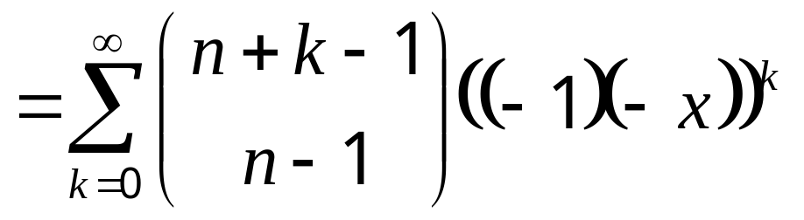
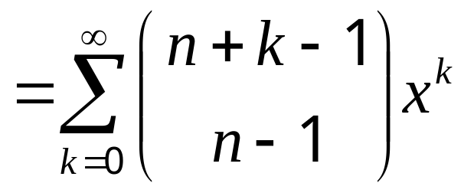
For |y|<1
Set

Slide 29
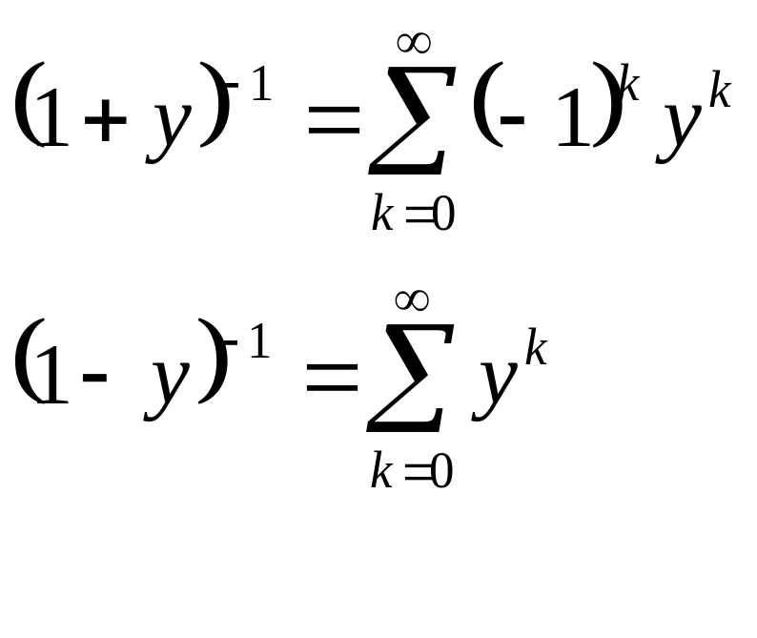
For |y| < 1 and let n=1

Slide 30
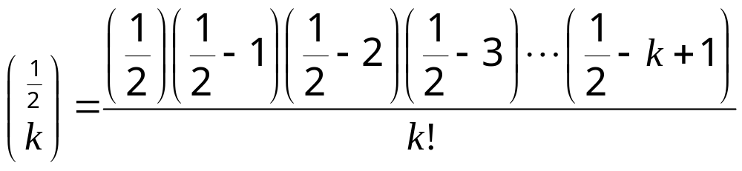
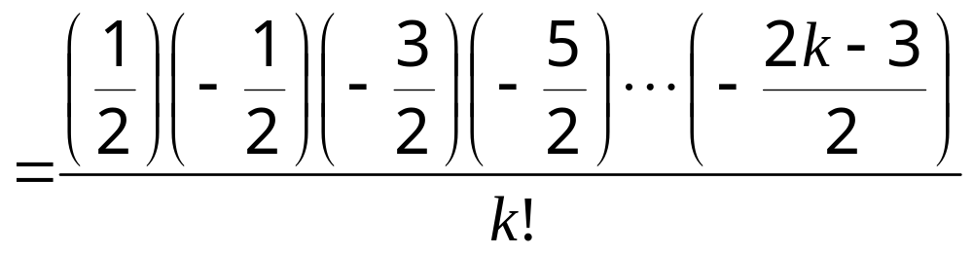
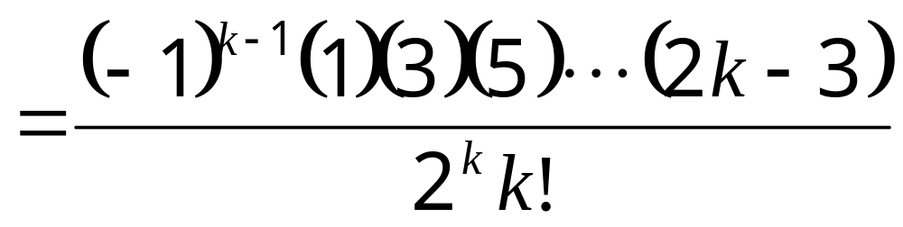
For a = 1/2

Slide 31
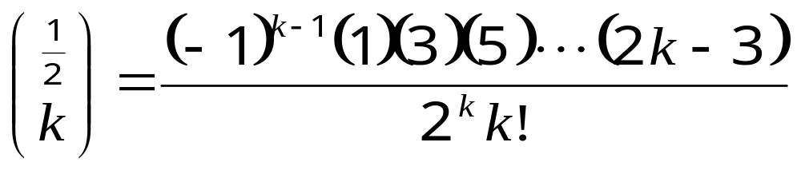
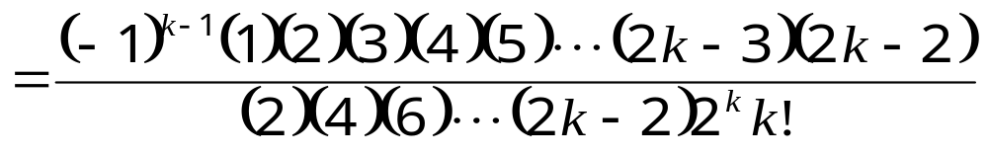
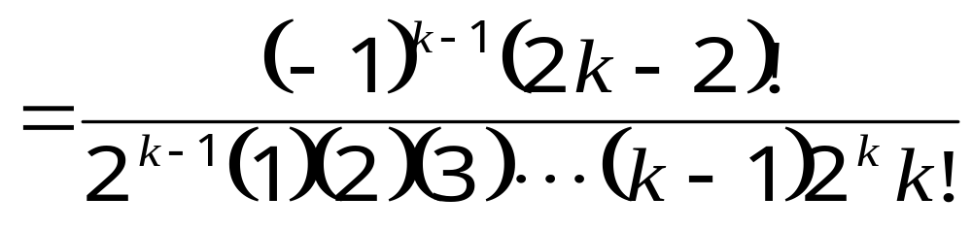
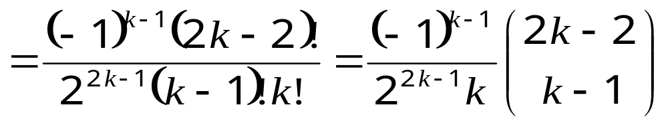
For a = 1/2 (cont’d)

Slide 32
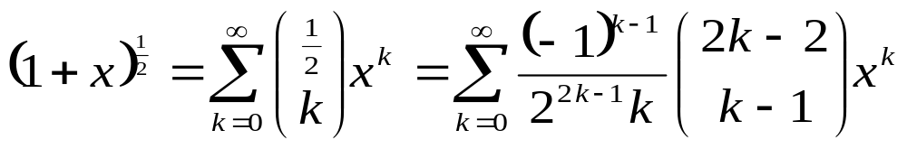
Special case for a =1/2
Consequently

Slide 33
Assignments
15
37
41

