Slide 1
Lecture 6
IEP and Applications

Slide 2
Summary
Review of IEP
Derangements
Permutations with forbidden position
Chessboard polynomial

Slide 3
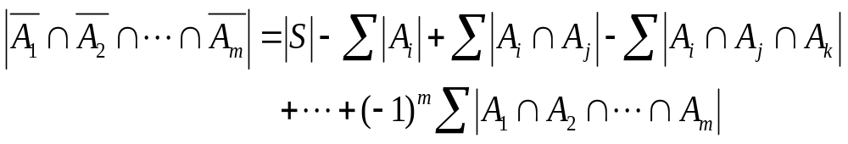
The inclusion-exclusion principle (IEP)
The number of objects in S which have none of the properties P₁, P₂, …., P_{m} is given by
where the first sum is over all 1-combination {i} of {1,2,3…,m}, the second sum is over all 2-combinations {i, j} of {1,2,..,m}, the third sum is over all 3-combinations {i, j, k} of {1,2,…,m}, and so on.

Slide 4
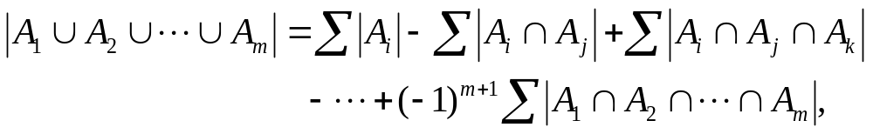
A corollary of IEP
The number of objects of S which have at least one of the properties P₁, P₂, …, P_{m} is given by
where the summations are as specified in IEP.

Slide 5
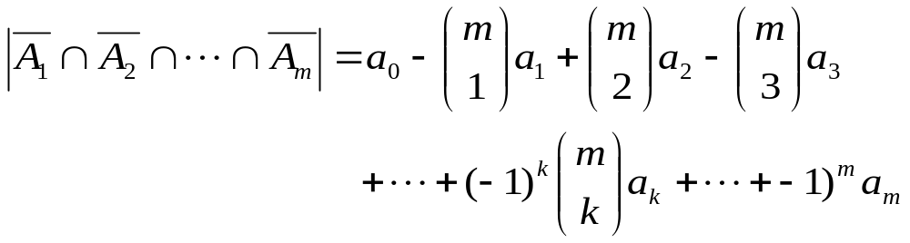
Special case for IEP
Assume that the size of the set A_{i1} ∩ A_{i2} ∩ … ∩ A_{ik} that occurs in the IEP depends only on k and not on which k sets are used in the intersection. Then
where a_{k} = |A_{i1} ∩ A_{i2} ∩ … ∩ A_{ik}|. This is because the kth summation that occurs in the IEP contains C(m, k) summands each equal to a_{k}.

Slide 6
Derangements

Slide 7
Derangements
A derangement of {1, 2, …, n} is a permutation i₁i₂…i_{n} of {1, 2, …, n} such that i₁ ≠ 1, i₂ ≠ 2, …, i_{n} ≠ n (i.e., no integer is in its natural position).
We denote by D_{n} the number of derangements of {1, 2, …, n}.

Slide 8
Examples
List the derangements for the set with n object, where n = 1,2, 3, 4, respectively.
For n =1, there are no derangements.
For n =2, the only derangement is 2 1
For n =3, there are two derangements:
2 3 1 and 3 1 2.
For n = 4, there are 9 derangements:
2143, 2341, 2413, 3142, 3412, 3421, 4123, 4312, 4321.

Slide 9
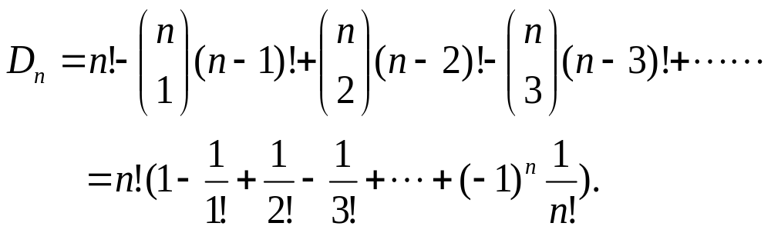
Exercise
Calculate D_{n} by applying IEP.

Slide 10
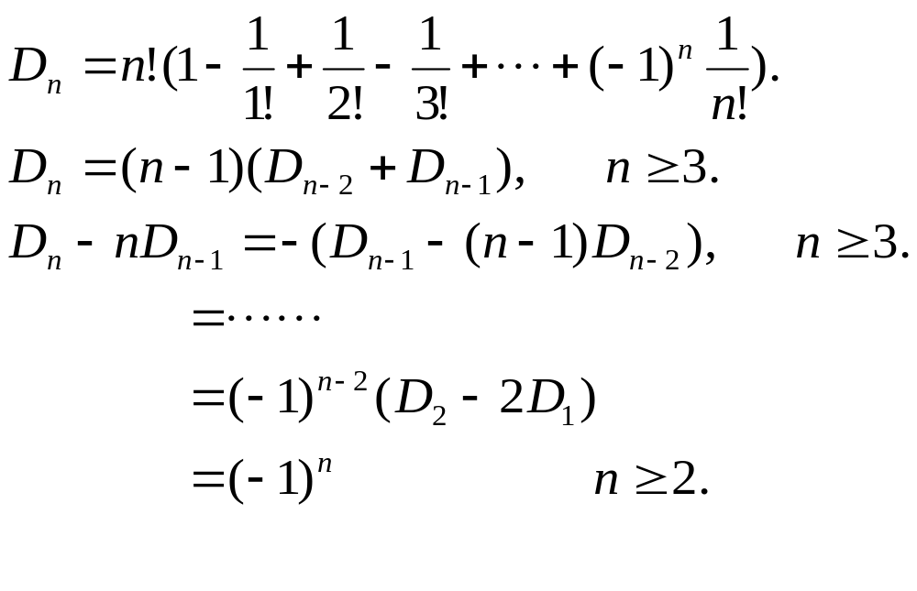
Formulas for Counting D_{n}
For n ≥ 1

Slide 11
Examples
At a party there are n men and n women. In how many ways can the n women choose male partners for the first dance? How many ways are there for the second dance if everyone has to change partners?
Answer: for the first dance there are n! possibilities. For the second dance, the number of possibilities is D_{n}.

Slide 12
Exercise
Suppose the n men and n women at the party above check their hats before the dance. At the end of the party their hats are returned randomly. In how many ways can they be returned if each man gets a male hat and each women gets a female hat, but no one gets the hat he or she checked?

Slide 13
Permutations with forbidden positions

Slide 14
Definition of P(X₁, X₂,…,X_{n})
Let X₁, X₂, …, X_{n} be (possibly empty) subsets of {1, 2, …, n}. We denote by P(X₁, X₂,…,X_{n}) the set of all permutations i₁i₂…i_{n} of {1, 2, …, n} such that i₁ is not in X₁, i₂ is not in X₂, …, i_{n} is not in X_{n.}
Let p(X₁, X₂,…,X_{n}) = | P(X₁, X₂,…,X_{n}) |

Slide 15
Examples
Let n = 4 and let X₁={1, 2}, X₂ ={2, 3}, X₃ ={3, 4} and X₄ ={1, 4}. Then P(X₁, X₂, X₃, X₄) consists of all permutations i₁i₂ i₃i₄ of {1,2 ,3 ,4} such that i₁ ≠ 1,2; i₂ ≠ 2,3; i₃ ≠ 3,4; i₄ ≠ 1,4. Hence, P(X₁, X₂, X₃, X₄) = {3412, 4123} and p(X₁, X₂,…,X_{n}) = 2.
Let X_{k} = {k} (k =1, 2, …,n). Then the set P(X₁, X₂,…,X_{n}) equals the set of all permutations i₁i₂…i_{n} of {1, 2, …, n} for which i_{k} ≠ k. We conclude that P(X₁, X₂,…,X_{n}) is the set of derangements of {1,2, …, n} and we have p(X₁, X₂,…,X_{n}) = D_{n}.

Slide 16

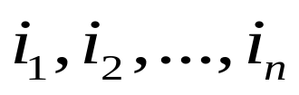



Placement of non-attacking rooks in chessboard
The permutation
of corresponds to the placement of
n rooks on the board in the square with coordinates .
The permutations in
correspond to placements of n non-attacking rooks on an n-by-n board in which there are certain squares in which it is forbidden to put a rook.

Slide 17




An example
Let ,
Then are in one-to-one correspondence with the placement of 5 non-attacking rooks on the board with forbidden positions as shown.
1
2
3
4
5
1
x
x
2
x
3
x
4
x
x
5
x
x

Slide 18


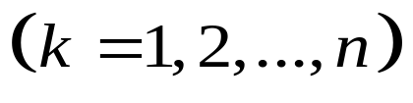
Placement of rooks in chess board
The number of ways to place n non-attacking, indistinguishable rooks on an n-by-n board with forbidden positions equals
(2)
Where is the number of ways to place non-attacking rooks on the n-by-n board where each of the k rooks is in a forbidden position.

Slide 19
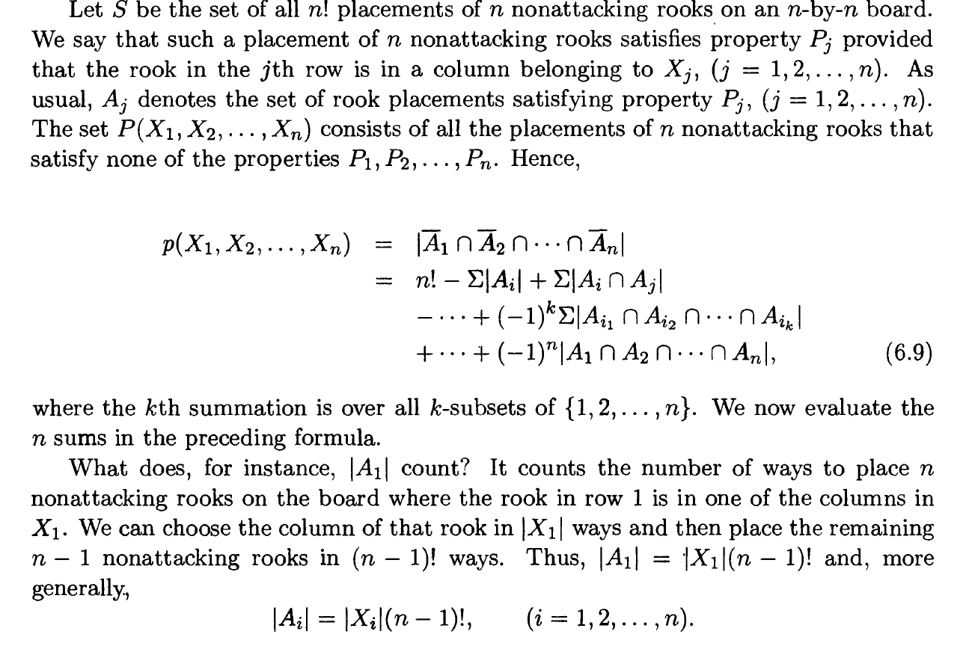

Slide 20
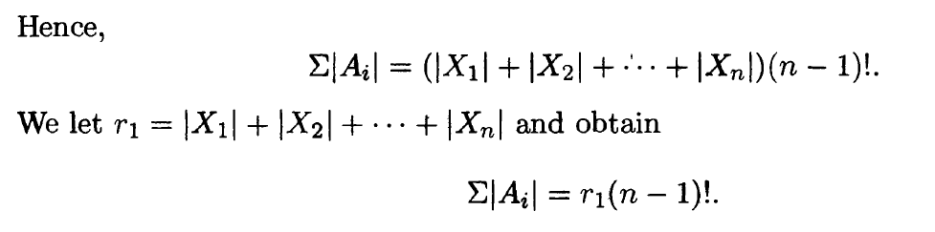
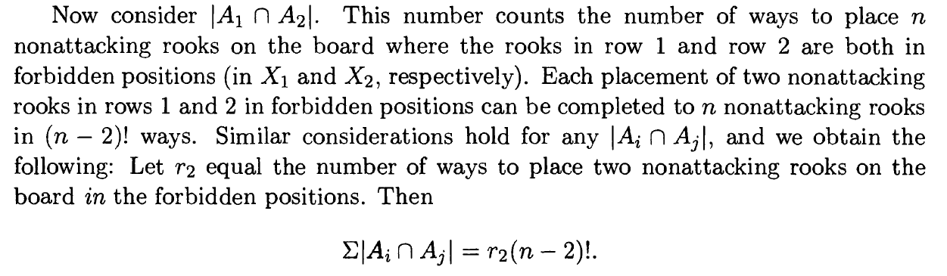

Slide 21
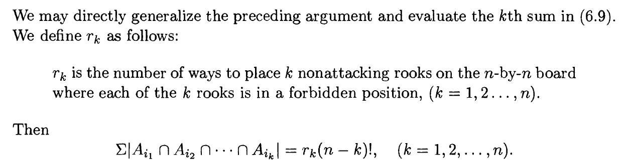

The number of ways to place n non-attacking, indistinguishable rooks on an n-by-n board with forbidden positions equals

Slide 22
An example
1
2
3
4
5
Determine the number of ways to place 5 non-attacking rooks on the following 5-by-5 board, with forbidden positions as shown.
1
x
2
x
x
3
x
x
4
x
x
5

Slide 23
Solution
We will decide the values of r₁, r₂, …, r₅. r₁ is the number of forbidden positions 7. Before evaluating r₂, r₃,…,r₅, we note that the set of forbidden positions can be partitioned into two “independent” parts, one part F₁ containing three positions and the other part F₂ containing four.
1
2
3
4
5
1
x
2
x
x
3
x
x
4
x
x
5
“Independent” means squares in different parts do not belong to a common row or column.

Slide 24
Evaluate r₂
We now evaluate r₂, the number of ways to place 2 non-attacking rooks in forbidden positions. The rooks may be both in F₁, both in F₂ or one in F₁ and one in F₂.
Hence, r₂ = 1+2+3x4 =15.
Continue to evaluate r3, r4, r5 by yourself.
1
2
3
4
5
1
x
2
x
x
3
x
x
4
x
x
5

Slide 25
An exercise
1
2
3
4
5
Determine the number of ways to place 5 non-attacking rooks on the following 5-by-5 board, with forbidden positions as shown.
1
x
2
x
x
3
x
x
x
4
x
x
x
5
x

Slide 26
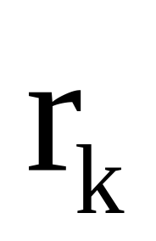

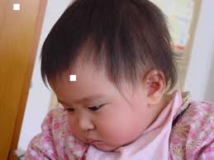
What is your problem?
What is your problem on calculating ?
Notes:
Discrete Mathematics and its Applications
(c)2001-2002, Michael P. Frank

Slide 27
Chessboard polynomial
A permutation of n-objects corresponds
to a non-attacking placement of n rooks
on a n-by-n chessboard.
o
e.g., 32451
o
o
o
o

Slide 28
Chessboard polynomial
The form of chessboard can be extended
Let r_{k} (C）denote the number of placement of k chesses to the chessboard C.

Slide 29
Examples
r₁( )=1，
r₁( )=2，
r₁( )=2，
r₂( )=0，
r₂( )=1。

Slide 30
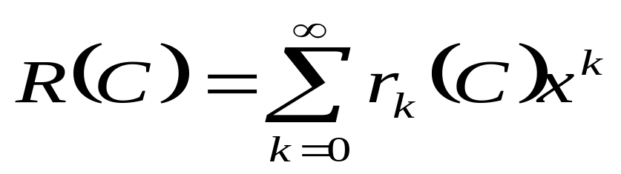
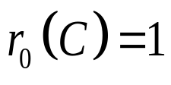

Chessboard polynomial
Let C be a chessboard.
is defined as the chessboard polynomial.
let ，even if

Slide 31
Chessboard polynomial
For a specified grid i in C, let C_{i} be a chessboard induced from C by deleting the row and the column of grid i；let C_{e} be induced from C by deleting grid i from C.

Slide 32
An example
*
C_{i}
C_{e}

Slide 33
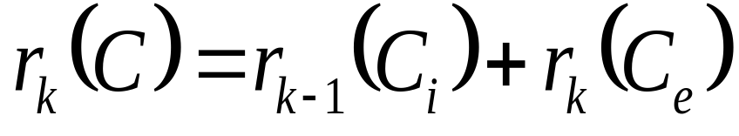
Chessboard polynomial
For a specified grid i, if place a chess, we get r_{k－1}(C_{i})；
otherwise，the number of placement is r_{k}(C_{e}).

Slide 34

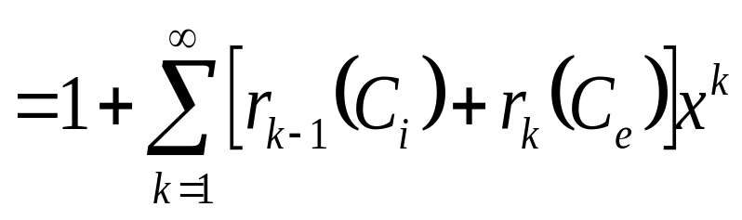
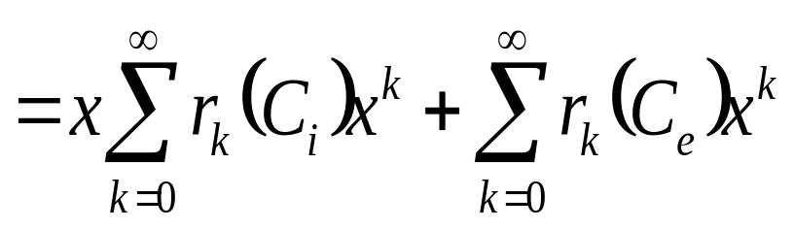
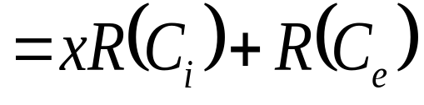
Chessboard polynomial
(3)

Slide 35
Examples
R( )=1+ x；
R( )= xR( )+ R( )= x+ (1+ x)=1+2x；
R( )= x R( ) + R( )
= x(1 + x )+1 + x
=1+ 2x +x²

Slide 36
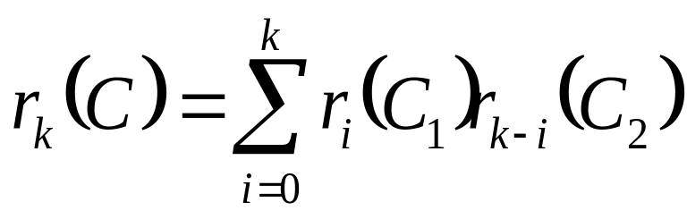
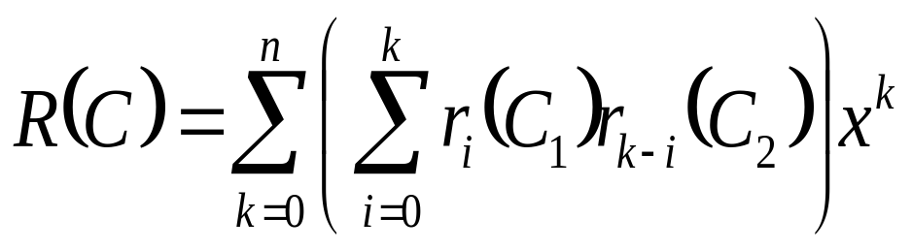
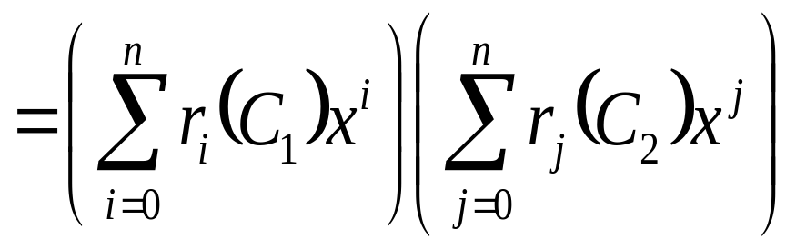
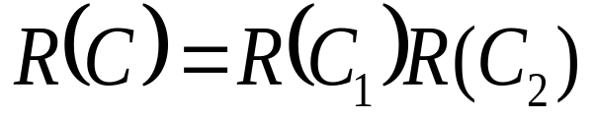
Chessboard polynomial
If C consists of two independent parts
C₁ and C₂
(4)

Slide 37
Chessboard polynomial
By the formulas（3）and（４），a complex
board can be separated into several simpler
ones in order to get the polynomial.
e.g, R ( ) = xR( )+R( )
= x(1+ x)² +(1+2x)²
=1+ 5x +6x² + x³
*
R( ) = xR( ) + R( )
= 1+6x +10 x² +4x³

Slide 38
Exercise
A B C D
Determine the number of ways to place 4 non-attacking rooks on the following 4-by-4 board, with forbidden positions as shown.
1 2 3 4
R( )=1+6x+10x²+4x³
R₄(C) =4!－6(4－1)!+10(4－2)!－4(4－3)!
+0(4－4)!=4
Notes:
Discrete Mathematics and its Applications
(c)2001-2002, Michael P. Frank

Slide 39
Section 6.5
Another forbidden position problem

Slide 40
Problem description
Suppose a class of 8 boys take a walk every day. They walk in a line of 8 so that every boy except the first is preceded by another. In order that a child not see the same person in front of him, on the second day they decide to switch positions so that no boy is preceded by the same boy who preceded him the first day. In how many ways can they switch positions?

Slide 41
Illustration of the problem
If we assign to the boys the numbers 1, 2, …, 8 with the last boy in the column of the first day receiving the number 1, …, and the first boy receiving the number 8 as in 1 2 3 4 5 6 7 8, then we are asked to determine the number of permutations of the set {1 2 3 4 5 6 7 8} in which the patterns 12, 23, 34 ,….,78 do not occur.
E.g., 31542876 is an allowable permutation while 84312657 is not.

Slide 42
Formulas for Counting Q_{n}
For n ≥1
Q_{n} = n! –C(n-1, 1)(n-1)! + C(n-1, 2) (n-2)! – C(n-1, 3)(n-3)! + …+(-1)^{n-1}(C(n-1, n-1)1!.
Q₁=1, Q₂=1, Q₃=3 and Q₄=11.
Q_{n} = D_{n} + D_{n-1}, (n≥2).

Slide 43
Assignments
3
8
11
25
31

