Slide 1
Chapter 8
Special Counting Sequences

Slide 2
Summary
Catalan numbers
Difference sequences and Stirling numbers
Partition number
Assignments

Slide 3
Catalan numbers

Slide 4
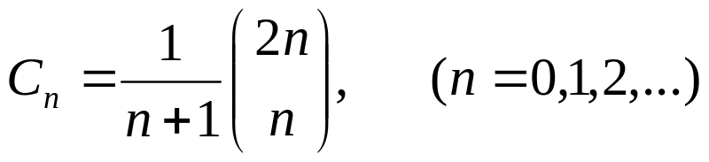
The Catalan sequence
The Catalan sequence is the sequence
C₀, C₁, C₂, …, C_{n}, …where

Slide 5
Theorem 8.1.1
The number of sequences a₁, a₂, …, a_{2n} of 2n terms that can be formed by using n +1’s and n -1’s whose partial sums satisfy a₁+ a₂+ …+ a_{k} ≥ 0 , (k=1,2, …, 2n) equals the nth Catalan number C_{n}.
Proof ?

Slide 6
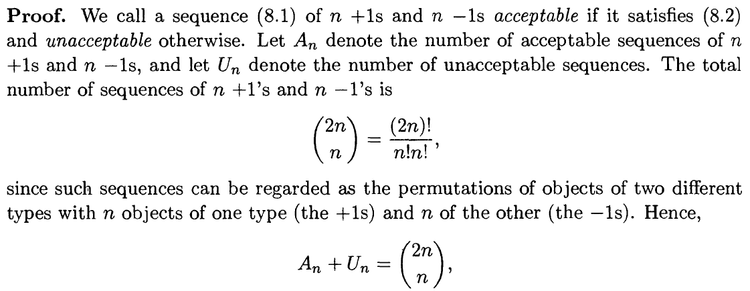
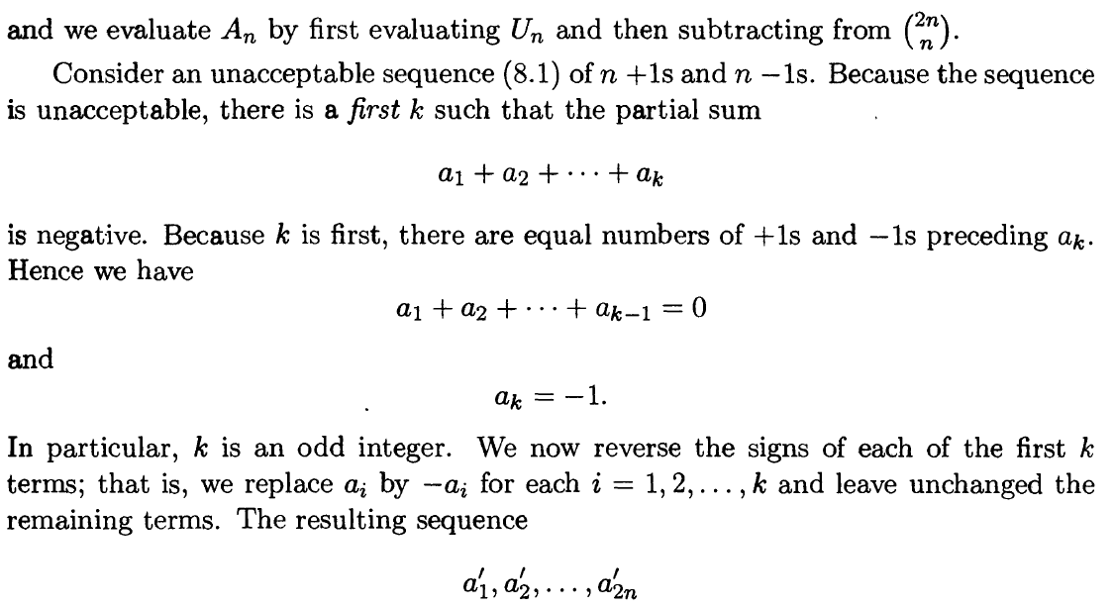

Slide 7
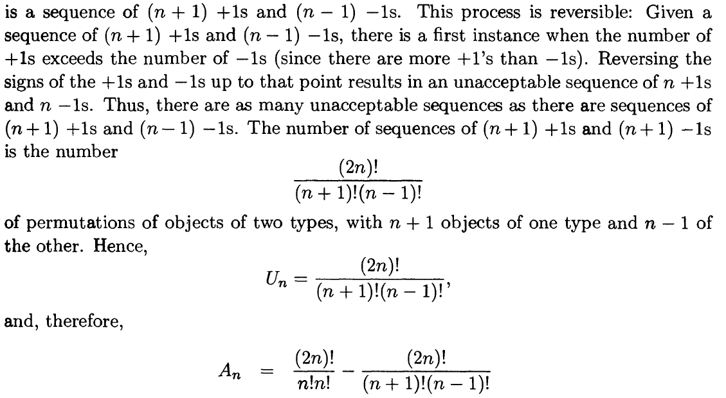
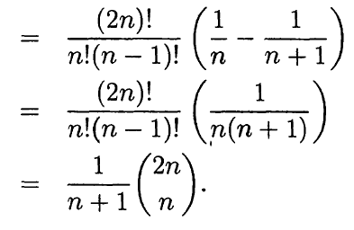

Slide 8
Examples
There are 2n people in line to get into a theatre. Admission is 50 cents. Of the 2n people, n have a 50 cent piece and n have a 1 dollar bill. The box office at the theatre rather foolishly begins with an empty cash register. In how many ways can the people in line up so that whenever a person with a $1 dollar bill buys a ticket, the box office has a 50 cent piece in order to make change?

Slide 9
Answer
If we regard the people as “indistinguishable” and identify a 50 cent piece with a +1 and a dollar bill with a -1, the answer is the number C_{n}.
If the people are regarded as “distinguishable”, what is the answer?
n!n!C_{n.}

Slide 10
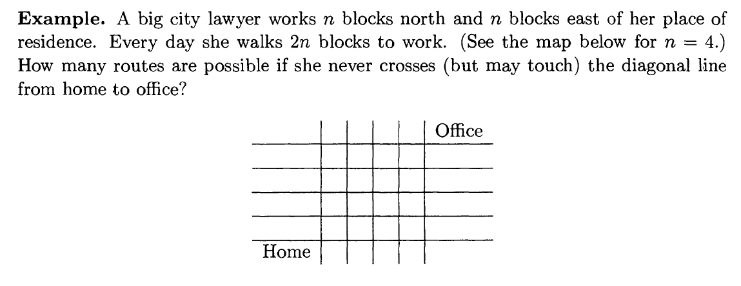
Example 1

Slide 11
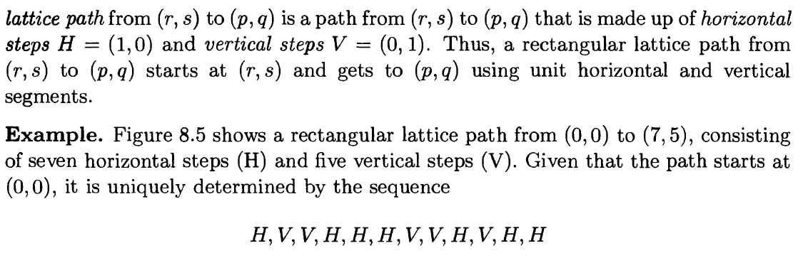
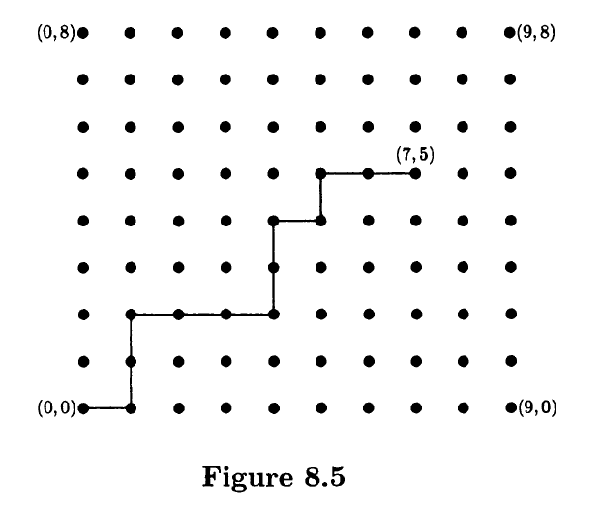
Example 2

Slide 12
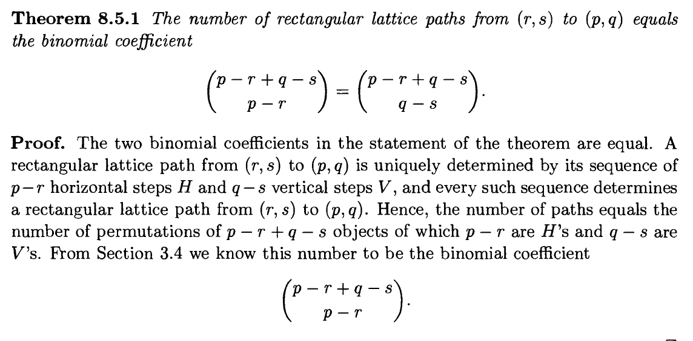

Slide 13
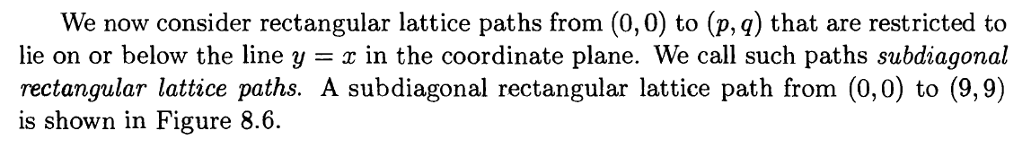
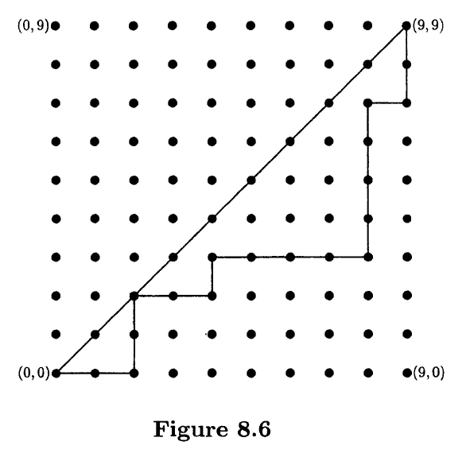

Slide 14
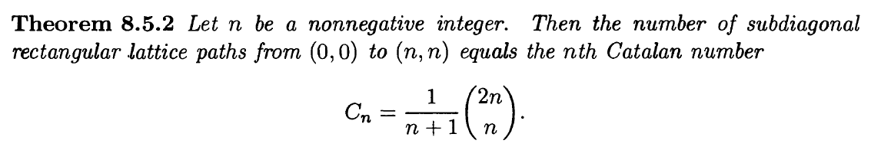
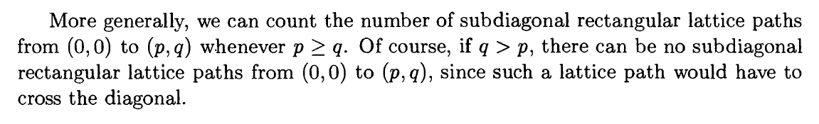
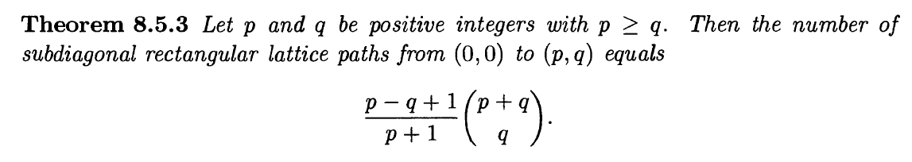

Slide 15
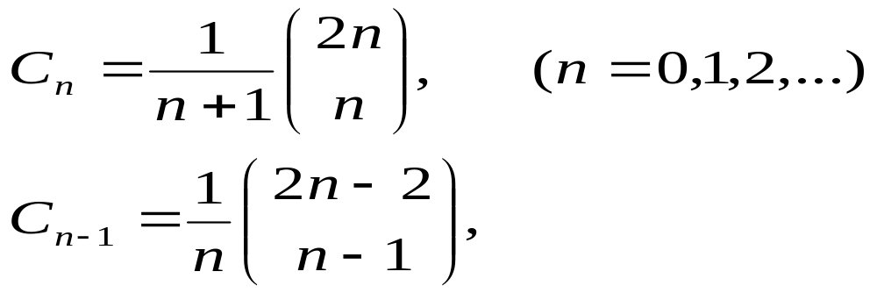
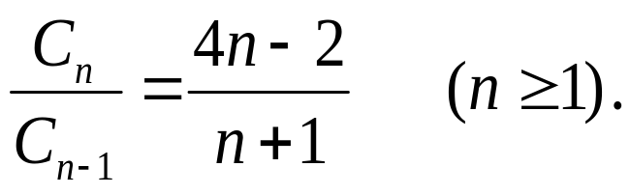
Recurrence relation of Catalan numbers
Since
By dividing , we obtain C₁ = 1 and

Slide 16
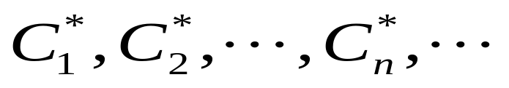
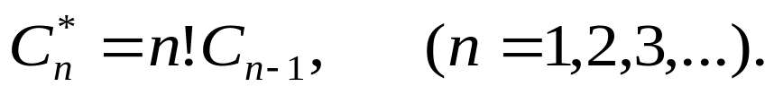
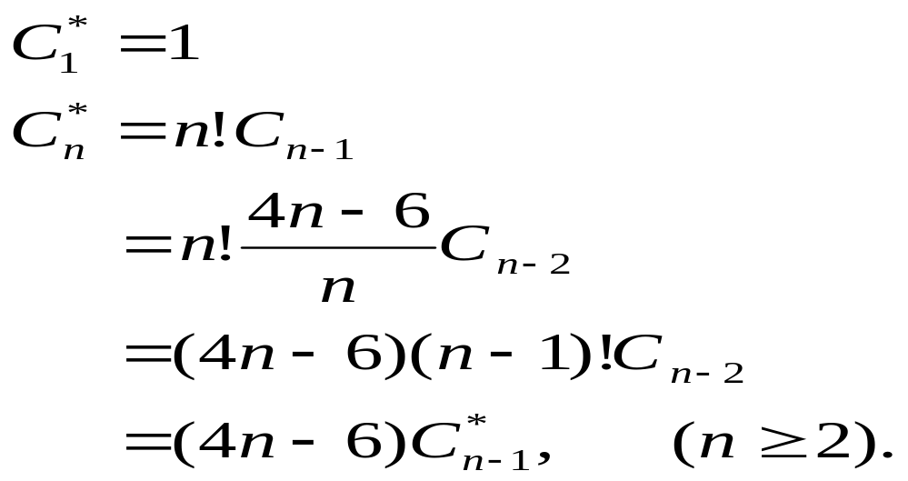
Pseudo-Catalan numbers
The Pseudo-Catalan sequence is the sequence
satisfying
We have

Slide 17
Difference sequences and Stirling numbers

Slide 18
Difference sequence
Let h₀, h₁, h₂, …, h_{n},… be a sequence of numbers. We define a new sequence
△h₀, △h₁, △h₂, …, △h_{n},…， called the (first order) difference sequence by
△h_{n} = h_{n+1}- h_{n}, (n ≥0).
The second-order difference sequence is defined by
△²h_{n} = △(△h_{n}) = △h_{n+1} - △h_{n}
= h_{n+2} – 2h_{n+1} + h_{n}, (n ≥ 0).

Slide 19
p^{th}-order difference sequence
The p^{th}-order difference sequence
△^{p}h₀, △^{p}h₁, △^{p}h₂, …, △^{p}h_{n},…，(p≥1)
can be defined inductively by letting
△^{p}h_{n} = △ (△^{p-1}h_{n})
Thus the p^{th}-order difference sequence is the first-order difference sequence of the (p-1)^{th}-order difference sequence.
We define the 0th-order difference sequence of a sequence to be itself; i.e., △⁰h_{n} = h_{n}, (n ≥ 0).

Slide 20
The difference table
h₀
h₁
h₂
h₃
h₄
….
△h₀
△h₁
△h₂
△h₃
….
△²h₀
△²h₁
△²h₂
….
△³h₀
△³h₁
….
…..
.….

Slide 21
Example
Let a sequence h₀, h₁, h₂, …, h_{n},… be defined by h_{n} = 2n²+3n+1, (n ≥ 0).
The difference table for this sequence is
1 6 15 28 45 66 91 …
5 9 13 17 21 25 …
4 4 4 4 4 …
0 0 0 0 ….
…….

Slide 22
Theorem 8.2.1
Let the general term of a sequence be a polynomial of degree p in n,
h_{n} = a_{p}n^{p} + a_{p-1}n^{p-1} + … + a₁n + a₀, (n ≥ 0).
Then △^{p+1}h_{n} = 0 for all n ≥ 0.
Proof:?

Slide 23
Linearity property of differences
Suppose g_{n} and f_{n} are the general terms of two sequences and h_{n} = g_{n} + f_{n} , (n ≥ 0). Then
△h_{n} = △g_{n} +△f_{n} .
More generally, it follows inductively that
△^{p}h_{n} = △^{p}g_{n} +△^{p}f_{n} , (p ≥ 0).
and indeed if c and d are constants that
△^{p} (cg_{n} + df_{n}) = c△^{p}g_{n} +d△^{p}f_{n} , (n ≥ 0).

Slide 24
Theorem 8.2.2
The general term of the sequence whose difference table has its 0th diagonal equal to c₀, c₁, c₂, …, c_{p}≠0, 0, 0, … is a polynomial in n of degree p satisfying
h_{n} = c₀C(n, 0) + c₁C(n, 1) + c₂C(n, 2) + …
+c_{p}C(n, p).

Slide 25
Example
Consider the sequence with general term
h_{n} = n³ + 3n² – 2n + 1, (n ≥ 0).
Computing differences we obtain
1 3 17 49
2 14 32
12 18
6
the 0th diagonal of the difference table is 1, 2, 12, 6, 0, 0, ….
Hence, by the theorem another way to write h_{n} is
h_{n} = 1C(n, 0) + 2C(n, 1) + 12C(n, 2) + 6C(n, 3).

Slide 26
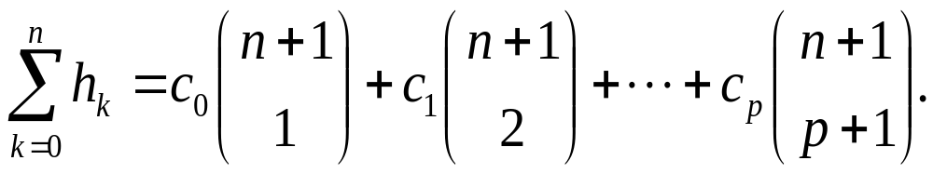
Partial sums of a sequence
Assume that the sequence h₀, h₁, h₂, …, h_{n},… has a difference table whose 0th diagonal equals, c₀, c₁, c₂, …, c_{p}≠0, 0, 0, … Then,

Slide 27
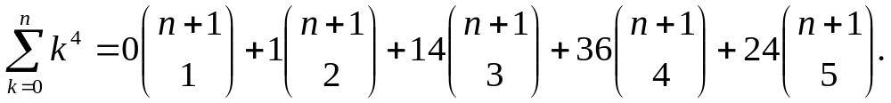
Example
Find the sum of the fourth powers of the first n positive integers.
Let h_{k} = k⁴. Computing the differences we obtain the 0th diagonal of the difference table equals 0, 1, 14, 36, 24, 0, 0, ….
Hence

Slide 28
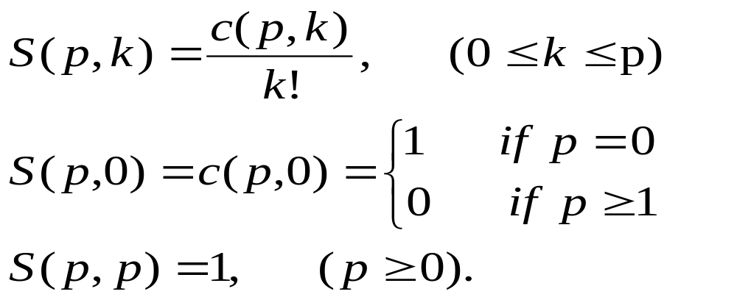
Stirling number of the second kind
Let h_{n}= n^{p,} the 0th diagonal of its difference table is c(p,0),c(p,1)…c(p,p)…
The Stirling number of the second kind is defined as

Slide 29
Recurrence relation of S(p,k)
If 1 ≤ k ≤ p, then
S(p, k) = kS(p – 1, k) + S(p – 1, k – 1)

Slide 30
Combinatorial meaning of S(p,k)
The stirling number of the second kind S(p,k) counts the number of partitions of a set of p elements into k indistinguishable boxes in which no box is empty.

Slide 31
Partition number S#(p,k)
S#(p,k) is the number of partitions of {1, 2, 3, …, p} into k nonempty, distinguishable boxes.
S#(p,k) = k! S(p, k)

Slide 32
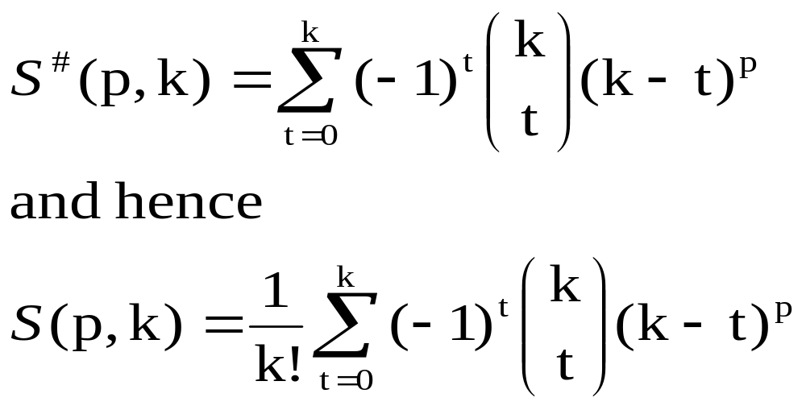
Calculation of S#(p,k) and S(p, k)
For each integer k with 0 ≤ k ≤ p we have
Proof: IEP ?

Slide 33
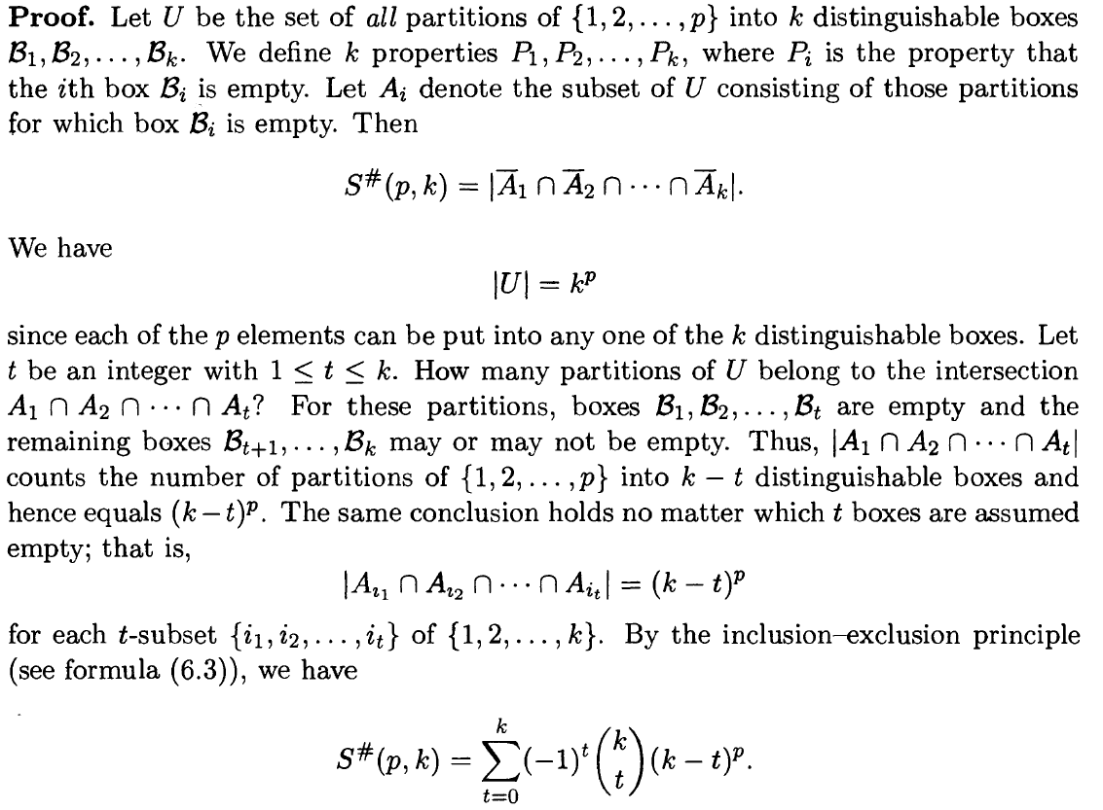

Slide 34
Bell number
The Bell number B_{p} is the number of partitions of a set of p elements into non-empty, indistinguishable boxes.
Note:
  The number of boxes is not specified.
  Since no box is empty, the number of boxes cannot exceed p.
  B_{p} = S(p, 0) + S(p, 1), + … + S(p, p).

Slide 35
Recurrence relations of Bell number
If p ≥ 1，then
B_{p} = C(p – 1, 0)B₀ + C(p – 1, 1)B₁+ …+
C(p – 1 , p – 1)B_{p-1}.
Proof:???

Slide 36
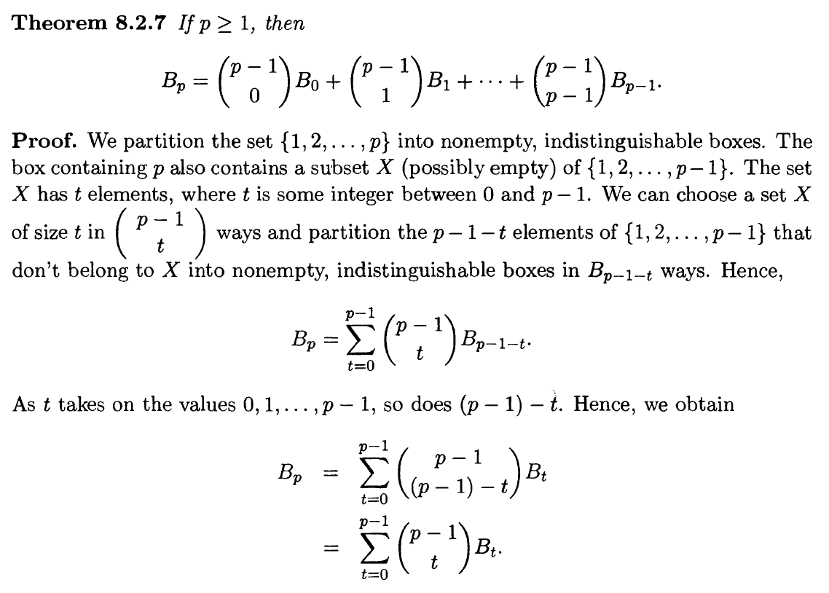

Slide 37
Stirling number of the first kind
The stirling number s(p, k) of the first kind counts the number of arrangements of p objects into k non-empty circular permutations.
If 1 ≤ k ≤ p, then
s(p, k) = (p – 1)s(p – 1, k) + s(p – 1, k – 1).
s(p, 0 ) = 0, (p ≥ 1）
s(p, p) = 1 , (p ≥ 0).

Slide 38
Partition numbers

Slide 39
Definition
A partition of a positive integer n is a representation of n as an unordered sum of one or more positive integers, called parts.

Slide 40

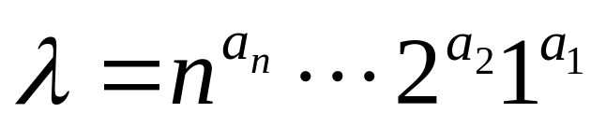
Representation
A partition of is sometime written as
where a_{i} is a non-negative integer equaling to the number of parts that equal to i.
Example: the partition of 5 are:
5¹, 4¹1¹, 3¹2¹, 3¹1², 2²1¹, 2¹1³, 1⁵.

Slide 41
Partition sequence
Let p_{n} denote the number of different partitions of the positive integer n, and for convenience let p₀ = 1. The partition sequence is the sequence of numbers p₀, p₁, …, p_{n},….
Q: Count p₀, p₁, p₂, p₃, p₄ and p₅.
A: p₀ = 1, p₁ = 1, p₂ = 2, p₃ = 3, p₄ = 5 and
p₅ = 7.

Slide 42
Calculate p_{n}
p_{n} equals the number of solutions in nonnegative integers a_{n}, …, a₂, a₁ of the equation
na_{n} + … + 2a₂ + 1a₁ = n.

Slide 43
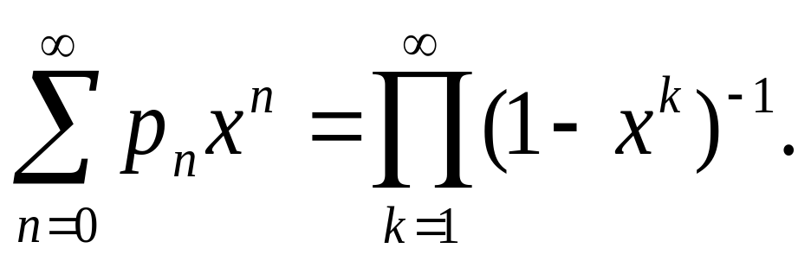
Generating functions for p_{n}
The generating function of the sequence of partition numbers is as following:

Slide 44
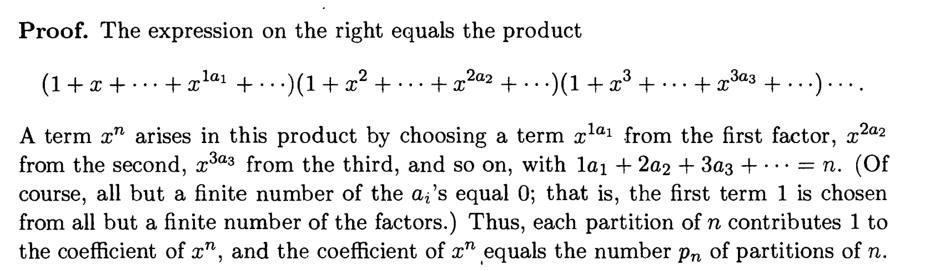

Slide 45
Discussion
The stirling number of the second kind S(p,k) counts the number of partitions of a set of p elements into k indistinguishable boxes in which no box is empty.
The Bell number B_{p} is the number of partitions of a set of p elements into non-empty, indistinguishable boxes.
The stirling number s(p, k) of the first kind counts the number of arrangements of p objects into k non-empty circular permutations.
The partition number p_{n} denotes the number of different partitions of the positive integer n.

Slide 46
Assignments
1
7
25

