Slide 1
Lecture 2
Pigeonhole Principle

Slide 2
Summary
Pigeonhole principle –simple form
Pigeonhole principle –strong form
Ramsey’s theorem

Slide 3
The Pigeonhole Principle
If m+1 pigeons are put into m pigeonholes, then at least one hole contains two or more pigeons.

Slide 4
Dirichlet Principle
Variously known as the Dirichlet Principle, the statement admits an equivalent formulation:
If n>m pigeons are put into m pigeonholes, there's a hole with more than one pigeon.

Slide 5
Formal Statement of Pigeonhole Principle
A more formal statement is also available:
Let |A| denote the number of elements in a finite set A. For two finite sets A and B, there exists a 1-1 correspondence f: A→B iff |A|=|B|.

Slide 6
Generalized Pigeonhole Principle
If N objects are assigned to k places, then at least one place must be assigned at least ⎡N/k⎤ objects.
E.g., there are N=280 students in this class. There are k=52 weeks in the year.
  Therefore, there must be at least 1 week during which at least ⎡280/52⎤= ⎡5.38⎤=6 students in the class have a birthday.

Slide 7
Pigeonhole Principle: Strong Form
Let q₁, q₂, …, q_{n} be positive integers. If
q₁+ q₂+ …+ q_{n}- n +1 objects are put into n boxes, then either the first box contains at least q₁ objects, or the second box contains at least q₂ object, ….., or the nth box contains at least q_{n} objects.

Slide 8
A Theorem of Ramsey
K₆ → K₃, K₃, of 6 (or more) people, either there are 3, each pair of whom are acquainted, or there are three, each pair of whom are unacquainted.

Slide 9
Proof for K₆ → K₃, K₃
Suppose K₆ is colored with two colors (say, red and black) in anyway. Consider the 5 edges connecting to node p, by the strong form of pigeonhole principle, at least 3 of them are the same color (say, red). Then either △abc is black, or one of the edges in △abc (say edge bc) is red. Then △pbc is red.
p
a
c
b

Slide 10
General statement for Ramsey’s Theorem
If m≥2 and n ≥2 are integers, then there is a positive integer p such that K_{p} → K_{m},K_{n}.
If K_{p} → K_{m},K_{n}, for any integer q ≥ p, K_{q} → K_{m},K_{n}.
The Ramsey number r (m, n) is the smallest integer p such that K_{p} → K_{m},K_{n}. e.g., r(3,3) = 6.

Slide 11
Lecture 3
Permutations and combinations

Slide 12
Summary
Addition and multiplication principle
Permutations of sets
Combinations of sets
Permutations of multi-sets
Combinations of multi-sets

Slide 13
Addition and multiplication principles
Let m be the number of ways to do task 1 and n the number of ways to do task 2 (with each number independent of how the other task is done), and assume that no way to do task 1 simultaneously also accomplishes task 2.
The addition principle: The task “do either task 1 or task 2, but not both” can be done in m+n ways.
The multiplication principle: The task “do both task 1 and task 2” can be done in mn ways.

Slide 14
Permutations of sets
A permutation of a set S of objects is a sequence containing each object once.
An ordered arrangement of r distinct elements of S is called an r-permutation.
The number of r-permutations of a set with n=|S| elements is
P(n,r) = n(n−1)…(n−r+1) = n!/(n−r)!
If r > n, then P(n,r) = 0. P(n,1) = n for each positive integer n.

Slide 15
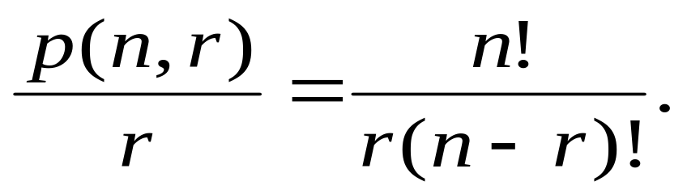
Circular permutations
The permutations that arrange objects in a line are called linear permutations. If the objects are arranged in a cycle, the permutations are called circular permutations.
The number of circular r-permutations of a set of n elements is given by
In particular, the number of circular permutations of n elements is (n - 1)!.

Slide 16
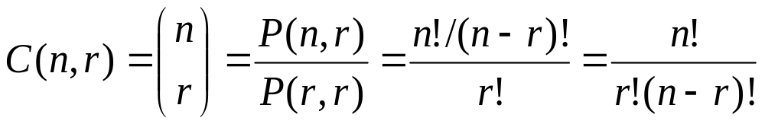
Combinations of sets
An r-combination of elements of a set S is simply a subset T⊆S with r members, |T|=r.
The number of r-combinations of a set with n=|S| elements is
Note that C(n,r) = C(n, n−r)
  Because choosing the r members of T is the same thing as choosing the n−r non-members of T.

Slide 17
Permutations of multi-sets
If S is a multiset, an r-permutation of S is an ordered arrangement of r of the objects of S. If |S| =n, then an n-permutation of S will also be called a permutation of S.
Let S be a multiset with objects of k different types where each has an infinite repetition number. Then the number of r-permutations of S is k^{r}.

Slide 18
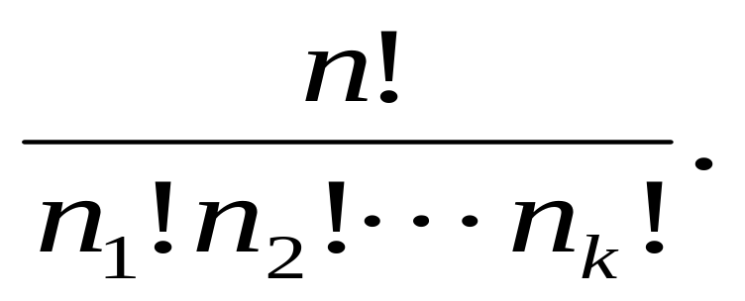
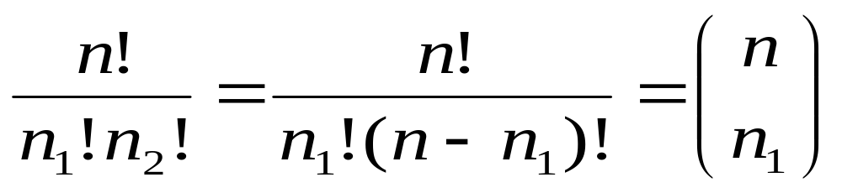
Finite Repetition Numbers
Let S be a multiset with objects of k different types with finite repetition numbers n₁, n₂, …, n_{k}, respectively. Let the size of S be n = n₁+ n₂+ …+ n_{k}. Then the number of permutations of S equals
Specially, when k=2

Slide 19
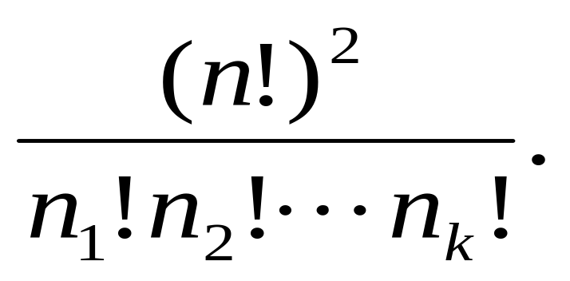
Chessboard Problem
There are n rooks of k colors with n₁ rooks of the first color, n₂ rooks of the second color, ……., and n_{k} rooks of the kth color. The number of ways to arrange these rooks on an n-by-n board so that no rook can attack another equals

Slide 20
Combinations of Multisets
If S is a multiset, then an r-combination of S is an unordered selection of r of the objects of S. Thus an r-combination is itself a multiset, a submultiset of S.
Example. If S = {2{a}, 1{b}, 3{c}}, then the 3-combinations of S are {2{a}, 1{b}}, {2.a, 1.c}, {1.a, 1.b, 1.c}, {1.a, 2.c}, {1.b,2.c}, {3.c}.

Slide 21
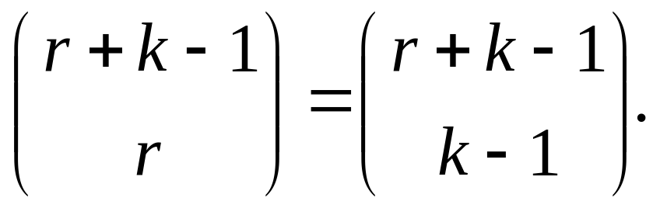
r-combinations
Let S be a multiset with objects of k different types where each has an infinite repetition number. Then the number of r-combinations of S equals

Slide 22
Chapter 4
Generating Permutations and Combinations

Slide 23
Summary
Generating permutations
Inversions in Permutations
Generating combinations
Generating r-combinations

Slide 24
Mobile Integer
Given an integer k we assign a direction to it by writing an arrow above it pointing to the left or to the right. Consider a permutation of {1,2,…,n} in which each of the integers is given a direction.
The integer k is called mobile if its arrow points to a smaller integer adjacent to it.

Slide 25
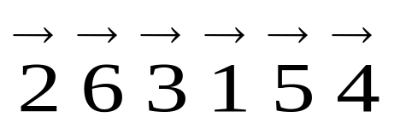
Example for mobile integer
For only 3, 5, and 6 are mobile.
Integer 1 can never be mobile since there is no integer smaller than 1.
The integer n is mobile, except in two cases:
  n is the first integer and its arrow points to the left.
  n is the last integer and its arrow points to the right.

Slide 26
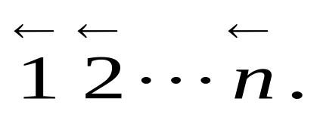
Algorithm for Generating the Permutations of {1,2,…,n}
Begin with
While there exists a mobile integer, do
find the largest mobile integer m.
switch m and the adjacent integer its arrow points to.
switch the direction of all integers p with p>m.

Slide 27
Inversions in Permutations
Let i₁i₂.... i_{n} be a permutation of the set {1,2, …,n}. The pair (i_{k}, i_{l}) is called an inversion if k<l and i_{k}>i_{l}.
An inversion in a permutation corresponds to a pair of numbers which are out of their natural order.
The only permutation of {1,2, …,n} with no inversions is 1 2 … n.

Slide 28
The number of inversions
Let a_{j} denote the number of inversions. It equals the number of integers which precede j in the permutation but are greater than j; it measures how much j is out of order.
The sequence of numbers a₁, a₂, …, a_{n} is called the inversion sequence of the permutation i₁i₂.... i_{n} .
The number a₁+ a₂+ …+ a_{n} measures the disorder of a permutation.

Slide 29
Examples of inversions
Consider the permutation 31524. It has four inversions, namely (3, 1), (3, 2), (5, 2), (5, 4).
The inversion sequence of the permutation 31524 is 1, 2, 0, 1, 0.
Q: The inversion sequence of the permutation 32514 is ???

Slide 30
A theorem
Let b₁, b₂, …, b_{n} be a sequence of integers satisfying
Then there exists a unique permutation of {1, 2, …, n} whose inversion sequence is b₁, b₂, …, b_{n} .

Slide 31
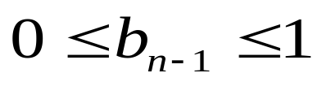
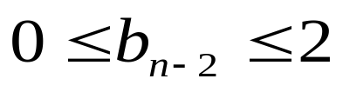
Algorithm I
n: write down n.
n-1: consider b_{n-1}. We are given that
If b_{n-1} =0, then n-1 must be placed before n. If b_{n-1} =1, then n-1 must be placed after n.
n-2: consider b_{n-2}. We are given that
If b_{n-2} = 0, then n-2 must be placed before the two numbers from step n-1. If b_{n-2} =1, then n-2 must be placed between the two numbers from step n-1. If b_{n-2} =2, then n-2 must be placed after the two numbers from step n-1.

Slide 32
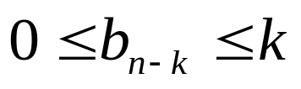
Algorithm I (cont’d)
n-k: (general step) consider b_{n-k}. We are given that In step n-k+1, the k numbers n, n-1, …, n-k+1 have already been placed in the required order. If b_{n-k} = 0, then n-k must be placed before all the numbers from step n-k+1. If b_{n-k} =1, then n-k must be placed between the first two numbers ……. If b_{n-k} =k, then n-k must be placed after all the numbers from step n-k+1.
1: We must place 1 after the b_{1st} number in the sequence constructed in step n-1.

Slide 33
Comments on Algorithm I
The algorithm can determine the unique permutation of {1, 2, …, n} whose inversion sequence is b₁, b₂, …, b_{n} .
The disadvantage of this algorithm is that the location of each integer in the permutation is not known until the very end; only the relative positions of the integers remain fixed throughout the algorithm.

Slide 34
Algorithm II
Begin with n empty locations which label 1, 2, …, n from left to right
1: put 1 in location number b₁ +1
2: put 2 in the (b₂ + 1)st empty location
……
k: (general step) counting from the left we put k in the (b_{k} +1)st empty location.
n: put n in the one remaining empty location.

Slide 35
Comments on Algorithm II
The algorithm can determine the unique permutation of {1, 2, …, n} whose inversion sequence is b₁, b₂, …, b_{n} .
The advantage of this algorithm is that the location of each integer in the permutation can be determined.

Slide 36
Generating combinations
Let S = {x_{n-1}, …, x₁, x₀} be a set of n elements. We now seek an algorithm which generates all of the 2^{n} combinations (subsets) of S.
We identify the 2^{n} combinations with the 2^{n} n-tuples (a_{n-1}, …, a₁, a₀) = a_{n-1}…a₁a₀ of 0’s and 1’s, where the ith term a_{i} correspond to the element x_{i} for each i = 0, 1, …, n-1.

Slide 37
Base 2 algorithm for generating the combinations of {x_{n-1}, …, x₁, x₀}
Begin with a_{n-1}…a₁a₀ = 0…00.
while a_{n-1}…a₁a₀ ≠ 1…11, do:
1) find the smallest integer j (between n-1 and 0) such that a_{j} = 0.
2) replace a_{j} by 1 and each of a_{j-1}, …, a₀ (which by our choice of j all equal 1) by 0.

Slide 38
Generating r-combinations
Let A and B be two r-combinations of the set {1, 2, …, n}. Then, we say that A precedes B in the lexicographic order provided the smallest integer which is in their union A∪B but not in their intersection A ∩ B is in A.

Slide 39
A theorem
Let a₁a₂…a_{r} ≠ (n-r+1)(n-r+2)…n be an r-combination of {1, 2, …, n}. Let k be the largest integer such that a_{k}< n and a_{k}+1 is different from each of a₁, a₂, …a_{r}.Then the r-combination which is the immediate successor of a₁a₂…a_{r} in the lexicographic ordering is
a₁…a_{k-1}(a_{k}+1)(a_{k}+2)…(a_{k}+r-k+1).

Slide 40
An example
Consider the 5-combination a₁a₂a₃a₄a₅ = 12389 of {1, 2, …, 9}. For k =3, a_{k} = 3 < 9 and a_{k}+1 = 4 is different from 1, 2, 3, 8, 9. Then the r-combination which is the immediate successor of a₁a₂…a₅ in the lexicographic ordering is a₁a₂(a₃+1)(a₃+2)…(a₃+5-3+1) = 12456.

Slide 41
Algorithm for generating the r-combinations
Begin with the r-combination a₁a₂…a_{r} =12…r. While a₁a₂…a_{r} ≠ (n-r+1)(n-r+2)…n, do
1) determine the largest integer k such that a_{k}+1 ≤ n and a_{k}+1 is not one of a₁, a₂, …a_{r .}
2) replace a₁a₂…a_{r} with the r-combination a₁a₂…a_{k-1}(a_{k}+1)(a_{k}+2)…(a_{k}+r-k+1).

Slide 42
Comments
Now we understand how to generate permutations and r-combinations of a set.
Question: How to generate r-permutations of an n-element set?
If we combine the algorithm for generating permutations of a set with the algorithm for generating r-combinations of an n-element set, we obtain an algorithm for generating r-permutations of an n-element set.

Slide 43
Chapter 5
The Binomial Coefficients

Slide 44
Summary
Pascal’s formula
The binomial theorem
Identities
Unimodality of binomial coefficients
The multinomial theorem
Newton’s binomial theorem

Slide 45
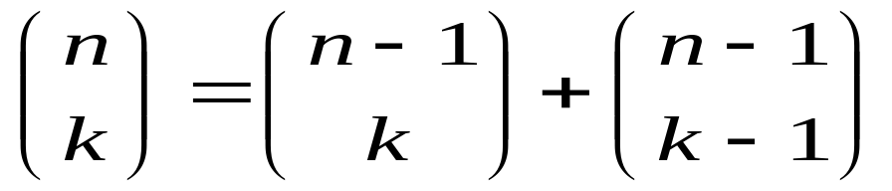
Pascal’s formula
For all integers n and k with 1≤k ≤n-1,
Hint: Let S be a set of n elements. We distinguish one of the elements of S and denote it by x. We then partition the set X of k-combinations of S into two parts , A and B such that all those k-combinations in A do not contain x while those in B contain x. Then
C(n, k) = |A| + |B| = C(n-1, k) + C(n-1, k-1).

Slide 46
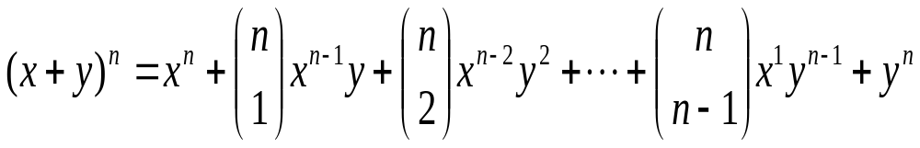
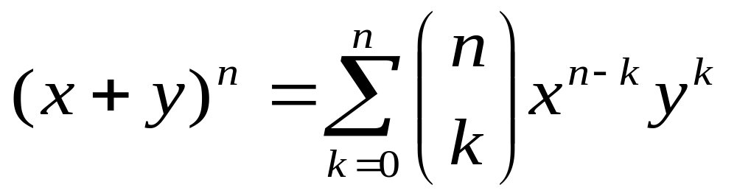
Binomial Theorem
Let n be a positive integer. Then for all x and y,
In summation notation,

Slide 47
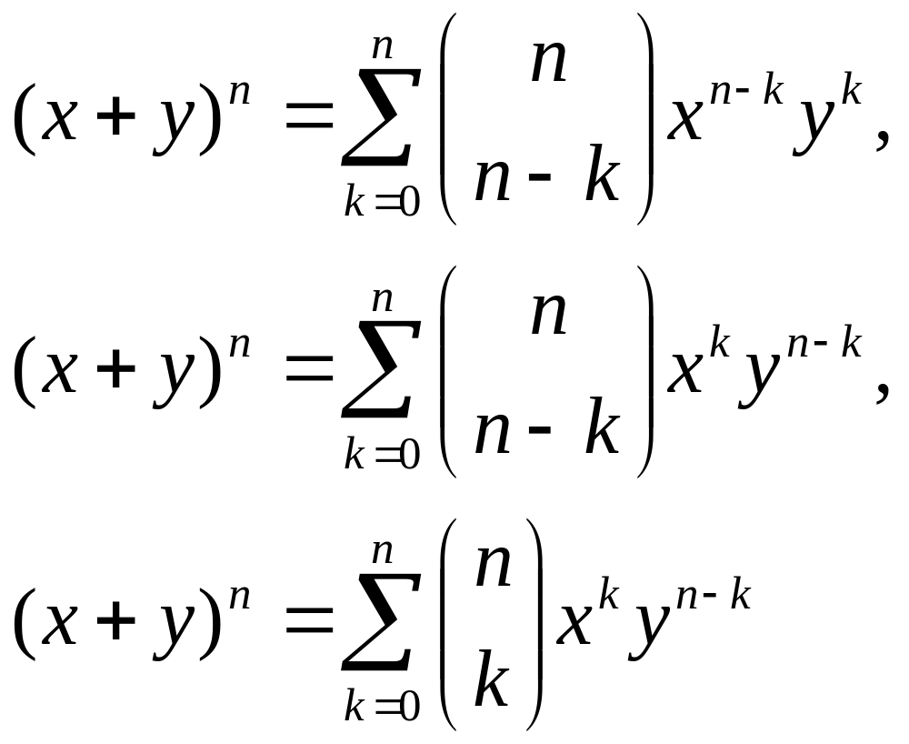
Equivalent forms

Slide 48
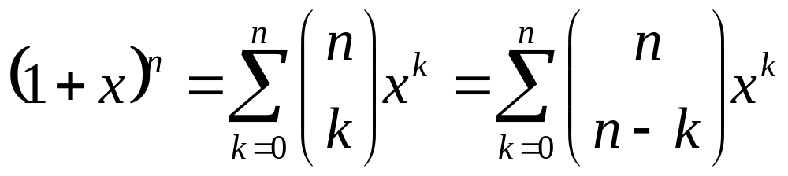
Special case
Let n be a positive number. Then for all x,

Slide 49
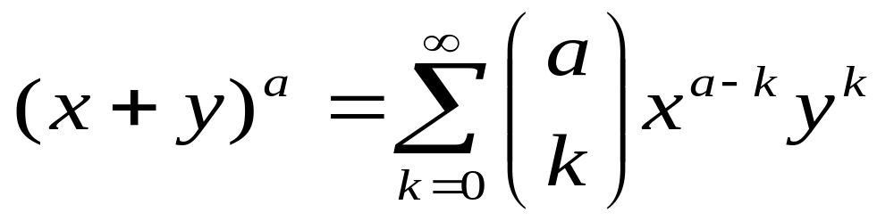
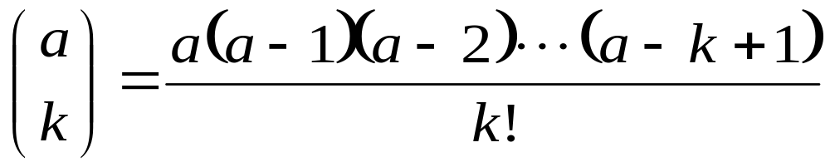
Newton’s Binomial Theorem
Let a be a real number . Then for all x and y with 0 ≤ |x| <|y|,
where

Slide 50
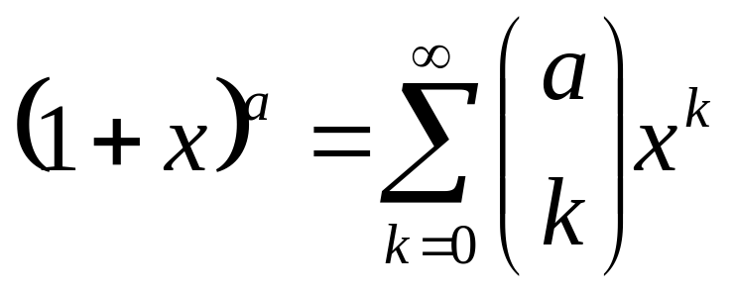
Special case
For any real number a,

Slide 51
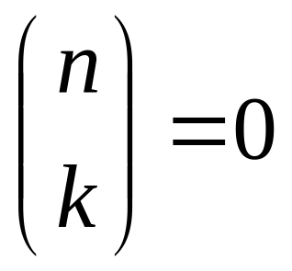

Correspondence
e.g. If a is a positive integer n, then when k>n
So

Slide 52
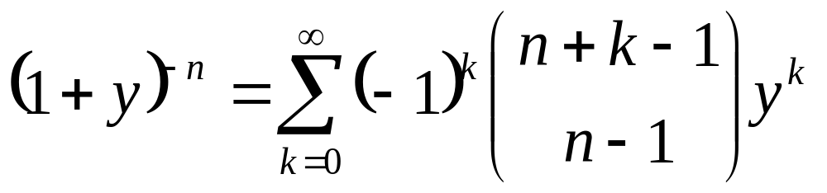
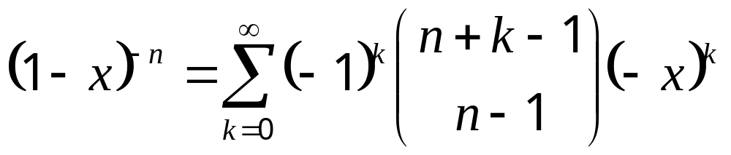
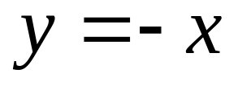
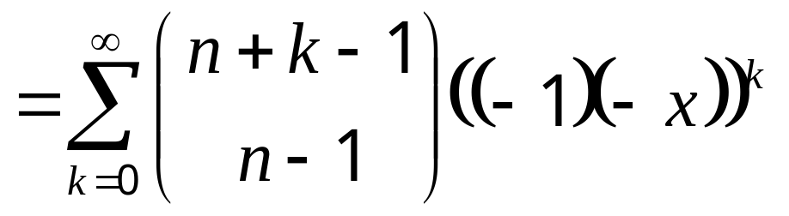
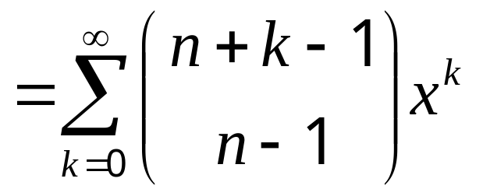
For |y|<1
Set

Slide 53
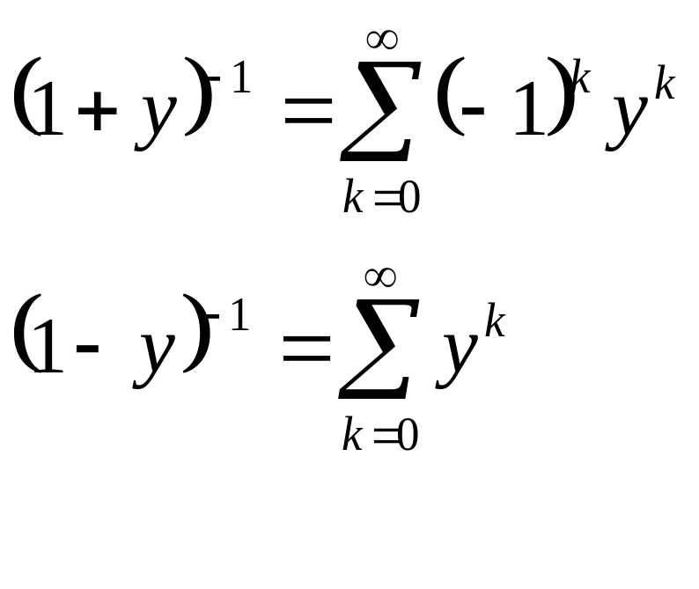
For |y| < 1 and let n=1

Slide 54
Lecture 6
IEP and Applications

Slide 55
Summary
The inclusion-exclusion principle
Combinations with repetition
Derangements
Permutations with forbidden positions

Slide 57
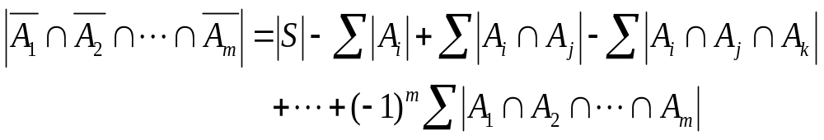
The inclusion-exclusion principle (IEP)
The number of objects in S which have none of the properties P₁, P₂, …., P_{m} is given by
where the first sum is over all 1-combination {i} of {1,2,3…,m}, the second sum is over all 2-combinations {i, j} of {1,2,..,m}, the third sum is over all 3-combinations {i, j, k} of {1,2,…,m}, and so on.

Slide 58
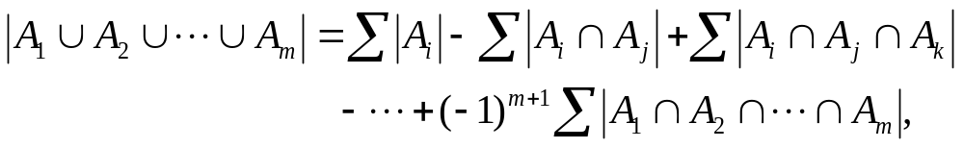
A corollary of IEP
The number of objects of S which have at least one of the properties P₁, P₂, …, P_{m} is given by
where the summations are as specified in IEP.

Slide 59
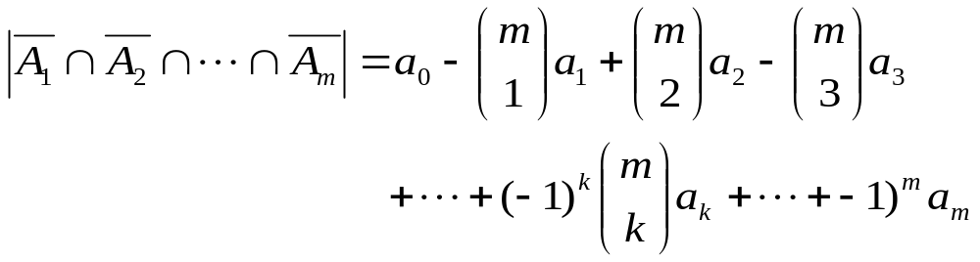
Special case for IEP
Assume that the size of the set A_{i1} ∩ A_{i2} ∩ … ∩ A_{ik} that occurs in the IEP depends only on k and not on which k sets are used in the intersection. Then
where a_{k} = |A_{i1} ∩ A_{i2} ∩ … ∩ A_{ik}|. This is because the kth summation that occurs in the IEP contains C(m, k) summands each equal to a_{k}.

Slide 60
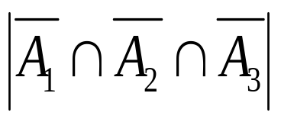
Combinations with repetition
Example 1: Determine the number of 10-combinations of the multiset T = {3{a}, 4{b}, 5{c}}.
Hint: Let T* = {∞{a}, ∞{b}, ∞{c}}, P₁ (resp., P₂, and P₃) be the property that a 10-combination of T* has more than 3 a’s (resp., 4 b’s and 5 c’s) and A₁ (resp., A₂ and A₃) be the 10—combinations of T* which have property P₁ (resp., P₂ and P₃). We wish to determine the size of the set

Slide 61
Hint (cont’d)
The set A₁ consists of all 10-conbinations of T* in which a occurs at least 4 times. If we take any one of these 10-combinations in A₁ and remove 4 a’s, we are left with a 6-combination of T*. Conversely, if we take a 6-combination of T* and add 4 a’s to it, we get a 10-combination of T* in which a occurs at least 4 times. Thus the number of 10-combinations in A₁ equals the number of 6-combinations of T*. Hence, |A₁| = C(6+3-1,6) = 28. Similarly, A₂ (resp., A₃) equals the number of 5 (resp., 4)-combinations of T*. Hence, |A₂| = C(5+3-1,5)=21, |A₃| = C(4+3-1,4)=15.

Slide 62
Hints (cont’d)
The set A₁∩A₂ consists of all 10-combinations of T* in which a occurs at least 4 times and b occurs at least 5 times. By above analysis, |A₁∩A₂ | equals the number of 1-combinations of T*, so that |A₁∩A₂ | = C(1+3-1, 1) =3. Similarly, |A₂∩A₃|=0, |A₁∩A₃|=1 and |A₁ ∩ A₂∩A₂|=0. Putting all these results into the IEP, we obtain = 6.

Slide 63
r-combination and integral solution
The number of r-combinations of the multiset {n₁*a₁, n₂*a₂,…,n_{k}*a_{k}} equals the number of integral solutions of the equation
x₁+x₂+…+x_{k}=r
which satisfy 0≤x_{i}≤n_{i} (i=1,2,…,k).
The number of these solutions can be calculated by the method just illustrated.

Slide 64
Derangements

Slide 65
Derangements
A derangement of {1, 2, …, n} is a permutation i₁i₂…i_{n} of {1, 2, …, n} such that i₁ ≠ 1, i₂ ≠ 2, …, i_{n} ≠ n (i.e., no integer is in its natural position).
We denote by D_{n} the number of derangements of {1, 2, …, n}.

Slide 66
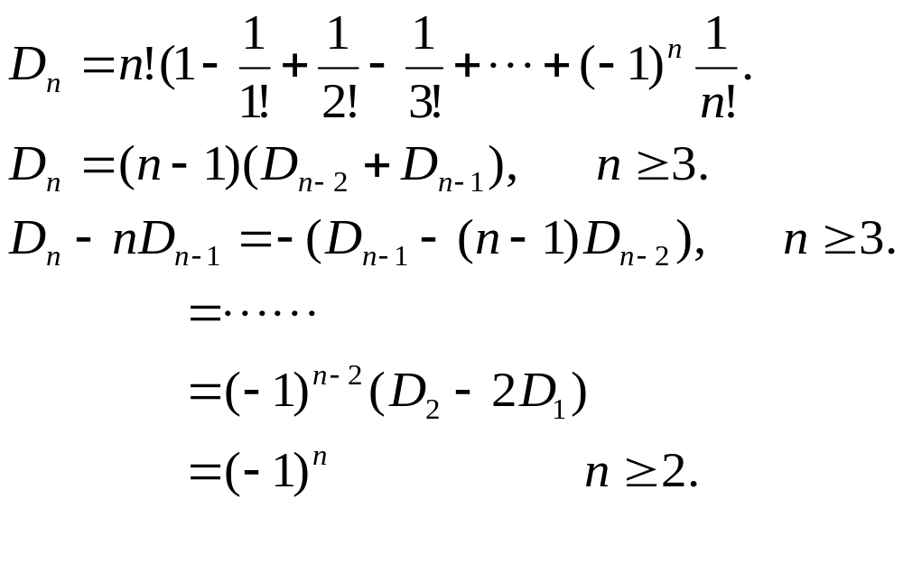
Formulas for Counting D_{n}
For n ≥ 1

Slide 67
Permutations with forbidden positions

Slide 68
Definition of P(X₁, X₂,…,X_{n})
Let X₁, X₂, …, X_{n} be (possibly empty) subsets of {1, 2, …, n}. We denote by P(X₁, X₂,…,X_{n}) the set of all permutations i₁i₂…i_{n} of {1, 2, …, n} such that i₁ is not in X₁, i₂ is not in X₂, …, i_{n} is not in X_{n.}
Let p(X₁, X₂,…,X_{n}) = | P(X₁, X₂,…,X_{n}) |

Slide 69
Placement of non-attacking rooks in chessboard
The permutation i₁i₂…i_{n} of {1, 2, …, n} corresponds to the placement of n rooks on the board in the square with coordinates (1, i₁), (2, i₂), …, (n, i_{n}).
The permutations in P(X₁, X₂,…,X_{n}) correspond to placements of n non-attacking rooks on an n-by-n board in which there are certain squares in which it is forbidden to put a rook.

Slide 70
An example
Let n =5, X₁ ={1, 4}, X₂ ={3}, X₃ = {4}, X₄ ={1, 5}, X₅ ={2, 5}. Then P(X₁, X₂, X₃, X₄, X₅) are in one-to-one correspondence with the placement of 5 non-attacking rooks on the board with forbidden positions as shown.
1
2
3
4
5
1
x
x
2
x
3
x
4
x
x
5
x
x

Slide 71
Placement of rooks in chess board
The number of ways to place n non-attacking, indistinguishable rooks on an n-by-n board with forbidden positions equals
n! – r₁(n-1)! + r₂(n-2)! - ... + (-1)^{k} r_{k}(n-k)!+…+(-1)^{r}r_{n}.
where r_{k} is the number of ways to place k non-attacking rooks on the n-by-n board where each of the k rooks is in a forbidden position (k=1, 2, …, n).

Slide 72

Chessboard polynomial
The form of chessboard can be extended
Let r _{k} (C）denote the number of placement of k chesses to the chessboard C.

Slide 73
Chessboard polynomial
∞
Let C be a chessboard. R(C)= ∑ r_{k}(C) x^{k}
is defined as the chessboard polynomial.
let r₀(C)=1，even if C=Ф
For a specified grid i in C, let C_{i} be a chessboard
induced from C by deleting the row and the
column of grid i；let C_{e} be induced from C by
Deleting grid i from C. Then,
r_{k}(C)=r_{k－1}(C_{i})＋r_{k}(C_{e})，
k=0

Slide 74
Chessboard polynomial
for a specified grid i, if place a chess, we get
r_{k－1}(C_{i})；
otherwise，the number of placement is
r_{k}(C_{e}). Hence,
R(C)= ∑ r_{k}(C) x^{k}
＝１＋∑[r_{k－1}(C_{i})+ r_{k}(C_{e})]x^{k}
= x ∑ r_{k}(C_{i})x^{k} + ∑ r_{k}(C_{e})x^{k}
＝xR(C_{i}) + R(C _{e}) (3)
∞
k=0
∞
k=0
∞
∞
k=0
k=0

Slide 75
If C consists of two independent parts
C₁ and C₂
r_{k}(C) = ∑ r_{i}(C₁) r_{k－i}(C₂)
k
i=0
n
k
故 R(C) = ∑ (∑ r_{i}(C₁) r_{k－i}(C₂) ) x^{k}
= (∑ r_{i}(C₁) x^{i}) (∑ r_{j}(C₂) x^{j} )
k=0
i=0
n
n
i=0
j=0
∴ R(C) = R(C₁) R(C₂) (4)

Slide 76
By the formulas（３）and（４），a complex
board can be separated into several simpler
ones in order to get the polynomial.
e.g, R ( ) = xR( )+R( )
= x(1+ x)² +(1+2x)²
=1+ 5x +6x² + x³
*
R( ) = xR( ) + R( )
= 1+6x +10 x² +4x³

Slide 77
Chapter 7
Recurrence Relations and Generating functions

Slide 78
Summary
Linear homogeneous recurrence relations
Generating functions
Recurrences and generating functions
A geometry example
Exponential generating functions
Assignments

Slide 79
Linear Homogeneous Recurrence Relations

Slide 80
Linear Recurrence Relation
A sequence of numbers h₀, h₁,…, h_{n}, … is said to satisfy a linear recurrence relation of order k, provided there exist quantities a₁, a₂, …, a_{k}, with a_{k} ≠ 0, and a quantity b_{n} (each of these quantities a₁, a₂, …, a_{k}, b_{n} may depend on n) such that
h_{n} = a₁h_{n-1}+a₂h_{n-2}+…+a_{k}h_{n-k}+b_{n}, (n ≥ k).

Slide 81
Homogeneous
The linear recurrence relation
h_{n} = a₁h_{n-1}+a₂h_{n-2}+…+a_{k}h_{n-k}+b_{n}, (n ≥ k) is called homogeneous provided b_{n} = 0.
The linear recurrence relation is said to have constant coefficients provided a₁, a₂, …, a_{k} are constants.

Slide 82
Theorem 7.2.1
Let q be a non-zero number. Then h_{n} = q^{n} is a solution of the linear homogeneous recurrence relation
h_{n} – a₁h_{n-1} – a₂h_{n-2} – … – a_{k}h_{n-k}= 0, (a_{k} ≠ 0, n ≥ k) (7.20)
with constant coefficients iff q is a root of the polynomial equation
x^{k} – a₁x^{k-1} – a₂x^{k-2} – … – a_{k} = 0. (7.21)
If the polynomial equation has k distinct roots q₁, q₂, …, q_{k}, then h_{n} = c₁q₁^{n} + c₂q₂^{n} + … + c_{k}q_{k}^{n} (7.22)
is the general solution of (7.20) in the following sense: no matter what initial values for h₀, h₁, …, h_{k-1}are given, there are constants c₁, c₂, …, c_{k} so that (7.22) is the unique sequence which satisfies both the recurrence relation (7.20) and the initial conditions.

Slide 83
Comments
If the roots q₁, q₂, …, q_{k} of the characteristic equation are not distinct, then h_{n} = c₁q₁^{n}+c₂q₂^{n}+…+c_{k}q_{k}^{n} is not a general solution of the recurrence relation.

Slide 84
Theorem 7.2.2
Let q₁, q₂, …, q_{t} be the distinct roots of the characteristic equation of the linear homogeneous recurrence relation (7.20) with constants coefficients. Then if q_{i} is an s_{i}-fold root of the characteristic equation (7.21) , then the general solution of the recurrence relation is
h_{n} = H_{n}⁽¹⁾ + H_{n} ⁽²⁾ + … + H_{n}^{(t)}, where
H_{n}^{(i)} = c₁q_{i}^{n} + c₂nq_{i}^{n} + … + c_{si}n^{si-1}q_{i}^{n}
= (c₁ +c₂n+…+c_{si}n^{si-1})q_{i}^{n}.

Slide 85
Generating Functions

Slide 86
Definition of generating functions
Let h₀, h₁, …, h_{n}, …… be an infinite sequence of numbers. Its generating function is defined to be the infinite series
g(x) = h₀ + h₁x + h₂x² +…+ h_{n}x^{n} +……
The coefficient of x^{n} in g(x) is the nth term h_{n} of the sequence, and thus x^{n} acts as a “place holder” for h_{n}.

Slide 87
Recurrences and generating functions

Slide 88
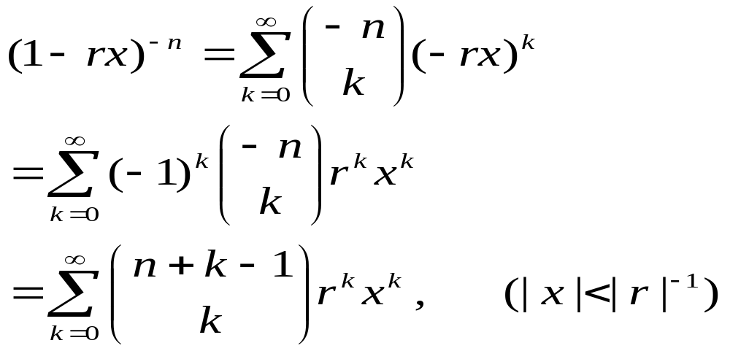
Review: Newton’s binomial theorem
If n is a positive integer and r is a non-zero real number, then

Slide 89
Examples (cont’d)
Solve the recurrence relation
h_{n} = 5h_{n-1} – 6 h_{n-2}, (n≥2) subject to the initial values h₀ = 1 and h₁ = -2.
Hints: let g(x) = h₀+h₁x+h₂x²+…+h_{n}x^{n}+…. be the generating function for h₀, h₁, h₂, …, h_{n} … we then have the following equations

Slide 90
g(x) = h₀+h₁x+h₂x²+…+h_{n}x^{n}+….
-5xg(x) = -5h₀x -5h₁x² - 5h₂x³ -…- 5h_{n-1} x^{n} -….
6x² g(x) = 6h₀x² +6h₁x³ +6h₂x⁴ +…+6h_{n-2}x^{n} +….
Adding these three equations, we obtain
(1-5x+6x²)g(x) = h₀+(h₁-5h₀)x+(h₂-5h₁+6h₀)x²+…+(h_{n}-5h_{n-1}+6h_{n-2})x^{n}+….
= h₀+(h₁-5h₀)x = 1-7x (by assumptions)
Hence, g(x) = (1-7x)/(1-5x+6x²)
= 5/(1-2x) – 4/(1-3x)
Notes:
1。Given a broadcast/multicast, to determine broadcast/multicast tree(power of each node) such the total cost is minimized.
BIP(Broadcast Incremental Power), MIP, MST,SPT have been proposed. Performance through simulation.
2.3。 Each node have k levels power. To determine power level of each node, such that total cost of broadcast is minimized.
For 3, Heuristic algorithm based directed Steiner tree method was proposed.
Our work is similar with 2,, but our algorithm is better than 2.

Slide 91
By Newton’s binomial theorem
(1-2x)⁻¹ = 1+2x+2²x²+…+2^{n}x^{n}…..
(1-3x)⁻¹ = 1+3x+3²x²+…+3^{n}x^{n}…..
Therefore,
g(x) = 1 + (-2)x + (-15)x² +…+ (5×2^{n} – 4×3^{n})x^{n}+…
and we obtain
h_{n} = 5×2^{n} – 4×3^{n} (n = 0, 1, 2, …).

Slide 92
Exponential generating functions

Slide 93
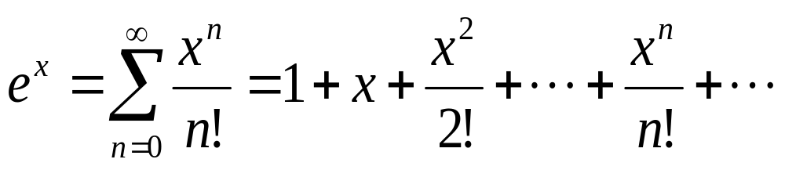
Review: Taylor’s series for e^{x}

Slide 94
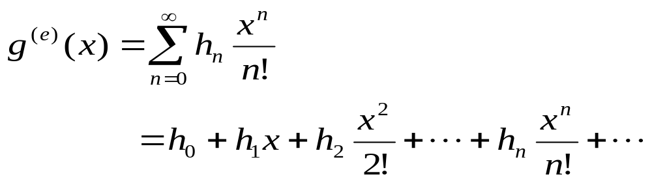
Definition of exponential generating functions
The exponential generating function for the sequence h₀, h₁, h₂, …, h_{n}, … is defined to be

Slide 95
A theorem
Let S be the multiset {n₁.a₁, n₂.a₂,…, n_{k}.a_{k}} where n₁, n₂, …, n_{k} are non-negative integers. Let h_{n} be the number of n-permutations of S. Then the exponential generating function g^{(e)}(x) for the sequence h₀, h₁, h₂,…,h_{n},… is given by
g^{(e)}(x)= f_{n1}(x) f_{n2}(x) …. f_{nk}(x)
where for i=1, 2, …, k,
f_{ni}(x) = 1 +x+x²/2!+…+x^{ni}/n_{i}!.

Slide 96
Examples
Determine the number of ways to color the squares of a 1-by-n chessboard, using the colors red, white, and blue, if an even number of squares are to be colored red.
Hints: Let h_{n} denote the number of such colorings where we define h₀ =1. Then h_{n} equals the number of n-permutations of a multiset of three colors, each with an infinite repetition number, in which red occurs an even number of times. Thus the exponential generating function for h₀, h₁, h₂,…h_{n} ,… is the product of red, white and blue factors:

Slide 97
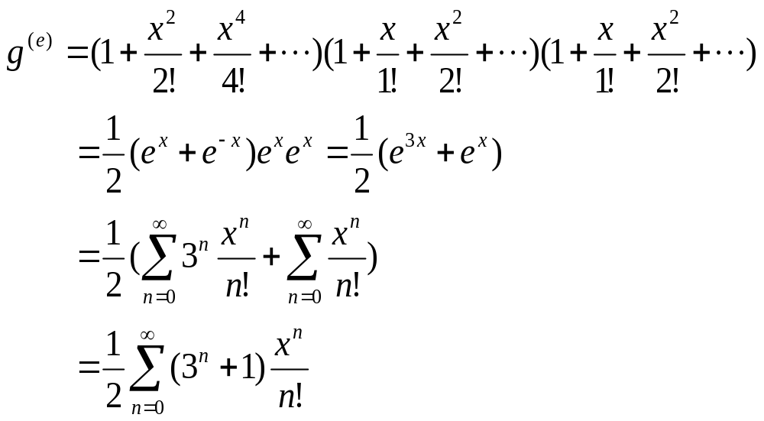
Hence, h_{n} = (3^{n}+1)/2.

Slide 98
Chapter 8
Special Counting Sequences

Slide 99
Summary
Catalan numbers
Difference sequences and Stirling numbers
Partition number
Assignments

Slide 100
Catalan numbers

Slide 101
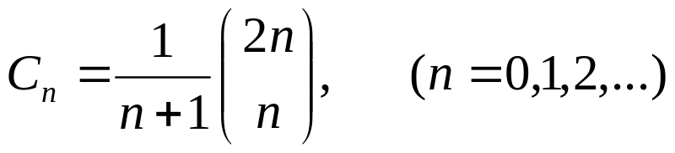
The Catalan sequence
The Catalan sequence is the sequence
C₀, C₁, C₂, …, C_{n}, …where

Slide 102
Theorem 8.1.1
The number of sequences a₁, a₂, …, a_{2n} of 2n terms that can be formed by using n +1’s and n -1’s whose partial sums satisfy a₁+ a₂+ …+ a_{k} ≥ 0 , (k=1,2, …, 2n) equals the nth Catalan number C_{n}.

Slide 103
Examples
There are 2n people in line to get into a theatre. Admission is 50 cents. Of the 2n people, n have a 50 cent piece and n have a 1 dollar bill. The box office at the theatre rather foolishly begins with an empty cash register. In how many ways can the people in line up so that whenever a person with a $1 dollar bill buys a ticket, the box office has a 50 cent piece in order to make change?

Slide 104
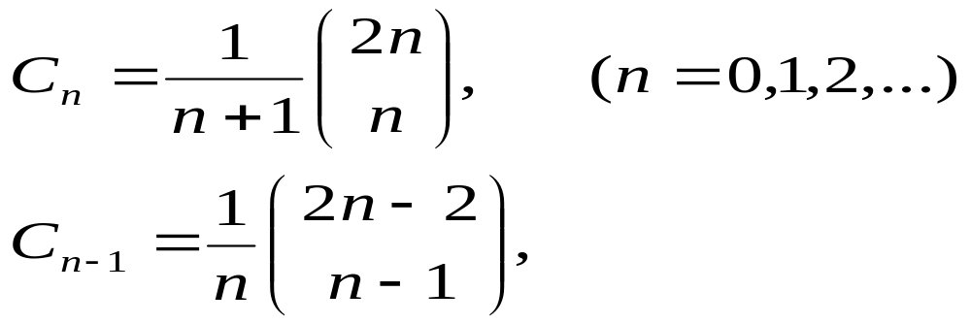
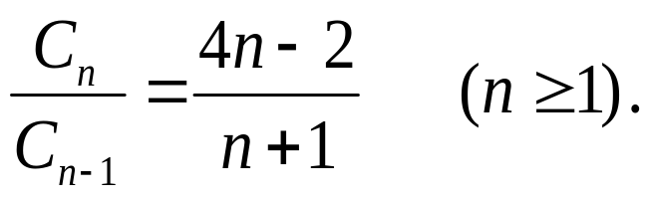
Recurrence relation of Catalan numbers
Since
By dividing , we obtain C₁ = 1 and

Slide 105
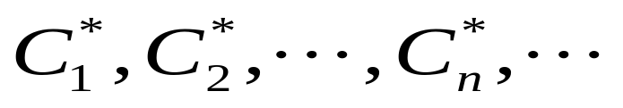
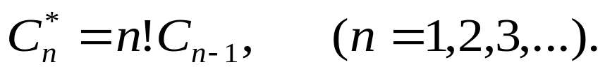
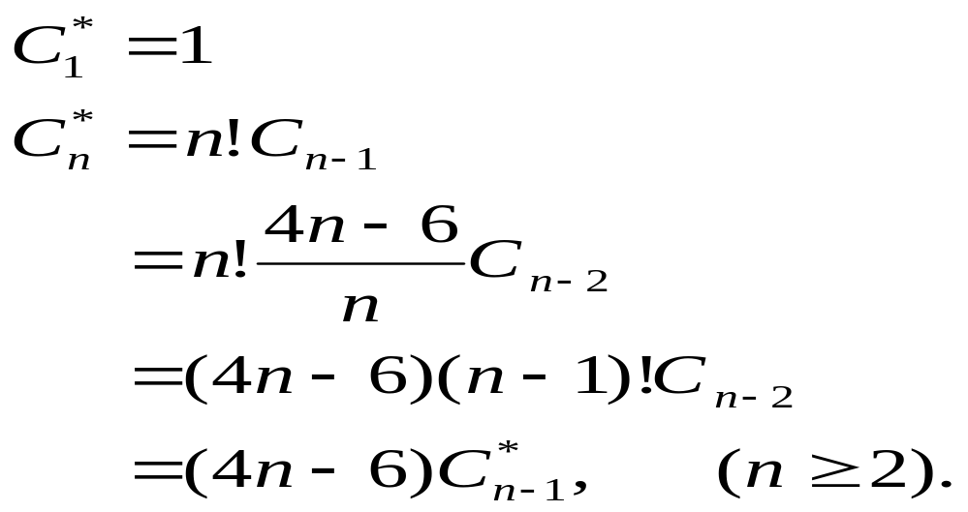
Pseudo-Catalan numbers
The Pseudo-Catalan sequence is the sequence
satisfying
We have

Slide 106
Difference sequences and Stirling numbers

Slide 107
Difference sequence
Let h₀, h₁, h₂, …, h_{n},… be a sequence of numbers. We define a new sequence
△h₀, △h₁, △h₂, …, △h_{n},…， called the (first order) difference sequence by
△h_{n} = h_{n+1}- h_{n}, (n ≥0).
The second-order difference sequence is defined by
△²h_{n} = △(△h_{n}) = △h_{n+1} - △h_{n}
= h_{n+2} – 2h_{n+1} + h_{n}, (n ≥ 0).

Slide 108
p^{th}-order difference sequence
The p^{th}-order difference sequence
△^{p}h₀, △^{p}h₁, △^{p}h₂, …, △^{p}h_{n},…，(p≥1)
can be defined inductively by letting
△^{p}h_{n} = △ (△^{p-1}h_{n})
Thus the p^{th}-order difference sequence is the first-order difference sequence of the (p-1)^{th}-order difference sequence.
We define the 0th-order difference sequence of a sequence to be itself; i.e., △⁰h_{n} = h_{n}, (n ≥ 0).

Slide 109
The difference table
h₀
h₁
h₂
h₃
h₄
….
△h₀
△h₁
△h₂
△h₃
….
△²h₀
△²h₁
△²h₂
….
△³h₀
△³h₁
….
…..
.….

Slide 110
Theorem 8.2.1
Let the general term of a sequence be a polynomial of degree p in n,
h_{n} = a_{p}n^{p} + a_{p-1}n^{p-1} + … + a₁n + a₀, (n ≥ 0).
Then △^{p+1}h_{n} = 0 for all n ≥ 0.

Slide 111
Linearity property of differences
Suppose g_{n} and f_{n} are the general terms of two sequences and h_{n} = g_{n} + f_{n} , (n ≥ 0). Then
△h_{n} = △g_{n} +△f_{n} .
More generally, it follows inductively that
△^{p}h_{n} = △^{p}g_{n} +△^{p}f_{n} , (p ≥ 0).
and indeed if c and d are constants that
△^{p} (cg_{n} + df_{n}) = c△^{p}g_{n} +d△^{p}f_{n} , (n ≥ 0).

Slide 112
Theorem 8.2.2
The general term of the sequence whose difference table has its 0th diagonal equal to c₀, c₁, c₂, …, c_{p}≠0, 0, 0, … is a polynomial in n of degree p satisfying
h_{n} = c₀C(n, 0) + c₁C(n, 1) + c₂C(n, 2) + …
+c_{p}C(n, p).

Slide 113
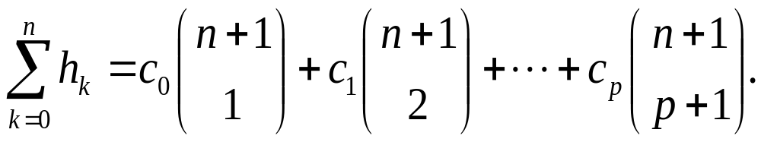
Partial sums of a sequence
Assume that the sequence h₀, h₁, h₂, …, h_{n},… has a difference table whose 0th diagonal equals, c₀, c₁, c₂, …, c_{p}≠0, 0, 0, … Then,

Slide 114
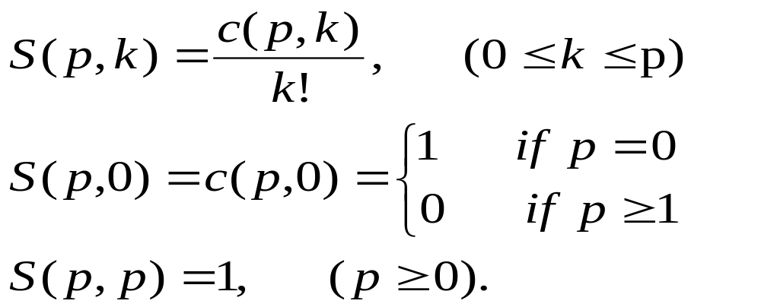
Stirling number of the second kind
Let h_{n}= n^{p,} the 0th diagonal of its difference table is c(p,0),c(p,1)…c(p,p)…
The Stirling number of the second kind is defined as

Slide 115
Recurrence relation of S(p,k)
If 1 ≤ k ≤ p, then
S(p, k) = kS(p – 1, k) + S(p – 1, k – 1)

Slide 116
Combinatorial meaning of S(p,k)
The stirling number of the second kind S(p,k) counts the number of partitions of a set of p elements into k indistinguishable boxes in which no box is empty.

Slide 117
Partition number S#(p,k)
S#(p,k) is the number of partitions of {1, 2, 3, …, k} into k nonempty, distinguishable boxes.
S#(p,k) = k! S(p, k)

Slide 118
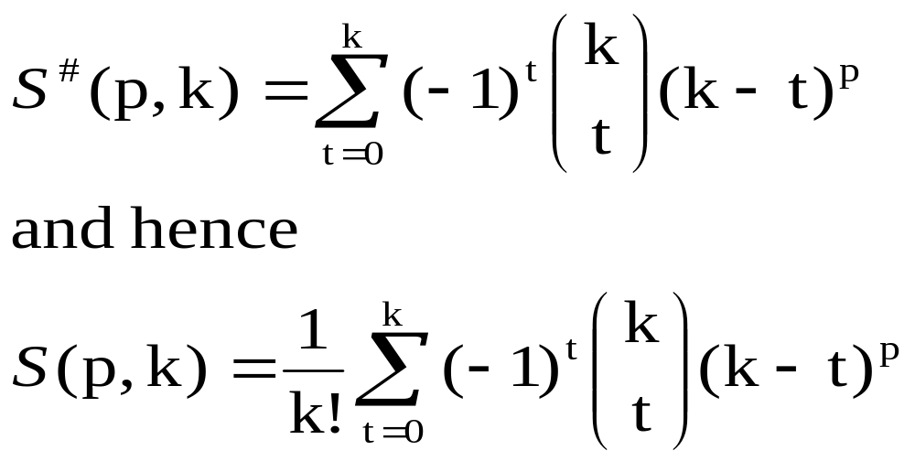
Calculation of S#(p,k) and S(p, k)
For each integer k with 0 ≤ k ≤ p we have

Slide 119
Bell number
The Bell number B_{p} is the number of partitions of a set of p elements into non-empty, indistinguishable boxes.
Note:
  The number of boxes is not specified.
  Since no box is empty, the number of boxes cannot exceed p.
  B_{p} = S(p, 0) + S(p, 1), + … + S(p, p).

Slide 120
Recurrence relations of Bell number
If p ≥ 1，then
B_{p} = C(p – 1, 0)B₀ + C(p – 1, 1)B₁+ …+
C(p – 1 , p – 1)B_{p-1}.

Slide 121
Stirling number of the first kind
The stirling number s(p, k) of the first kind counts the number of arrangements of p objects into k non-empty circular permutations.
If 1 ≤ k ≤ p, then
s(p, k) = (p – 1)s(p – 1, k) + s(p – 1, k – 1).
s(p, 0 ) = 0, (p ≥ 1）
s(p, p) = 1 , (p ≥ 0).

Slide 122
Partition numbers

Slide 123
Definition
A partition of a positive integer n is a representation of n as an unordered sum of one or more positive integers, called parts.

Slide 124
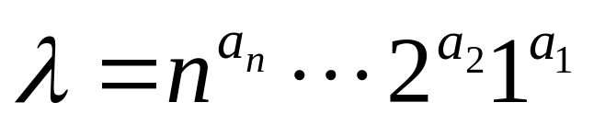
Representation
A partition of n is sometime written as
where a_{i} is a non-negative integer equaling to the number of parts that equal to i.
Example: the partition of 5 are:
5¹, 4¹1¹, 3¹2¹, 3¹1², 2²1¹, 2¹1³, 1⁵.

Slide 125
Partition sequence
Let p_{n} denote the number of different partitions of the positive integer n, and for convenience let p₀ = 1. The partition sequence is the sequence of numbers p₀, p₁, …, p_{n},….
Q: Count p₀, p₁, p₂, p₃, p₄ and p₅.
A: p₀ = 1, p₁ = 1, p₂ = 2, p₃ = 3, p₄ = 5 and
p₅ = 7.

Slide 126
Calculate p_{n}
p_{n} equals the number of solutions in nonnegative integers a_{n}, …, a₂, a₁ of the equation
na_{n} + … + 2a₂ + 1a₁ = n.

Slide 127
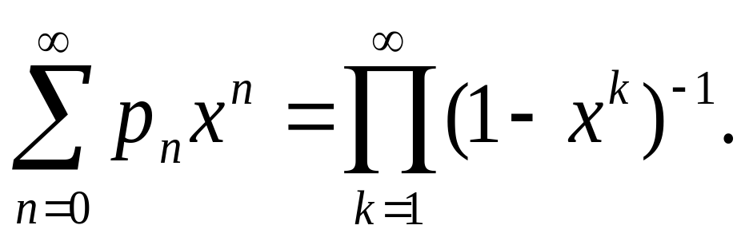
Generating functions for p_{n}
The generating function of the sequence of partition numbers is as following:

Slide 128
Discussion
The stirling number of the second kind S(p,k) counts the number of partitions of a set of p elements into k indistinguishable boxes in which no box is empty.
The Bell number B_{p} is the number of partitions of a set of p elements into non-empty, indistinguishable boxes.
The stirling number s(p, k) of the first kind counts the number of arrangements of p objects into k non-empty circular permutations.
The partition number p_{n} denotes the number of different partitions of the positive integer n.

Slide 129
Chapter 9
Matchings in bipartite graphs

Slide 130
Summary
Problem formulation
Matchings
Systems of distinct representatives
Stable marriages
Assignments

Slide 131
Problem formulation

Slide 132
Association of chessboard and bipartite graph
Let X = {x₁, x₂, x₃, …, x_{m}} and Y ={y₁, y₂, …, y_{n}} be the rows and columns of the chessboard. Construct G = (X, △, Y) as follows: (x_{i}, y_{j}) is in △ iff the square at the intersection of row x_{i} and column y_{j} is allowed in the chessboard.
Each bipartite graph is the rook-bipartite graph of some board with forbidden positions.

Slide 133
Example
A chessboard and its corresponding bipartite graph:
y₁
y₂
y₃
y₄
y₅
x₁
y₁
x₁
×
x₂
y₂
x₂
×
×
x₃
y₃
x₃
×
×
×
y₄
x₄
x₄
×
y₅

Slide 134
Matchings
Matching: A matching in a graph G is a set of non-loop edges with no shared endpoints
x₁
y₁
x₁
y₁
x₂
y₂
x₂
y₂
x₃
y₃
x₃
y₃
y₄
y₄
x₄
x₄
y₅
y₅
A matching in G
G

Slide 135
Rooks placement and matchings
Let B be a board and G be its corresponding bipartite graph. Non-attacking rooks on the board B correspond to matchings in the bipartite graph G.
The number of non-attacking rooks that can be placed on B equals the number of edges in a matching of G.

Slide 136
Example
A rook placement and its corresponding matching
y₁
y₂
y₃
y₄
y₅
x₁
y₁
x₁
×
x₂
y₂
x₂
×
×
x₃
y₃
x₃
×
×
×
y₄
x₄
x₄
×
y₅
A matching in G

Slide 137
Domino cards placement and bipartite graphs
Consider a board B whose squares are alternatively colored black and white with some forbidden squares. Let X = {w₁, w₂, w₃,…, w₇} and Y ={b₁, b₂,…, b₆} be the squares colored white and black, respectively. Construct G = (X, △, Y) as follows: (w_{i}, b_{j}) is in △ iff the squares w_{i} and b_{j} has a common side.
w₁
×
w₂
b₁
w₃
b₁
b₂
b₃
b₄
b₅
b₆
b₂
w₄
×
w₅
×
×
b₃
×
b₄
×
w₁
w₂
w₃
w₄
w₅
w₆
w₇
×
w₆
b₅
w₇
b₆
G

Slide 138
Domino card Coverings and matchings
Consider a matching M in G, each of the edges of M corresponds to a domino, and because no two edges in M have a common vertex, no two of these dominos overlap.
B can be covered with k domino cards iff G has a matching with k edges.

Slide 139
Job assignment and matchings
Four people x_{i}, (i=1,2, 3, 4) apply for five jobs y_{j}, (j = 1, 2, 3, 4, 5). Suppose that x₁ is qualified for jobs y₁, y₃, y₄, y₅; x₂→{y₁, y₂, y₄}, x₃ → {y₂, y₄} and x₄→{y₂, y₃, y₄, y₅}. How to assign the job such that it will be assigned to a qualified person?

Slide 140
Solution
x₁
y₁
x₁
y₁
x₂
y₂
x₂
y₂
x₃
y₃
y₃
x₃
y₄
y₄
x₄
x₄
y₅
y₅
G
A job assignment strategy

Slide 141
Matching

Slide 142
Max-matching
Maximal Matching: A maximal matching in a graph is a matching that cannot enlarged by adding an edge
Max-Matching: A max-matching is a matching of maximum size among all matchings in the graph (in some books, it is called maximum matching)

Slide 143
Example
Consider the following bipartite graph G. the edges (x₁, y₂) and (x₂,y₁) form a matching with size 2, it is a max-matching. While the matching (x₁, y₁) cannot be enlarged by adding edges, it is a maximal matching but not a max-matching.
x₁
y₁
x₂
y₂

Slide 144
M-saturated
M-saturated Vertices: The vertices incident to the edges of a matching M
M-unsaturated Vertices: The vertices which are not saturated by M

Slide 145
M-augmenting Path
M-alternating path: Given a matching M, and an M-alternating path is a path that alternates between edges in M and edges not in M
M-augmenting path: An M-alternating path whose endpoints are unsaturated by M

Slide 146
Another definition of M-augmenting path
A path joining u and v is an M-augmenting path provided that the following properties hold:
  The fist ,third, fifth,…and the last edges of the path do not belong to the matching M;
  The second, fourth, sixth,…edges of the path belong to the matching M
  Neither u nor v meets an edge of the matching M.

Slide 147
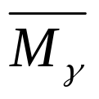
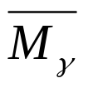
Comments
The length of an M-augmenting path is an odd number 2k+1 with k ≥ 0. k+1 edges of the path are edges of G-M while k of the edges of the path are edges of M.
M_{r}: the set of edges of the path that belong to M
: the set of edges of the path that do not belong to M
| | = |M_{r}| + 1

Slide 148
Example
Consider the right bigraph G. M ={(x₁, y₁), (x₂, y₂), (x₃, y₄)}is a matching, r = x₄y₂x₂y₁x₁y₃ is a M-augmenting path. M_{r} = {(x₁, y₁), (x₂, y₂)} and is the red edges. Let M’ = (M – M_{r}) ∪ . Then M’ is a matching larger than M.
y₁
x₁
x₂
y₂
y₃
x₃
y₄
x₄
y₅

Slide 149
Maximum Bipartite Matching
A matching M is a max-matching in G iff G has no M-augmenting path
(⇒) Suppose G has an M-augmenting path. Then, we can produce a matching larger than M. (see the above example)
(⇐) Let M’ be a matching in G larger than M. Then, we can construct an M-augmenting path. (read text book page 306-309.)

Slide 150
Hall’s theorem
x₁
y₁
An X,Y-bigraph G has a matching that saturates X iff |N(S)|>=|S| for all S⊆X.
x₂
y_{k}
y_{k+1}
x_{m}
S
x_{n}
y_{l}
N(S)

Slide 151
The Marriage Theorem
A X,Y-bigraph G with |X|=|Y| has a perfect matching iff |N(S)|>=|S| for all S⊆X.
Perfect matching is a matching M such that all the vertices in G are saturated.

Slide 152
Corollary
For k>0, any k-regular bipartite graph has a perfect matching.
k-regular graph is a graph G which vertices have the same degree k.

Slide 153
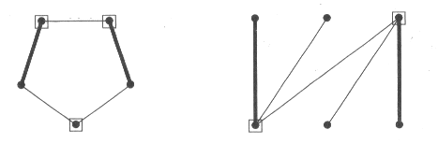
Vertex Cover
Vertex Cover: A vertex cover of a graph G is a set S⊆V(G) that contains at least one endpoint of every edge.

Slide 154
Min-cover
c(G) = min{|S|: S is a vertex cover of G}
We call a cover S of G which satisfies
|S| = c(G),
that is, a cover with the smallest number of vertices, a min-cover.

Slide 155
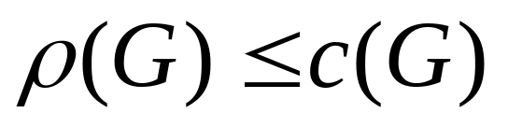
Max-matching and min-cover
If G is a bigraph, then
That is, the largest number of edges in a matching of G does not exceed the smallest number of vertices in a cover of G.
Proof: Each vertex of a cover S can incident with at most one edge in a matching M, S can “cover” M provided that |S| ≥ |M|.

Slide 156
Konig Theorem
If G is a bipartite graph, then the maximum size of a matching in G equals to the minimum size of a vertex cover in G

Slide 157
Matching Algorithm
Input: An X,Y-bigraph G, a matching M in G, and the set U of M-unsaturated vertices in X.
Output: an M-augmenting path or a vertex cover of size |M|.

Slide 158
(0) begin by labeling with (*) all vertices in U call all vertices in U unscanned. Go to (1)
(1) if in the previous step, no new label has been given to a vertex of X, then stop. Otherwise go to (2).
(2) while there exists a labeled but unscanned vertex of X, select a labeled but unscanned vertex of X, say x_{i}, and label with (x_{i}) all vertices in Y which are joined to x_{i} by an edge not belonging to M and which have not been previously labeled. The vertex x_{i} is now scanned. If there are no labeled but unscanned vertices go to (3)

Slide 159
(3) If in step (2), no new label has been given to a vertex of Y, then stop. Otherwise go to (4)
(4) While there exists a labeled, but unscanned vertex of Y, select a labeled but unscanned vertex of Y, say y_{i}, and label with (y_{i}) any vertex of X which is joined to y_{i} by an edge belonging to M and which has not been previously labeled. The vertex y_{i} is now scanned. If there are no labeled but unscanned vertices, go to (1).

Slide 160
Breakthrough and non-breakthrough
Breakthrough: there is a labeled vertex of Y which does not meet an edge of M
In the case of breakthrough occurring in the algorithm, an M-augmenting path can be find and a matching with one more edge than M can be constructed.
Non-breakthrough: each vertex of Y which is labeled also meets some edge of M.
In the case of non-breakthrough, we conclude that M is the max-matching.

Slide 161
Matching Theorem
Repeatedly applying matching Algorithm to a bipartite graph produces a matching and a vertex cover of equal size

Slide 162
Time Complexity of the matching Algorithm
Let G be an X,Y-bigraph with n vertices and m edges.
1. The matching algorithm executes at most n/2 times since c(G)<=n/2.
2. Each execution of the algorithm considers each edge at most once.
⇒ The execution time of the algorithm is O(mn).

Slide 163
Systems of distinct representatives

Slide 164
System of representatives
Let Y be a finite set and let A = (A₁, A₂, …, A_{n}) be a family of n subsets of Y. A family (e₁, e₂,…,e_{n}) of elements of Y is called a system representatives of A, provided e₁ ∈ A₁, e₂∈ A₂, …, e_{n} ∈ A_{n}.
If the elements e₁, e₂,…, e_{n} are different, then (e₁, e₂,…,e_{n}) is called a system of distinct representatives, abbreviated SDR.

Slide 165
Comments
A family of non-empty sets always has a system of representatives. We need only to pick one element from each of the sets to obtain a system of representatives.
However, the family does not always have an SDR even though all the sets in the family are non-empty. E.g., the family (A₁ ={x}, A₂ = {x}, A₃, A₄…) has no SDR.

Slide 166
Marriage condition
In order for the family A = (A₁, A₂, …, A_{n}) of sets to have an SDR if and only if the following condition hold:
(MC): For each k = 1, 2, …, n and each choice of k distinct indices i₁, i₂,…i_{k} from {1,2, 3,..,n}, |A_{i1} ∪ A_{i2} ∪ … A_{ik}| ≥ k.

Slide 167
Bipartite graph and representative system
A = (A₁, A₂, …, A_{n}) is the set of subsets of Y = {y₁, y₂,…,y_{m}}. Let G = (X, △, Y) be defined as follows:
X = {1, 2, …, n} is the set that index the members of the family A, Y = {y₁, y₂,…,y_{m}}, △ = { {i, y_{j}}: y_{j} is in A_{i}}.

Slide 168
Theorem 9.3.3
Let A = (A₁, A₂, …, A_{n}) be a family of subsets of a set Y. Then the largest number of sets of A which can be chosen such that they have an SDR equals the smallest value taken on by the expression |A_{i1} ∪ A_{i2} ∪ … A_{ik}| + n - k over all choices of k = 1, 2, 3, …, n and all choices of k distinct indices i₁, i₂,…i_{k} from {1,2, 3,..,n}.

Slide 169
Example
We define a family A = (A₁, A₂, A₄, A₅, A₆) of subsets of {a, b, c, d, e, f} by A₁ = {a, b, c}, A₂ = {b, c}, A₃ = {b, c}, A₄ = {b, c}, A₅ = {c}, A₆ = {a, b, c, d}.
Then with n = 6, k = 1 , min_{i=1, 2, …, 6} |A_{i}|+6-1 = 6; with k = 2, min _{i1, i2=1, 2, …, 6}|A_{i1} ∪ A_{i2}| + 6 – 2 = 6; with k = 3, min_{i1, i2, i3 =1, 2, …,6} |A_{i1} ∪ A_{i2} ∪ A_{i3}| + 6 – 3 = 5, with k = 4, min_{i1, i2, i3, i4 =1, 2, …,6} |A_{i1} ∪ A_{i2} ∪ A_{i3} ∪ A_{i4} | + 6 – 4 = 4, …….
Hence, 4 is the largest number of sets with an SDR.

Slide 170
Stable marriages

Slide 171
Definition
A complete marriage is called unstable, if for two partners, both would regard the partner more preferable than their current spouse. A complete marriage is called stable provided it is not unstable.
E.g., if “A and a get married; B and b get married; A prefers b to a and b prefers A to B”, then it is an unstable marriage.
A
a
B
b

Slide 172
Preferential ranking matrix
This matrix is an n-by-n array of n rows, one corresponding to each of the women w₁, w₂, …, w_{n}, and n columns, one corresponding to each of the n men m₁, m₂, .., m_{n}. In the position at the intersection of row i and column j we place the pair (p, q) of numbers representing, respectively, the ranking of m_{j} by w_{i} and the ranking of w_{i} by m_{j}. A complete marriage corresponds to a set of n positions of the matrix which includes exactly one position from each row and one position from each column.

Slide 173
Theorem 9.4.1
For each preferential ranking matrix there is a stable complete marriage.

Slide 174
Deferred acceptance algorithm
Begin with every woman marked as rejected. While there exists a rejected woman, do:
(1) each woman marked as rejected choose the man whom she ranks highest among all those men who have not yet rejected her.
(2) each man picks out the woman he ranks highest among all those women who have chosen him and who he has not yet rejected, defer decision on her, and now rejects the others.

Slide 175
Example
We apply the algorithm to the following preferential ranking matrix, the result of the algorithm are:
A -> a, B->b, C->d, D->a; a rejects D.
D->d, d reject C
C->a, a rejects A
A ->b, b rejects B
B->a, a rejects B
B->c. there are no rejections. Hence, (A, b),(B, c), (C,a), (D, d).
a
b
c
d
A
1,2
2,1
3,2
4,1
B
2,4
1,2
3,1
4,2
C
2,1
3,3
4,3
1,4
D
1,3
4,4
3,4
2,3

Slide 176
Women optimal
A stable complete marriage is called optimal for a woman, provided that a woman gets as a spouse a man whom she ranks at least as high as the spouse she obtains in every other stable complete marriage.
A stable complete marriage is called women-optimal (resp., men-optimal) provided it is optimal for each woman (resp., man).

Slide 177
Theorem 9.4.2
The stable complete marriage obtained from the deferred acceptance algorithm, with the women choosing the men, is women-optimal. If the men choose the women in the algorithm, the resulting complete marriage is men-optimal.

Slide 178
Corollary 9.4.3
In the women-optimal stable complete marriage, each man is paired with the woman he ranks lowest among all the partners that are possible for him in a stable complete marriage.

Slide 179
Chapter 10
Combinatorial designs

Slide 180
Summary
Modular arithmetic
Block designs
Steiner triple systems
Latin squares
Assignments

Slide 181
Modular arithmetic

Slide 182
Algorithm to compute the GCD
GCD (a, b):
Set A = a and B = b.
While A × B ≠ 0, do
if A ≥ B, then replace A by A – B.
else, replace B by B – A.
Set GCD = B.
Question: How to compute GCD(a₁, a₂, a₂ ,…, a_{n})?

Slide 183
Theorem 10.1.2
Let n be an integer with n ≥ 2 and let a be a non-zero integer in Z_{n} = {0, 1, 2, …, n-1}. Then a has a multiplicative inverse in Z_{n} iff the greatest common divisor (GCD) of a and n is 1. If a has a multiplicative inverse, then it is unique.

Slide 184
Corollary 10.1.3
Let n be a prime number. Then each non-zero integer in Z_{n} has a multiplicative inverse.
If GCD (a, b) = 1, then we call a and b relatively prime.

Slide 185
Calculate the inverse
Determine if 11 has a multiplicative inverse in Z₃₀ and, if so, calculate the multiplicative inverse.
By applying the algorithm, GCD(11, 30) = 1 and the results are displayed in the table. By theorem 10.1.2, 11 has a multiplicative inverse in Z₃₀. We use the equations in the table:
1= 3-1×2=3-1×(8-2×3) = 3×3 – 1×8
=3×(11-1×8) – 1 × 8 = 3×11 – 4×8
= 11×11 - 4×30 , hence, 11⁻¹ = 11 in Z₃₀.
A
B
30
11
30=2×11+8
8
11
11=1×8+3
8
3
8=2×3+2
2
3
3=1×2+1
2
1
2=2×1+0
0
1
d = 1

Slide 186
Fields
For each prime p and each integer k ≥ 2, there exists a polynomial of degree k with coefficients in Z_{p} which does not have a non-trivial factorization.
Example: for Z₂, x³ + x + 1 =0 has no non-trivial factorization in Z₂.
The polynomial has a root denoted as i, i.e., i³ + i + 1 = 0.

Slide 187
Field
The p^{k} elements of the finite field is
{a +bi+ci²+…+di^{k-1}: a, b, c, and d in Z_{p}}, where i is a root of the polynomial.
i^{k} can be calculated by the polynomial.

Slide 188
Block designs

Slide 189
An Example
suppose 7 varieties of products need to be tested by 7 consumers. Each consumer is asked to compare a certain 3 of the varieties. The test is to have a property that each pair of the 7 varieties is compared by exactly one person. Can such a testing experiment be designed?

Slide 190



Terms
Let k, and v be positive integers with 2 ≤ k ≤ v.
Let X be any set of v elements, called varieties, and let B be a collection B₁, B₂, …, B_{b} of k element subsets of X called blocks. Then B is a balanced block design on X, provided each pair of elements of X occurs together in exactly blocks. The number is called the index of the design.
The assumption above that k is at least 2 is to prevent trivial solutions: if k = 1, then a block contains no pairs and = 0.

Slide 191
BIBD
If k = v, that is the complete set of varieties occurs in each block, then the design is called a complete block design. It corresponds to a testing experiment in which each individual compares each pair of varieties. From combinatorial point of view they are trivial, forming a collection of sets all equal to X.
If k < v, and B is balanced, then we have a balanced incomplete block design, or BIBD for short. We henceforth deal with BIBD.

Slide 192

Conclusions concerning BIBD
In a BIBD,
1. each variety is contained in
blocks.
2. bk = vr
3. < r.
4. b ≥ v

Slide 193

SBIBD
A BIBD for which b = v, that is for which the number b of block equals the number v of varieties, is called symmetric, and this is shortened to SBIBD.
Correspondingly, in a SBIBD:
b = v ➔ k = r.

Slide 194
Starter blocks and developed blocks
Let v ≥ 2 be an integer and consider the set of integers mod v: Z_{v} = {0, 1, 2, …, v-1}, whose addition and multiplication are denoted by the usual symbols + and ×.
Let B = {i₁, i₂, …, i_{k}} be a subset of Z_{v} consisting of k integers. For each integer j in Z_{v}, we define B+j = {i₁+j, i₂+j, …, i_{k}+j} to be the subset of Z_{v} by adding mod v the integer j to each of the integers in B.
The v sets B = B+ 0, B+1, B+ 2, …, B+ v-1 so obtained are called the blocks developed from the block B and B is called the starter block.

Slide 195
Difference set mod v
Let B be a subset of k integers in Z_{v}. Then B is called a difference set mod v, provided each non-zero integer in Z_{v} occurs the same number of times among the k(k-1) differences among distinct elements of B (in both order): x – y (x, y in B; x ≠ y).
Since there are v-1 non-zero integers in Z_{v}, each non-zero integer in Z_{v} must occur
times as a difference in a difference set.

Slide 196
Theorem 10.2.5
Let B be a subset of k < v elements of Z_{v} which forms a difference set mod v. Then the blocks developed from B as a starter block form a SBIBD with index

Slide 197
Steiner triple systems

Slide 198
Steiner triple systems
Balanced block design with block size k = 3 are called Steiner triple systems.
BIBD’s with block size 2 are trivial. To get a BIBD with =2, simply take each of the blocks with = 1 twice. To get one with = 3, take each of the blocks three times.

Slide 199

Parameters
Let B be a Steiner triple system with parameters b, v, k = 3, r, . Then
If the index is =1, then there is a non-negative integer n such that v = 6n+1 or v = 6n+3.

Slide 200
Construction of Steiner triple systems
If there are Steiner triple systems of index =1 with v and w varieties, respectively, then there is a Steiner triple system of index = 1 with vw varieties.

Slide 201
How to construct
Let B₁ be a Steiner triple system of index =1 with the v varieties a₁, a₂, …, a_{v} and let B₂ be a Steiner triple system of index =1 with the w varieties b₁, b₂,…, b_{w}. We consider a set X of vw varieties c_{ij}, ( i = 1, 2, …, v, j = 1, 2, …, w) which we may think of as the entries of a v-by-w array whose rows correspond to a_{i} and whose columns correspond to b_{j} as shown:

Slide 202
We define a set B of triples of the elements of X. Let {c_{ir}, c_{js}, c_{kt}} be a set of 3 elements of X. then {c_{ir}, c_{js}, c_{kt}} is a triple of B iff one of the following holds:
b₁
b₂
…
b_{w}
a₁
c₁₁
c₁₂
…
c_{1w}
a₂
c₂₁
c₂₂
…
c_{2w}
…
…
…
…
…
a_{v}
c_{v1}
c_{v2}
…
c_{vw}
r = s = t, and {a_{i}, a_{j}, a_{k}} is a triple of B₁. put another way, the elements {c_{ir}, c_{js}, c_{kt}} are in the same column of the array and the rows in which they lie correspond to a triple of B₁
i = j = k, and {b_{r}, b_{s}, b_{t}} is a triple of B₂. put another way, the elements {c_{ir}, c_{js}, c_{kt}} are in the same row of the array and the columns in which they lie correspond to a triple of B₂

Slide 203
b₁
b₂
…
b_{w}
a₁
c₁₁
c₁₂
…
c_{1w}
a₂
c₂₁
c₂₂
…
c_{2w}
…
…
…
…
…
a_{v}
c_{v1}
c_{v2}
…
c_{vw}
(iii) i, j and k are all different and {a_{i}, a_{j}, a_{k}} is a triple of B₁, and r, s and t are all different and {b_{r}, b_{s}, b_{t}} is a triple of B₂. put another way, c_{ir}, c_{js}, and c_{kt} are in 3 different rows and 3 different columns of the array, and the rows in which they lie correspond to a triple of B₁ and the columns in which they lie correspond to a triple of B₂.

Slide 204
Resolvability class
If the triples of B can be partitioned into parts so that each variety occurs in exactly one triple in each part, then the Steiner triple system of index = 1 is called resolvable and each part is called a resolvability class.
Note that each resolvability class is a partition of the set of varieties into triples.

Slide 205
Example
In the above example, the Steiner triple system with 9 varieties can be partitioned into 4 parts
{0, 1, 2} {0, 3, 6} {0, 4, 8} {0, 5, 7}
{3, 4, 5} {1, 4, 7} {1, 5, 6} {1, 3 ,8}
{6, 7, 8} {2, 5, 8} {2, 3, 7} {2, 4 ,6}.
It is a resolvability class.

Slide 206
Parameters in resolvability class
v = 6n + 3
b = v(v-1)/6 = (2n+1)(3n+1)
k = 3
r = (v-1)/2=3n+1
= 1.
The number of triples in each resolvability class is
v/3 = 2n +1.

Slide 207
Latin Squares

Slide 208
Latin square of order n
Let n be a positive integer and let S be a set of n distinct elements. A Latin square of order n, based on the set S, is a n-by-n array each of whose entries is an element of S such that each of the n elements of S occurs once in each row and once in each column.
Each of the rows and each of the columns of a Latin square is a permutation of the elements of S.

Slide 209
Examples
0
1
2
3
0
1
2
0
1
1
2
3
0
1
2
0
1
0
2
3
0
1
2
0
1
3
0
1
2

Slide 210
Partitions in Latin squares
Consider a Latin square of order n based on Z_{n}, let k be any element of Z_{n}. The positions occupied by k’s are positions for n non-attacking rooks on an n-by-n board. Let A(k) be the set of positions occupied by k’s, then A(0), A(1), …, A(n-1) is a partition of the set of n² positions of the board. Each consisting of n positions for non-attacking rooks.

Slide 211
Example
For the 4-by-4 Latin square A. We have
A(0) = {(0,0),(1,3),(2,2),(3,1)}
A(1) = {(0,1),(1,0),(2,3), (3,2)}
A(2) = {(0,2),(1,1),(2,0),(3,3)}
A(3) = {(0,3),(1,2),(2,1),(3,0)}
0
1
2
3
1
2
3
0
2
3
0
1
3
0
1
2

Slide 212
Comments
We can exchange A(0), A(1), …, A(n-1) at will and the result will always be a latin square. There are n! latin squares which result in this way.
Using this idea of interchanging the positions occupied by the various elements 0, 1, …, n-1 we can always bring a latin square to standard form, whereby in row 0 the integers 0, 1, …, n-1 occur in their natural order.

Slide 213
Constructing Latin squares by addition mod n
Let n be a positive integer. Let A be the n-by-n array whose entry a_{ij} in row i and column j is
a_{ij} = i + j (addition mod n), (i, j = 0, 1, 2, …, n-1).
Then A is a Latin square of order n based on Z_{n}.

Slide 214
Constructing Latin squares by multiplicative inverses
Let n be a positive integer and let r be a non-zero integer in Z_{n} such that the GCD of r and n is 1. Let A be the n-by-n array whose entry a_{ij} in row i and column j is
a_{ij} = r × i + j (arithmetic mod n), (i, j = 0, 1, 2, …, n - 1). Then A is a Latin square of order n based on Z_{n}.
The Latin square A is denoted as L_{n}^{r}

Slide 215
Properties of Latin squares
Let R_{n} and S_{n} be as shown. Let A be any n-by-n array based on Z_{n}. Then A is a Latin square iff the following conditions hold:
Consider both R_{n} × A and S_{n} × A, the resulting set of ordered pairs thus obtained equals the set of all ordered pairs that can be formed using the elements of Z_{n}.
0
0
…
0
1
1
…
1
R_{n} =
…
…
…
…
n-1
n-1
…
n-1
0
1
…
n-1
0
1
…
n-1
S_{n} =
…
…
…
…
0
1
…
n-1

Slide 216
Example
In each of the two juxtaposed arrays, each ordered pair occurs exactly once.
0
0
0
0
1
2
(0,0)
(0,1)
(0,2)
1
1
1
1
2
0
(1,1)
(1,2)
(1,0)
2
2
2
2
0
1
(2,2)
(2,0)
(2,1)
0
1
2
0
1
2
(0,0)
(1,1)
(2,2)
0
1
2
1
2
0
(0,1)
(1,2)
(2,0)
0
1
2
2
0
1
(0,2)
(1,0)
(2,1)

Slide 217
Orthogonal
Let A and B be Latin squares on the integers in Z_{n}. Then A and B are called orthogonal, provided in the juxtaposed array A × B each of the ordered pairs (i, j) of integers in Z_{n} occurs exactly once.
There do not exist two orthogonal Latin squares of order 2.
Let A₁, A₂, …, A_{k} be Latin squares of order n. We say they are mutually orthogonal, provided each pair A_{i}, A_{j} (i ≠ j) of them is orthogonal. We refer to mutually orthogonal Latin squares as MOLS.

Slide 218
Theorem 10.4.3
Let n be a prime number. Then L_{n}¹, L_{n}², …, L_{n}^{n-1} are n-1 MOLS of order n.

Slide 219

Construction of Latin squares by field arithmetic
Let F be a finite field with n = p^{k} elements for some prime p and positive integer k. Let a₀ = 0, a₁, a₂, …, a_{n-1} be the elements of F with a₀ the zero element of F. Consider any non-zero element a_{r} of F and define an n-by-n array A as follows:
The element a_{ij} in row i and column j of A is a_{ij} = a_{r} × a_{i} +a_{j}, (i, j = 0, 1, …, n-1).
The Latin square is denoted as

Slide 220

Theorem 10.4.4
Let n = p^{k} be an integer which is a power of a prime number p. Then
are n-1 MOLS of order n.

Slide 221
Construction of larger Latin squares from smaller ones
If there is a pair of MOLS of order m and there is a pair of MOLS of order k, then there is a pair of MOLS of order mk. More generally,
N(mk) ≥ min{N(m), N(k)}.
Let n ≥ 2 be an integer and let
n = p₁^{e1} × p₂^{e2} × … × p_{k}^{ek}
be the factorization of n into distinct prime numbers p₁, p₂, …, p_{k}. Then N(n) ≥ min{p_{i}^{ei}-1: i = 1, 2, …, k}.

Slide 222
Example
Let A and B be two MOLS of order 3 and C, D be two MOLS of order 4. Construct two Latin squares of order 12.
0
2
1
0
1
2
B =
1
0
2
A =
1
2
0
2
1
0
2
0
1
0
1
2
3
0
1
2
3
1
0
3
2
2
3
0
1
C =
D =
2
3
0
1
3
2
1
0
3
2
1
0
1
0
3
2

Slide 223
Let (a_{ij}, C) replace a_{ij} in A, then a 12-by-12 array A × C (the elements are ordered pairs) is constructed. The following is an example of (a₁₂, C), where a₁₂ = 0 in A.
(0,0)
(0,1)
(0,2)
(0,3)
(a₁₂, C) =
(0,1)
(0,0)
(0,3)
(0,2)
(0,2)
(0,3)
(0,0)
(0,1)
(0,3)
(0,2)
(0,1)
(0,0)

Slide 224
At last, replace the ordered pairs in the array with the numbers in Z₁₂. e.g.,
(0,0)→0, (0,1)→1, (0,2)→2, (0,3)→3,
(1,0)→4, (1,1)→5, (1,2)→6, (1,3) →7,
(2,0)→8, (2,1) →9, (2,2)→10, (2,3) →11.
Note: there are exactly 12 different pairs in the array. Why?
Similarly, we can construct the 12-by-12 array B×D.
A×C and B×D are orthogonal.

Slide 225
Corollary 10.4.9
Let n ≥2 be an integer which is not twice an odd number. Then there exists a pair of orthogonal Latin squares of order n.
It cannot guarantee the existence of a pair of MOLS of order n = 2, 6 ,10, 14, 18, …, 4k+ 2, …

Slide 226

MOLS and BIBD
Let n ≥ 2 be an integer. If there exist n-1 MOLS of order n, then there exists a resolvable BIBD with parameters
b = n²+n, v = n², k = n, r = n+1, = 1.
Conversely, if there exists a resolvable BIBD with above parameters , then there exist n-1 MOLS of order n.

Slide 227
Construction of BIBD with MOLS
Let A₁, A₂, …, A_{n-1} denote the n-1 MOLS of order n. We use the n+1 arrays
R_{n}, S_{n}, A₁, A₂, …, A_{n-1} where R_{n} and S_{n} are defined as in page 63 to construct a block design B with parameters
b = n²+n, v = n², k = n, r = n+1, = 1.
Review: A_{i}(k), R_{n}(k) and S_{n}(k).

Slide 228
We take the set X of varieties to be the set of v = n² positions of an n-by-n array; that is,
X = {(i, j): i = 0, 1, …, n-1; j = 0, 1, …, n-1}.
Each of the n+1 array determines n blocks:
R_{n}(0) R_{n}(1) …. R_{n}(n-1)
S_{n}(0) S_{n}(1) ….. S_{n}(n-1)
A₁(0) A₁(1) …. A₁(n-1)
…………………
A_{n-1}(0) A_{n-1}(1) …. A_{n-1}(n-1)
Thus, we have b = n × (n+1) = n² + n blocks, each containing k = n varieties. Let B denote this collection of blocks, then B is a BIBD with the specified parameters.

Slide 229
Latin rectangle
Let m and n be integers with m ≤ n. An m-by-n Latin rectangle, based on the integers in Z_{n}, is an m-by-n array such that no integers is repeated in any row or in any column.
If m = n, the Latin rectangle is a Latin square.

Slide 230
Completion
We say that an m-by-n Latin rectangle L can be completed, provided it is possible to attach n-m rows to L and obtain a Latin square L* (called a completion of L) of order n.

Slide 231
Completion of Latin rectangle
Let L be an m-by-n Latin rectangle based on Z_{n} with m < n. Then L has a completion.
Construction method: define a bigraph G =(X, △, Y), X = {x₀, x₁, …, x_{n-1}} corresponds to columns 0, 1, …, n-1 of the rectangle L, Y = {0, 1, …, n-1} is the elements on which L is based. △ = {(x_{i}, j): j does not occur in column i of L}. G has a perfect matching. Suppose the edges of a perfect matching are{(x₀, i₀), (x₁, i₁), …., (x_{n-1}, i_{n-1})}. Then (m+1)-by-n array obtained by adjoining i₀, i₁, …,i_{n-1} as a new row is a Latin rectangle. Continue the process until the n-by-n Latin square is completed.

Slide 232
Semi-Latin square
Consider an n-by-n array L in which some positions are unoccupied and other positions are occupied by one of the integers {0, 1, 2, …, n-1}. Suppose that if an integer k occurs in L, then it occurs n times and no two k’s belong to the same row or column. Then we call L a semi-Latin square.
If m different integers occur in L, then we say L has index m.

Slide 233
Completion of semi-Latin square
Let L be a semi-Latin square of order n and index m where m < n. Then L has a completion.
Construction method: define a bigraph G =(X, △, Y), X = {x₀, x₁, …, x_{n-1}} correspond to rows 0, 1, …, n-1 of the rectangle L, Y = {y₀, y₁, …, y_{n-1}} correspond to columns of L. △ = {(x_{i}, y_{j}): the position at row i column j is unoccupied. Then G is (n-m)-regular and has a perfect matching. This matching identifies the desired position for number m. Continue to place other numbers m+1, m+2…. until L is completed.

Slide 234
Chapter 14
Polya counting

Slide 235
Summary
Permutation and symmetry groups
Burnside theorem
Polya counting formula
Assignments

Slide 236
Equivalent and inequivalent colorings
For both the tetrahedron and square, if allowed to freely move around, the 16 ways to color its corners are partitioned into parts in such a way that two colorings in the same part are regarded as the same (the colorings are equivalent), and two colorings in different parts are regarded as different (the colorings are inequivalent).
The number of inequivalent colorings is thus the number of different parts.

Slide 237
Permutation and symmetry groups

Slide 238

Permutation and function
Let X be a finite set. Without loss of generality, we take X to be the set {1, 2, 3, …, n}. Each permutation i₁, i₂, i₃, …, i_{n} of X can be viewed as a one-to-one function from X to itself defined by
f: X → X , where f(1) = i₁, f(2) = i₂, …., f(n) = i_{n}.
A permutation is denoted by a 2-by-n array as follows:

Slide 239
Permutation group
A permutation group, is defined to be a non-empty subset G of permutations in S_{n}, satisfying the following three properties:
(closure under composition) For all permutations f and g in G, f。g is also in G.
(identity) The identity permutation l of S_{n} belongs to G.
(closure under inverses) For each permutation f in G, the inverse f⁻¹ is also in G.

Slide 240
Symmetric group
The set S_{n} of all permutations of X = {1, 2, …, n} is a permutation group, called the symmetric group of order n.
The set G ={l} consisting only of the identity permutation is a permutation group.

Slide 241
Symmetry
Let Q be a geometrical figure. A symmetry of Q is a (geometric) motion that brings the figure Q onto itself. The geometric figures like a square, a tetrahedron, and a cube are composed of corners (or vertices) and edges, and in the case of three-dimensional figure, of faces (or sides). As a result, each symmetry acts as a permutation on the corners, on the edges, and in the case of three dimensional figures, on the faces.

Slide 242
Symmetry groups
We conclude that the symmetries of Q act as a permutation group G_{C} on its corners (called corner-symmetry group), a permutation group G_{E} on its edges (called edge-symmetry group), and in the case Q is three dimensional, a permutation group G_{F} on its faces (called face-symmetry group).

Slide 243
Dihedral group
In a similar way we can obtain the symmetry group of a regular n-gon for any n ≥ 3. Besides the n rotations p_{n}⁰=l, p_{n}, p_{n}², …,p_{n}^{n-1}, we have n reflections r₁, r₂, …, r_{n}. If n is even, then there are n/2 reflections about opposite corners and n/2 reflections about the lines joining the midpoints of opposite sides. If n is odd, then the reflections are the n reflections about the lines joining a corner to the side opposite it. The resulting group
G_{C} = {p_{n}⁰=l, p_{n}, p_{n}²,…, p_{n}^{n-1}, r₁, r₂, …, r_{n}} of 2n permutations of {1, 2, …, n} is an instance of a dihedral group of order 2n.

Slide 244
Coloring
Suppose we have a group G of permutations of a set X where X = {1, 2, …, n}. A coloring of X is an assignment of a color to each element of X. Let C be a collection of colorings of X.

Slide 245

f*c
Let c be a coloring in C, is a permutation in G. denote the colors of 1, 2, …, n as c(1), c(2), …, c(k), respectively.
(f*c)(i_{k}) = c(k)
It means, by applying f, k is changed to i_{k}, then the color in i_{k} is c(k).
In other word, f is a permutation on the color set C.

Slide 246
Equivalent coloring
Let G be a group of permutations acting on a set X. Let C be a collection of colorings of X such that for all f in G and all c in C, the coloring f*c of X is also in C. Thus G acts on C in the sense that it takes colorings in C to colorings in C.
Let c₁ and c₂ be two colorings in C. c₁ is equivalent (under the action of G) to c₂ provided there is a permutation f in G such that f*c₁ = c₂.

Slide 247
Burnside’s theorem

Slide 248
Stabilizer
1
a
2
d
l*c= c
b
4
c
3
Let G(c) = {f: f in G, f*c = c}, that is G(c) is the set of all permutations that fix the coloring c. we call G(c) the stabilizer of c.
E.g., in the previous example, G(c) = {l, r₄} is a stabilizer of coloring c = {R, B, B, R}.
We denote C(f) = {c: c in C, f*c = c}.

Slide 249
Theorem 14.2.1
For each coloring c, the stabilizer G(c) of c is a permutation group. Moreover, for any permutations f and g in G, g*c = f*c if and only if f⁻¹。g is in G(c).

Slide 250
Corollary 14.2.2
Let c be a coloring in C. the number
|{f*c: f in G}| of colorings that are equivalent to c equals the number |G|/|G(c)| obtained by dividing the number of permutations in G by the number of permutations in the stabilizer of c.

Slide 251

Burnside’s theorem
Let G be a group of permutations of X and let C be a set of colorings of X such that f*c is in C for all f in G and all c in C. Then the number N(G, C) of inequivalent colorings in C is given by
In words, the number of inequivalent colorings in C equals the average of the number of colorings fixed by the permutations in G.

Slide 252
Polya’s counting formula

Slide 253


Factorization
Let be a
permutation of the set {1,2,3,4,5,6,7,8}. Then f has a factorization as follows:

Slide 254
Cycle factorization
Let f be any permutation of the set X. Then with respect to the operation of composition f has a factorization
f = [i₁ i₂ … i_{p}]。[j₁ j₂ .. j_{q}] 。…。[l₁ l₂…l_{r}] into cycles where each integer in X occurs in exactly one of the cycles. We call it cycle factorization of f.
The cycle factorization of f is unique apart from the order in which the cycles appear, and this order is arbitrary.
Every element of X occurs exactly once in the cycle factorization.

Slide 255
#(f)
#(f) is the number of cycles in the cycle factorization of a permutation f.
E.g., for f = [1 4 7 3]。[2 9]。[5 6]。[8], #(f) = 4.
It is independent of the sizes of the cycles.

Slide 256
Theorem 14.3.1
Let f be a permutation of a set X. Suppose we have k colors available with which to color the elements of X. Let C be the set of all colorings of X. Then the number |C(f)| of colorings of C that are fixed by f equals k^{#(f)}.

Slide 257
Type of a permutation
Let f be a permutation of X where X has n elements. Suppose that the cycle factorization of f has e₁ 1-cycles, e₂ 2-cycles, … and e_{n} n-cycles. Then 1e₁+2e₂+…+ne_{n} = n. we call the n-tuple (e₁, e₂,…,e_{n}) the type of the permutation f and write type(f) = (e₁, e₂,…,e_{n}) .
#(f) = (e₁ + e₂+…+ e_{n})
Different permutation may has the same type. Why?

Slide 258
Monomial of a permutation
We introduce n indeterminates z₁, z₂, …, z_{n} where z_{k} is to correspond to a k-cycle (k=1, 2, …,n). To each permutation f with type(f) = (e₁, e₂,…,e_{n}) we associate the monomial of f, mon(f) = z₁^{e1}z₂^{e2}…z_{n}^{en}.

Slide 259

Generating function
Let G be a group of permutations of X. The generating function for the permutations in G according to type is
If we combine terms, the coefficient of z₁^{e1}z₂^{e2}…z_{n}^{en} equals the number of permutations in G of type(e₁, e₂, …, e_{n}).

Slide 260

Cycle index
The cycle index of G is the generating function divided by the number |G| of permutations in G. That is

Slide 261
Theorem 14.3.2
Let X be a set of n elements and suppose we have a set of k colors available with which to color the elements of X. Let C be the set of all k^{n} colorings of X. Let G be a group of permutations of X. Then the number of inequivalent colorings is the number |N(G, C)| = P_{G}(k, k,…, k) obtained by substituting z_{i}=k, (i =1, 2, …, n) in the cycle index of G.

Slide 262
Example
We are given a set of k colors. What is the number of inequivalent ways to color the corners of a square?
The cycle index of the dihedral group D₄ has already been determined to be P_{D4}(z₁,z₂,z₃,z₄)=(z₁⁴+2z₄+3z₂²+2z₁²z₂)/8.
Hence the answer is P_{D4}(k,k,k,k)=(k⁴+2k+3k²+2k³)/8.
If k = 6, then the number of inequivalent colorings is
P_{D4}(6,6,6,6)=(6⁴+2×6+3×6²+2×6³)/8 = 231.

Slide 263
Theorem 14.3.3
Let X be the set of elements and let G be a group of permutations of X. Let {u₁, u₂, …, u_{k}} be a set of k colors and let C be any set of colorings of X with the property that G acts as a permutation group on C. Then the generating function for the number of inequivalent colorings of C according to the number of colors of each kind is the expression
P_{G}(u₁+…+u_{k}, u₁²+…+u_{k}², …., u₁^{n}+…+u_{k}^{n}).

Slide 264
Theorem 14.3.3 (cont’d)
P_{G}(u₁+…+u_{k}, u₁²+…+u_{k}², …., u₁^{n}+…+u_{k}^{n}) is obtained from the cycle index P_{G}(z₁, z₂,…z_{n}) by making the substitutions z_{j}=u₁^{j}+…u_{k}^{j} (j = 1, 2, …, n).
The coefficient of u₁^{p1}u₂^{p1}…u_{k}^{pk} equals the number of inequivalent colorings in C with p₁ elements of X colored u₁, p₂ elements colored u₂,…, p_{k} elements colored u_{k}.

