Slide 1

LLM Basics
LLM Series by Max Meng

Slide 2
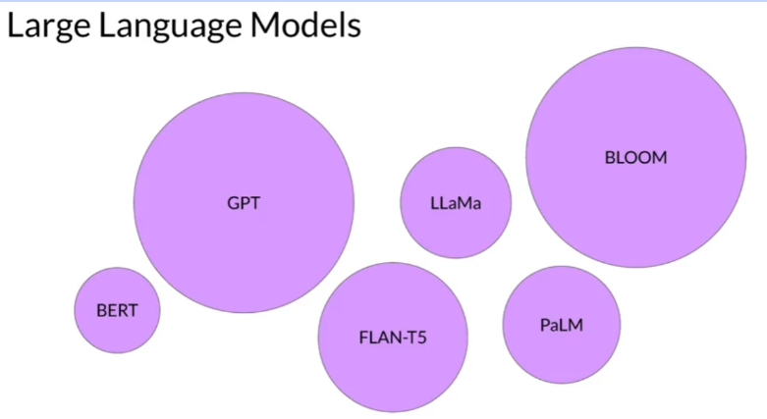
Large Language Models
Notes:
AI -> has Genetic Algorithms, Statistic Learning, Evolutionary Algorithms, Probabilistic Models, Symbolic AI / Logic-Based AI

Slide 3
A Brief History
Notes:
AI -> has Genetic Algorithms, Statistic Learning, Evolutionary Algorithms, Probabilistic Models, Symbolic AI / Logic-Based AI

Slide 4
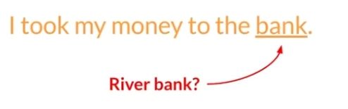
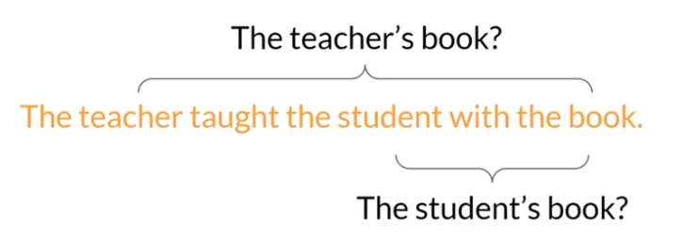
Understanding Languages is Challenging!

Slide 5
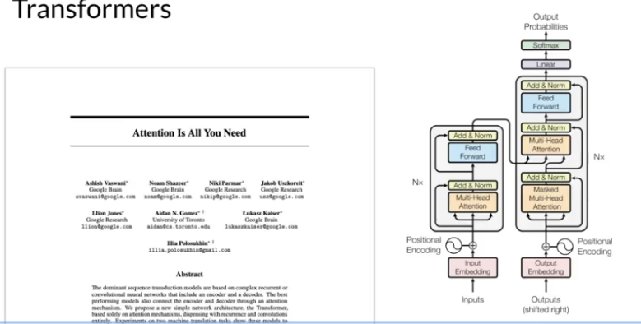
What did right?

Slide 6
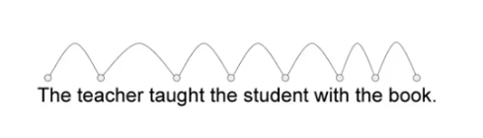

What did right?

Slide 7
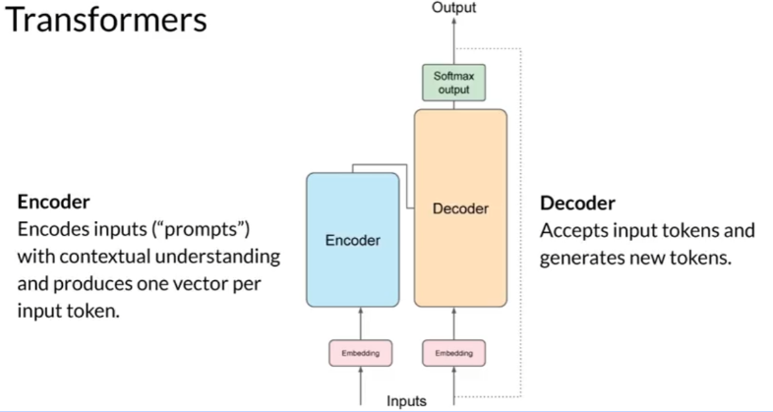
Transformer

Slide 8
Prompt Engineering
01

Slide 9
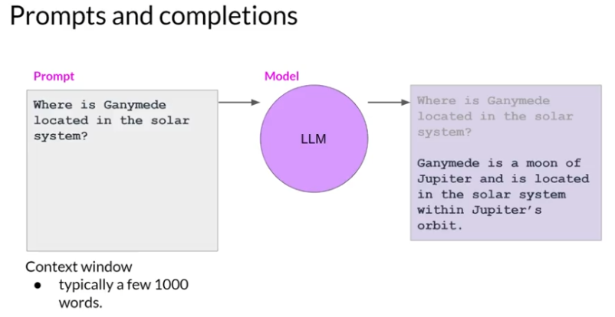
Prompt and Prompt Engineering

Slide 10
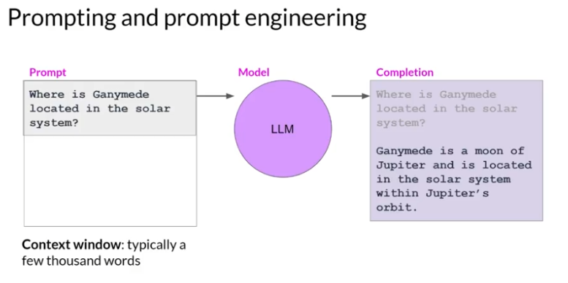
Prompt and Prompt Engineering

Slide 11
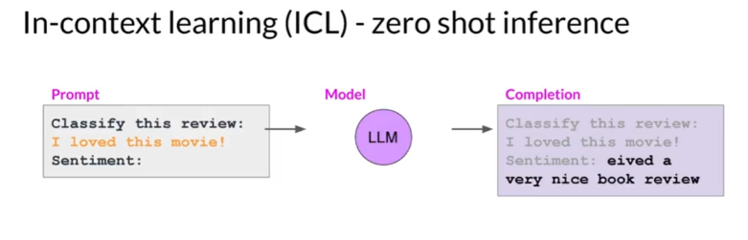
In-Context Learning (ICL) - Zero Short Inference

Slide 12
In-Context Learning (ICL) - One/Few Short Inference
Notes:
Normally 5 examples

Slide 13
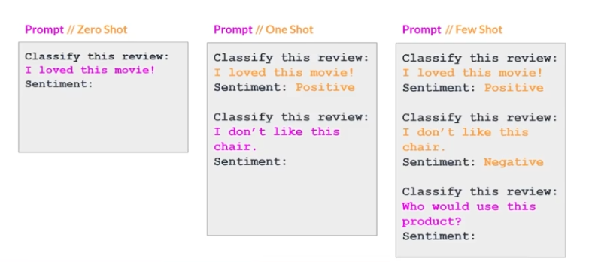
Summary of In-Context Learning (ICL)
Notes:
Once you've found the model that is working for you, there are a few settings that you can experiment with to
influence the structure and style of the completions that the model generates.
Generally, if you find that your model isn't performing well, say, including five or six examples, you should try fine-tuning your model instead. Fine-tuning performs additional training on the model using new data to make it more capable of the task you want it to perform.

Slide 14
LLM Configuration
02

Slide 15
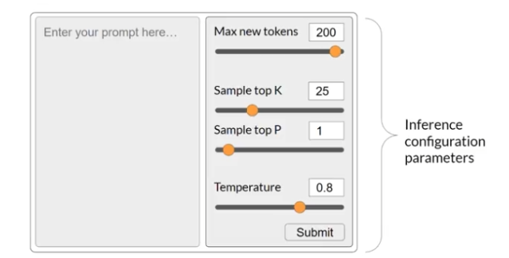
Inference Parameters

Slide 16
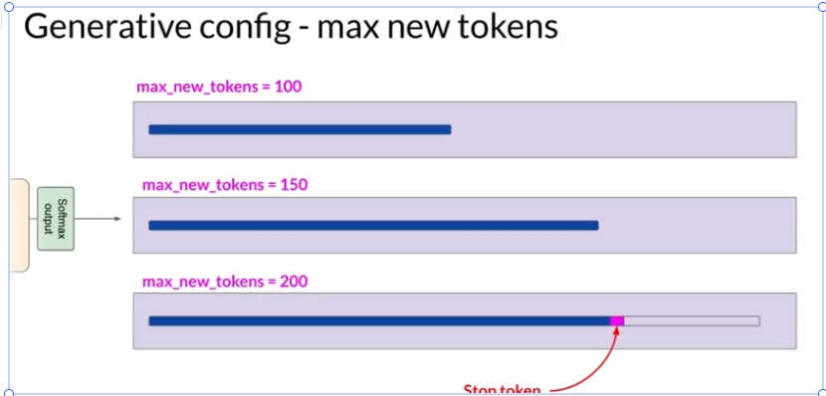
Inference Parameters - Max New Tokens

Slide 17
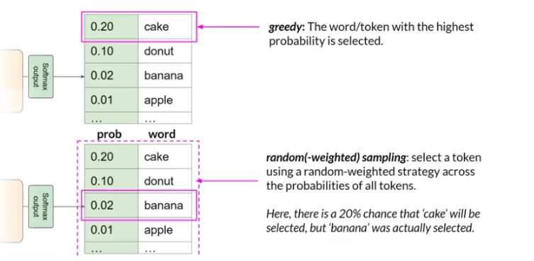
Inference Parameters - Greedy vs. Random Sampling

Slide 18
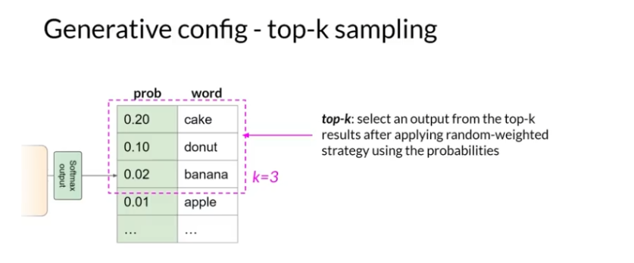
Inference Parameters - Top K Sampling

Slide 19
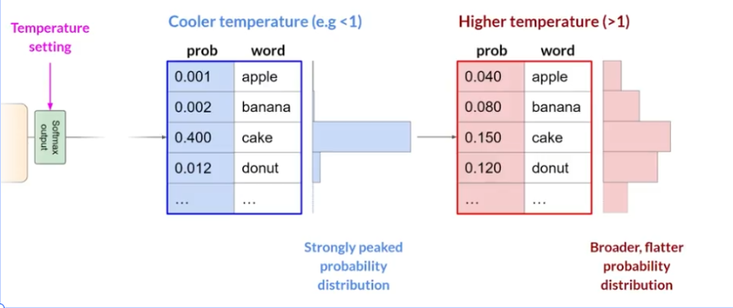
Inference Parameters - Temperature

Slide 20
GenAI Project Lifecycle
03

Slide 21
GenAI Project Lifecycle
Scope
Select
Modeling
Integration
Define the usecase
Choose an existing model or pretain your own
Prompt Engineering
Evaluation
Optimize and Deploy model for Inference
Augment Model and build LLM-powered applications
Fine-Tuning
Align with Human Feedback

Slide 22
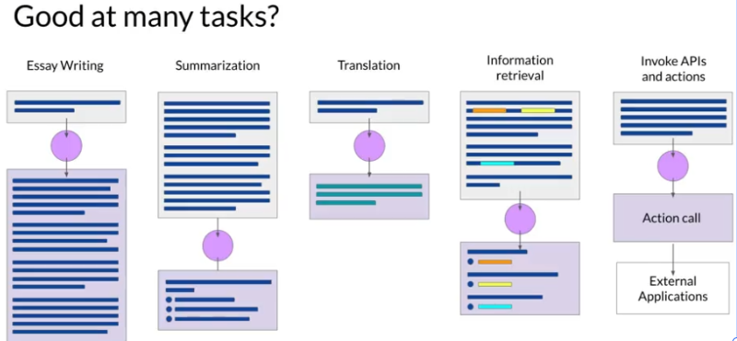
Tasks

Slide 23


Step 1 - Choose Your Model
Foundation Model
Pretrained LLM
Fine-Tune LLM
单击此处输入你的智能图
形项正文内容
单击此处输入你的智能图
形项正文

Slide 24
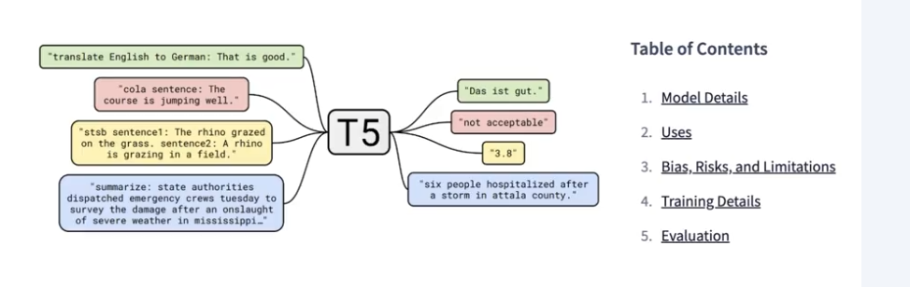
Step 2 - Model Hubs

Slide 25
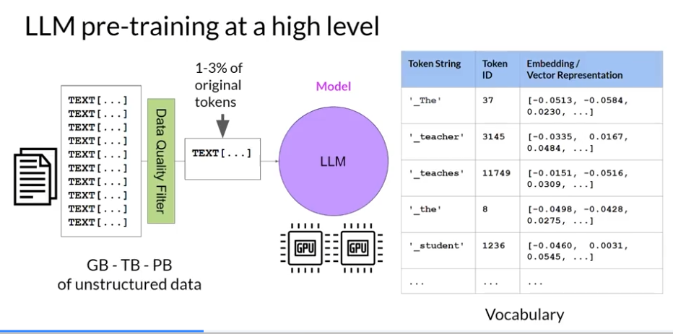
Model Architectures and Pre-Training Objectives
Notes:
LLMs encode a deep statistical representation of language. This understanding is developed during the models pre-training phase when the model learns from vast amounts of unstructured textual data. This can be gigabytes, terabytes, and even petabytes of text.
In this self-supervised learning step, the model internalizes the patterns and structures present in the language. These patterns then enable the model to complete its training objective, which depends on the architecture of the model, as you'll see shortly. During pre-training, the model weights get updated to minimize the loss of the training objective.

Slide 26
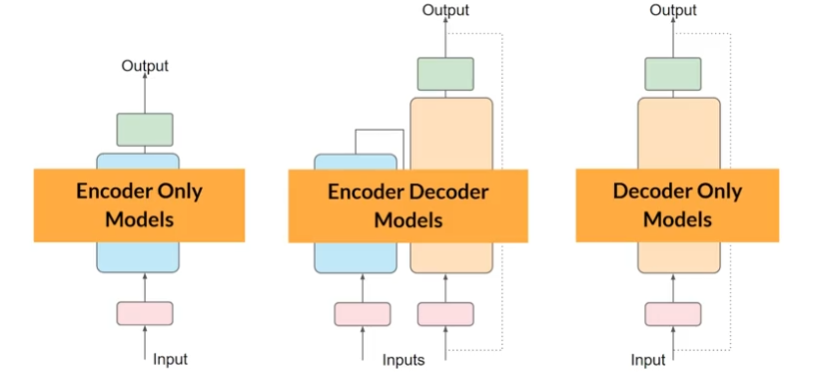
Transformers
Notes:
Encoder-only models are also known as Autoencoding models, and they are pre-trained using masked language modeling. Here, tokens in the input sequence or randomly mask, and the training objective is to predict the mask tokens in order to reconstruct the original sentence.

Slide 27
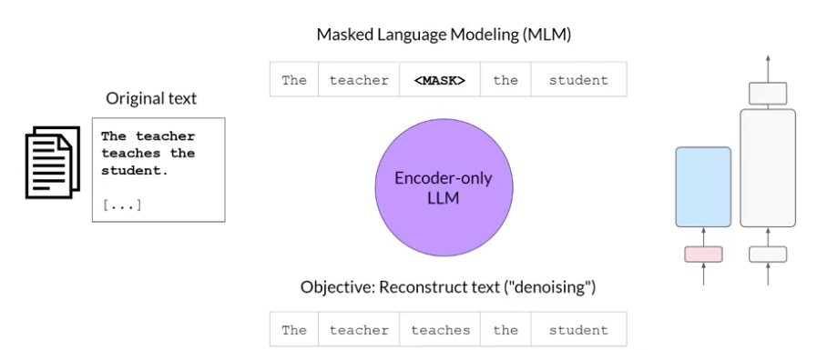
Autoencoding Models
Notes:
Encoder-only models are also known as Autoencoding models, and they are pre-trained using masked language modeling. Here, tokens in the input sequence or randomly mask, and the training objective is to predict the mask tokens in order to reconstruct the original sentence. This is also called a denoising objective. Autoencoding models spilled bi-directional representations of the input sequence, meaning that the model has an understanding of the full context of a token and not just of the words that come before. Encoder-only models are ideally suited to task that benefit from this bi-directional contexts.
Good at
Sentiment analysis
Named entity recognition
Word classifcation
Examples
BERT
ROBERTA

Slide 28
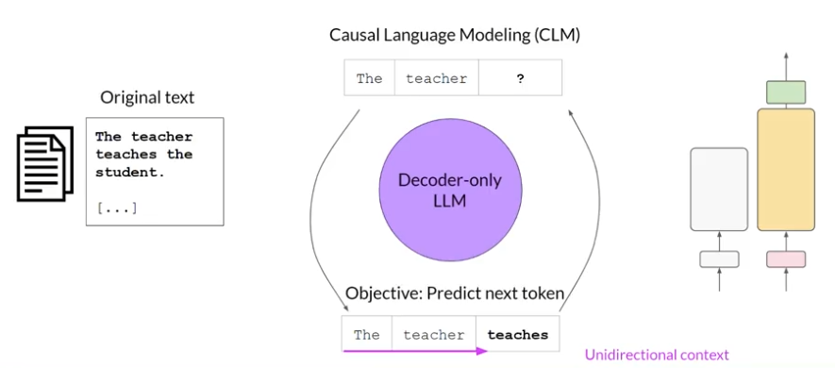
Autoregressive Models
Notes:
Decoder-only or autoregressive models, which are pre-trained using causal language modeling (只用 前面的词预测下一个词，即模型只能“看见过去”，不能“窥视未来”). Here, the training objective is to predict the next token based on the previous sequence of tokens. Predicting the next token is sometimes called full language modeling by researchers. Decoder-based autoregressive models, mask the input sequence and can only see the input tokens leading up to the token in question. The model has no knowledge of the end of the sentence. The model then iterates over the input sequence one by one to predict the following token. In contrast to the encoder architecture, this means that the context is unidirectional. By learning to predict the next token from a vast number of examples, the model builds up a statistical representation of language. Models of this type make use of the decoder component off the original architecture without the encoder.
Good at
Text generation
Other emergent behavior - depends on model size
Examples
GPT
BLOOM

Slide 29
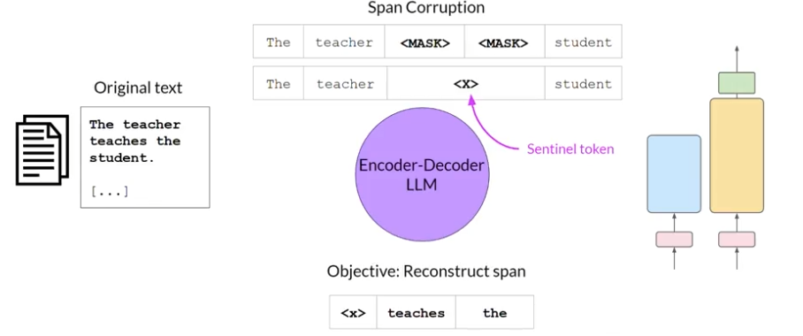
Sequence-to-Sequence Models
Notes:
Good at
Translatioin
Text summarization
Question answering
Examples
T5
BART

Slide 30
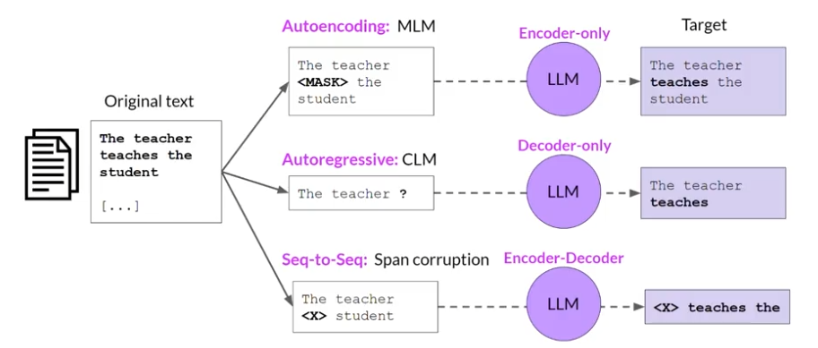
Model Architectures and Pre-Training Objectives

Slide 31
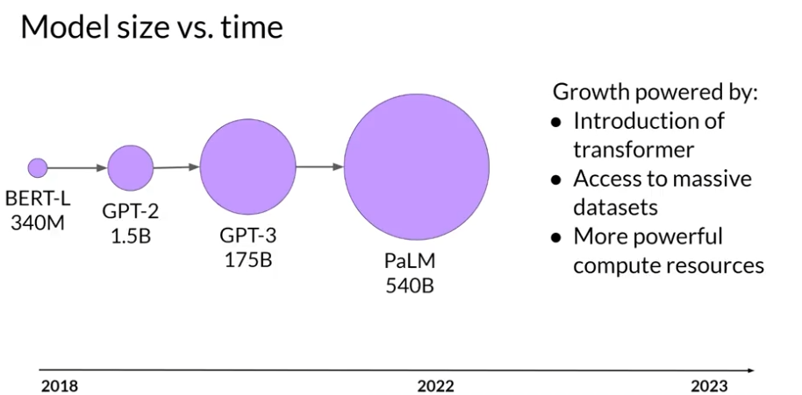
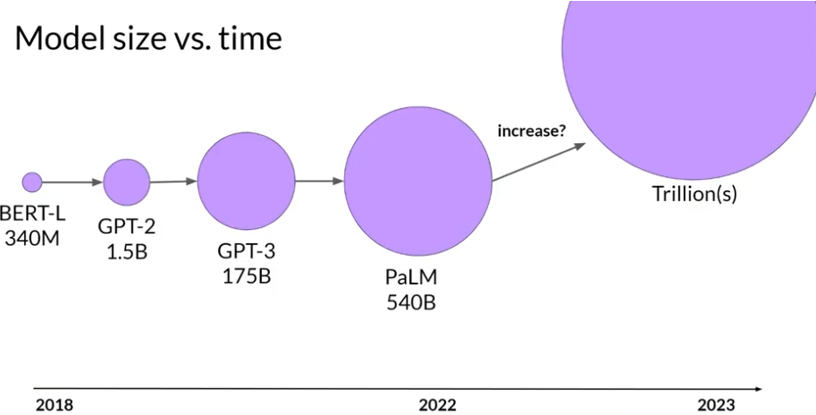
Model Size vs. Time

Slide 32
Computation Challenge
04

Slide 33
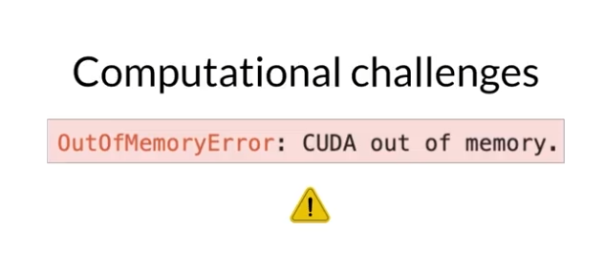
Computational Challenges

Slide 34
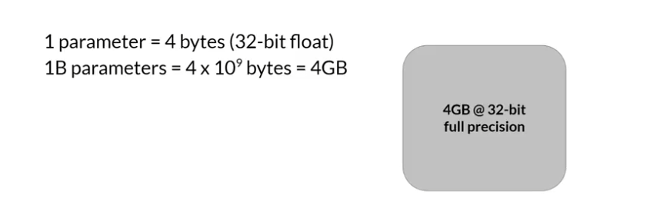
Approximate GPU RAM needed to store 1B parameters
Item | Stage | Bytes per Parameters
Model Parameters (Weights) | Inference / Training | 4 bytes per parameter
Adam optimizer (2 states) | Training | +8 bytes per parameter
Gradients | Training | +4 bytes per parameter
Activations and temp memory (variable size) | Training | +8 bytes per parameter (high-end estimation)
Total |  | = 4 bytes per parameter + 20 extra bytes per paramters
Notes:
If you want to train the model, you'll have to plan for additional components that use GPU memory during training. These include two Adam optimizer states, gradients, activations, and temporary variables needed by your functions. This can easily lead to 20 extra bytes of memory per model parameter.
训练时候，大约是 hosting的 5-6倍的 memory 的需求

Slide 35
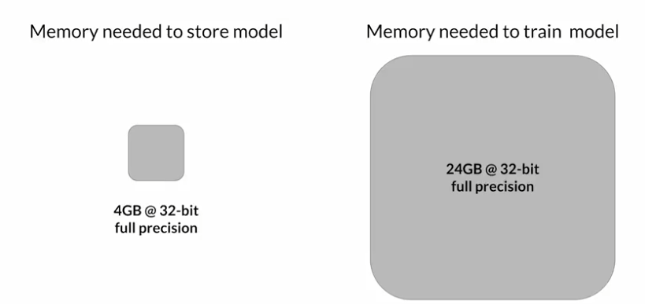
Approximate GPU RAM needed to store 1B parameters

Slide 36
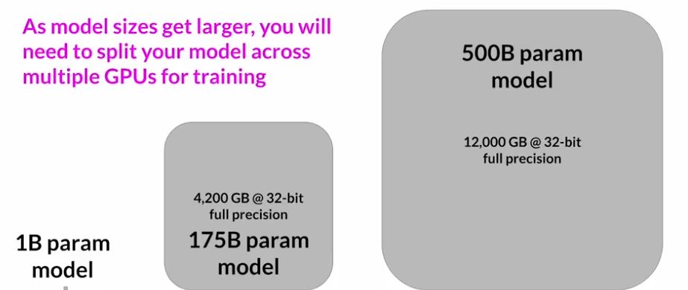
GPU RAM needed to Train Larger Models

Slide 37
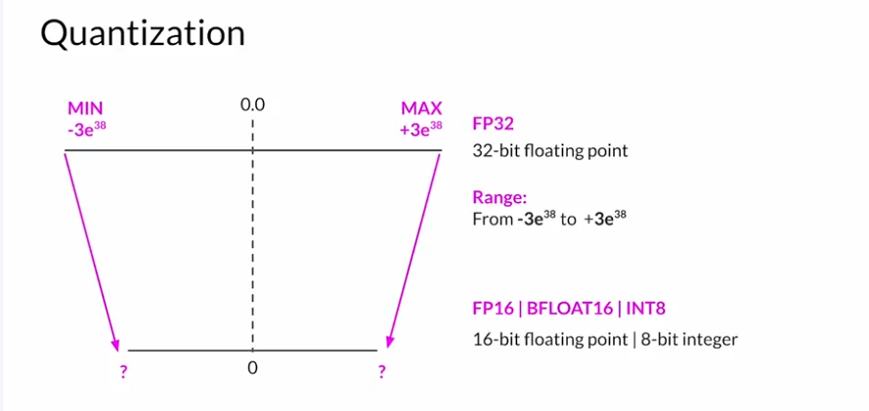
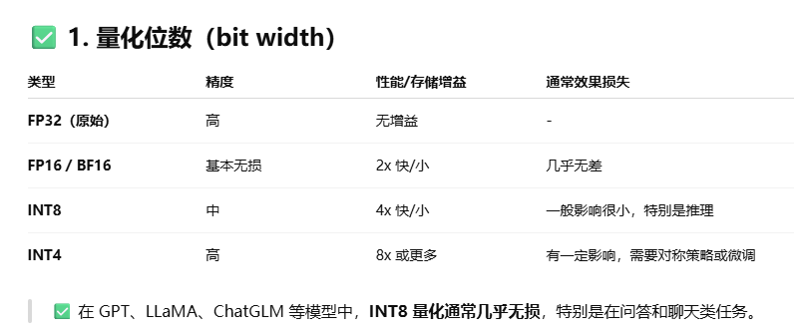
Quantization

Slide 38
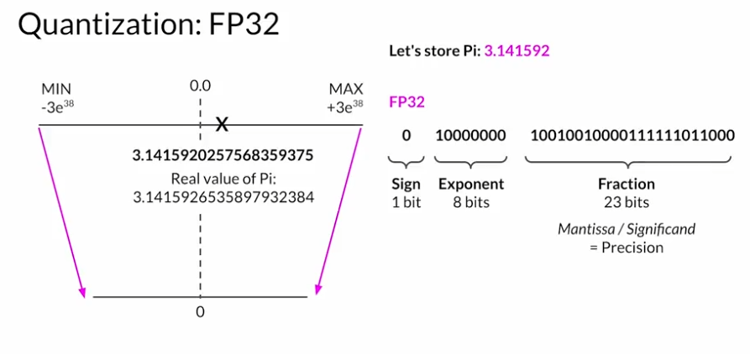
Quantization: FP32

Slide 39
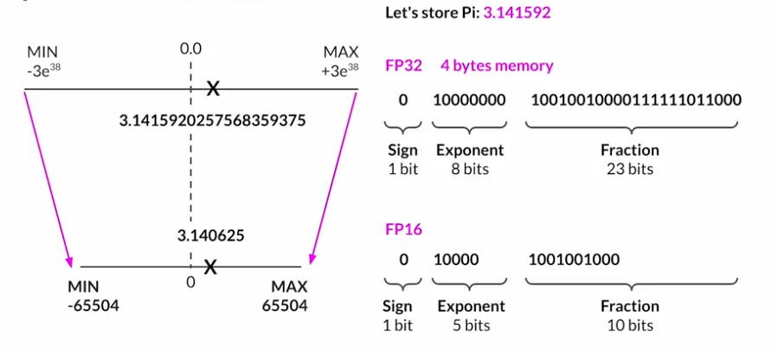
Quantization: FP16

Slide 40
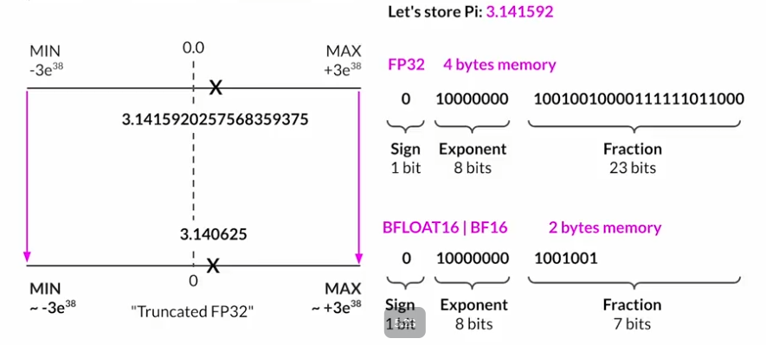
Quantization: BFLOAT16

Slide 41
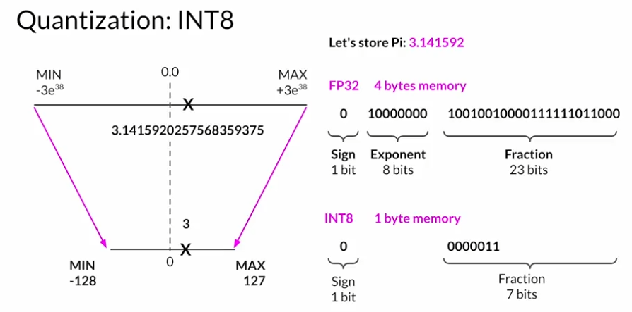
Quantization: INT8

Slide 42
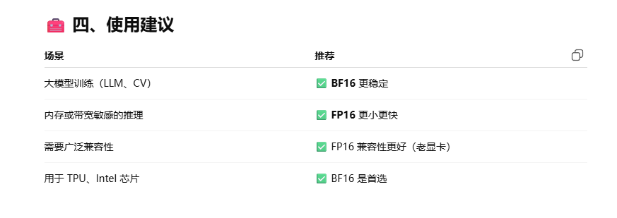
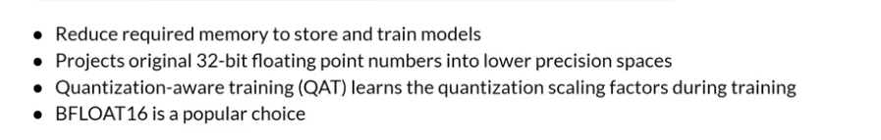
Quantization: Summary
 | Bits | Exponent | Fraction | Memory needed to store one value
FP32 | 32 | 8 | 23 | 4 bytes
FP16 | 16 | 5 | 10 | 2 bytes
BFLOAT16 | 16 | 8 | 7 | 2 bytes
INT8 | 8 | -/- | 7 | 1 byte

Slide 43
Efficient Multi-GPU Compute Strategies
05

Slide 44
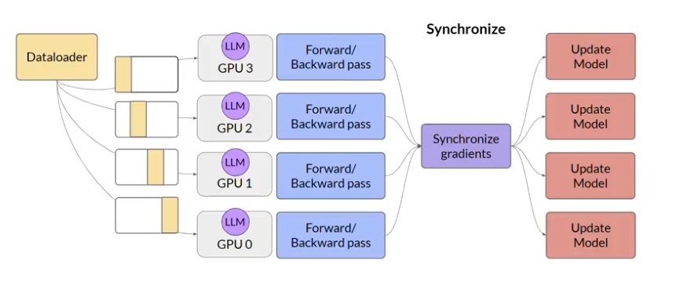
Distributed Data Parallel (DDP)

Slide 45
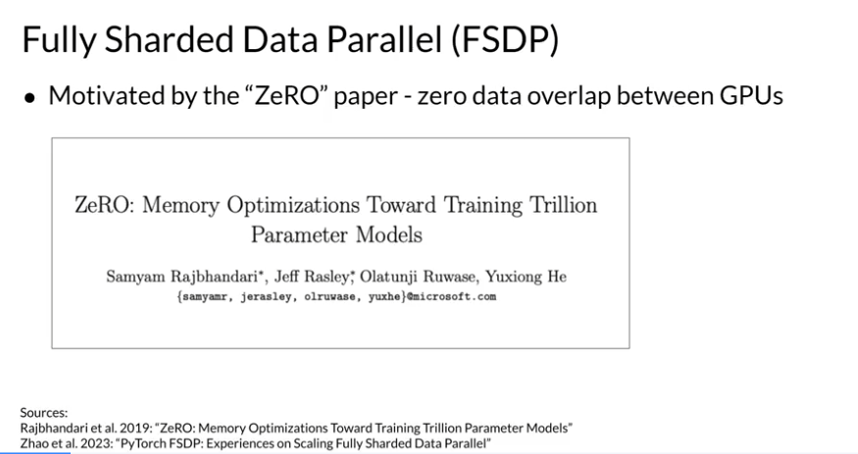
Distributed Data Parallel (DDP)

Slide 46
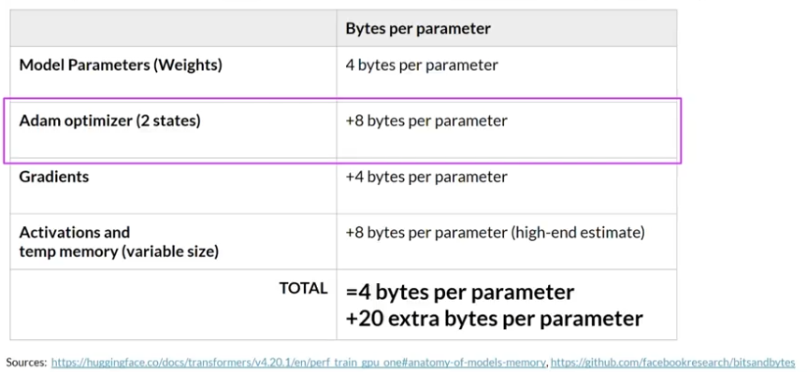
Recap: Additional GPU RAM needed for training

Slide 47
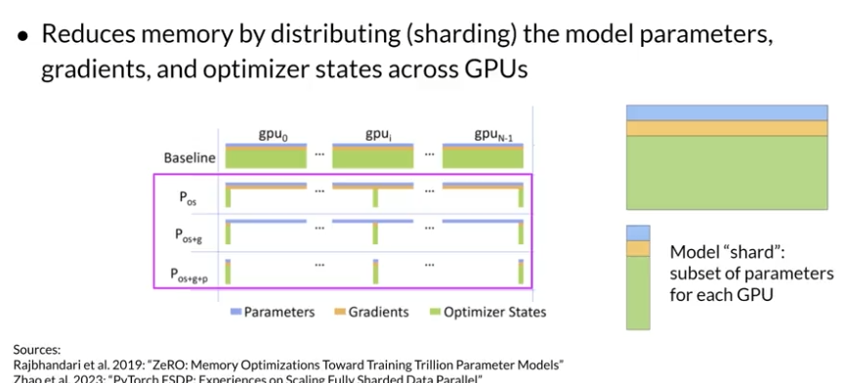
Zero Redundancy Optimizer (ZeRO)

Slide 48
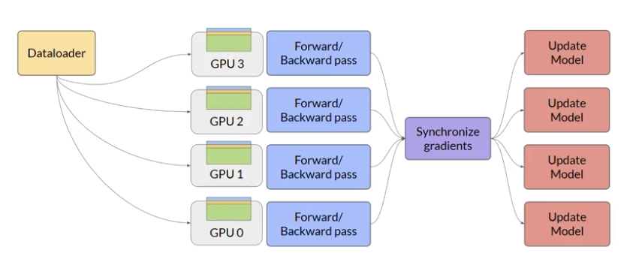
Distributed Data Parallel (DDP)

Slide 49
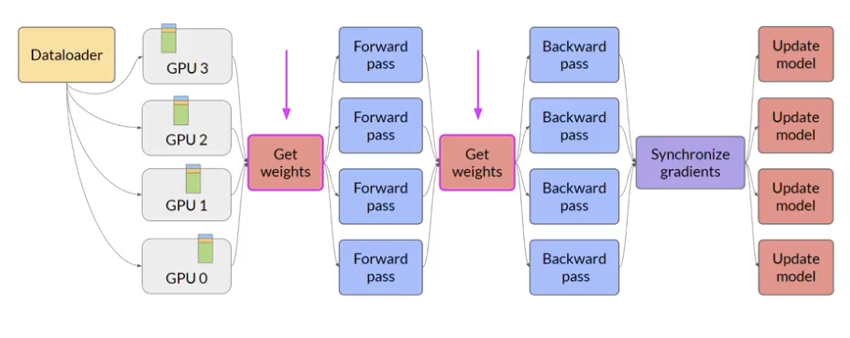
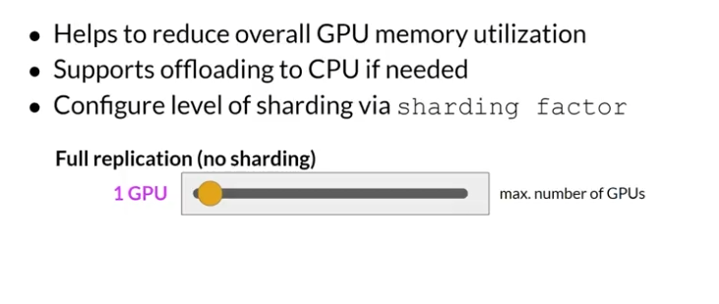
Fully Shareded Data Parallel (FSDP)

Slide 50
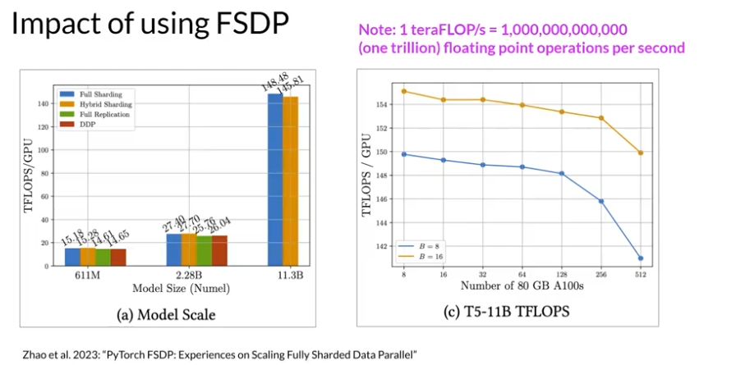
Impact of Using FSDP

Slide 51
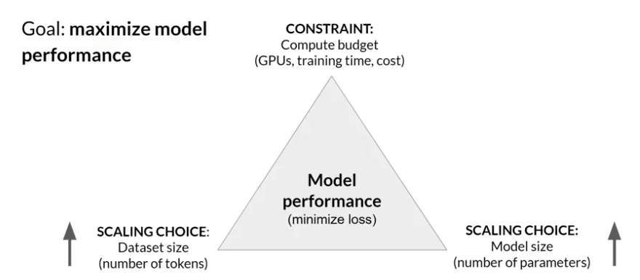
Scaling choices for pre-training

Slide 52
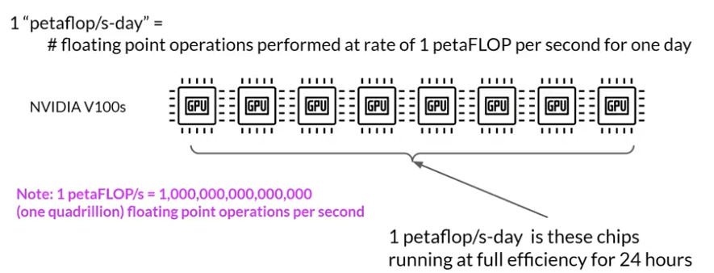
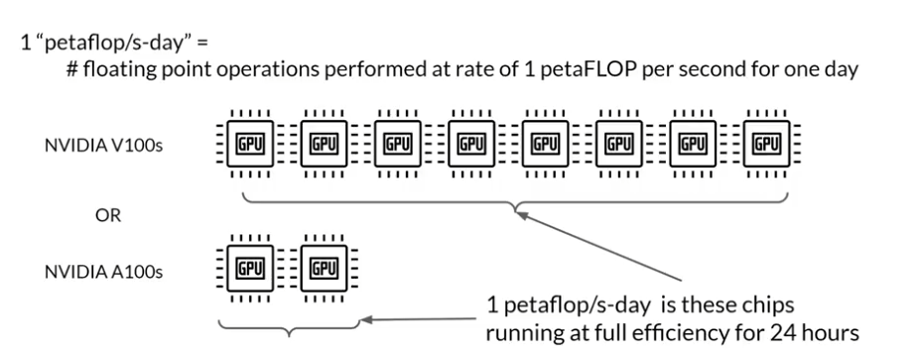
Compute Budget for Training LLMs

Slide 53
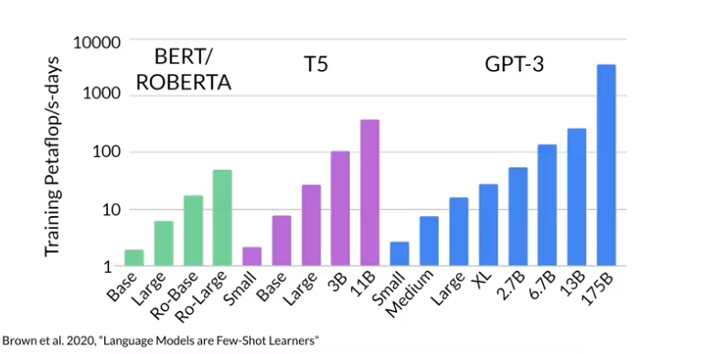
Number of PFlops/days to pre-train various LLMs

Slide 54
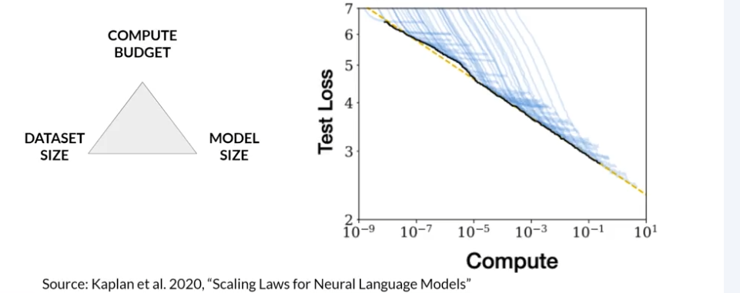
Compute Budget vs. Model Performance

Slide 55

Dataset size and model size vs. performance

Slide 56

How to balance these three?

Slide 57

Compute Optimal Models

Slide 58

Chinchilla Scaling Laws for Model and Dataset Size

Slide 59

Chinchilla Scaling Laws for Model and Dataset Size

Slide 60
Pre-Training for Domain Adaption
06

Slide 61

Pre-Training for Domain Adaption

Slide 62

BloombergGPT: Domain Adaption for Finance
Notes:
https://arxiv.org/abs/2303.17564

Slide 63
Chinchilla Scaling Laws for Model and Dataset Size

Slide 64
Chinchilla Scaling Laws for Model and Dataset Size

Slide 65
Chinchilla Scaling Laws for Model and Dataset Size

Slide 66
Chinchilla Scaling Laws for Model and Dataset Size

Slide 67
Chinchilla Scaling Laws for Model and Dataset Size

Slide 68
Chinchilla Scaling Laws for Model and Dataset Size

Slide 69
Chinchilla Scaling Laws for Model and Dataset Size

Slide 70
Chinchilla Scaling Laws for Model and Dataset Size

