Slide 1

Introduction
Machine Learning Series
Max

Slide 2

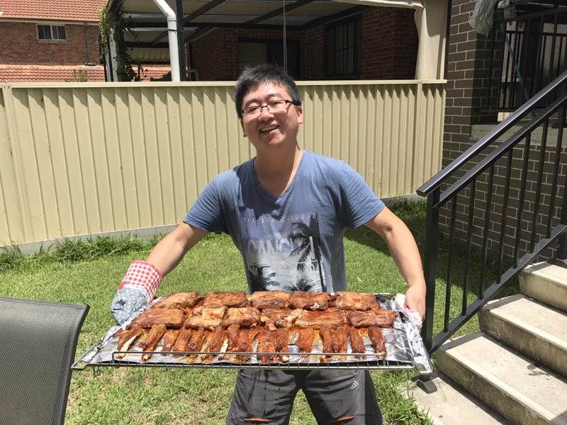





About Me
01
02
03
Data Science
Enterprise Architecture
Quant Trading

Slide 3




Buzz Words in AI
Agent
CNN, RNN, LSTM, Attention, Transformer
NLP, CV, LLM
Neural Network
Deep Learning
Linear Regression, Decision Tree, Random Forest, SVM, GBDT, XGBoost, Neural Network …
Machine Learning
Machine Learning, Statistic Learning, Evolutionary Algorithm, Symbolic AI …
Artificial Intelligence
Notes:
AI -> has Genetic Algorithms, Statistic Learning, Evolutionary Algorithms, Probabilistic Models, Symbolic AI / Logic-Based AI

Slide 4
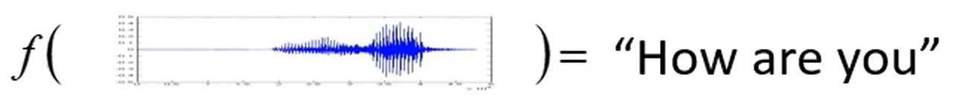
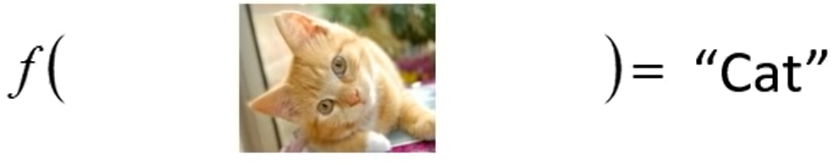
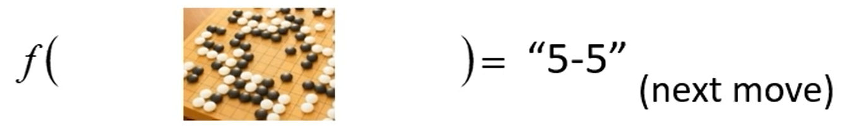

Machine Learning
Machine Learning is a process to build a mapping function from input variables X to target output variable y where human beings are hard to give clear instructions.
$$y=f_{w}(X)$$
Examples
Speech Recognition
Image Classification
Go Game

Slide 5

Evolvement of Machine Learning
$$y=f_{w}(X)$$
X -> normalization, feature engineering, dimensionality reduction, matrix decomposition (PCA), kernel function, manifold learning
f -> polynomial regression/classification, SVM, decision trees, random forest, GBDT, XGBoost/LightGBM/Catboost, Neural network
y -> discrete/continuous values, structural learning (policy), generative learning
w -> machine learning, statistical learning, self-supervised learning, reinforcement learning, generative learning

Slide 6

Complexity of Machine Learning Questions
$$y=f_{w}(X)$$
Y | Machine Learning Questions | Complexity
No Y | Unsupervised Learning / Clustering
Numerical | Regression
Categorical | Classification
Structure | Reinforcement Learning
Arbitrary | Hybrid Learning approaches
Low
High

Slide 7
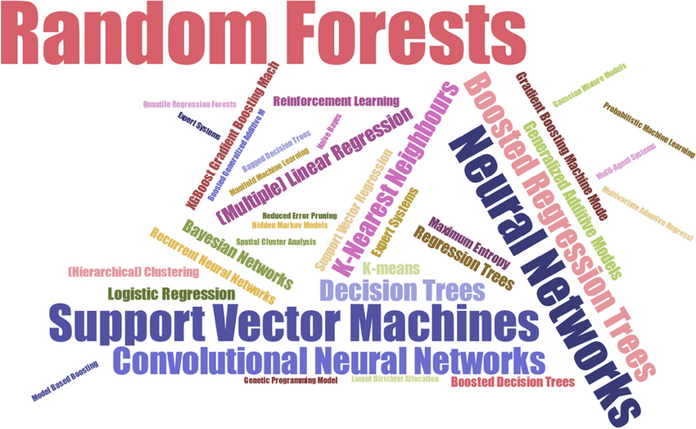
So many machine learning models!
Tree-based Models
XGBoost
LightGBM
CatBoost
Kernel-based Models
Neural Network

Slide 8
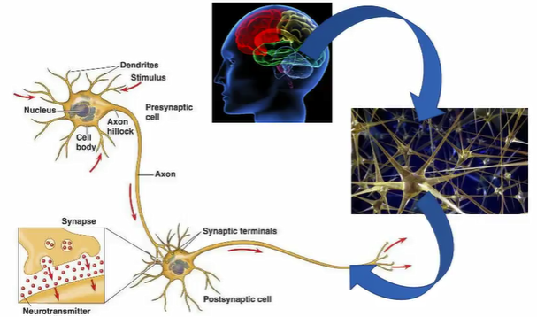
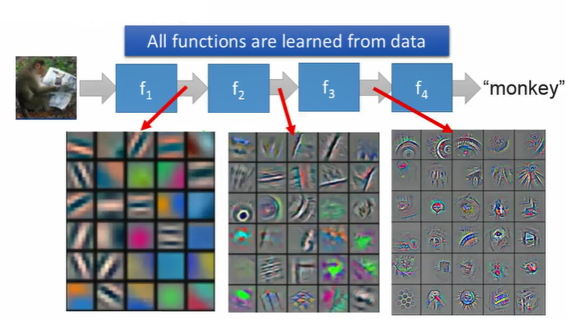
Why Neural Networks?
Capacity
No Feature Engineering
Notes:
High Capacity that allows neural network to simulate all kind of models.
Transaction date: holiday or not, first day of week, first day of month, shopping day and so on …
Numerical value: mean, media, variance, positive vs. negative, has decimal or not …
Network/graph: topological features …

Slide 9
History of Neural Network
1960s: Perceptron (single layer neural network);
1969: Perceptron has limitation; (a failure)
1980s: Multi-layer Perceptron;
1986: Back-propagation;
Usually more than 3 hidden layers is not helpful;
1989: one hidden layer is “good enough”, why deep?
2006: RBM initialization (breakthrough);
2009: GPU;
2011: Start to be popular in speech recognition;
2012: win ILSVRC competition (image);
2017: All you need is attention;
2020: LLM – GPT 3.5
Now
No algorithm to optimize
Insufficient data and Computational Resources
All kinds of network are proposed, LSTM, CNN, RNN, GRU
Transformer

Slide 10

Transformer
Parameters of A classic 8 heads, 6 layers and 512 hidden neuros Transformer
Embedding | 19M
Attention | 6 layers * 1.05M = 6.3M
Feedforward | 6 layers * 2.1M = 12.6M
LayerNorm and Biases | 6 layers * 50K = 0.3 M
Total | 38M
GPT-3 (175B parameters) has 96 layers, 96 attention heads, and a hidden size of 12,288.
Notes:
GPT-3, for instance, has 96 layers, 96 attention heads, and a hidden size of 12,288. 175B

Slide 11
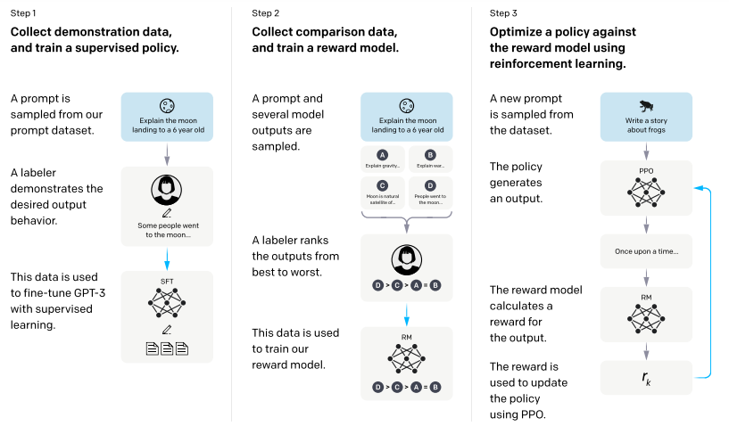
How to train a ChatGPT?
Self-supervised Learning
Supervised Fine-Tuning
Reinforcement Learning From Human Feedbacks
Notes:
Around $15-20k A100 80G

Slide 12
Training Cost
Feature | GPT-3 | GPT-4
Parameters | 175 billion | Around 1.7-1.8 billion
GPU Memory (Inference) | 350GB | 6 TB
Training Time | 34 days | 90-100 days
Training Cost | $4.6M USD | Around $80M USD
Notes:
Around $15-20k A100 80G

Slide 13
What’s happening and what will happen soon …
From “App + AI” to “AI + App”
Agentic AI: Autonomous Systems on the Rise
AI Security and Compliance Concerns
In Media, AI-Driven Automation in Advertising - Companies like Meta are leveraging AI to fully automate advertising processes.
Emergency of AI in Consumer Devices
Passive to Active
The rise of Large Language Models (LLMs) has enabled numerous individuals and small companies such as Cursor, Windsurf, Perplexity and so on to achieve significant success.

