Slide 1
Functions in Python
BUAD 5042

Slide 2
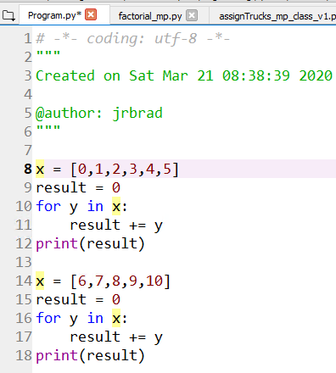
Functions
What problems does this code have?

Slide 3
Functions
Multiple instantiations of the same code within a program cause problems
More opportunities for errors
More maintenance
Blocks of reusable code solve this problem
These are called functions

Slide 4
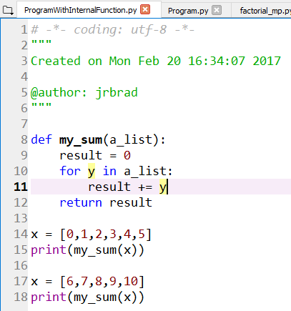
Example Function & Variable Scope
ProgramWithInternalFunction.py
Indentation
Arguments
return statement (not required)
Variable scope

Slide 5
Indentation
Function statements must be indented

Slide 6
Arguments
Variables passed from calling program to the function
a_list is an argument required by my_sum
a_list assumes value of x passed from main

Slide 7
return Statement
return sends variables back to main program

Slide 8
Variable Scope
main program: where execution begins
The first un-indented line that is not a function definition or a global variable
main starts here

Slide 9
Variable Scope
a_list is defined only in the function when it runs

Slide 10
Functions
Place all functions above the “main” program
Convention
Must be defined before they are used

Slide 11
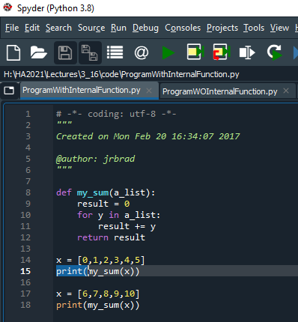
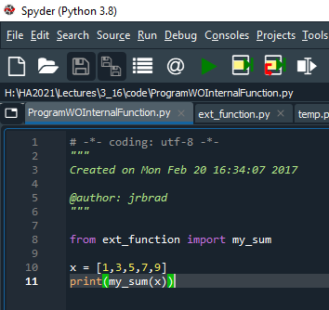
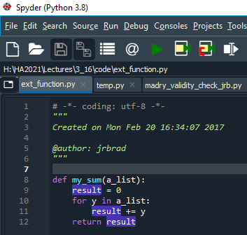
Internal versus External Functions
=

Slide 12
Functions
Placement of external functions:
Python looks in a few places for functions you import
Easiest is to place them in the same folder as the program that is using the function

