Slide 1
Tips for Algorithm Design & Coding Introduction to Assignment 2
BUAD 5042

Slide 2
Programming Tips
Algorithm development process
Programming techniques
Be cognizant of data types

Slide 3
What’s Should You do First?
What is the first thing you should do when you are developing an algorithm?

Slide 4
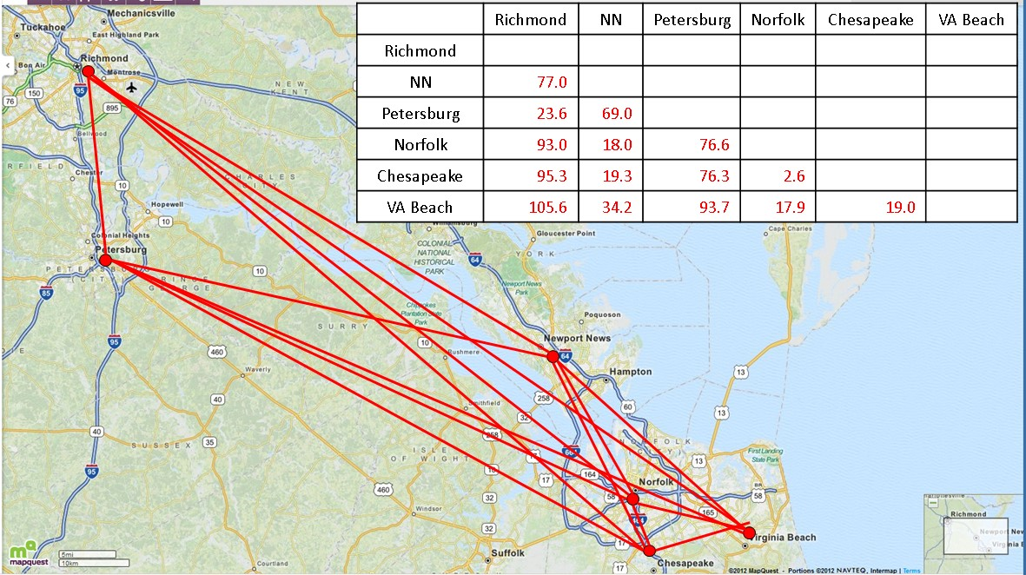
A Better Answer

Slide 5
A Better Answer
Review possible tactics and think which might be successful
Greedy methods based on intuitive attributes of good solutions
Solve related, simpler problems
Then, adjust solution for target problem
Divide and Conquer
Decompose a complex problem into multiple simpler problems
Greedy algorithm based on simplified math model
Construct a parameterized decision structure
Then, optimize the parameters

Slide 6
Development Example
Strategy
Conceptual Approach
Strategy:
Select an item in ascending order of value/weight ratio
Conceptual Approach:
Create a sorted list of items from the items dictionary
Iterate through list and for each item
Append next item to knapsack if it is within the capacity

Slide 7
Writing Code
Program line-by-line or in small chunks
Test each line/chunk
Use functions where reasonable
Easy to test
Checking code as you write it
Eliminates syntax errors in individual statements
Bugs may still exist in how the statements interact

Slide 8
Writing Code
Use good debugging techniques
Use breakpoints
Check variables in console
Use Variable explorer
Print statements

Slide 9
Writing Code
Check code where solutions are known
Small problems with obvious solutions
E.g., Bin Packing assignment (Assignment #2)
Pack items into as few bins as possible
Cart volume capacity is 10
Obvious solutions with item volumes 1, 5, 10
Problem data examples
10 items of volume 1
20 items of volume 1
n items of volume 5
m items of volume 1, n items of volume 5

Slide 10
Commenting
Commenting improves code maintainability and reuse
Create comments from algorithm outline before coding
Gives a structure to code development
Don’t need to worry about adding main comments later

Slide 11
Choose Best Data Type for the Situation
Lists
Good if you are going to iterate through the entire list
Methods: sort, iterable, reverse, append
Tuples
Similar to lists, but when the data shouldn’t change
Immutable
Not many built-in methods
Dictionaries
Fast random access: lookup by key
Takes a little more memory than lists

Slide 12
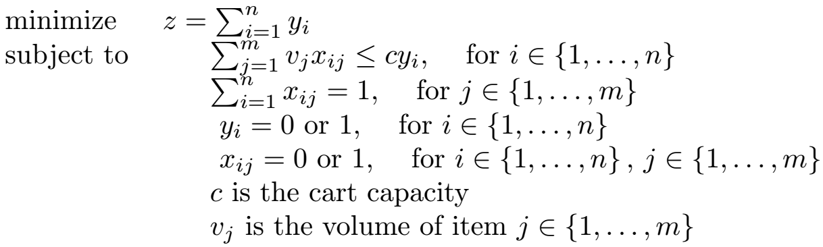
Assignment 2: Assigning Items to Bins
Pack all items into as few bins (carts) as possible without overloading bins
Optimization Formulation
Maximum number of bins n must be sufficiently large for a feasible solution

Slide 13
Assignment 2: Algorithm Inputs
Your focus: def binpack(articles, bin_cap)
Input arguments
articles
items: a dictionary of the items to be place in bins, with: keys representing the item ID values (integers) values representing the item volumes • e.g., for example: {0: 2, 1: 5...}
bin_cap
float data type
Volume of a bin, its maximum capacity

Slide 14
Assignment 2: Algorithm Outputs
Output
items_to_pack : a list of lists, where each sublist indicates the dictionary keys for the items assigned to one bin
Each sublist contains the item ID numbers for the items contained in a bin. For example, this list of lists—[[2,6,8,15],[1,11,7,9],...]—indicates that the 0th bin contains items with these IDs, [2,6,8,15], and the 1st bin contains items with these IDs: [1,11,7,9], etc.
Take care to (1) not overload the bins, (2) place all items in one bin, and (3) not assign items to more than one bin.
bin_contents
List of lists… each sublist contains article_ids in a bin
The number of sublists is the number of bins used

Slide 15
Business Problems
Truck trailer loading
Cart Packing in Distribution Centers
Packing boxes
Segmenting electronic communication
Machine production scheduling
Service engineer schedules
Scheduling of parallel processing computers

Slide 16
Assignment #2 Hint: Understanding Output
The output for each of the cart packing problems for Bin Packing will look like this:
Bins Packed for Problem 0 ....
num_ok/num_over: 7 / 0
This means that 7 bins were packed and all 7 were within capacity and zero were overcapacity.
If you get something like this,
Bins packed for Problem 1...
num_ok/num_over: 17/3
It means that 3 bins were overcapacity and the solution is not feasible. The second number must be 0 for each problem if all your bins are within capacity.

Slide 17
Assignment #2 Hint: Machine Precision
We must recognize that computers cannot (most of the time) exactly represent floating-point values, whether we are programming in Python or any other language. This is just a fact driven by the architecture of computers where values are represented as binary values. Float values, in Python, are represented in memory with 64 bits, only 53 of which are used to store the "value" of a float, and the remaining 11 bits are used to represent the sign and exponent of the value. The exponent, effective, moves the decimal point to the desired spot in the 53 bits of value.
We need to write our programs with the understanding that some numbers are too small to be represented and that the number in memory is not the exact value we would like. Depending how you write your bin packing algorithm code, machine precision is a possible cause of you putting items into a cart and, depending how to check to see if they will fit, you may inadvertently create a cart load that checked otherwise would be deemed to be overcapacity. I haven't seen this happen when using this assignment in the past, but the possibility of this presents a good opportunity to bring up the topic of machine precision.
For more information on how to calculate the Machine Precision:
https://www.adamsmith.haus/python/answers/how-to-find-machine-epsilon-using-numpy-in-python

