Slide 1
Dynamic Programming Approach & Sample Problems
BUAD 5042

Slide 2
DP Approach & Sample Problems
Small introductory problem
Shortest distance problem
Longest time problem
Project management

Slide 3
Introduction Problem
Flying from Richmond to Los Angeles
Find the lowest total fare
Airline hubs in Atlanta, Chicago, Philadelphia
Atlanta
$120
$200
Richmond
$150
Chicago
$175
Los Angeles
$90
$300
Philadelphia

Slide 4

Introduction Problem
$c\left(s,d\right)$: cost of link from s to d
c(R,A) = $120
Atlanta
$120
$200
Richmond
$150
Chicago
$175
Los Angeles
$90
$300
Philadelphia

Slide 5

Introductory Problem
$f\left(s,d\right)$: lowest total cost to Los Angeles (ultimate destination) from location s (the current state) by going to destination d next
$f\left(R,A\right)$: from Richmond to LA through Atlanta
Atlanta
$120
$200
Richmond
$150
Chicago
$175
Los Angeles
$90
$300
Philadelphia

Slide 6

Introductory Problem
$f^{∗}\left(s\right)$: least cost from s to ultimate destination
Atlanta
$120
$200
Richmond
$150
Chicago
$175
Los Angeles
$90
$300
Philadelphia

Slide 7
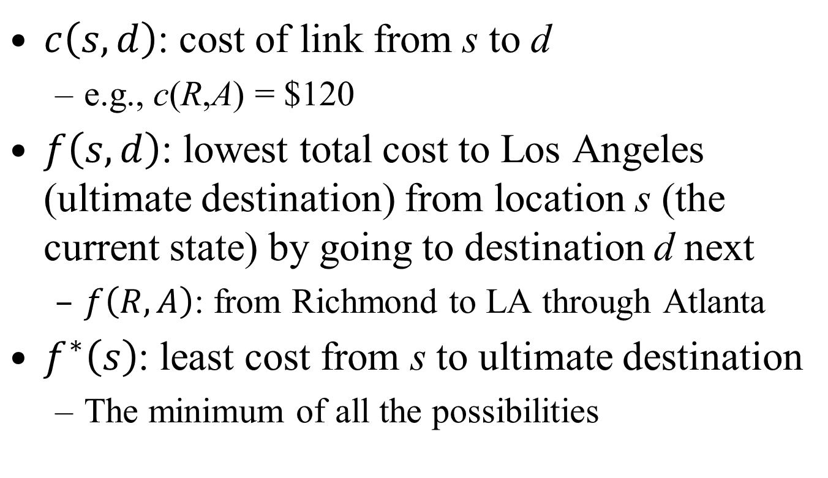
Notation Summary
$c\left(s,d\right)$: cost of link from s to d
e.g., c(R,A) = $120
$f\left(s,d\right)$: lowest total cost to Los Angeles (ultimate destination) from location s (the current state) by going to destination d next
$f\left(R,A\right)$: from Richmond to LA through Atlanta
$f^{∗}\left(s\right)$: least cost from s to ultimate destination
The minimum of all the possibilities

Slide 8
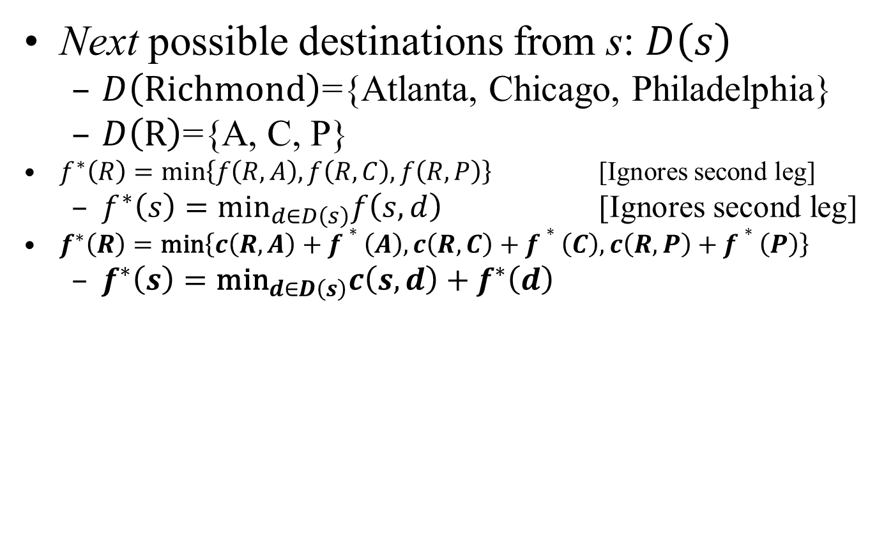
Introductory Problem
Next possible destinations from s: $D\left(s\right)$
$D\left(\text{Richmond}\right)$={Atlanta, Chicago, Philadelphia}
$D\left(\text{R}\right)$={A, C, P}
$f^{∗}\left(R\right)=\text{min}\left\{f\left(R,A\right),f\left(R,C\right),f\left(R,P\right)\right\}$ [Ignores second leg]
$f^{∗}\left(s\right)={\text{min}}_{d∈D\left(s\right)}f\left(s,d\right)$ [Ignores second leg]
$f^{∗}\left(R\right)=\text{min}\left\{c\left(R,A\right)+f∗\left(A\right),c\left(R,C\right)+f∗\left(C\right),c\left(R,P\right)+f∗\left(P\right)\right\}$
$f^{∗}\left(s\right)={\text{min}}_{d∈D\left(s\right)}{c\left(s,d\right)+f}^{∗}\left(d\right)$
Atlanta
$120
$200
Richmond
$150
Chicago
$175
Los Angeles
$90
$300
Philadelphia

Slide 9
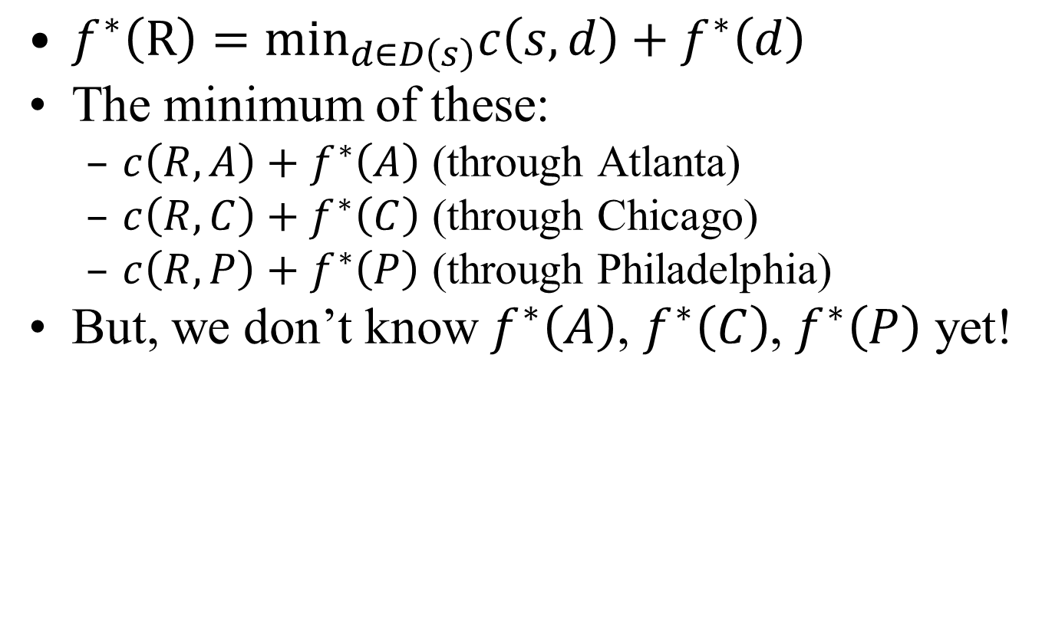
Introductory Problem
$f^{∗}\left(\text{R}\right)={\text{min}}_{d∈D\left(s\right)}{c\left(s,d\right)+f}^{∗}\left(d\right)$
The minimum of these:
${c\left(R,A\right)+f}^{∗}\left(A\right)$ (through Atlanta)
${c\left(R,C\right)+f}^{∗}\left(C\right)$ (through Chicago)
${c\left(R,P\right)+f}^{∗}\left(P\right)$ (through Philadelphia)
But, we don’t know $f^{∗}\left(A\right)$, $f^{∗}\left(C\right)$, $f^{∗}\left(P\right)$ yet!
Atlanta
$120
$200
Richmond
$150
Chicago
$175
Los Angeles
$90
$300
Philadelphia

Slide 10
Introductory Problem
Atlanta
$120
$200
Richmond
$150
Chicago
$175
Los Angeles
$90
$300
Philadelphia
We often work DP problems backwards:
f*(A) = c(A,LA) + f*(LA) = 200
f*(C) = c(C,LA ) + f*(LA) = 175
f*(P) = c(P,LA) + f*(LA) = 300

Slide 11
Main Idea
Dynamic program breaks complex networks down into a sequence of small, simple computations.
Apply to network stage by stage
Find the best path to the next stage

Slide 12
Introductory Problem
Atlanta
$120
$200
f*(A) = 200
Richmond
$150
Chicago
$175
Los Angeles
f*(C) = 175
$90
$300
Philadelphia
f*(P) = 300
f*(R) = min_{d∈{A,C,P}} f(R,d)
f*(R) = min{c(R,A)+f*(A), c(R,C)+f*(C), c(R,P)+f*(P)}
f*(R) = min{120 + 200, 150 + 175, 90 + 300}
f*(R) = min{320, 325, 390} = $320
Solution: fly through Atlanta

Slide 13
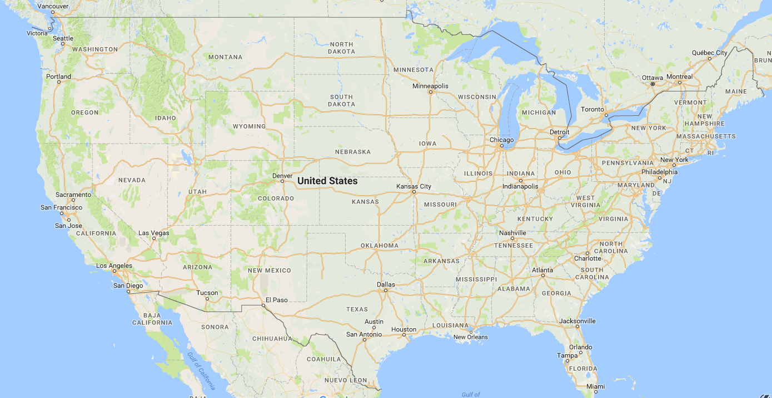
Shortest Distance: Wmbg to LA
Destination: Los Angeles
DE
SL
851
St. Louis
904
878
449
498
Williamsburg
B
A
Oklahoma City
389
LR
1012
W
Barstow
677
504
OK
LA
115
Albuquerque
319
Little Rock
120
1340
SD
1358
Dallas
D

Slide 14
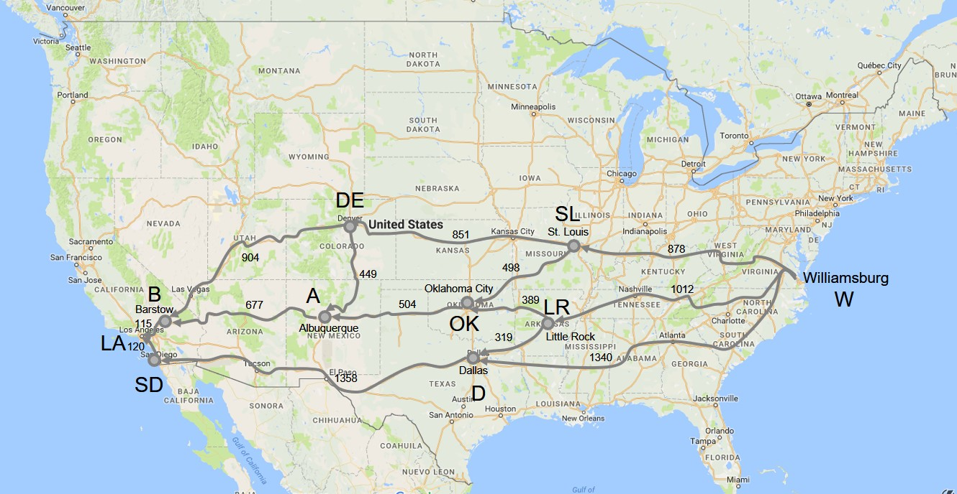
DP Worksheet
f*(LA) = 0
f*( ) = min{c( , )+f*( ), c( , )+f*( )}
f*( ) = min{c( , )+f*( ), c( , )+f*( )}

Slide 15
DP Worksheet
f*( ) = min{c( , )+f*( ), c( , )+f*( )}
f*( ) = min{c( , )+f*( ), c( , )+f*( )}
f*( ) = min{c( , )+f*( ), c( , )+f*( )}

Slide 16
DP Worksheet
f*( ) = min{c( , )+f*( ), c( , )+f*( )}
f*( ) = min{c( , )+f*( ), c( , )+f*( )}
f*( ) = min{c( , )+f*( ), c( , )+f*( )}

Slide 17
DP Worksheet
f*( ) = min{c( , )+f*( ), c( , )+f*( )}
f*( ) = min{c( , )+f*( ), c( , )+f*( )}
f*( ) = min{c( , )+f*( ), c( , )+f*( )}

Slide 18
DP Worksheet
f*( ) = min{c( , )+f*( ), c( , )+f*( )}
f*( ) = min{c( , )+f*( ), c( , )+f*( )}
f*( ) = min{c( , )+f*( ), c( , )+f*( )}

Slide 19
DP Worksheet
f*( ) = min{c( , )+f*( ), c( , )+f*( )}
f*( ) = min{c( , )+f*( ), c( , )+f*( )}
f*( ) = min{c( , )+f*( ), c( , )+f*( )}

Slide 20
DP Worksheet
f*( ) = min{c( , )+f*( ), c( , )+f*( ) ), c( , )+f*( )}
f*( ) = min{ , , ,}

Slide 21
Shortest Distance
Dynamic Programming gives us
Shortest distance from Williamsburg to LA
Also, shortest distance from all points to LA
Sometimes useful to save these data
E.g., Google Maps

Slide 22
Dynamic Programming
Programming (Python) considerations
We want the optimal objective function value
We also want to know the optimal decision:
Which set of airline connections is optimal?
Which tasks are on the critical path?
Which route is the shortest to LA?
What information do we want to keep track of?
What Python data structures are best?

Slide 23
Dynamic Programming
What information should we keep track of?
Cost, route
How?
Keep track of the best route to destination as you are computing the shortest distance
Or backtrack, once you find the shortest distance
What Python data structures are best?
Dictionary
Key: location
Value
List of cost and route (list?)
List of cost and best next location (string?)

Slide 24
Project Management
Projects require many tasks to be completed
Constructing a building, building a ship, manufacturing large aircraft
Possibly tens of thousands of tasks
Some tasks need to be completed before others can begin
Some tasks must precede others
We call these precedence relationships
E.g., you cannot start construction until you have a building permit

Slide 25
Project Management
Building a house
Get building permit (1)
Excavate for foundation (2)
Pour foundation (3)
Bring electrical service to the house (4)
Frame the house (5)
Install exterior siding (6)
Install wiring (7)
Install drywall (8)
Install roofing (9)
Paint interior (10)
Paint exterior (11)
Inspection (12)

Slide 26
Project Management
Arrows indicate precedence relationships
What is the longest path (time)?
This is the critical path
1
4
7
4
2
6
11
1
10
3
1
2
3
5
3
5
12
Finish
6
8
10
5
6
7
9
Task durations are in days

Slide 27
Project Management
We are interested in determining the longest sequence of tasks from start to finish
Why?

Slide 28
Project Management
Arrows indicate precedence relationships
What is the longest path (time)?
This is the critical path
4
4
1
7
4
6
3
6
11
f*(12) = 1
6
3
3
5
1
1
10
2
2
3
5
12
Finish
6
8
10
6
5
6
7
9
Task durations are in days

Slide 29
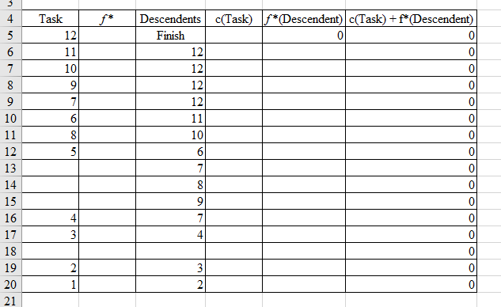
Project Management

Slide 30
Dynamic Programming
So, what is dynamic programming?
Rather than solving a large, complex problem…
Solving a series of smaller, simple problems
Where did it get its name?

