Slide 1
Dynamic Programming & Recursive Programming
BUAD 5042

Slide 2
Programming a DP Solution
Programming backwards recursion
Topological sort
Integrated/implicit topological sort
Recursion
Examples of recursive functions
Another approach for some problems
Solve by state and stage
Knapsack solutions
DP solutions versus HA and enumeration

Slide 3
Programming a DP Solution
Programming backwards recursion
Topological sort
Integrated/implicit topological sort
Recursion
Examples of recursive functions
Another approach for some problems
Solve by state and stage
Knapsack solutions
DP solutions versus HA and enumeration

Slide 4
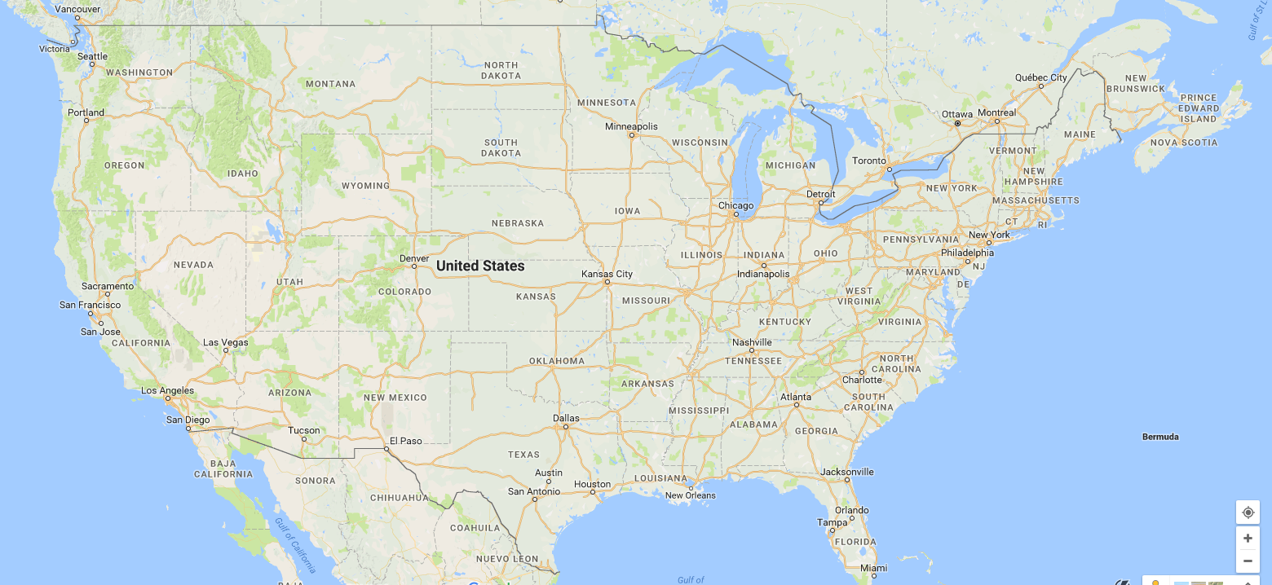
Shortest Distance: Wmbg to LA
DE
SL
851
St. Louis
904
878
449
498
Williamsburg
B
A
Oklahoma City
389
LR
1012
W
Barstow
677
504
OK
LA
115
Albuquerque
319
Little Rock
120
1340
SD
1358
Dallas
D
In what order can we make the computations?
Topological sort, linearization
LA
B
SD
D
A
DE
OK
SL
LR
W

Slide 5
Topological Sort Method
Explicit topological sort
Compute f*() for locations in that order
Store f*() values in a variable
…to recall distances from all locations
… for future computations
You’ll have the optimal distances you need at each step of the path
Implicit topological sort
Check which locations can be computed in next stage

Slide 6
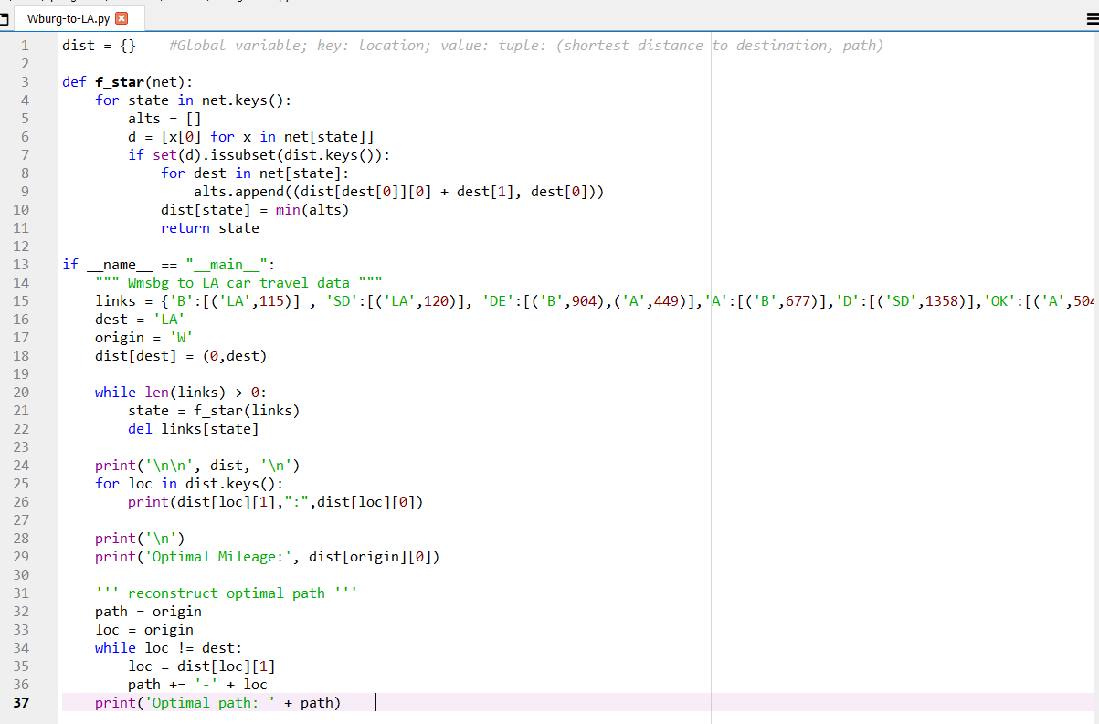
Implicit Topological Sort
Wburg-to-LA.py (From Lesson 7)
Keep track only of next best location to visit

Slide 7
Implicit Topological Sort
Wburg-to-LA.py (From Lesson 7)
f_star() computes shortest distances for locations whose downstream distances are all available—an implicit topological sort
Have all the immediate destinations from a point been computed?
Minimum is based on the 0-th element of the tuple
(mileage, path)

Slide 8
Implicit Topological Sort
Wburg-to-LA.py (From Lesson 7)
Initialize
Compute shortest distances from locations as long as locations
remain to compute

Slide 9
Programming a DP Solution
Programming backwards recursion
Topological sort
Integrated/implicit topological sort
Recursion
Examples of recursive functions
Another approach for some problems
Solve by state and stage
Knapsack solutions
DP solutions versus HA and enumeration

Slide 10
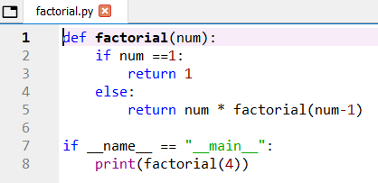
Recursive Programs
Factorials: n! = n×(n-1)×(n-2)× … ×1
Note that n! = n×(n-1)!
factorial.py

Slide 11
Recursive Programs
Recursive structure
main() factorial(4)
Stack Memory
factorial(4)
24
factorial(4) 4× factorial(3)
Function Calls
Function Returns
factorial(3)
6
factorial(2)
factorial(3) 3× factorial(2)
factorial(3)
factorial(2)
2
factorial(2) 2× factorial(1)
factorial(4)
main()
factorial(1)
1
factorial(1)

Slide 12
Recursive Calls and the Stack
The (memory) stack stores the state of a computer program (or function) when another function call interrupts it
… as when a function recursively calls itself
The function can’t finish until the subsequent call is completed
Examples:
Factorial computation
Dynamic programming

Slide 13
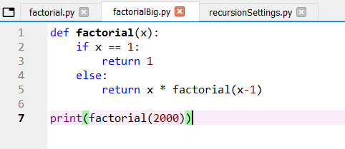
Stack Size and Recursive Limit
Download from:
Blackboard
This is a big problem…

Slide 14
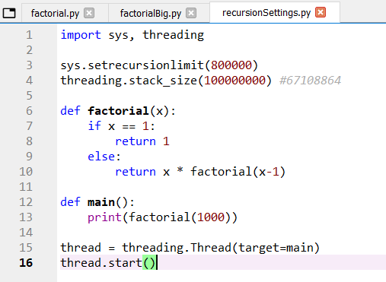
Stack Size and Recursive Limit
The solution…

Slide 15
“Forward” DP Solution
Destination: Los Angeles
DE
SL
851
St. Louis
904
878
449
498
Williamsburg
B
A
Oklahoma City
389
LR
1012
W
Barstow
677
504
OK
LA
115
Albuquerque
319
Little Rock
120
1340
SD
1358
Dallas
D

Slide 16
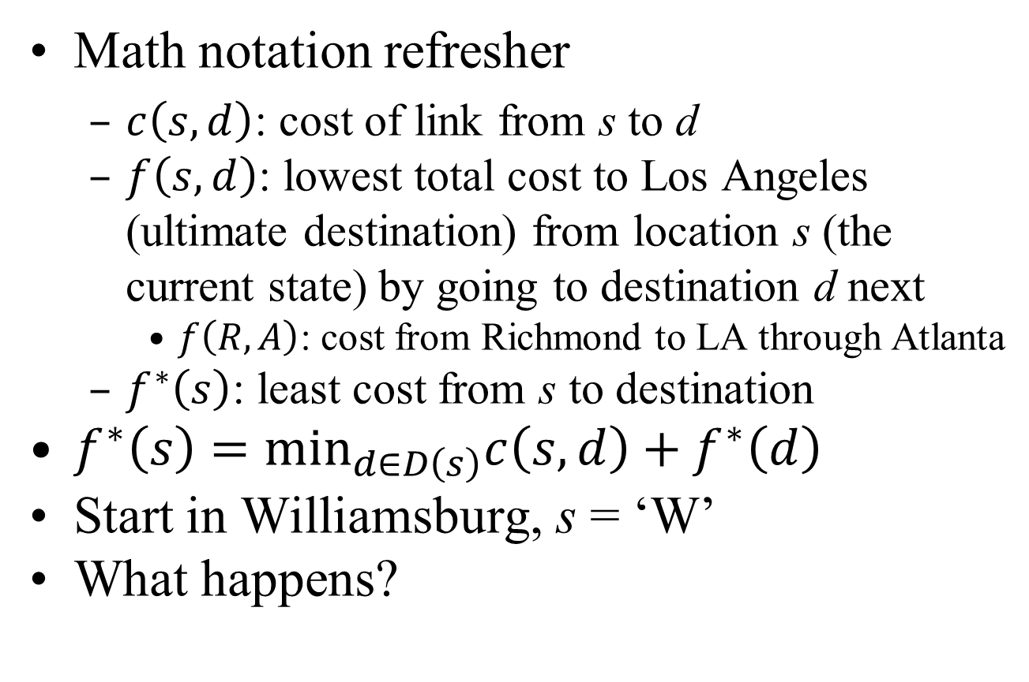
Introduction Problem
Math notation refresher
$c\left(s,d\right)$: cost of link from s to d
$f\left(s,d\right)$: lowest total cost to Los Angeles (ultimate destination) from location s (the current state) by going to destination d next
$f\left(R,A\right)$: cost from Richmond to LA through Atlanta
$f^{∗}\left(s\right)$: least cost from s to destination
$f^{∗}\left(s\right)={\text{min}}_{d∈D\left(s\right)}{c\left(s,d\right)+f}^{∗}\left(d\right)$
Start in Williamsburg, s = ‘W’
What happens?

Slide 17
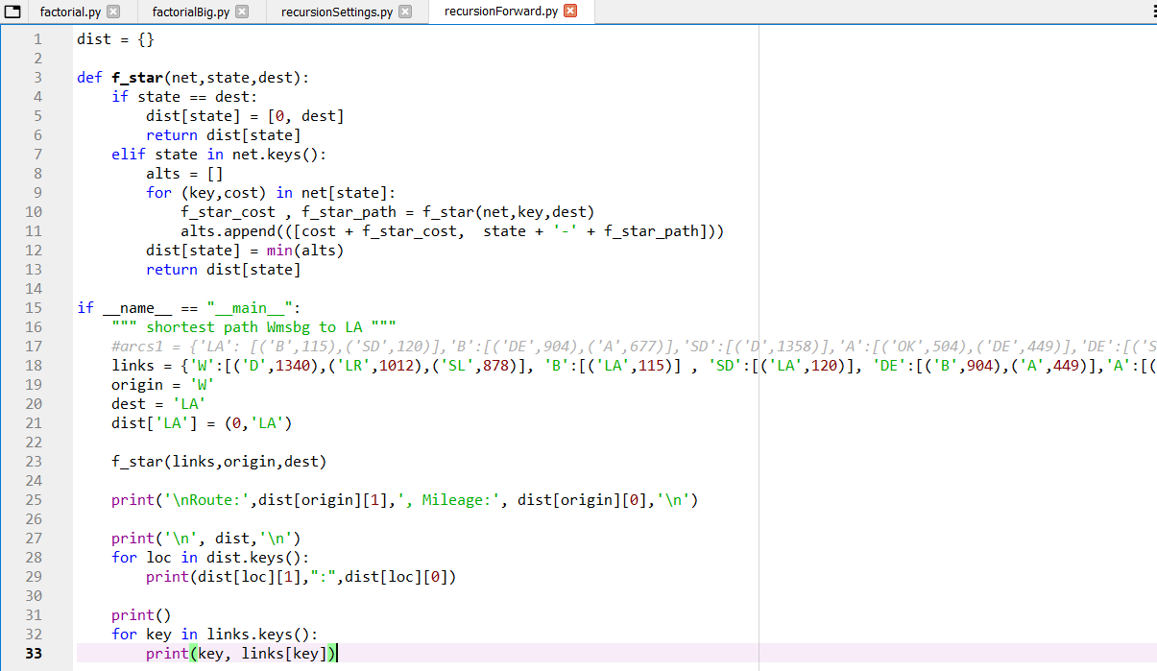
“Forward” DP Solution
Recursive algorithm… in forward direction
recursionForward.py
Recursion: the function calls itself

Slide 18
Recursion: What’s Going On?
f_star(net,′W′,dest)
f_star(net,′D′,dest)
f(W,D)
f(W,LR)
f(W,SL)
f*(W)
f*(D)
f_star(net,′SD′,dest)
f*(SL)
f*(SD)
f(SL,DE)
f(SL,OK)
f_star(net,′SD′,dest) = 120
f*(OK)
f_star(net,′LR′,dest)
f*(DE)
f(DE,B)
f(DE,A)
f(OK,A)
Already have f*(B)
f*(A)
Already have f*(A)
f*(LR)
f_star(net,′OK′,dest)
f(LR,OK)
f(LR,D)
f*(OK)
f_star(net,′A′,dest)
Already have f*(SD)
f*(A)
f_star(net,′B′,dest)
f*(B)
f_star(net,′B′,dest) = 115

Slide 19
Programming a DP Solution
Programming backwards recursion
Topological sort
Integrated/implicit topological sort
Recursion
Examples of recursive functions
Another approach for some problems
Solve by state and stage
Knapsack solutions
DP solutions versus HA and enumeration

Slide 20
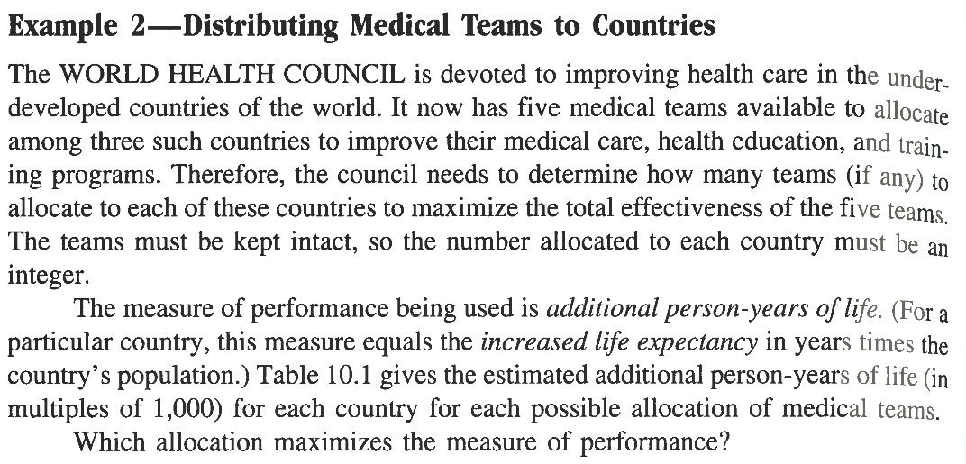
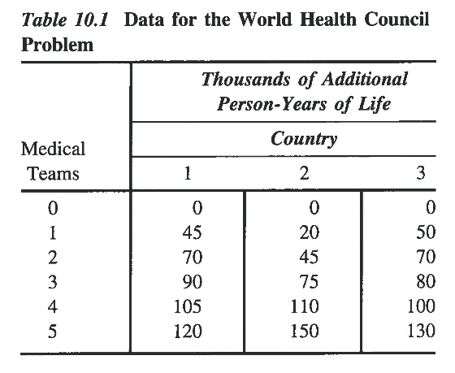
Hillier and Lieberman Example
World Health Council, Chpt. 10, pg. 434
Place 5 doctors in countries to cause the greatest increase in lifespan

Slide 21
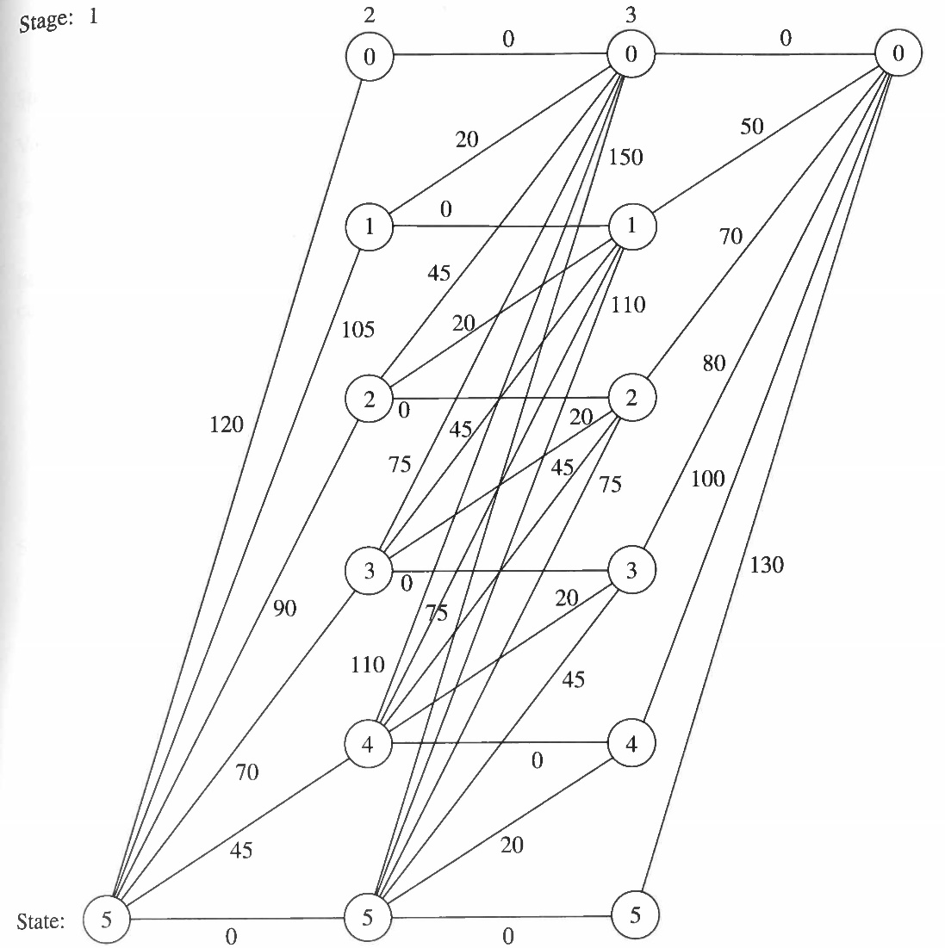
Hillier and Lieberman Example

Slide 22
Simplified World Health Example
3 doctors, 3 countries
Analyze by stage (by country), state (# Drs remaining)
Stage (Country)
1
2
3
Finish
0
0
0
0
0
0
90
20
50
State (number Drs remaining)
45
75
70
80
1
0
1
1
20
70
45
2
2
0
2
45
20
3
3
0
3
0
3

Slide 23
Programming a DP Solution
Programming backwards recursion
Topological sort
Integrated/implicit topological sort
Recursion
Another approach for some problems
Solve by state and stage
Knapsack solutions
DP solutions versus HA and enumeration
Examples of recursive functions

Slide 24
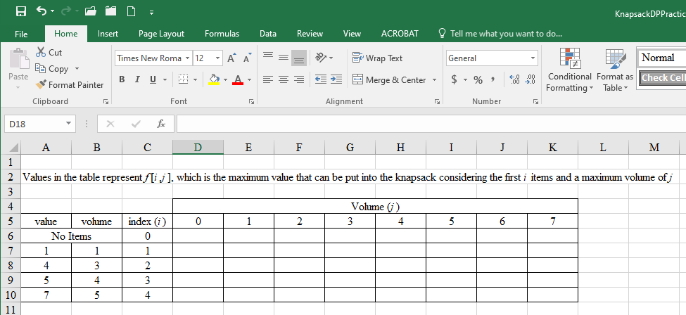
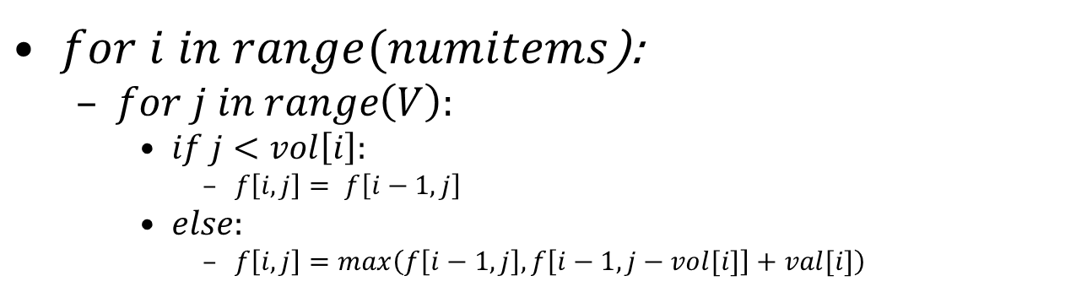
Knapsack DP Solution
$for i in range(numitems$):
$for j in range\left(V\right):$
$if j<vol\left[i\right]:$
$f\left[i,j\right]= f\left[i−1,j\right]$
$else:$
$f\left[i,j\right]=max\left(f\left[i−1,j\right],f\left[i−1,j−vol[i]\right]+val[i]\right)$

Slide 25
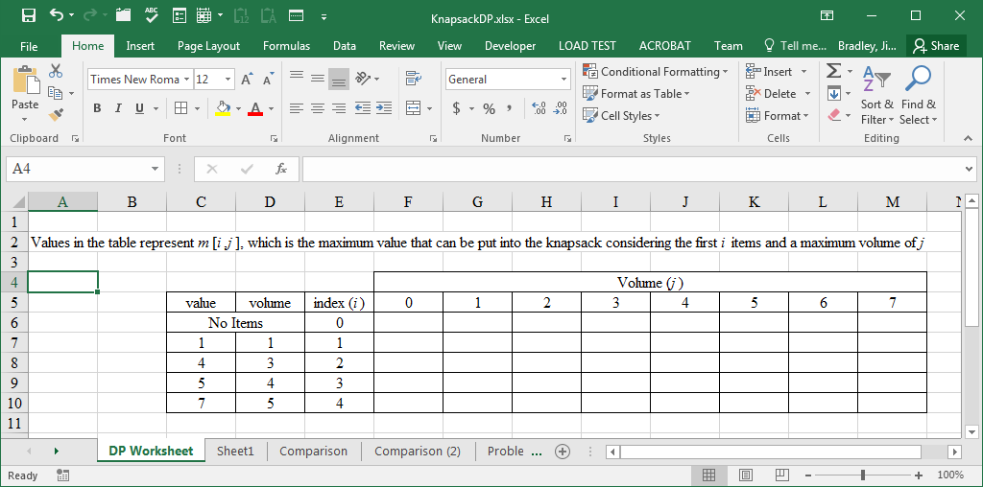
Knapsack DP Solution
f(i,j) when item can’t be loaded
That is, j – vol(i) < 0
f(i,j) = f(i-1,j)

Slide 26
Knapsack DP Solution
f(i,j) selects maximum of
f(i-1,j)
f(i-1,j – vol_{i}) ) + val_{i}

Slide 27
Knapsack DP Solution
f(n,knapsack_cap) selects maximum of
f(n-1,knapsack_cap)
f(n-1,knapsack_cap – vol_{n}) + vol_{n}

Slide 28
Knapsack DP Solution
O(nV) running time
n items
Volume V

Slide 29
Knapsack DP Solution
A programming solution
Create a list of lists to replicate the matrix in the Excel solution
Apply the Excel method to populate the matrix
Characteristics
Obtains optimal solution
Consumes vast memory for large problems

Slide 30

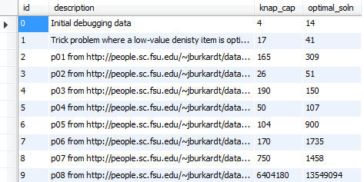

Knapsack DP Solution
Another programming solution
Rather than keep entire matrix in memory, just remember the last row…
Need to keep track of items in the knapsack
Characteristics
Obtains optimal solution
Still takes considerable memory: about 3 GB for Problem 9

Slide 31
Knapsack DP Solution
A even better programming solution
Recursive function
You don’t need to compute all the quantities in the Excel matrix
Characteristics
Obtains optimal solution
Possibly less memory requirements
Possible stack issues

Slide 32
Knapsack DP Solution
Even better solution: recursive function
Python function to compute optimal solution for f(item_index,volume) = f(i,j)
In main() program, call f(n,knapsack_cap)
n = number of items, consecutive indexing

Slide 33
Heuristic Algorithms versus DP
Optimal?
Enumeration: yes
DP: yes
Heuristic Algorithm: no
Computation time:
Except for very small problems…
Enumeration > DP > Heuristic Algorithm
Heuristic Algorithm: negligible
Heuristic algorithms gain advantage as problem size increases

Slide 34
Enumeration vs DP vs Heuristics
AMD Ryzen 9 3.8GHz, 12-core CPU

Slide 35
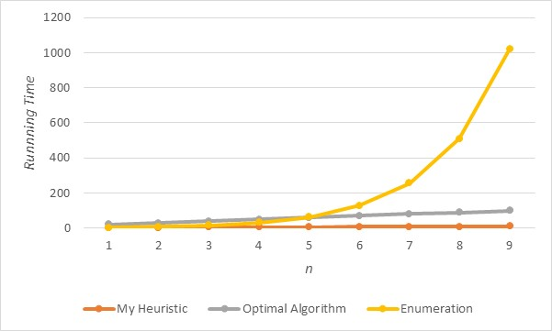
Enumeration versus DP
From previous lecture
For Problem 9
Enumeration much slower for P9

