Slide 1
Final Project Adder/Subtractor
Meng Wai Chan
CSc 343

Slide 2
Objective
The objective of this final test project is to evaluate our ability to use LPM modules generated from Quartus to design and simulate digital computational circuits. The tasks consist of creating a Static Random-Access Memory (SRAM) using LPM with 16 words and 32 bits. Create a Add/Sub digital circuit using LPM to handle 32 bit addition and subtraction using data from a Memory Initialization File (MIF) to execute and test if our circuit is functioning.

Slide 3
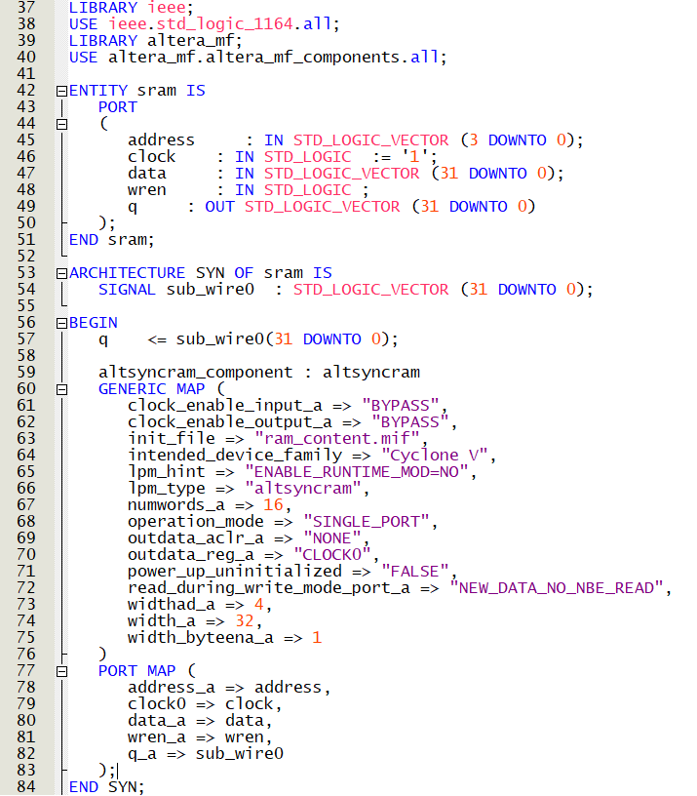
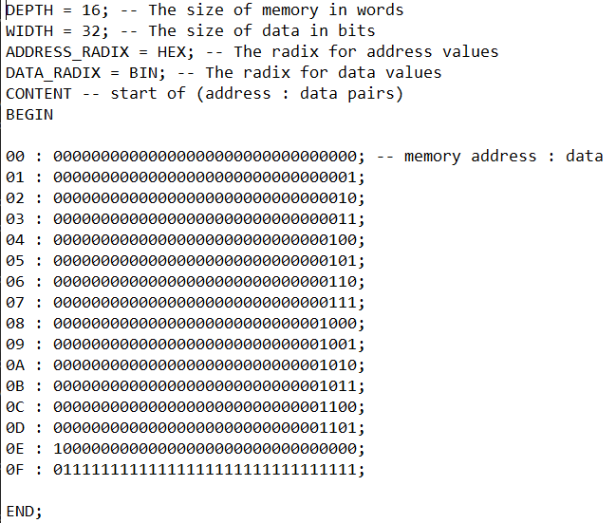
SRAM

Slide 4
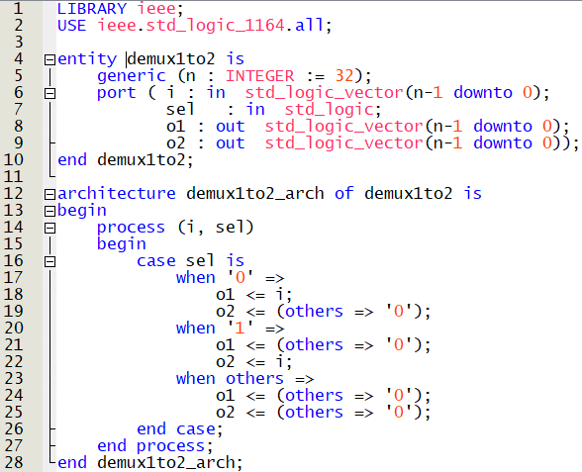
Demux 1 to 2

Slide 5
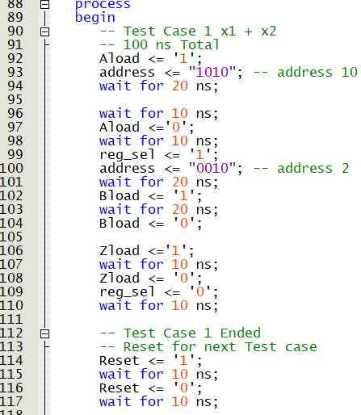
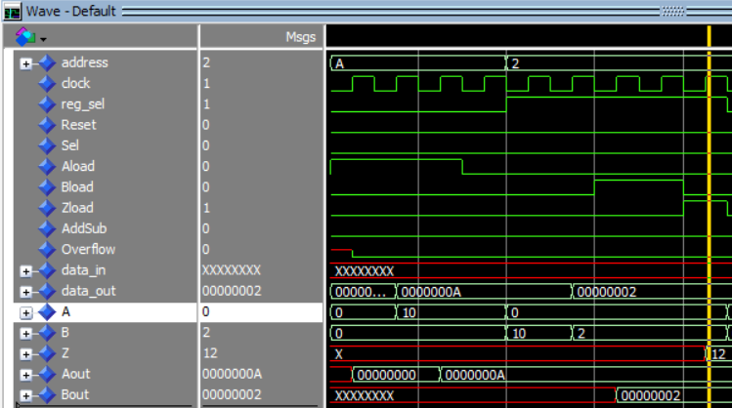
Addition

Slide 6
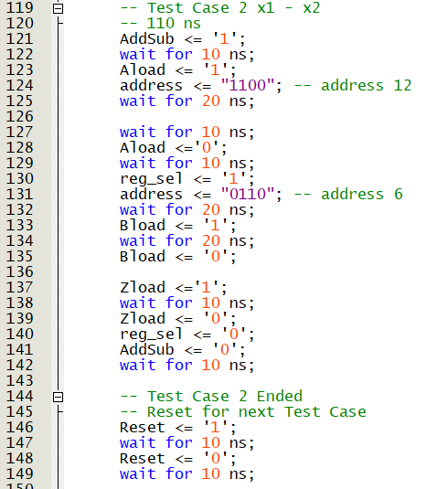
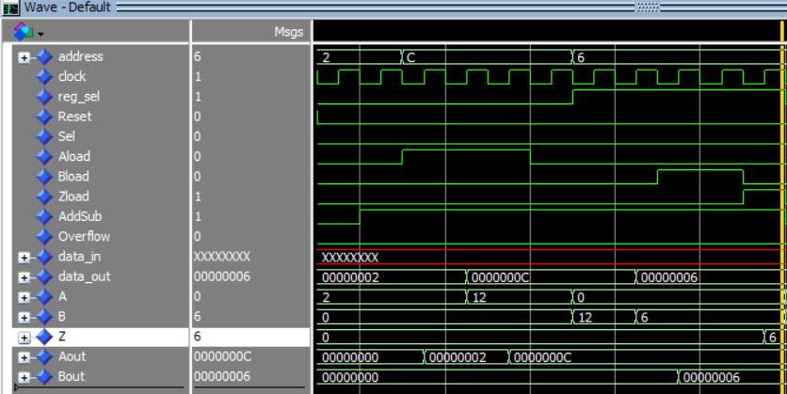
Substract

Slide 7
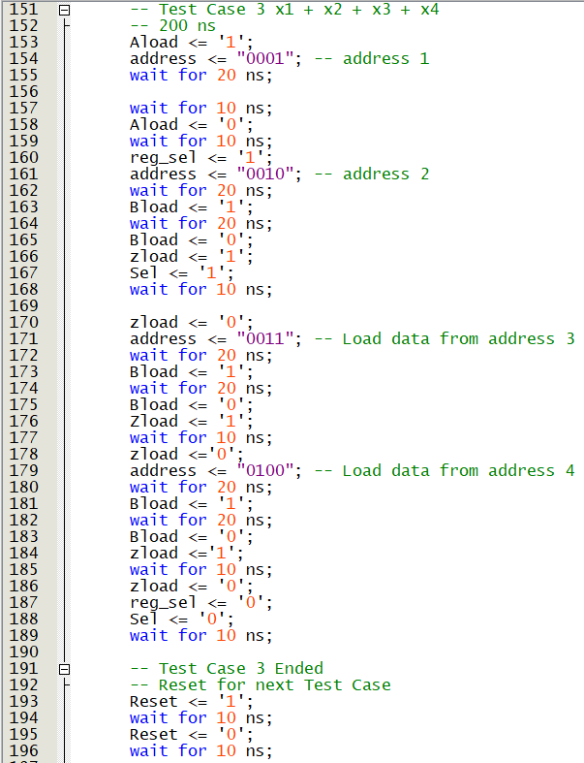
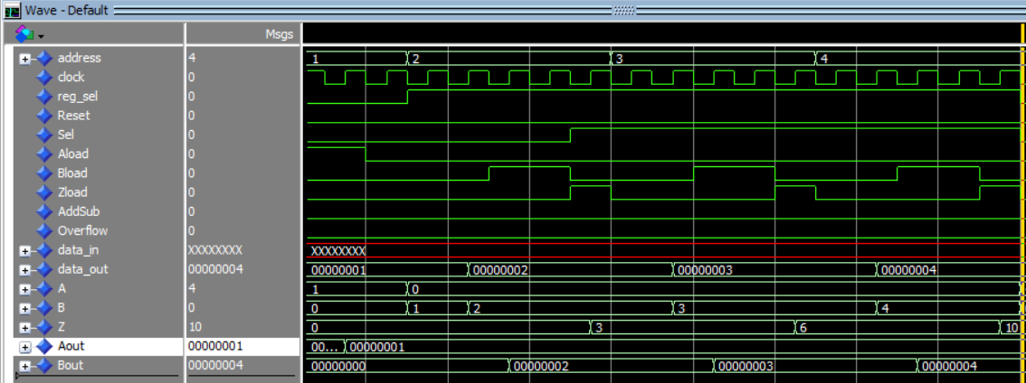
Cumulative Add

Slide 8
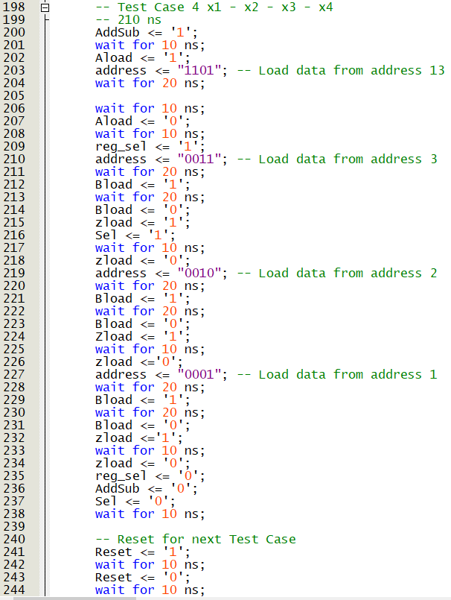
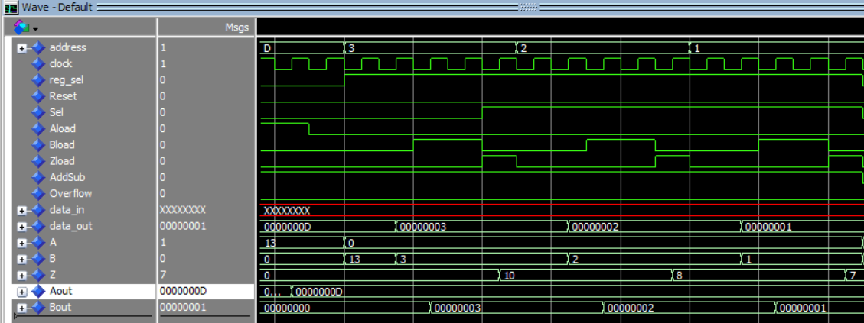
Cumulative Subtract

Slide 9
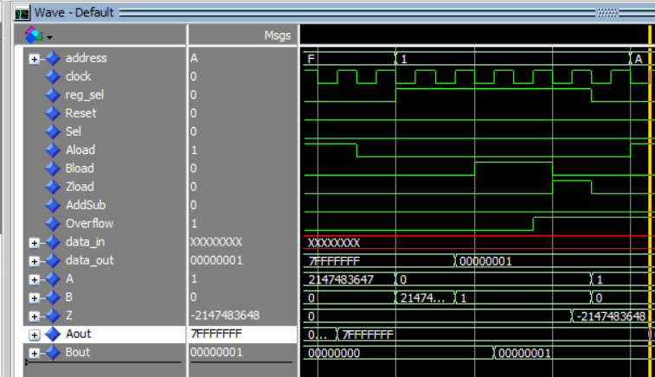
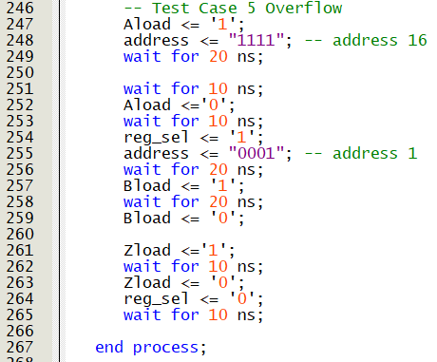
Overflow

Slide 10
Thank you!

