Slide 1
Take Home Test
Dot Product Optimization
Meng Wai Chan
Professor Gertner

Slide 2
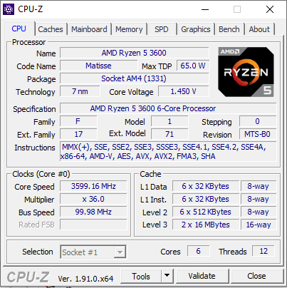
CPUID
CPU Processing Capabilities
My processor support MMX(+), SSE, SSE2, SSE3, SSSE3, SSE4.1, SSE4.2, SSE4A, x86-64, AMD-V, AES, AVX, AVX2, FMA3, and SHA instructions

Slide 3
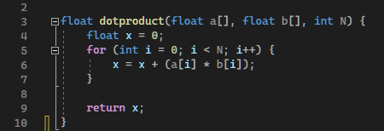
D0t Product Function

Slide 4
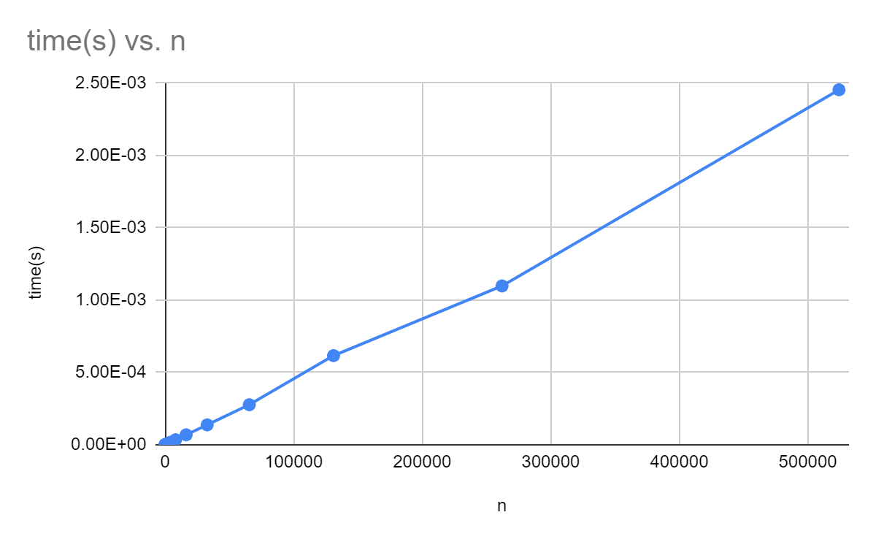
Conventional Runtime
n | time(s)
8 | 3.00E-07
16 | 2.00E-07
32 | 2.00E-07
64 | 3.00E-07
128 | 6.00E-07
256 | 1.10E-06
512 | 2.20E-06
1024 | 4.40E-06
2048 | 8.70E-06
4096 | 1.72E-05
8192 | 3.48E-05
16384 | 6.89E-05
32768 | 1.38E-04
65536 | 0.0002769
131072 | 0.0006163
262144 | 0.001098
524288 | 0.0024542

Slide 5
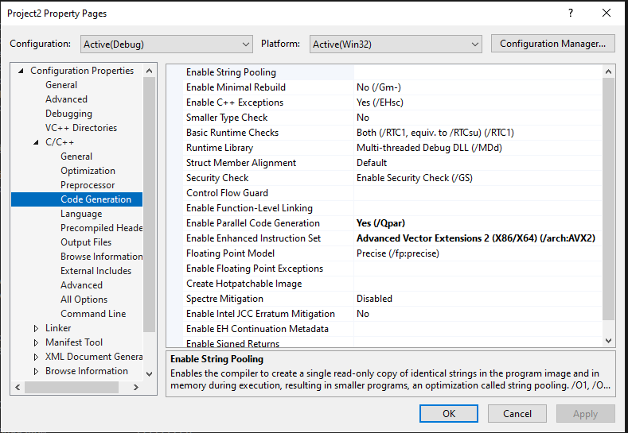
Automatic Parallelization Automatic Vectorization
We changed the settings within Visual Studio to activate automatic parallelization and vectorization.

Slide 6
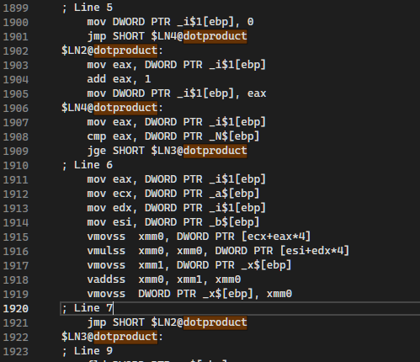
Assembly Code After Automatic Parallelization Automatic Vectorization

Slide 7
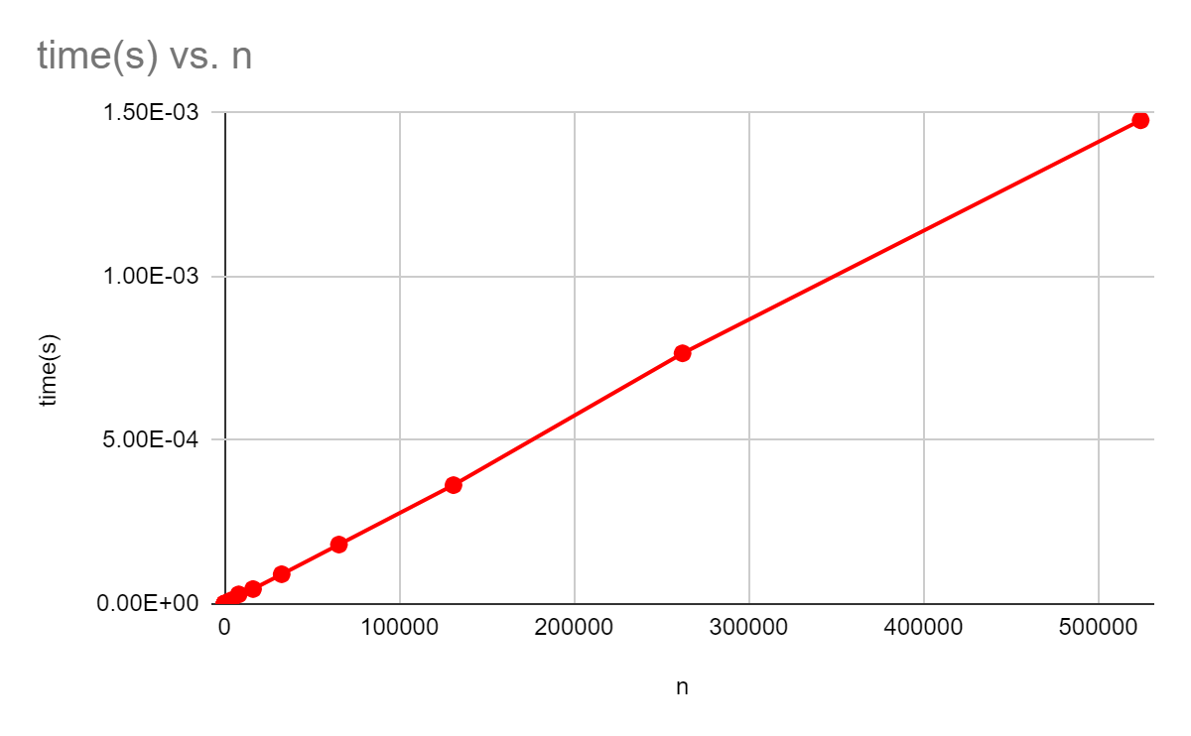
AVX2 Runtime
n | time(s)
8 | 4.00E-07
16 | 1.00E-07
32 | 4.00E-07
64 | 3.00E-07
128 | 5.00E-07
256 | 8.00E-07
512 | 1.50E-06
1024 | 2.90E-06
2048 | 5.80E-06
4096 | 1.14E-05
8192 | 2.93E-05
16384 | 4.55E-05
32768 | 9.08E-05
65536 | 0.0001815
131072 | 0.000363
262144 | 0.0007657
524288 | 0.0014775

Slide 8
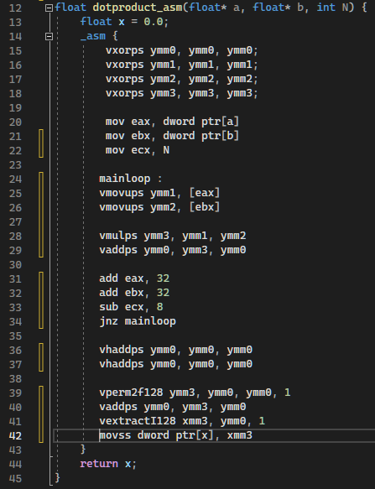
Manual Assembly Optimization
We optimize it by using our own assembly code to compile and generate a more efficiently as you can see from the graph below, by fixing the code generated by AVX2.

Slide 9
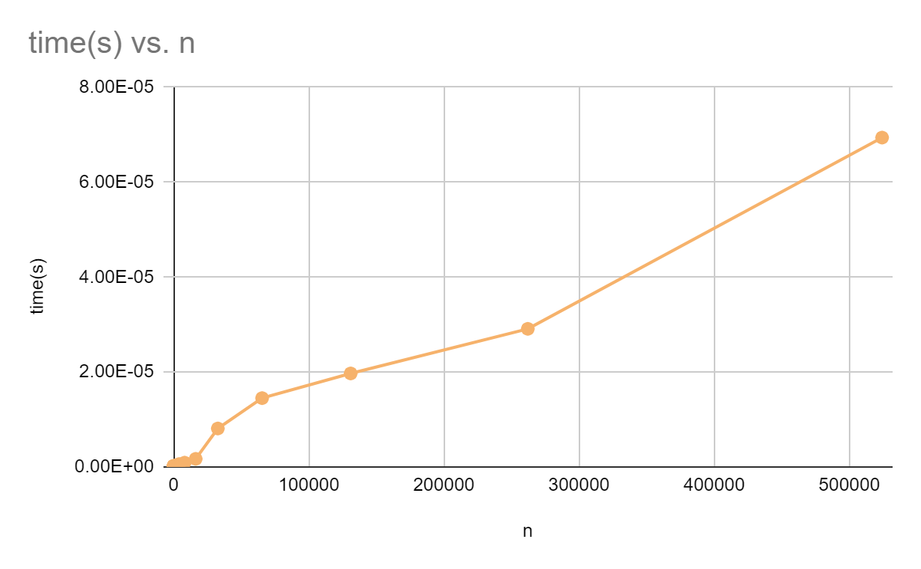
Manual Assembly Runtime
n | time(s)
8 | 2.00E-07
16 | 2.00E-07
32 | 2.00E-07
64 | 2.00E-07
128 | 1.00E-07
256 | 2.00E-07
512 | 1.00E-07
1024 | 2.00E-07
2048 | 3.00E-07
4096 | 6.00E-07
8192 | 9.00E-07
16384 | 1.70E-06
32768 | 8.10E-06
65536 | 1.45E-05
131072 | 1.97E-05
262144 | 2.91E-05
524288 | 6.94E-05

Slide 10
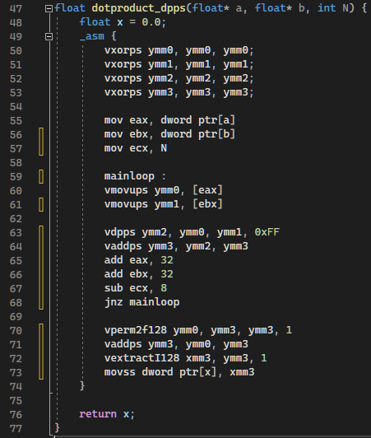
DPPS Optimization
We optimized the dot product assembly code using the DPPS vector instruction.

Slide 11
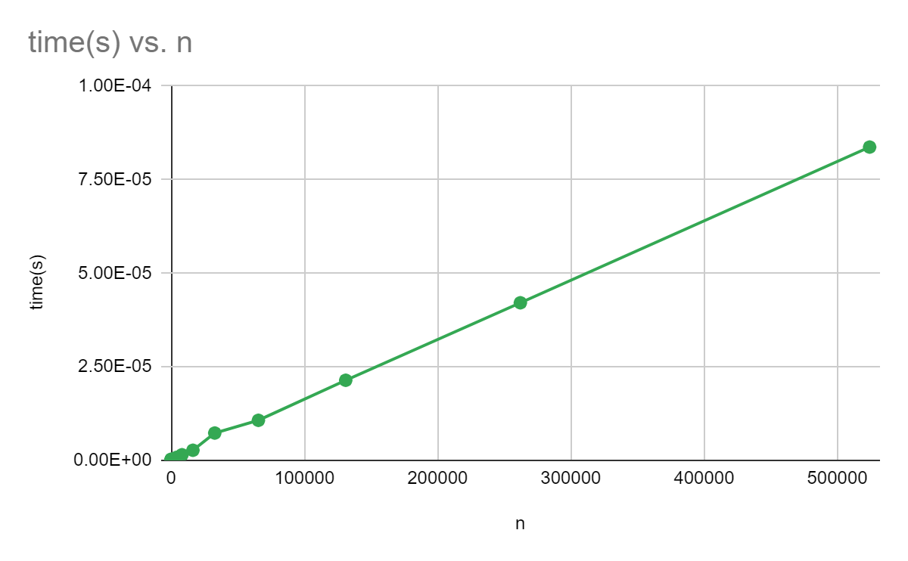
DPPS Runtime
n | time(s)
8 | 2.00E-07
16 | 3.00E-07
32 | 1.00E-07
64 | 1.00E-07
128 | 1.00E-07
256 | 2.00E-07
512 | 2.00E-07
1024 | 3.00E-07
2048 | 4.00E-07
4096 | 8.00E-07
8192 | 1.50E-06
16384 | 2.70E-06
32768 | 7.30E-06
65536 | 1.07E-05
131072 | 2.14E-05
262144 | 4.21E-05
524288 | 8.37E-05

Slide 12
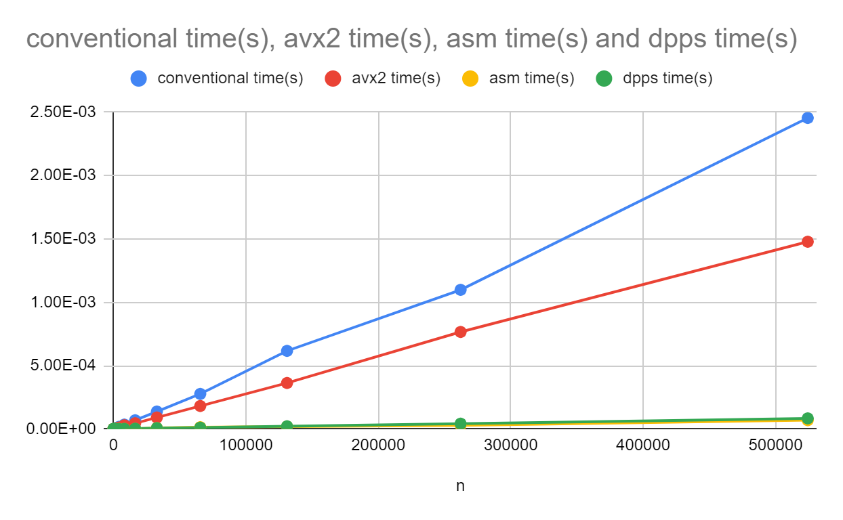
All Plots Comparison

Slide 13
Thank You!!

