Slide 1
01
Mercari Price Suggestion Challenge
Supervised Machine Learning Problem
Group 1 -- MAKE
Abinav Bharadwaj
Evan Kang
Meng Wang
Kami Wu
Machine Learning II

Slide 2
02
Agenda
Evaluation
Business Understanding
Data
Understanding
Data
Preparation
Modeling
Deployment
Q&A

Slide 3
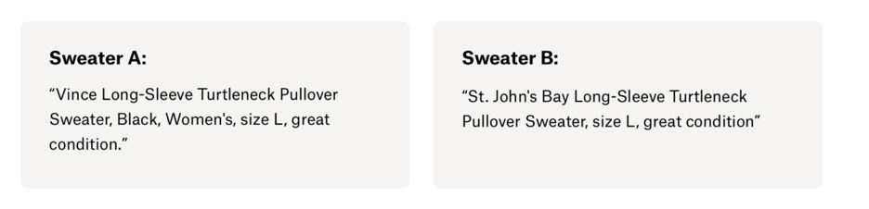
Business Understanding
03
Can you automatically suggest product prices to online sellers?
Problem
Consistent struggle gauging how much something is worth:
$335
$9.99
Purchase decisions affected by different attributes
Brand name
Item description
Sellers want goods to sell at a price as high as possible while remaining attractive to potential customers
Mercari would like to be able to offer pricing recommendations for the items people post on its community-powered shopping platform
Data Mining Solution
Algorithm that automatically suggests ideal prices, based on user-inputted text descriptions of their products

Slide 4
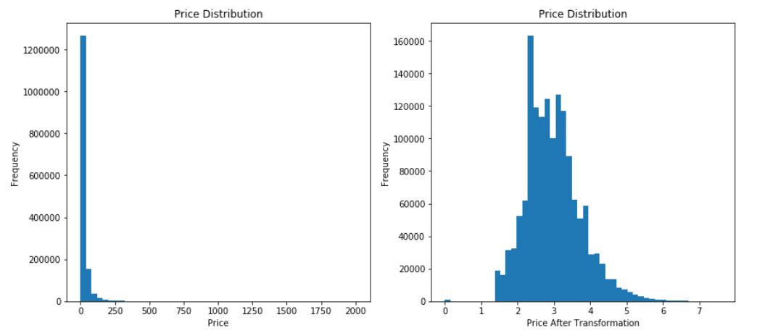
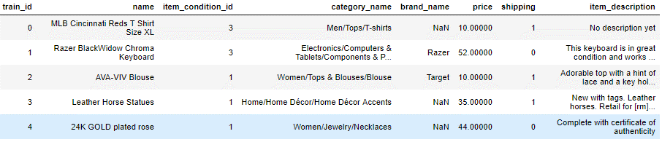
Data Understanding
04
We explore the data and get a better understanding of how to solve the business problem
Data Information
Price – log transformation to tackle the right skewed distribution
Source: Kaggle – The Mercari Price Suggestion Challenge
Size: 1,482,535 observations and 7 columns
Target variable: Price (std: 38.59)
Independent variables:
Categorical: item_condition, shipping
Numeric: price (target variable)
Text : name, category_name, brand_name, item description
Missing Values: brand_name, category_name, item_description
Shipping
55% of shipping fees paid by buyers
Prices of products when Buyers pay shipping is higher than those when Sellers pay shipping
Notes:
Data is obtained from Kaggle, The Mercari Price Suggestion Challenge. This data set has 1,482,535 observations and 7 columns.
All variables do not include null values, except category name and brand name. Brand name has 6327 null values, counted for 0.43 %, while brand name has 632682 null values, counted for 42.68%. Though item description does not have any null values, but it has about xx % of the column values having “no description yet”, which need to replace later with null.
As mentioned in the Business Understanding, the goal of this supervised machine learning, data mining problem is to create an algorithm that automatically suggest the right product prices, based on user-inputted text descriptions of their products, including details such as product category name, brand name, and item condition.
A sample instance from the dataset is {name:MLB Cincinnati Reds T Shirt Size XL, item_condition_id: 3, category_name: Men/Tops/T-shirts, brand_name: NA, price: 10, shipping:1, item description: No description yet}.
The target variable is price, ranging from $0 (free item) to $2,009, and it has a typical right skewed distribution with the mean of 26.73752 and the std 38.58607, thus it need to transform in a log format for later modeling process.
Another interesting finding is that almost 55 % of the products have shipping fee paid by buyers. However, it is interesting that the price when buyers pay shipping fees is higher than the price when sellers pay shipping, which violates common sense.

Slide 5
Data Preparation
05
05
Steps to prepare and format the data as needed for the model
Missing Values
Missing values in category_name, brand_name and item_description → re-categorize as ‘missing’
Split Data
Split data into training and test set → re-categorize categories in test set, but not in training data, as ‘missing’
Transform Variables
Numerical variables
Categorical variables
Text variables
price
Item_condition_id;
shipping; brand_name
Name
Category_name
Transform into sparse matrix
Item_description
Use normal logarithm to make right-skewed variable more normally distributed
Encode as numbers
Tokenize
73,000+ columns
Convert to dummy variables
Count appearance of each token
Calculate TF-IDF of each token
Dimension Reduction
Tried SVD to reduce dimensions, but dramatically increased RMSE → dimension reduction doesn’t work in our case

Slide 6
Modeling Process
05
06
Stacking linear regression model is the best model for our problem
Linear Regression
Tree-based Model
Neural Network
Ridge Regression
Light GBM
Controlled parameters
Activation function:
Hidden layer: ReLu
Output layer: Linear
Parameter: alpha
Light GBM is a gradient boosting framework that uses tree-based learning algorithm.
Best parameter: 0.9
Best RMSE: 27.9359
Tuned parameters
Parameters: learning rate, max depth, lambda
Parameters: layer, unit
Lasso Regression
Best parameters:
Layer = 1
Unit = 50
Best parameters:
Learning rate = 0.3
Max depth = 5
Lambda = 1
Parameter: alpha
Best parameter: 0.01
Best RMSE: 26.3330
Wide neural nets are better than deep neural nets
Best RMSE: 38.0820
Best RMSE: 28.4371
Stacking
Average
Weighted Average
Linear Regression
RMSE: 26.5660
RMSE: 26.0179
RMSE: 25.9960

Slide 7
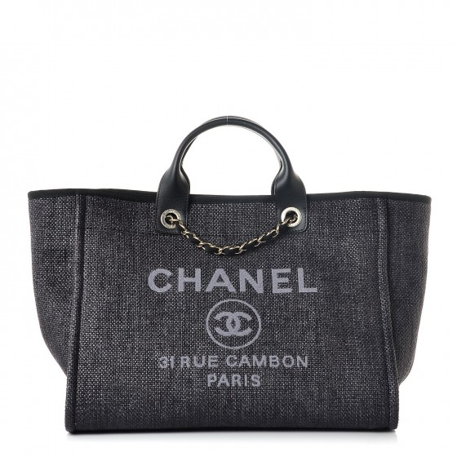
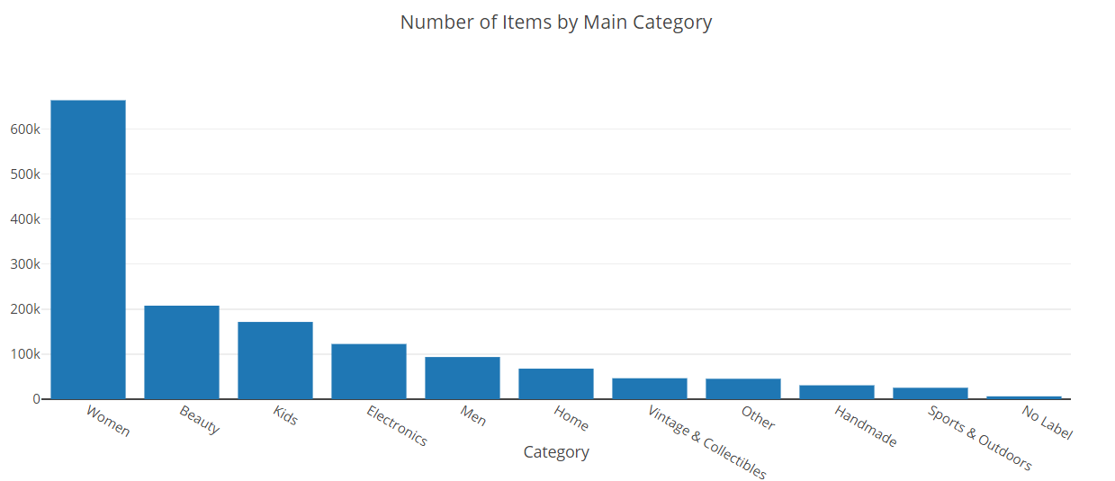
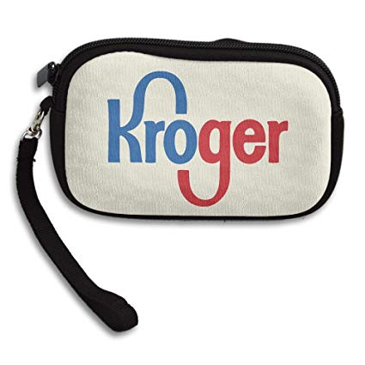
Evaluation
08
We suggest two different methods for Mercari to evaluate the model
Model Limitation
1
Imbalanced item amounts in main categories
2
Too many missing brand_name values
45% Rows
No Brand Names
70% of 4800 Brands
Appear < 15 times
Validation in Business
To use or not to use?
A/B Test
Offer a ±X% range for suggested price;
Count how many sellers use suggested price
Group A: suggest price; Group B: control group
Compare how quickly items in each group sold

Slide 8
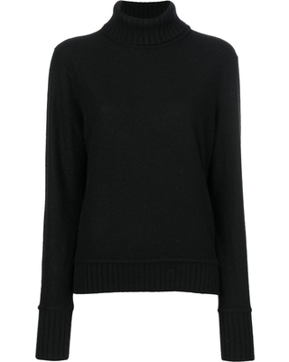
Deployment
09
We can recommend a price range for sellers to list their items
Issues and Risks
Lack of information regarding brand name –> misprediction?
Discernable and exploitable patterns in item valuation
Ethical Concerns
Misuse of data
Targeting Sellers with similar goods
Sale of data to 3rd parties
Deployment will increase the satisfaction of users on the platform, drive more traffic to the app and, in turn, increase profits for Mercari through platform taxation of all sold items
Suggested List Price: $320 - $350

Slide 9
10
Thank You
Q & A

