Slide 1


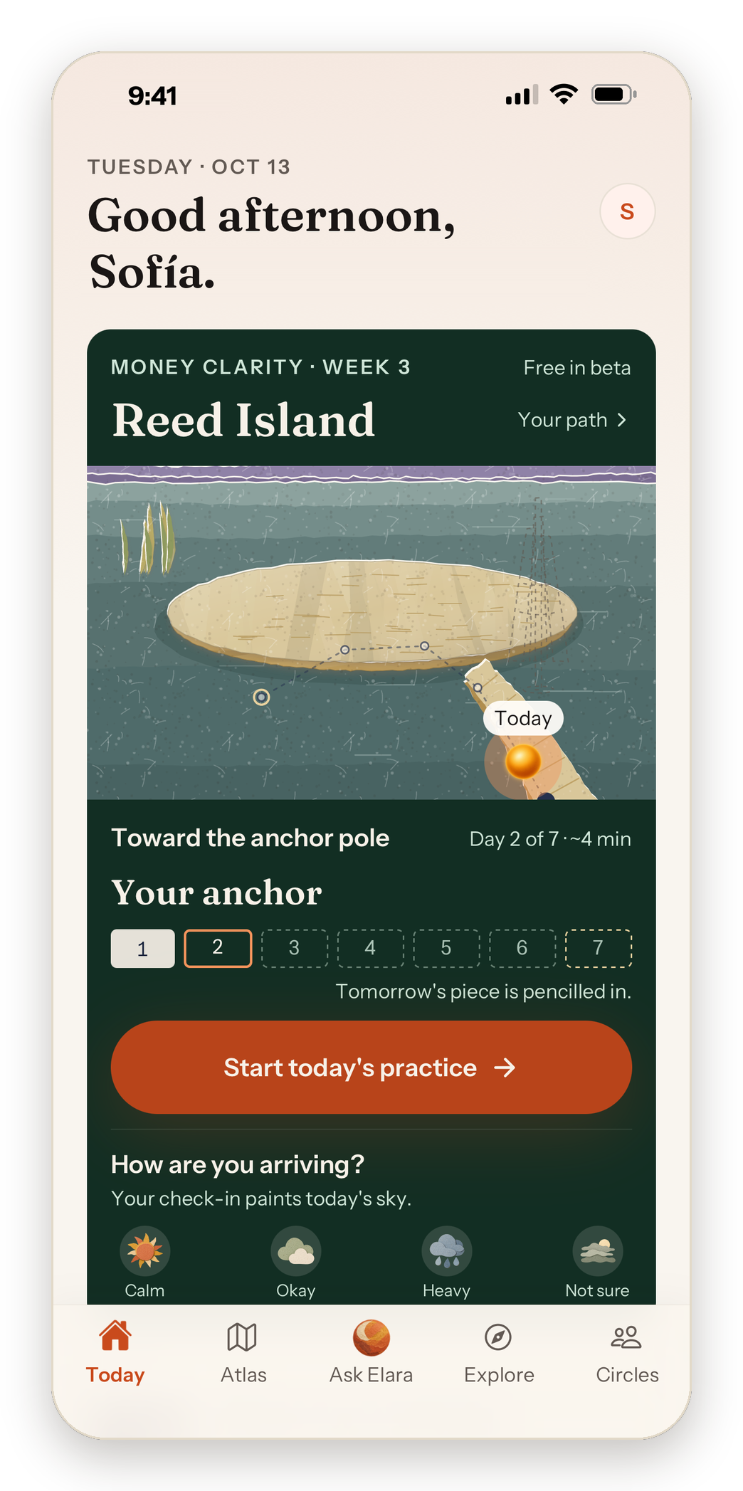
elara
Clarity
about what
to do next.
Spanish-first guidance for women.
One small step a day, with a path they can see.
Initially for Spanish-speaking / Latina women
October 2026 · In TestFlight · founding beta next
Illustrative product image · Today, sample member
Notes:
Today image: the TestFlight Today screen (October 2026) with a sample member name, initial and a clean status bar. Background: Reed Island, current design.

Slide 2

elara
The problem
02
She arrives
needing stability.
She doesn't lack information.
She needs to know what to do next.
Life at a crossroads
Family responsibility
“Estoy pasando por una encrucijada de vida, no tengo motivación, ni dirección, no se que hacer y me siento abrumada.”
“Aceptando la enfermedad de mi mamá, sentirme sola pensando que todo me tocaba a mí y miedo al futuro”
Open responses from Elara's target community, May 2026. Original Spanish.

Slide 3
elara
Demand signal
03
4,610
Money & financial
55%
Mental load
40%
women told us
what's weighing
on them.
39%
Habits & discipline
Life direction
39%
Anxiety & stress
35%
Money is the entry point. The need is broader.
May 2026 open survey, n = 4,610; up to 3 challenges each. Share of respondents. Target-community research, not a representative study.

Slide 4

elara
The insight
04
She doesn't need
more content.
She needs
somewhere to go.
Elara gives her one small step a day, and each step moves her somewhere she can see.
Mist Meadow · current design

Slide 5
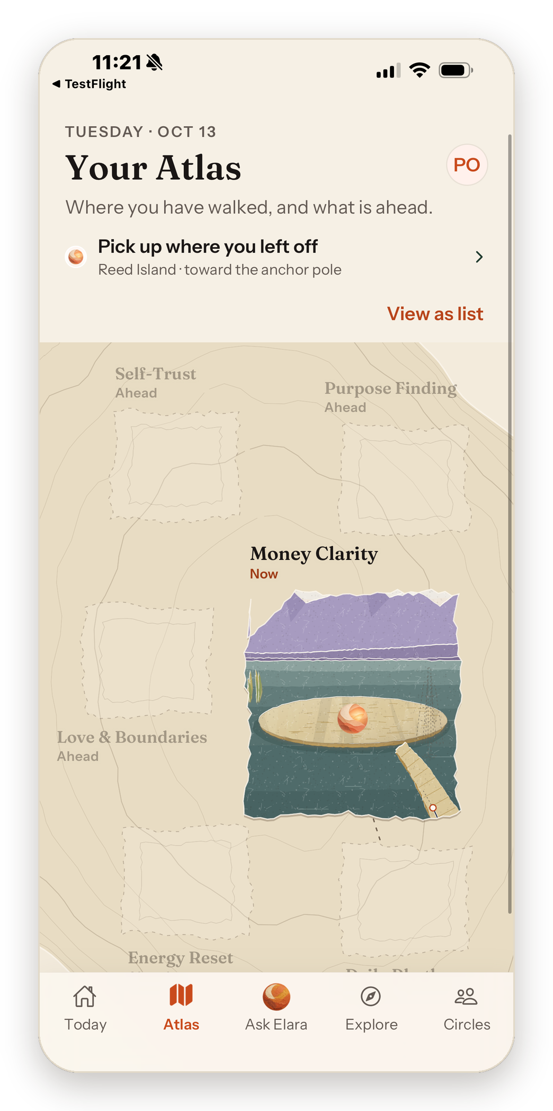
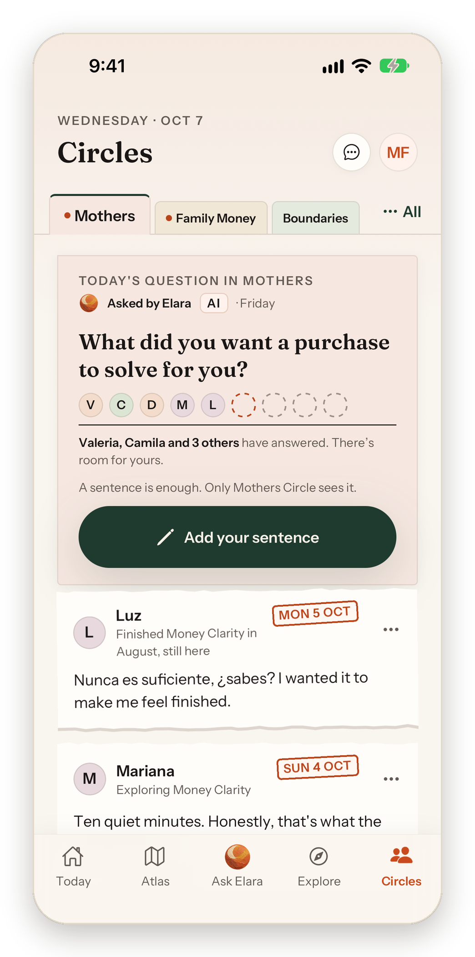
elara
How Elara works
05
A daily path,
with company
along the way.
Today gives her a next step. Atlas keeps the journey visible. Ask Elara and Circles help her work through it.
Today
Atlas
Circles
Where she is now
Where she has been
Women on the same path
Today and Atlas: in TestFlight · Circles: current design, in development
Notes:
Atlas: TestFlight screen, October 2026. Today: the same TestFlight screen with a sample member. Circles: current design.

Slide 6




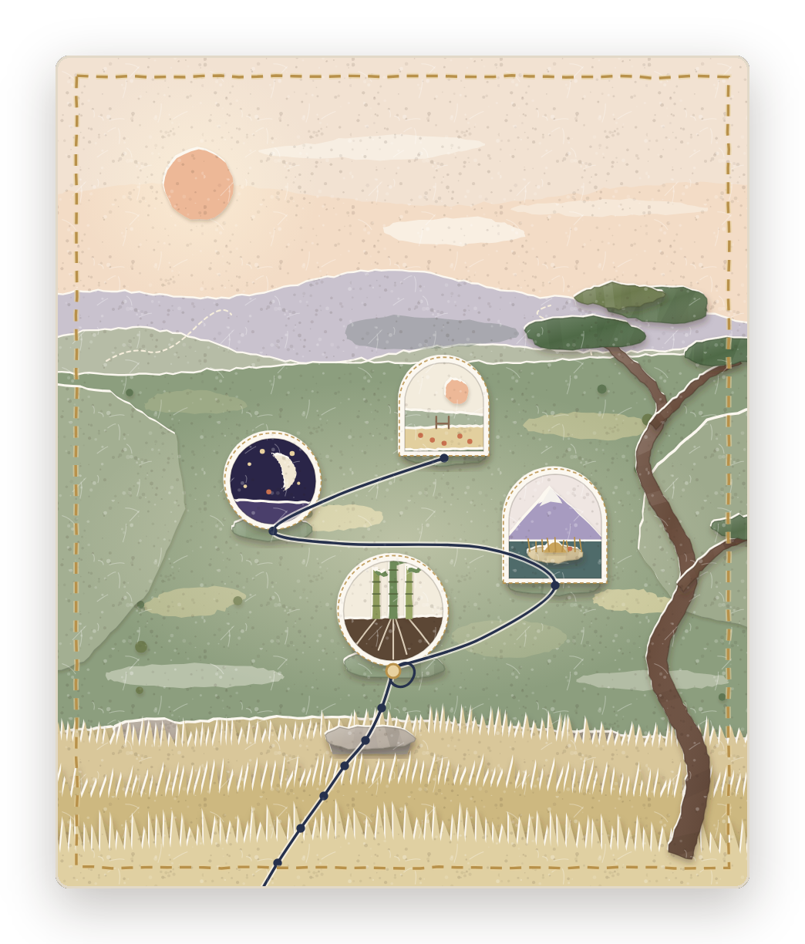
elara
Paths + Atlas
06
One path.
Five distinct worlds.
Money Clarity is designed as a five-week journey. Each week has a world; each day moves her through it.
World artwork is the current design. Week 3, Reed Island, is visible in TestFlight.
Five worlds of Money Clarity
Mist Meadow
Celestial Night
Reed Island
Guadua Roots
The Overlook
Week 1
Week 2
Week 3
Week 4
Week 5

Slide 7
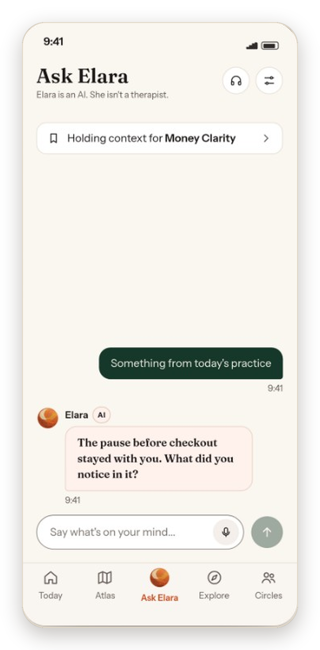
elara
Today + Ask Elara
07
She can pick up
where she left off.
Today keeps her place on the path and puts the next practice within reach.
Ask Elara can help her talk through the question with context from her ongoing journey.
Today image: TestFlight screen, sample member. How Ask Elara uses her context is product intent, not a measured outcome.
Today and the Ask Elara tab: in TestFlight · Ask Elara shown in current design

Slide 8
elara
Circles
08
Small private rooms
built around a
shared question.
Up to ten women. Their words stay with the room, and a weekly question gives them a reason to return.
No likes, no counts, no public feed.
Current design, in development · room formation and scale still being tested

Slide 9
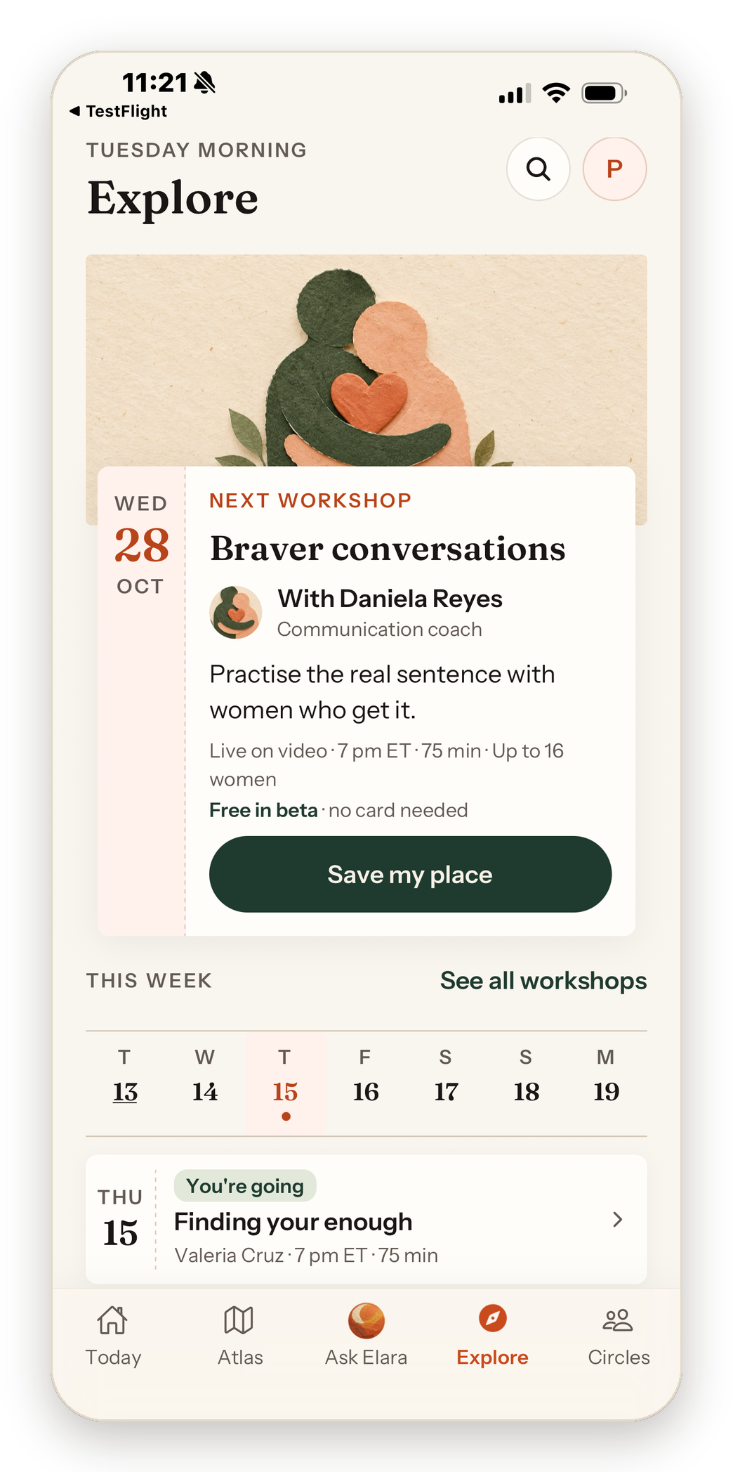
elara
Explore
09
Trusted voices,
in her daily routine.
Explore brings short guidance and live workshops alongside her path.
Next: browsing workshops day by day, with the next date shown when a day is empty.
Explore: in TestFlight · day-by-day browsing in development · hosts and events illustrative

Slide 10

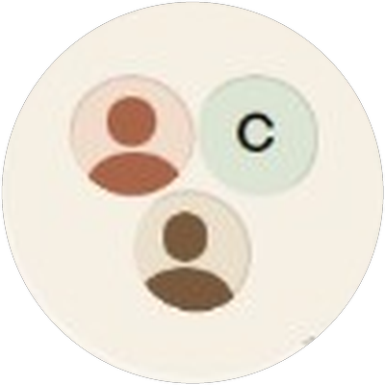


elara
Retention
10
She comes
back for
continuity,
not streaks.
HER WEEK
Life happens
EXPLORE
Voices she trusts
ASK ELARA
She talks it through
A reason
to return
CIRCLES
Women who know her story
TODAY · PATHS
She takes today's step
Each part gives her a reason to open Elara tomorrow. No points, no badges.
ATLAS
She sees how far she's come
Retention hypothesis to validate

Slide 11
elara
Distribution
11
Trust can become a distribution engine.
2.2M+
Alejandra's total audience across TikTok, YouTube, Instagram and other channels
We launch through her existing monthly challenges, not paid ads.
Audience & demand signals
Alejandra's prior offers · not Elara
80K
4,610
2,300
3,000
9,000
Instagram community
survey responses
beta email sign-ups
finance-guidance buyers
applications for $3K trip spots
Audience figures as reported in October 2026; survey from May 2026. Signals, not Elara revenue or users. Prior offers are Alejandra's, not Elara's.

Slide 12
elara
Business model
12
The core model
Survey intent, not conversion
A free first week,
then membership.
55%
The founding beta is free. The planned model keeps the first week of a path open; membership supports the deeper journey.
of May 2026 survey respondents indicated willingness to pay at some price
Yes: 27% + 28% = 55%
Later
Paid workshops and live creator experiences in Explore.
27% Yes, $10+/month 28% Yes, under $10/month
42% Maybe · 3% No
May 2026 survey, n = 4,610. Pricing and the paid offer are still to be validated.

Slide 13

elara
Team
13
Product builder
Audience builder
Kara “Mengxi”
Wang
Alejandra
Ramirez
Co-founder
Product, UX/design, founder-led build
Co-founder
Distribution, trust, community
Capital One, fintech, product design
About six years building trust
Product design consultant through the Techstars network
2.2M+ audience across channels
80K Instagram community
Zero-to-one product development
Prior purchases of her guidance
Leads product and design with contract developers
One builds the product. One brings the women and the trust.
Audience figures as reported in October 2026.

Slide 14
elara
The next proof
14
Clarity about
what to do next.
Mist Meadow
Celestial Night
Reed Island
Guadua Roots
The Overlook
In TestFlight
Next proof: activation, movement into Week 2, repeat use, and willingness to pay.

Slide 15
elara
Appendix · for diligence
A1
Positioning: a trusted voice, with
context that can keep growing.
What context changes
Approaches · conceptual
A money practice can acknowledge family obligations alongside her own goals for independence.
General-purpose AI tools
Adaptive · generic
General content libraries
Static · generic
Creator guides and courses
Static · culturally specific
Elara (intended)
Adaptive · culturally specific
Starting advantages
Creator trust
Cultural context
Adaptive AI
Community
An existing audience and community.
Built first for Spanish-speaking / Latina women.
Designed to carry context across guidance and reflection.
Shared circles alongside personal guidance.
Elara's intended position. Conceptual, not a performance comparison. From the September 2026 deck.

Slide 16
elara
Appendix · launch plan
A2
The next 90 days.
Bring the existing community into Elara in waves, then test whether the guided path gives them a reason to return.
Month 1
Month 2
Month 3
Invite and learn
Build continuity
Test the offer
Invite beta sign-ups in waves.
Pair a familiar challenge with Today, Atlas, and Circles.
Use evidence from the first cohorts to refine membership and the free-to-paid boundary.
Learn: onboarding completion and the first practice.
Learn: return visits and Week 2 entry.
Learn: repeat use and willingness to pay.
Engagement hypothesis to validate: monthly challenge → personal reflection → relevant next step → next challenge
Illustrative sequence. Existing email sign-ups are not active users. Timing, engagement and paid conversion remain to be validated.

