Slide 1
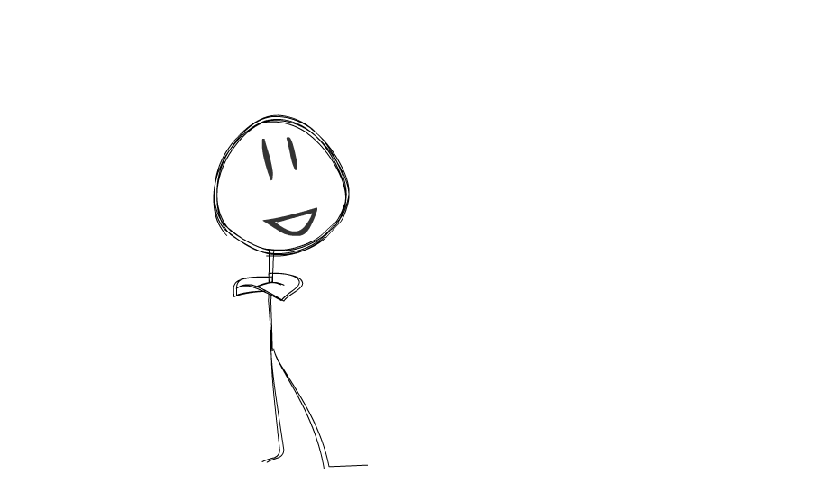
meet
Rahul

Slide 2
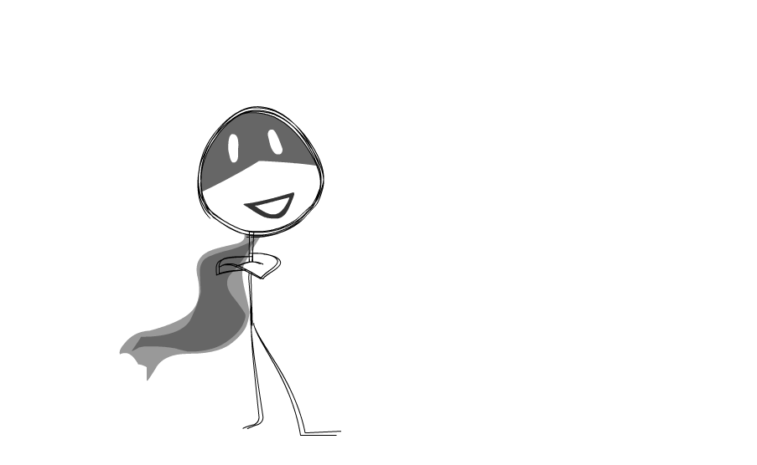
a.k.a

Slide 3
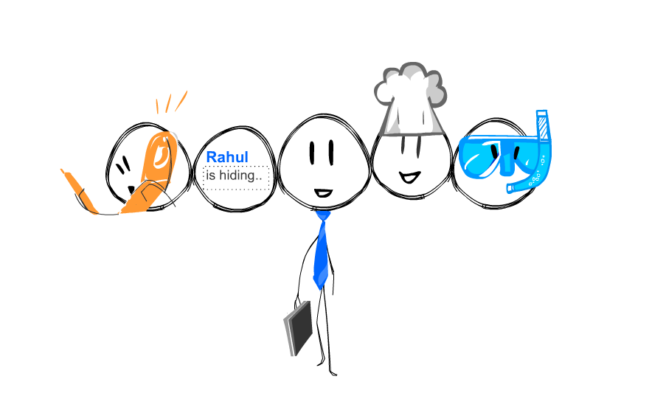
Mr. Multiple Profiles!

Slide 4
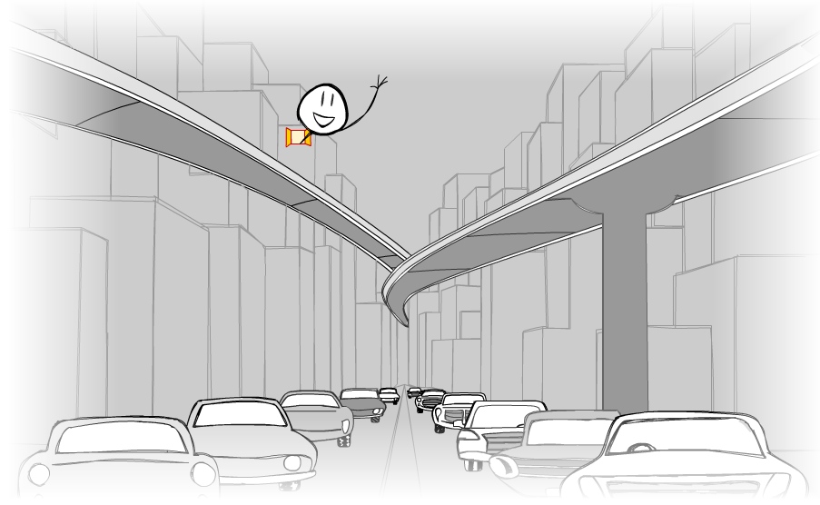
Rahul lives in a global village..

Slide 5
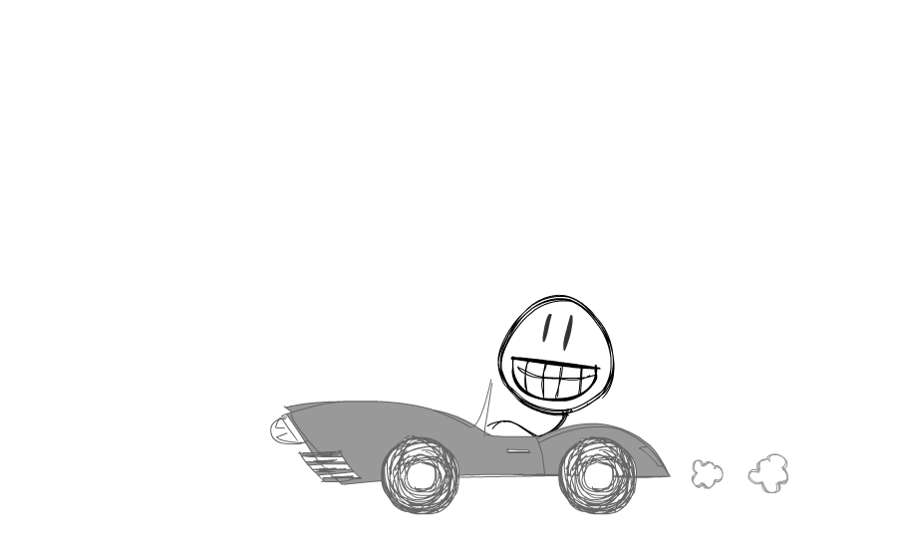
drives an eco friendly car..

Slide 6
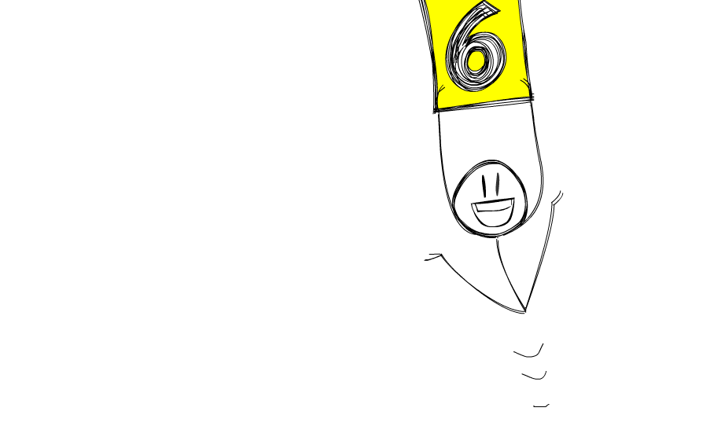
and is a great sport..

Slide 7
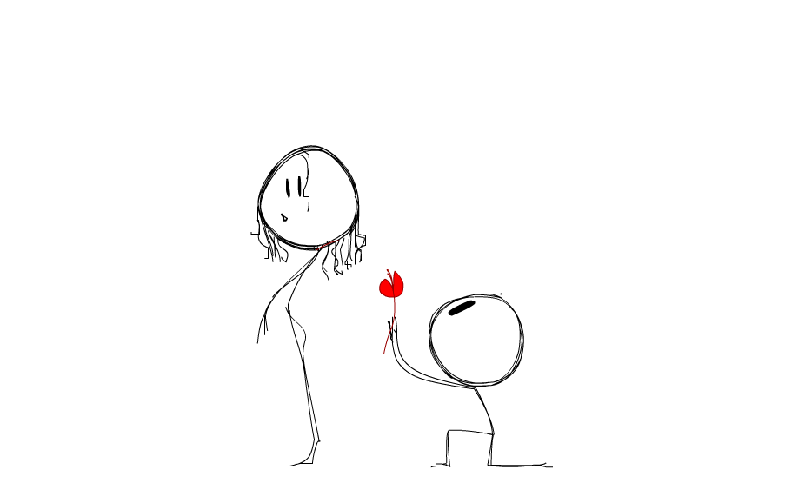
Rahul makes time for..

Slide 8
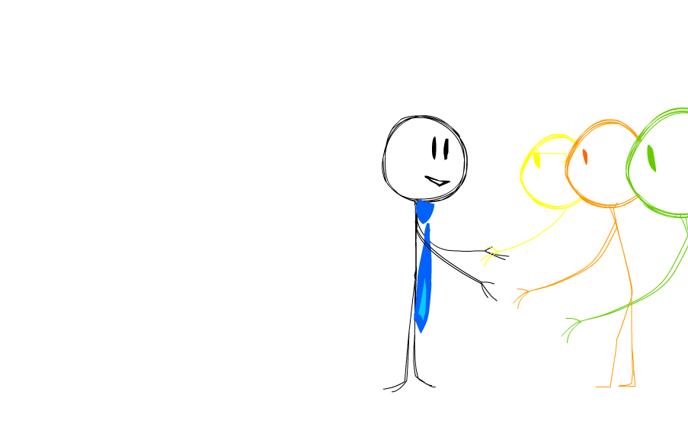
Rahul is great at..

Slide 9
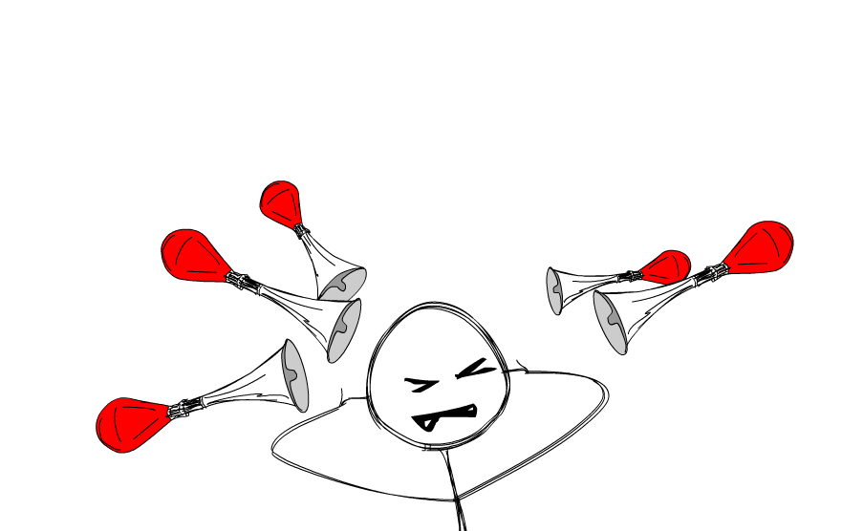
Rahul is lousy at..

Slide 10
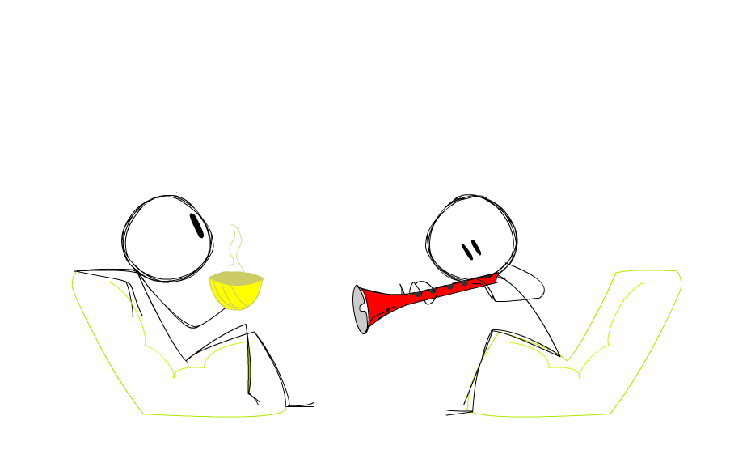
Rahul loves a good conversation!

Slide 11
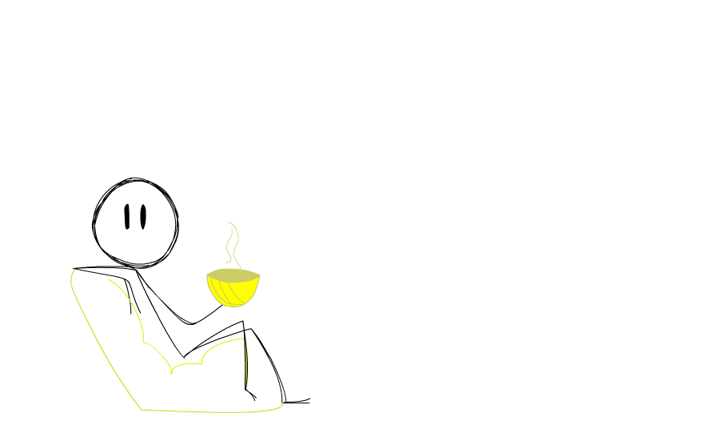
Would you like to start a conversation with
Rahul ?

Slide 12
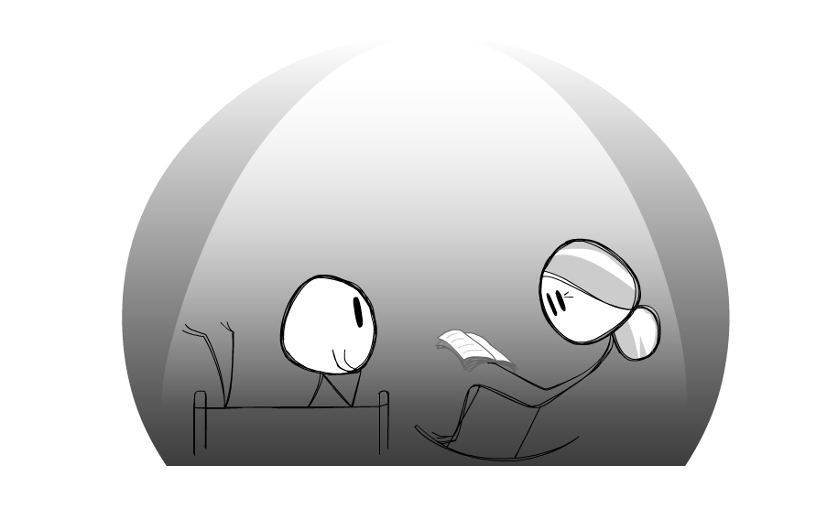
..tell him a story

Slide 13

..or chat with him

Slide 14
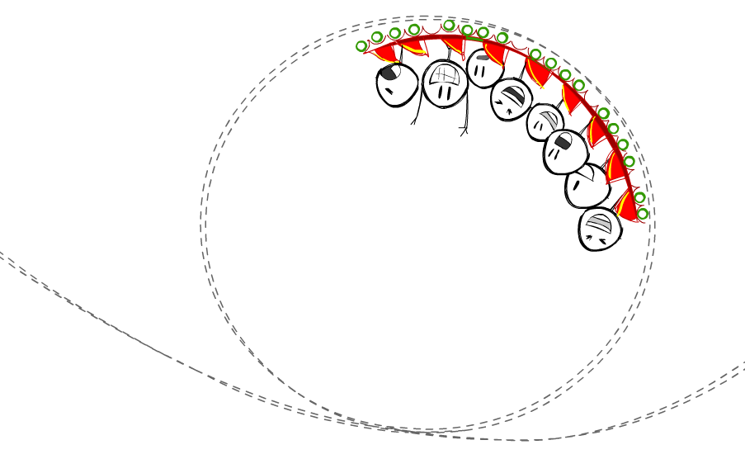
..or just hang out with his gang?

Slide 15
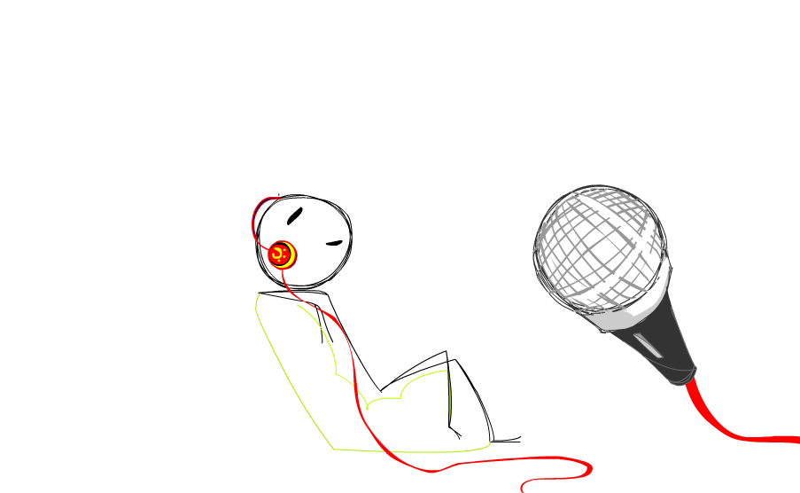
We can help you start the conversation

Slide 16
All you need to do is..

Slide 17
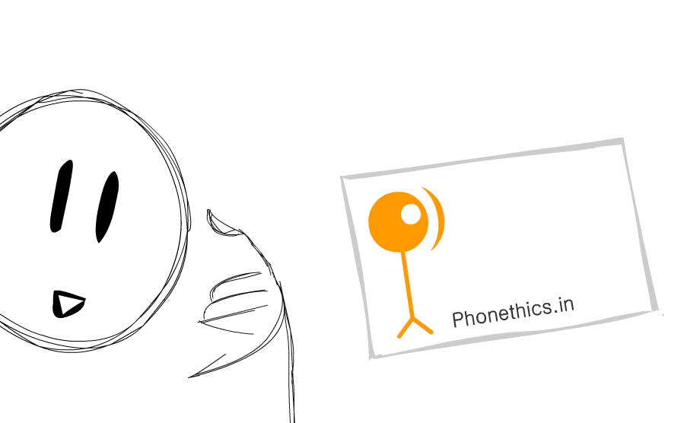
Contact
Saurabh@Phonethics.in

