Slide 1
Corona-viruse Tweet Sentiment - Multi-class classification
Yanling meng
Springboard capstone 3

Slide 2
Why?
To predict Tweet sentiments using original tweets:
Knowing what the public thinks about corona-virus (Covid) will help policy makers/stakeholders to make related decisions during the pandemic.

Slide 3


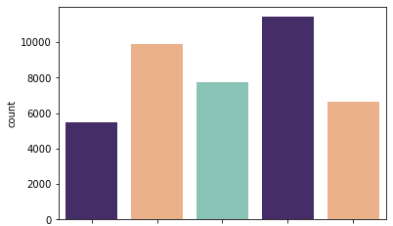
About Data
Sentiment Counts
Training data used: 41157 labeled observations
Testing data used: 3798 observations
Extremely Negative
Negative
Neutral
Positive
Extremely Positive

Slide 4
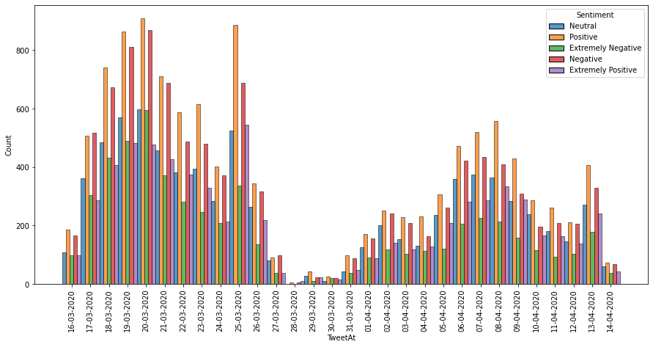
About Data: Tweets 2020-03-16~2020-04-14

Slide 5
Clean the original tweet text
Lower-cased all original tweets
Remove Punctruation, repeats and numbers
Remove @***
Cleaning website links with “url”
Remove stop words, such as “it, them, on, by”

Slide 6

Preprocess Data (Training data): Transform cleaned tweets into matrices with numbers
Text into tokens (word groups)
Recognize words with same stem (Stem and Lemmatize)
Transform all processed texts into one big matrices with 3652 columns
(CountVectorizer)
Split the training set (test = 0.15):
X: the matrices from above
y: Sentiment as numbers
WordCloud before transform

Slide 7
Models Tried:
SVC (Support Vector Classification): Effective in high dimensional spaces.
RandomForest: commonly used to provide a better accuracy in predicting outcomes over the decision tree
XGBoost: push the limits of computing power for boosted trees algorithms
Multilayer Networks: provides better modeling for complex networks and control model complexity/capacity

Slide 8

Model Selection(1/2): Accuracies
SVC-linear
0.67
Random-Forest
0.52
XGBoost
0.60
Multi-Layer
0.70

Slide 9
Model Selection(2/2): Local Running time
SVC-linear
Hours
Random-Forest
Hours
XGBoost
Hours
Multi-Layer
Minutes

Slide 10
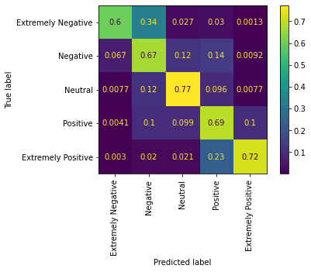
FINAL METRICS USING NN:
Extremely Negative
Negative
Normalized
Confusion
Matrix
True Labels
Neutral
Positive
Extremely Positive
EX Negative
Negative
Neutral
Predicted Labels
Positive
EX Positive

Slide 11
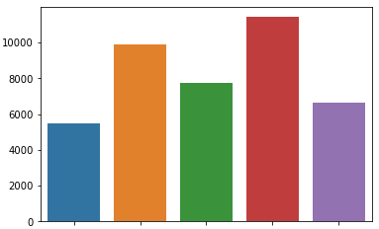
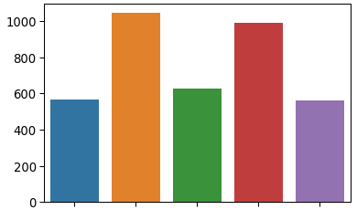
Train on the whole training set and predict on the test set
Train
Test
Count
EX Negative
EX Negative
Negative
Negative
Neutral
Neutral
Positive
Positive
EX Positive
EX Positive

Slide 12
Cons for Neural Network:
Easier if use tensor tokenizer, but not as good as CountVectorizer so need to transform a vector/array to create a tensor object that takes up more memory spaces.
Can not easily tune the model using GridSearchCV or RandomSearchCV as for SVC or RandomForest.

Slide 13
Future Modeling (1/2): Using 3 categories may result in higher accuracies.
Extremely Negative
Negative
Positive
Extremely Positive

Slide 14
Future Modeling (2/2):
Treat the imbalance using SMOTE or Class_weight.
The test set for this giving dataset was using tweets before the training tweets, and locations were too hard to be cleaned. Use more information if they were available such as time and location of the tweets.

Slide 15
Thank You and Questions? Let people know why use Accurate:

