Slide 1
Corona-viruse Tweet Sentiment - Multi-class classification
Yanling meng
Springboard capstone 3

Slide 2
Problem
Knowing what the public thinks about corona-virus will help policy makers to decide on the strategies against the COVID pandemic.

Slide 3


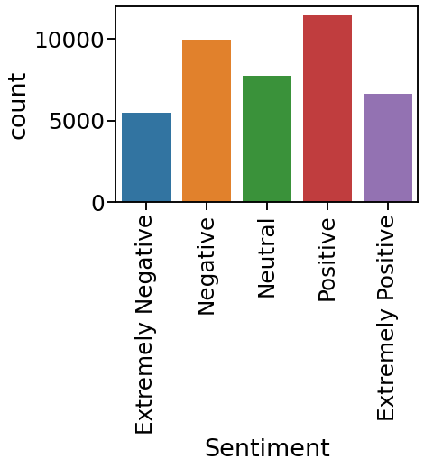
About data
Countplot of training sentiment
Taining data used: 41157 non-null ‘OriginalTweet’ and ‘Sentiment’ observations
Testing data used: 3798 non-null ‘OriginalTweet’

Slide 4
Clean the original tweet text
Lower-case all
Remove Punctruation, repeats amd numbers
Remove @***
Cleaning url
Remove stop words

Slide 5

Vecorize
WordCload before tfidf
Tokenize: TweetTokenizer
Stem and Lemmatize
Vectorize:
CountVectorizer(min_df = 10, max_df = 0.7)
train_test_split
Fit_transform(X_train)
Transform(X_test)
(Also tried tfidf, slightly lower accuracy)

Slide 6
Model Tried_1: SVC
SVCmodel = LinearSVC() F1 accuracy: 0.56
GridSearchCV F1 accuracy: 0.60
Parameters: {'C': [0.1, 100], 'gamma': [1,0.001], 'kernel':['rbf','poly','sigmoid','linear'], 'degree':[0, 3]}
Best parameters: {'C': 100, 'degree': 0, 'gamma': 1, 'kernel': 'rbf’}

Slide 7
Model Tried_2: RandomForest
RF = RandomForestClassifier() F1 accuracy: 0.52
GridSearchCV F1 accuracy: 0.50
Parameters: {'max_depth’: [8, 64], 'n_estimators': [64, 256, 512]}
Best parameters {'max_depth': 64, 'n_estimators’: 512}

Slide 8
Model Tried_3: XGBoost
** Label encoder used before modeling
XGBoost = XGBClassifier() F1 accuracy: 0.55
GridSearchCV F1 accuracy: 0.58
Parameters: { 'n_estimators': [20, 100, 500], 'colsample_bytree': [0.2, 0.8], 'max_depth': [10,50], 'reg_alpha': [1.1, 1.3], 'reg_lambda': [1.1, 1.3], 'subsample': [0.5, 0.9]}
Best parameters: { 'n_estimators': 500, 'colsample_bytree': 0.2, 'max_depth': 10, 'reg_alpha': 1.1, 'reg_lambda’: 1.1, 'subsample': 0.9’}

Slide 9

Selected SVC based on accuracy score
SVC
0.60
RandomForest
0.52
XGBoost
0.60

Slide 10
Final SVC metrics (1/2): SVC(C=100, degree=0, gamma=1, kernel='rbf')
classification_report | precision | recall | f1-score | support
Extremely Negative | 0.66 | 0.66 | 0.66 | 790
Negative | 0.61 | 0.62 | 0.61 | 1516
Neutral | 0.75 | 0.75 | 0.75 | 1176
Positive | 0.65 | 0.63 | 0.64 | 1687
Extremely Positive | 0.70 | 0.70 | 0.70 | 1005
accuracy |  |  | 0.67 | 6174
macro avg | 0.67 | 0.67 | 0.67 | 6174
weighted avg | 0.67 | 0.67 | 0.67 | 6174

Slide 11
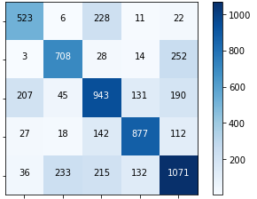
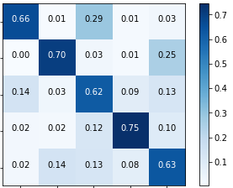
Final SVC metrics (2/2): SVC(C=100, degree=0, gamma=1, kernel='rbf')
Confusion Matrix
Normalized
Extremely Negative
Negative
True Label
Neutral
Positive
Extremely Positive
EX Negative
EX Negative
Negative
Negative
Neutral
Neutral
Positive
Predicted Label
Positive
EX Positive
EX Positive

Slide 12
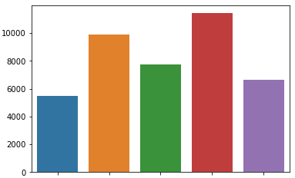
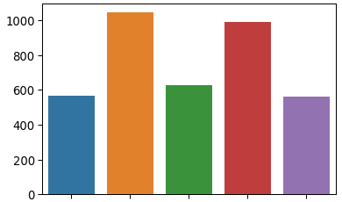
Train the whole training set and predict on the test set
Train
Test
Count
EX Negative
EX Negative
Negative
Negative
Neutral
Neutral
Positive
Positive
EX Positive
EX Positive

Slide 13
Questions:
In reality: would LinearSVC be the best choice??
Multilayer Neural Network: what is the input??
XGBoost needed a beter tuning??

