Slide 1
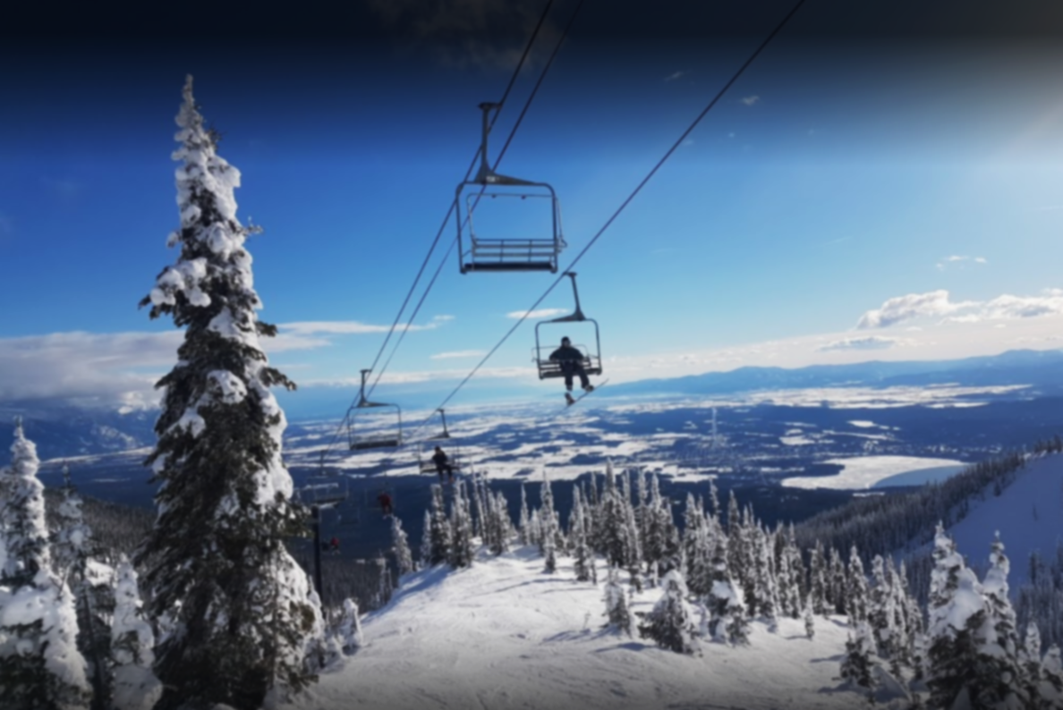
Big Mountain Ticket Price for Next Season
Yanling Meng

Slide 2
The Big Question: Increase ticket price or cut cost?
Conditions: - We have recently installed an additional chair lift which increases the operating costs by $1,540,000 this season. - Our pricing strategy has been to charge a premium above the average price of resorts. What we want to know based on data analysis: how important some facilities are compared to others.

Slide 3
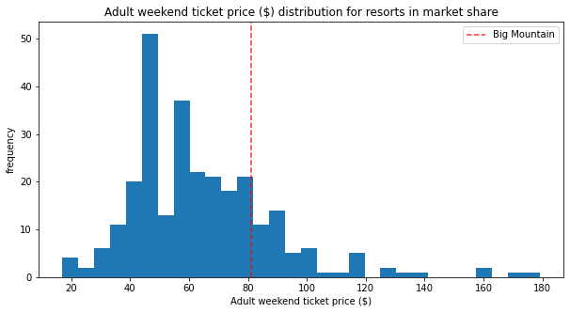
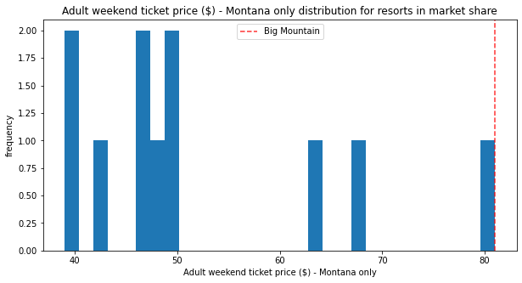
The Model Says: We Should Charge for More!
Big Mountain currently charges $81.00, but the model predicted price is $95.87!!
Although Big Mount already has facilities at the higher end compared with all the other resorts, their ticket price is among the highest in Montana.

Slide 4
The Data
We have data from 330 facilities in different states with 276 weekday prices and 279 weekend prices.
The weekend adult ticket price is used to fit a Random Forest model.

Slide 5
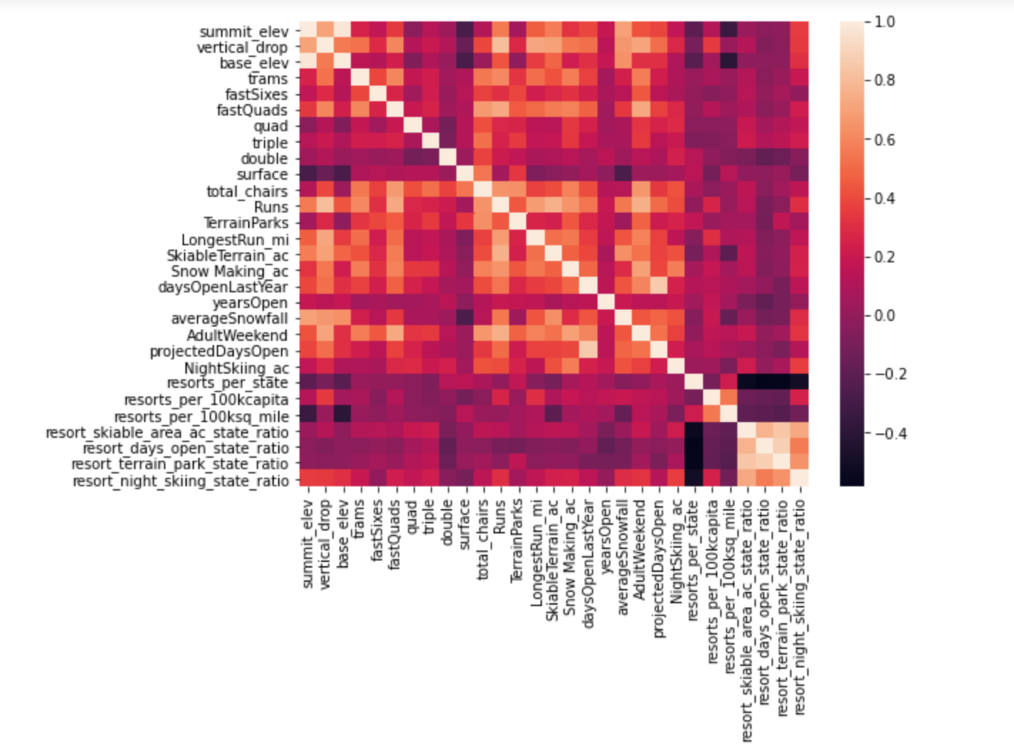
Correlation between Price and Facilities
High Corr
Low/No Corr

Slide 6
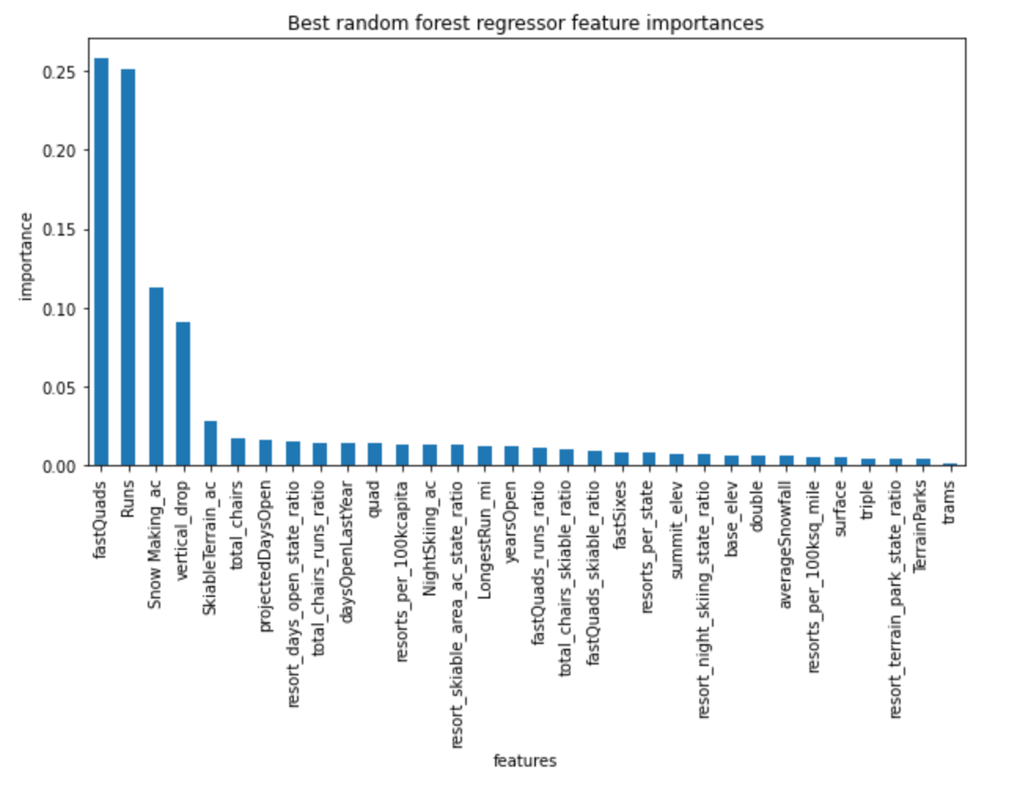
Most Important Facilities
FastQuads, Runs, Snow Making Area, and Vertical drop accounts for about 70% of the total importance

Slide 7
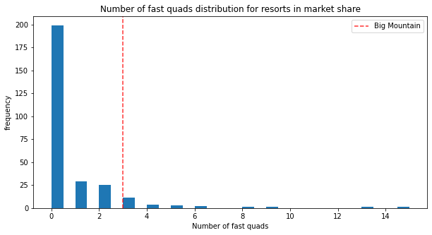
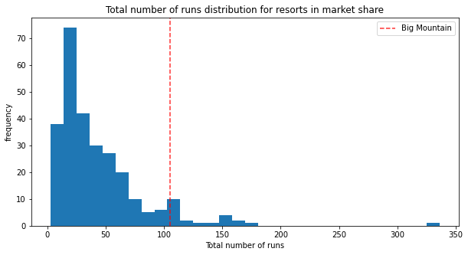
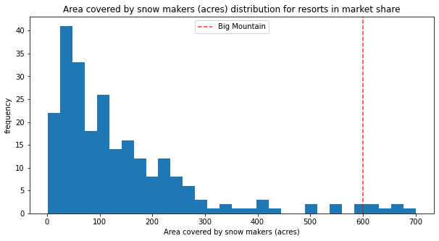
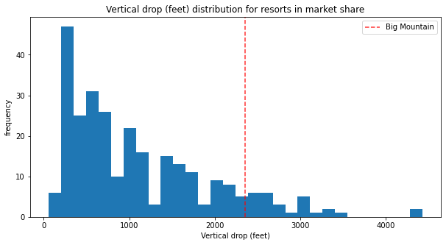
Most Important Facilities
Fast quads
Runs
Snow making
Vertical drop

Slide 8
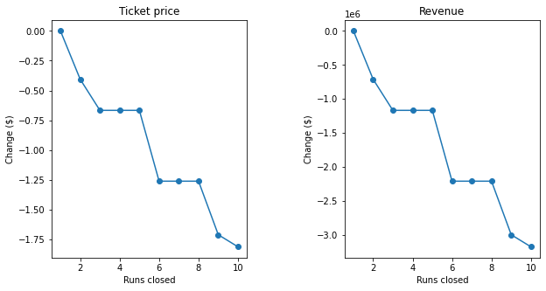
Recommended scenarios
Adding a run, increasing the vertical drop by 150 feet, and installing an additional chair lift increases support for ticket price by $1.99. Over the season, this could be expected to amount to $3474638.
Big Mount can also try out gradually closing 3 to 6 runs to test out the loss in tickets sold vs. cost reduction.

Slide 9
Summary and More Possibilities
Summary:
We could add chair lift and vertical drop with an elevated weekend adult ticket price
Other possibilities:
Reducing more acres of snow making may make a difference if cost of snow making per acre was available.
Night-time skiing cost could be reduced without significant reduction in ticket price.
Add more fastquads may also be a good reason to increase ticket price given the cost of adding this facility.

