Slide 1

Will They Subscribe or Not?
Yanling Meng
Springboard Capstone Project Presentation

Slide 2
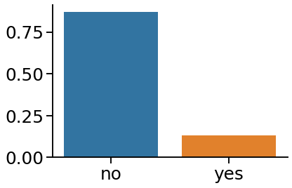
The Main Question:
Will a customer subscribe to a termed deposit after the direct marketing campaign.

Slide 3
Information We Have:
Total of 22500 customers (15% subscribed):
Four types of information, 20 columns in total:
Information about the customer: such as job, education, age
Information about the campaign: such as how was the customer contacted, in what month he/she was contacted.
Other information about the previous campaign(s): such as how many previous campaigns has contacted the customer, and how many days since contacted by previous campaign.
Social and Economic context: such as consumer price index, Euribor 3 month index.

Slide 4
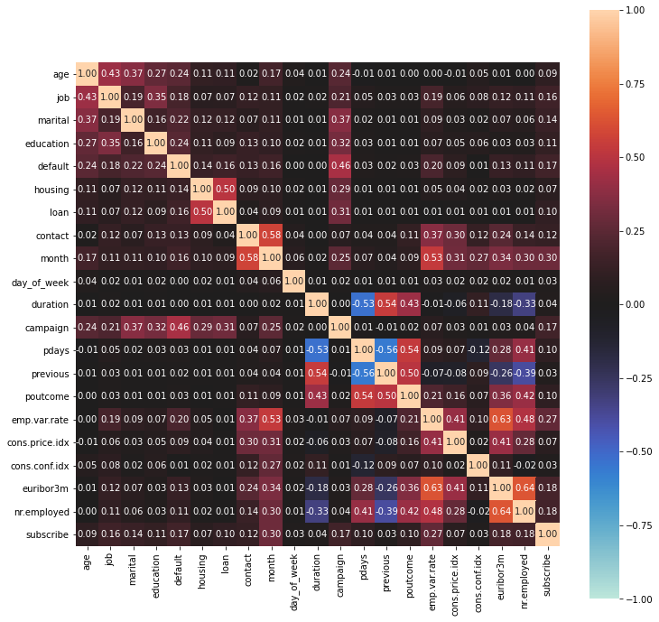
Variables Correlated with ‘Subscribe’?

Slide 5
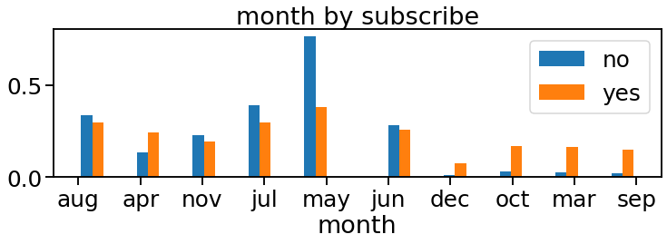
More Contacts in May Said ‘No’!

Slide 6
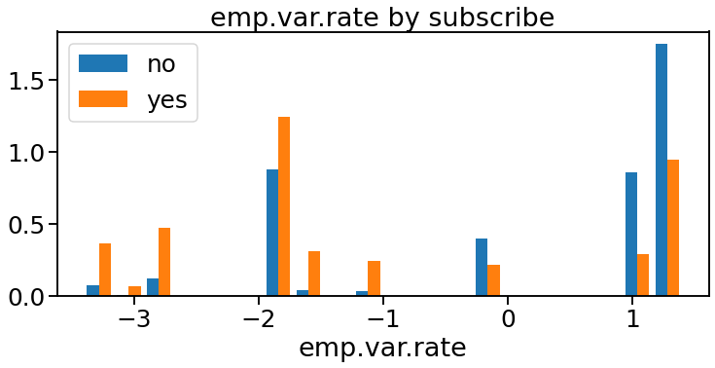
More ‘No’s with Higher Employment Variation Rate (quarterly)

Slide 7
Preparing for Modeling
Using SMOTE() to treat the imbalance.
Separate categorical and numerical variables
Categorical: get dummies
Rejoin the two parts to get back whole dataset
Identify X and y.
Split the training data into training and testing part
Scale X using MinMaxScaler

Slide 8

Preprocessing: Tried Two Models
LogisticRegression
Best F_macro value = 0.759 after GridSearchCV
RandomForestClassifier
Best F_macro value = 0.931 after GridSearchCV

Slide 9

RandomForestClassifier: GridSearchCV Vs. RandomSearchCV
GridSearchCV:
Best F_macro value = 0.931
RandomSearchCV:
Best F_macro value = 0.927

Slide 10
RandomForestClassifier Metrics
Fit the Training-Split with Tuned Hyperparameters
Get Predict Values using X_test
Evaluate Model with Metrics

Slide 11
RandomForestClassifier Metrics
 | Precision | Recall | F1-score | Support
no | 0.92 | 0.95 | 0.93 | 3928
yes | 0.94 | 0.90 | 0.92 | 3501
accuracy |  |  | 0.93 | 7429
macro avg | 0.93 | 0.93 | 0.93 | 7429
weighted avg | 0.93 | 0.93 | 0.93 | 7429

Slide 12
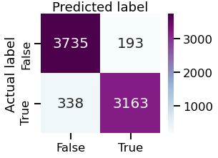
Confusion Matrix

Slide 13
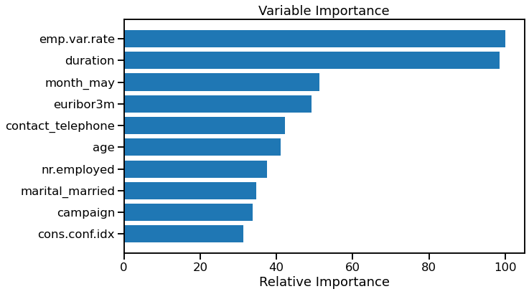
Feature Importance

Slide 14
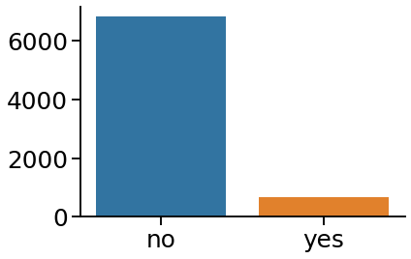
Final Step: to Predict the Test Data

Slide 15
Future Use of The Modeling
Change contact strategies: choose costumers that are more likely to subscribe.
Question: Features are all important as a ‘No’?

