Slide 1
Frequencies of Google Book Titles - NGRAM
Interesting Data Sets
Yanling Meng
SpringBoard 2021

Slide 2
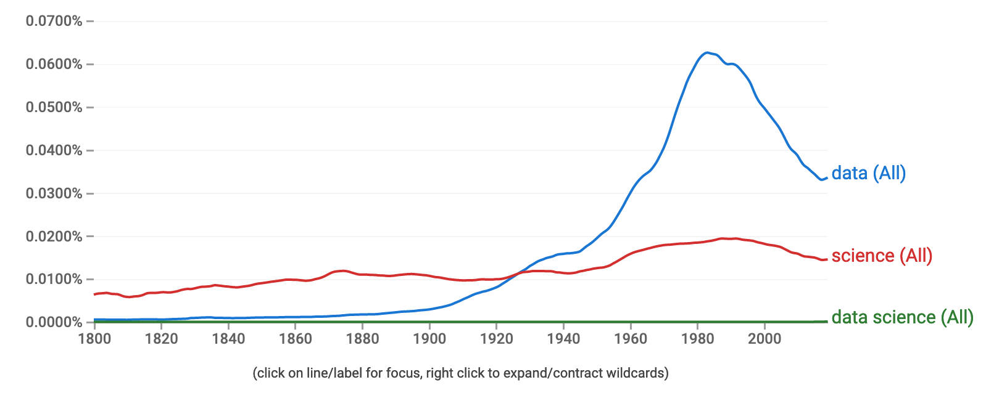
A Lot “Data” in 80s and 90s

Slide 3
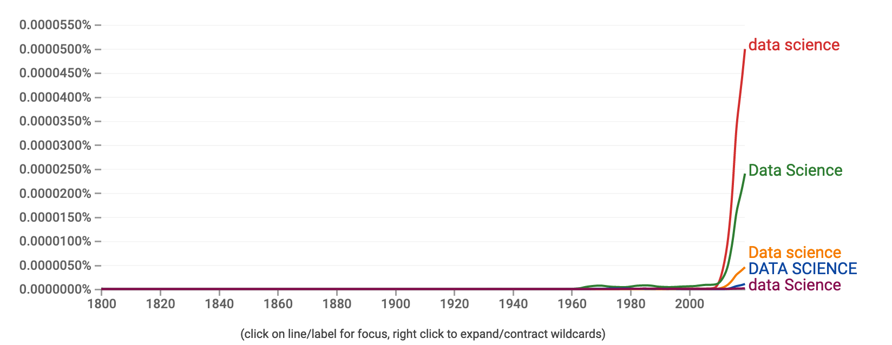
“Data Sciece” Is New and Growing Fast

Slide 4
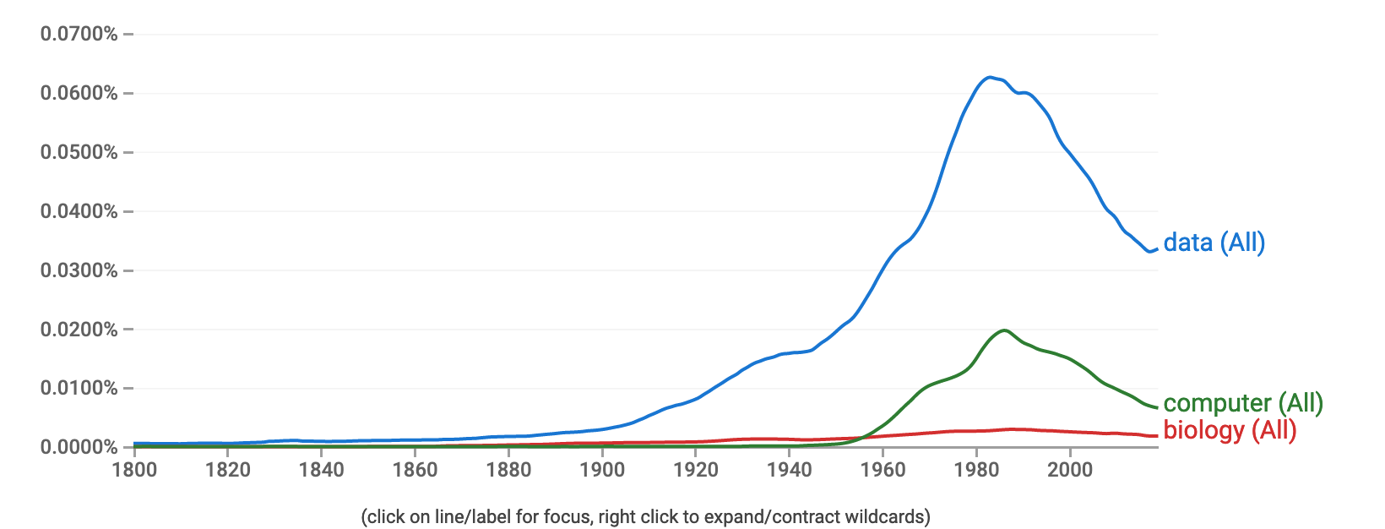
“Data” Increased at the Same Time with “Computer” in 80s

Slide 5
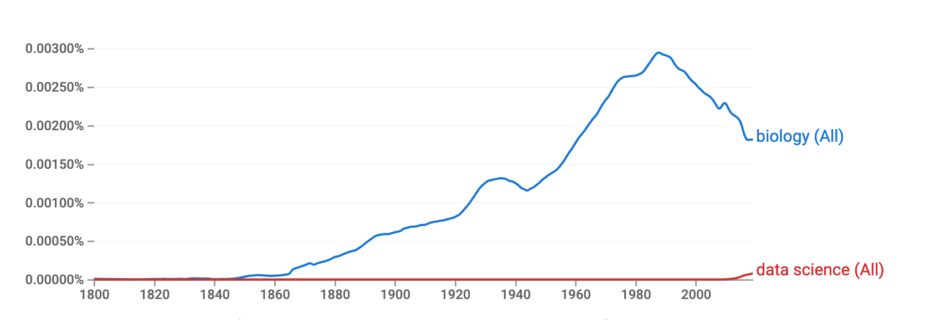
“Biology” Was Important in the 90s

Slide 6
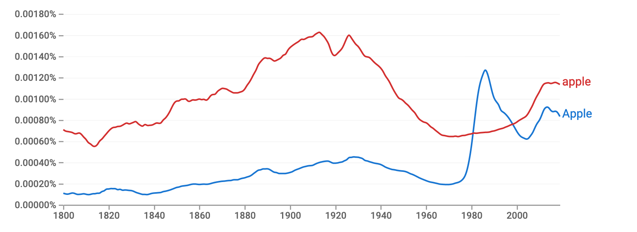
Famous Brands Names

Slide 7
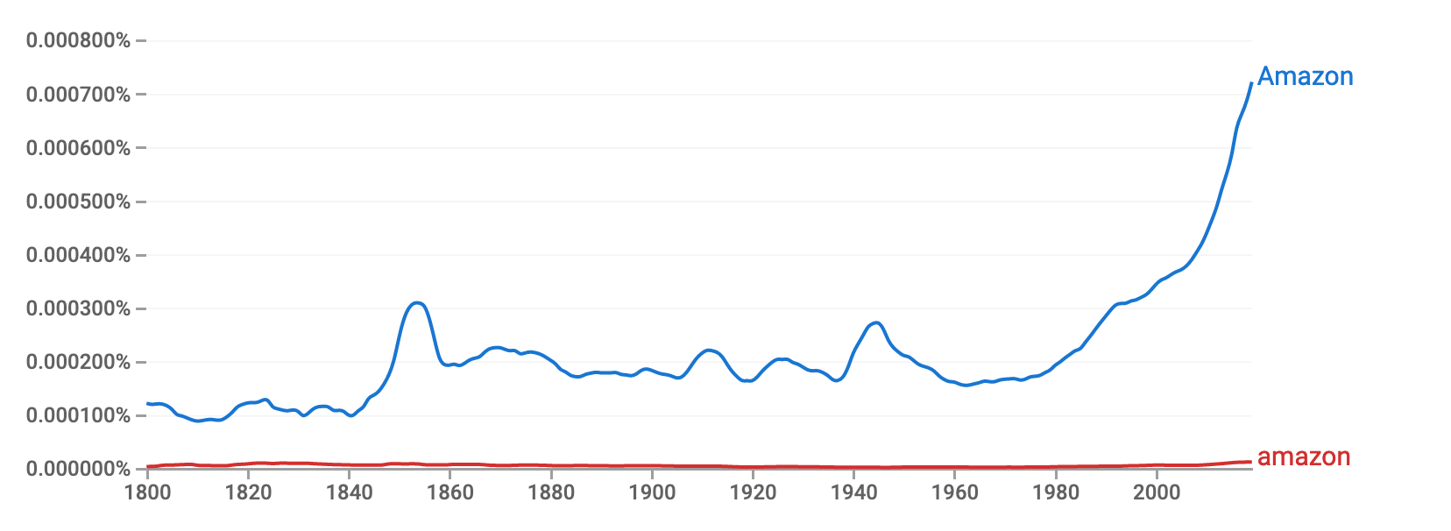
Famous Brands Names

Slide 8
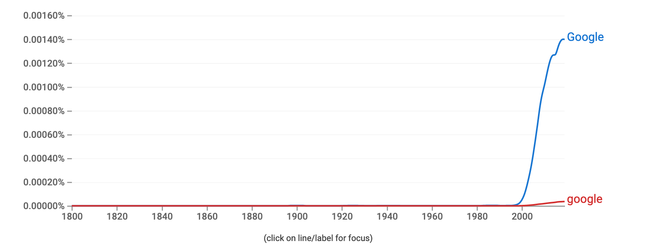
Famous Brands Names

Slide 9
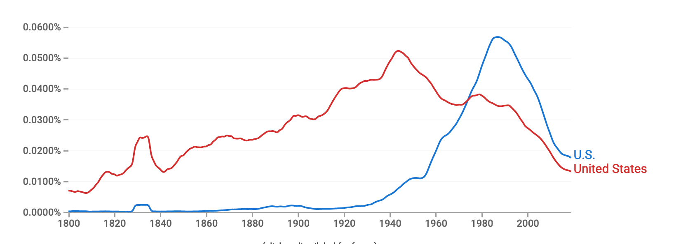
Abbreviations

