Slide 1
C4-S2 Practice NodeJS-MangoDB
We want to manage a database of tasks
Each task should have:
A title (mandatory)
A status (completed or not, by default it is not completed)
A priority (an optional integer: the tasks with priority 1 are more urgent than tasks with priority 2 or more)

Slide 2
Request definitions
For each mission define all your requests here, you can add more rows
REQUEST | REQUEST TYPE GET POST PUT DELETE | PATH | PARAMETERS | BODY (FOR POST AND PUT ONLY) | RESPONSE
Get all tasks | - GET | /tasks |  |  | Array object of tasks
Add a task | - POST | /add_task |  | { “Title”: “…”, “priority”:”…”, ….. } | Array object of new task added
Delete a task | - DELETE | /task | /:id |  | Array object of not delete tasks
Update a task | - PUT | /task/edit/ | /:id |  | Array object of tasks

Slide 3
Request definitions
For each mission define all your requests here, you can add more rows
REQUEST | REQUEST TYPE GET POST PUT DELETE | PATH | PARAMETERS | BODY (FOR POST AND PUT ONLY) | RESPONSE
Get specific tasks | - GET | /tasks/notcompleted |  |  | Array object of tasks not completed
Get all student | - GET | /students |  |  | Array object of all student

Slide 4
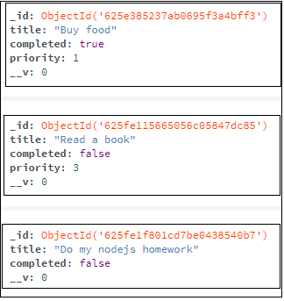
MISSION 1: MangoDB connection
In MangoDB Compass:
Create a new database
Create a new collection Tasks in this database
In the file models/task_model.js:
Connect to your MangoDB database
Define the Schema for the Tasks collection
Create the Model

Slide 5
MISSION 2: Create new task
Define a request to create a new task:
Which HTTP method ?
Which path ?
What data ? In request ? In response ?
In the file server.js:
Define the route for this request
Write the code to create a new task in the database
Test with Thunder Client and check in MangoDB Compass that the data is created
Try to put “hello!” as priority for a task. What happens ? Why ?
In the file /public/js/main.js:
Complete the function addTask in the front to create a new task from the browser

Slide 6
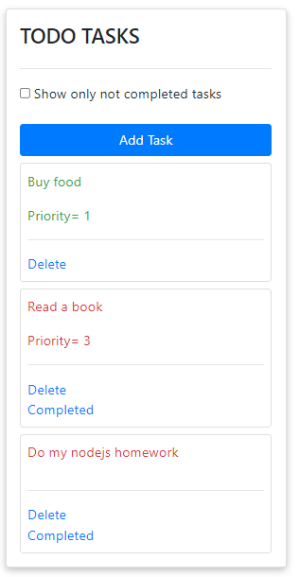
MISSION 3: Read
Define a request to read all tasks
Write the back code and test it with Thunder
Complete the function displayTask in the front to get all tasks from server and display them (check the template in the HTML)

Slide 7
MISSION 4: Delete
Define a request to delete one task
Write the back code and test it with Thunder
Complete the function clickTask in the front to delete the task the user want to remove

Slide 8
MISSION 5: Update
When the user click on the ‘completed’ button on a task, this task should be marked as completed in the database, and the display color changed to green
Define a request to complete one task
Write the back code and test it with Thunder
Complete the function clickTask in the front to update the task the user has completed

Slide 9
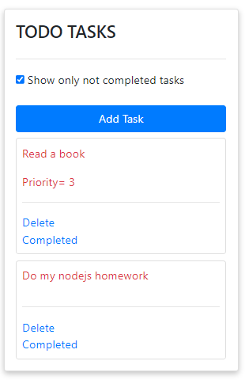
MISSION 6: Read with filter
If the user checked the checkbox, only the tasks that are not completed should be displayed
Define a request to read only not completed tasks
Write the back code and test it with Thunder
Write the front code: update the function displayTasks

Slide 10
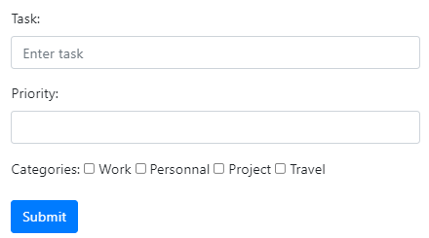
MISSION 7: Add categories
Change your Schema to add a field categories as an array of strings: one task can have many categories
Add checkboxes in the create task form
Update the code in the front and in the back to add the selected categories in the database

Slide 11
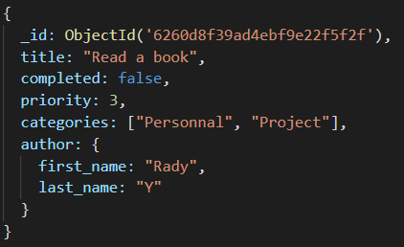
MISSION 8: Add author
Change your Schema to add a field author as an object with a first_name and a last_name
Update the form to ask for the user first name and last name
Update the code in the front and in the back to add the author in the database
Example of data:

Slide 12
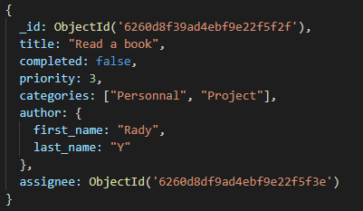

EXTRA - MISSION 9: Use 2 collections
Example of data:
https://www.geeksforgeeks.org/mongoose-populate-method/
Tasks collection:
Create a new collection students
In the Tasks Schema, define a reference to the author of the task
When reading the lists of tasks, use the populate method to get the data about the student of the task
Students collection:

