Slide 1
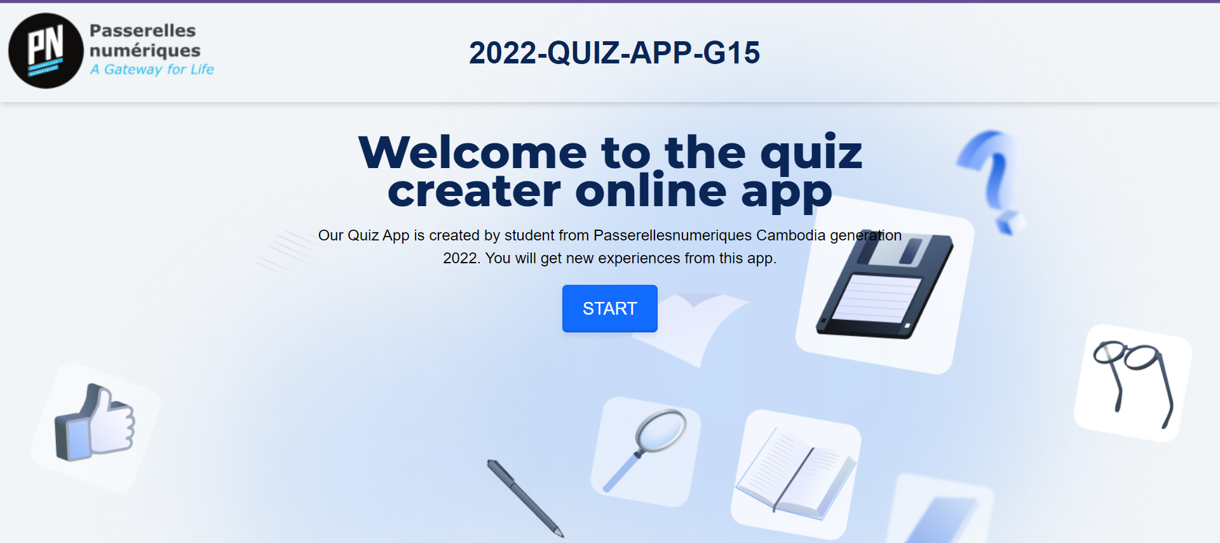
2022-QUIZ-APP-G15

Slide 2
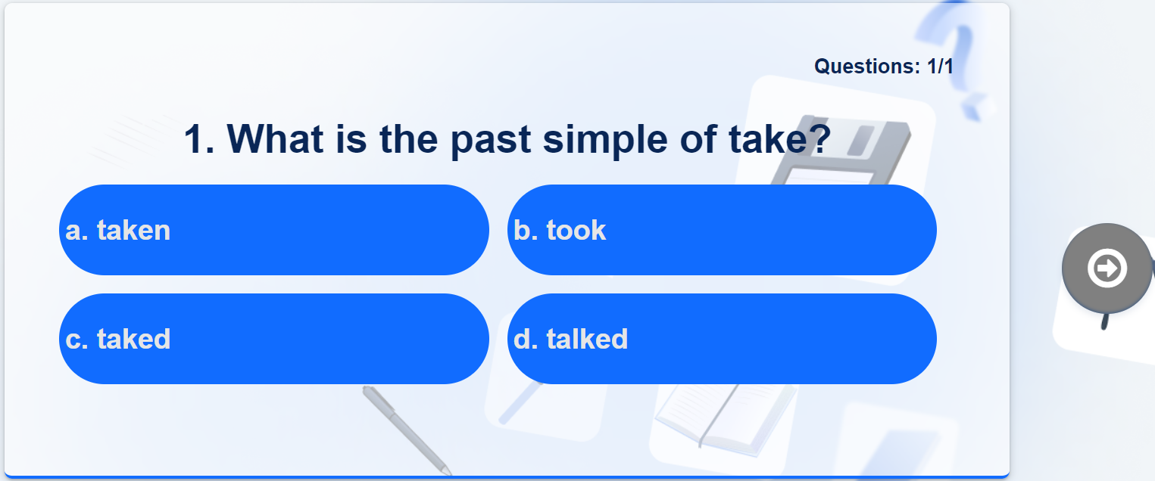
The Seller (Mengyi)
Features
Play Quiz

Slide 3
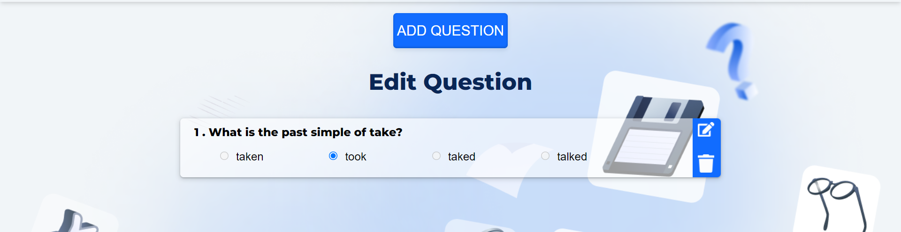
Features (Continue…)
Edit Quiz
Edit Questions
Add Questions
Remove Questions

Slide 4
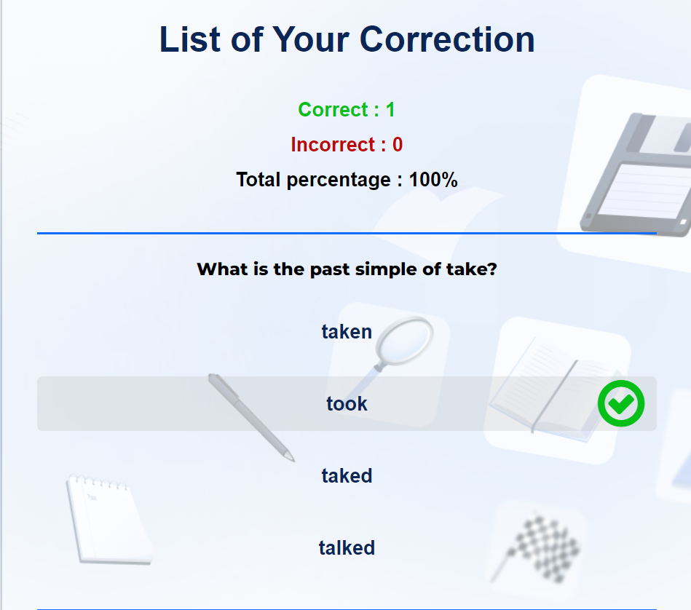
Features (Continue…)
Store data in local storage
Result and Corrections

Slide 5
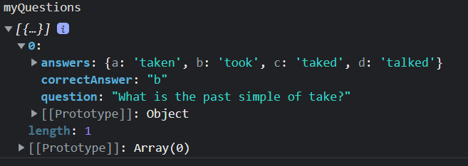
The Tech (Nga)
Delete Question
Data structure
Steps
Get the list of delete images
Get the index of the delete image using the event.target
When clicked on the delete image, the DOM of the question that contains that specific delete image.
Remove in the array of myQuestions and update in local storage

Slide 6
The Managers (Nga and Mengyi)
How does the team work together?
Assign tasks for each other
Help each other in debugging the code
Work with Git Hub
Asks for advice from the coach
2. What were your best team achievements?
Be able to create an awesome quiz app
Learn more about JS DOMs and styles
Teamwork
Communication with coach
3. What your team need to improve?
Comment on the code
Follow instructions

