Slide 1

Neuronify
Mengyi Xu & Reza Sharif
Bellairs workshop 2026

Slide 2
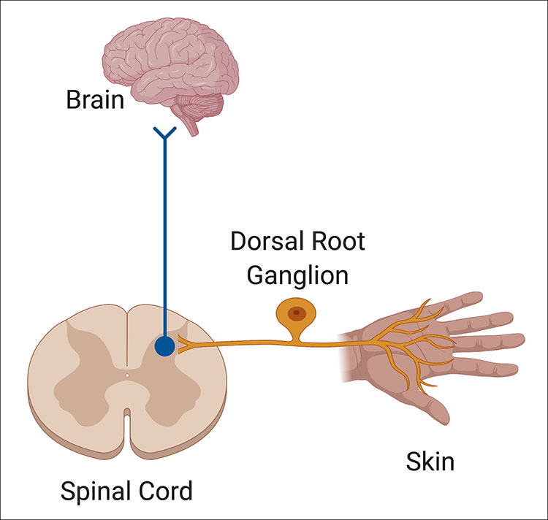
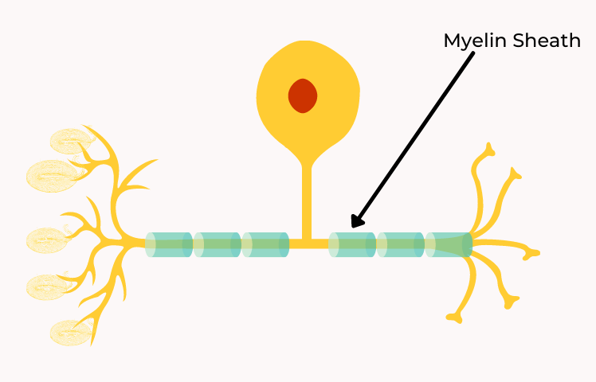
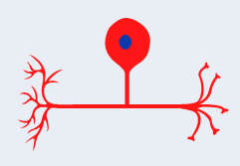
How touch and pain signals travel to the brain
Aβ – Fibers
Touch
C – Fibers
Pain
Notes:
https://www.brainfacts.org/thinking-sensing-and-behaving/touch/2021/the-neurons-responsible-for-making-a-touch-feel-pleasant-111021

Slide 3
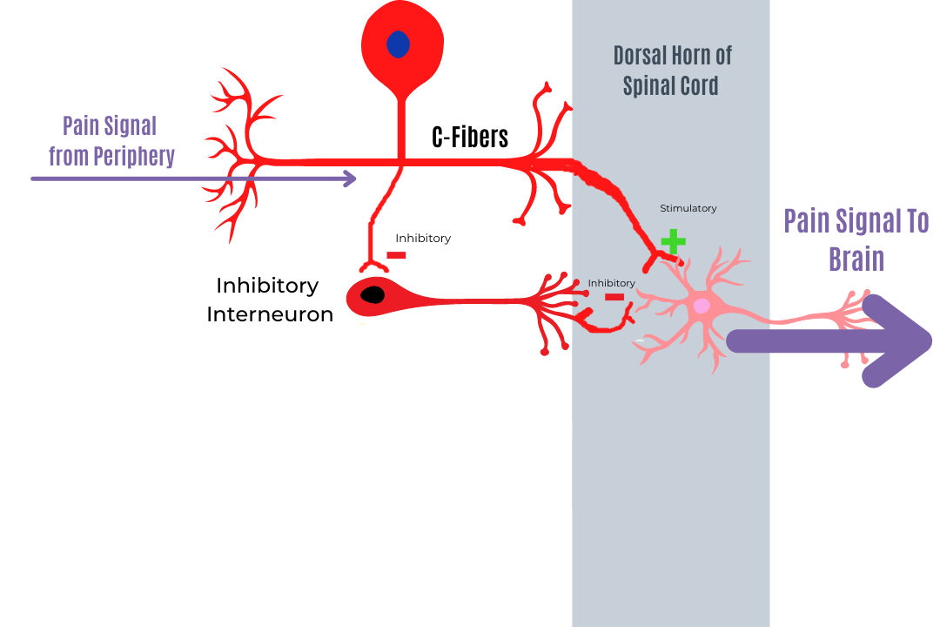
How touch and pain signals travel to the brain
Notes:
https://www.simplypsychedu.com/community/public/posts/492101-an-introduction-to-pain

Slide 4
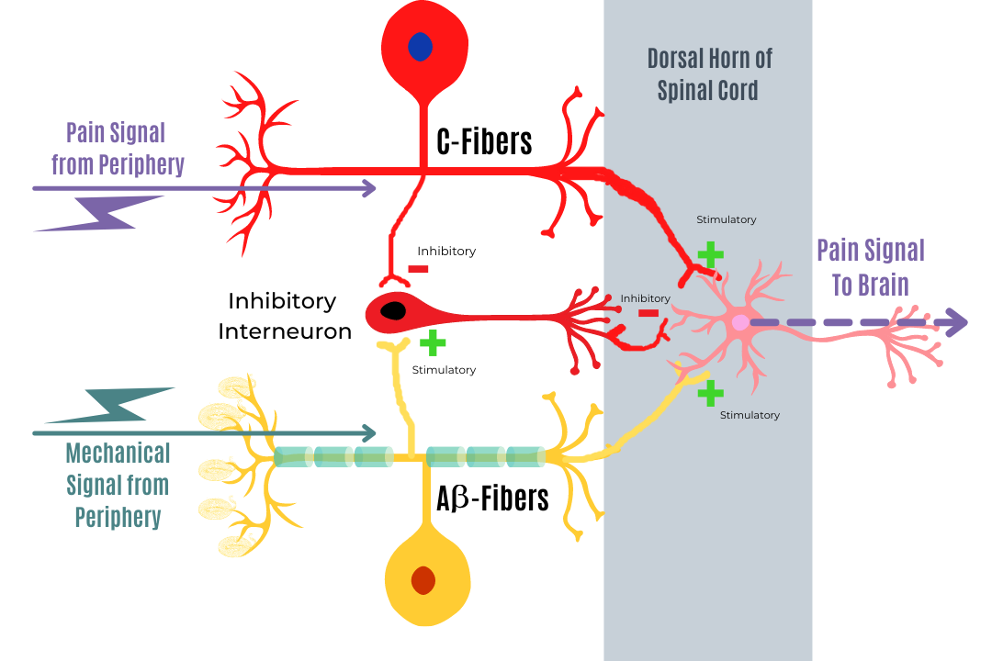
How touch and pain signals travel to the brain
Notes:
A-beta fibers, which are mechanoreceptors, do the opposite of C-fibers. A-beta fibers (yellow neuron in the diagram below) synapse on inhibitory interneurons (red neuron in the diagram below) and stimulate them. By stimulating the inhibitory interneurons, the pain signal is reduced.
https://www.simplypsychedu.com/community/public/posts/492101-an-introduction-to-pain

Slide 5
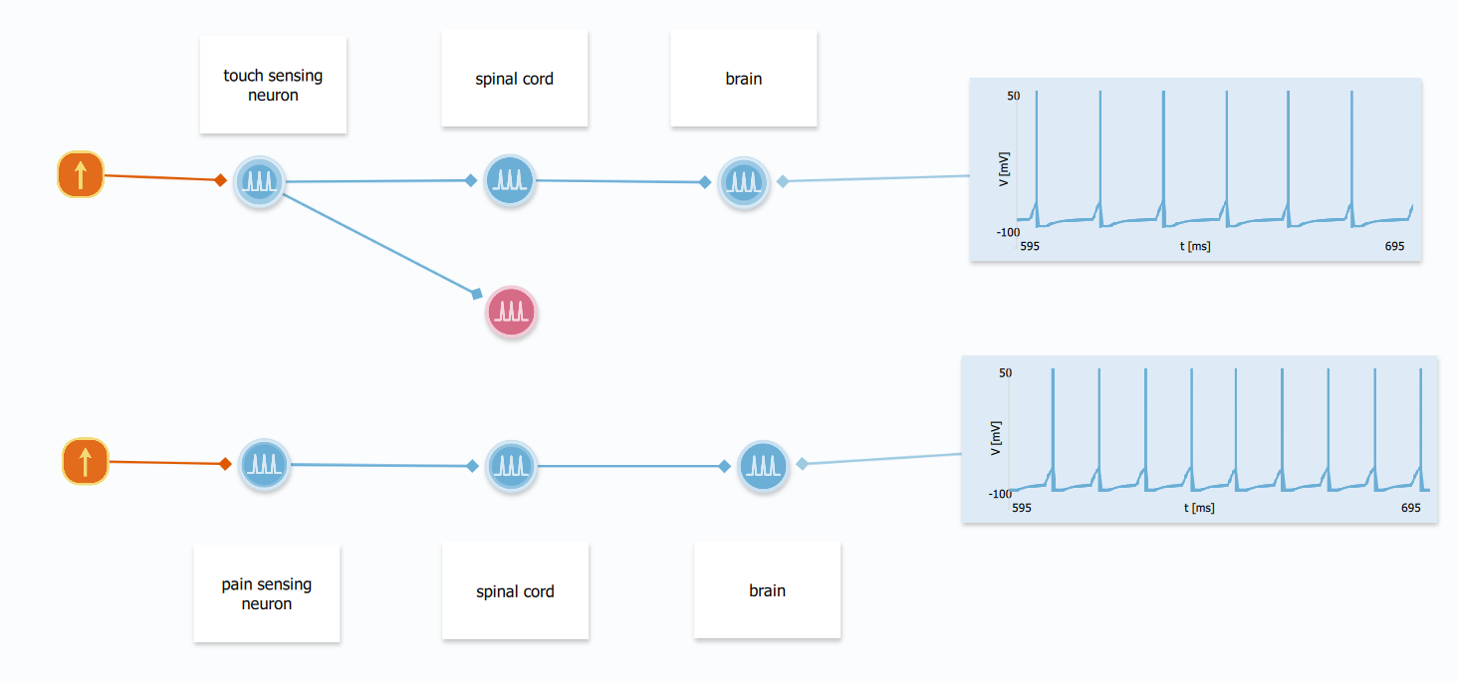
Low input -> touch & high input -> pain
Notes:
For touch: current output to be 0.4 nA
For pain: current output to be 0.6 nA

Slide 6
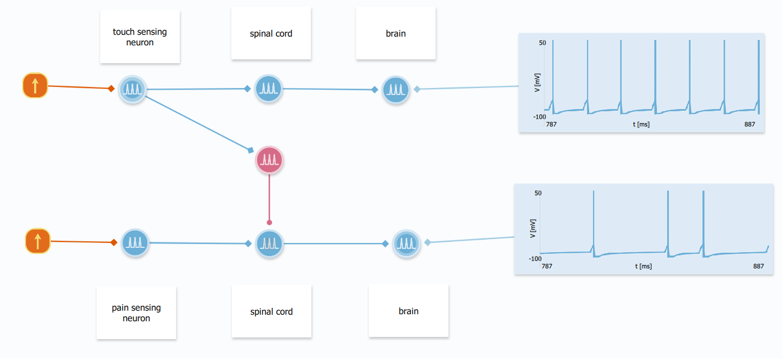
Touch relief pain

Slide 7
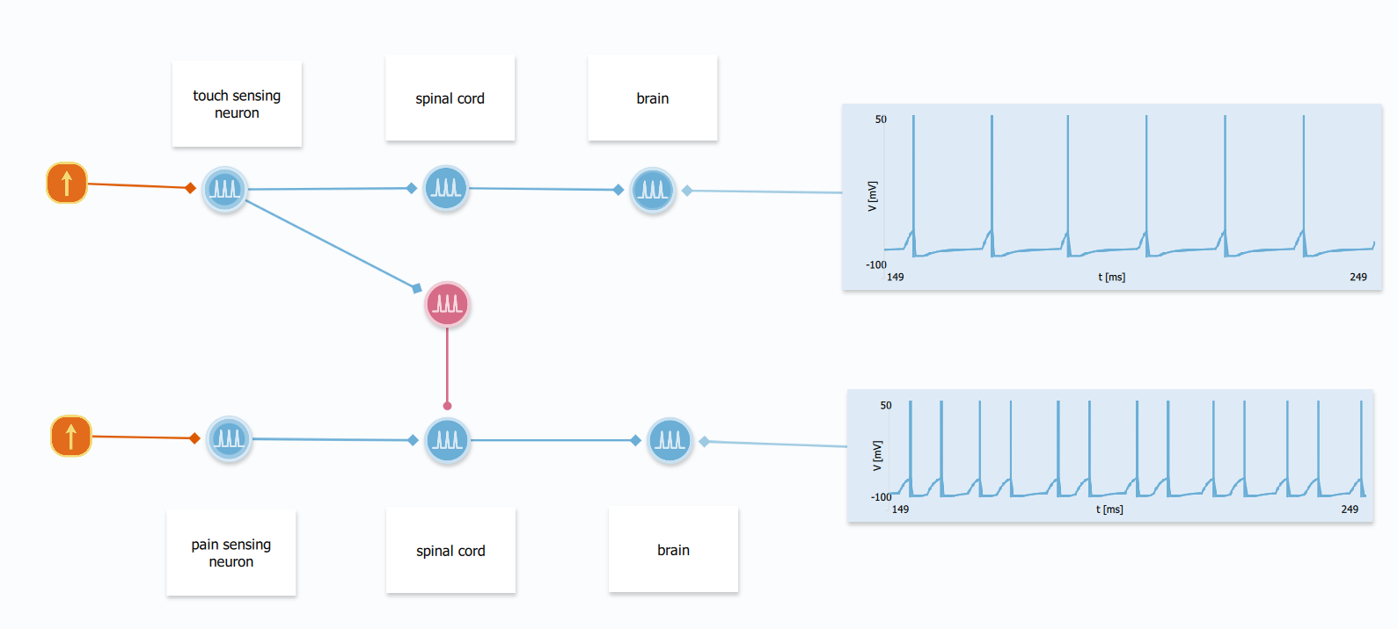
Chronic pain: pain threshold decreases
Notes:
Set the pain sensing neuron threshold below -70, around -72

Slide 8
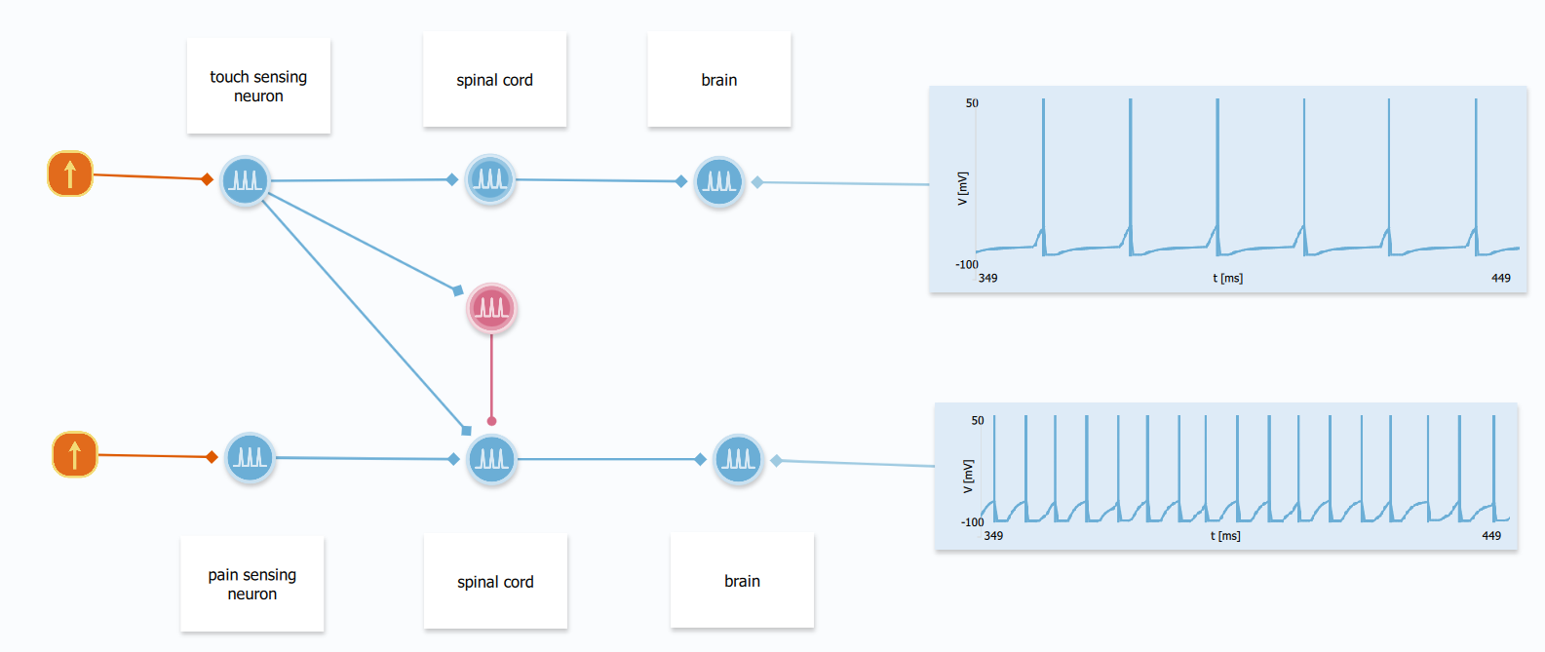
Chronic pain: touch evokes pain
Notes:
Set the maximum current from touch sensing neuron to be 5 nA and time constant to be 6 ms

