Slide 1
How do we feel touch & pain?
Mengyi Xu , Haoyi Qiu, Marie-Eve Paquet, Arjun Krishnaswamy, Yves de Koninck, Majid Mohajerani, Reza Sharif Naeini
Bellairs workshop 2026

Slide 2
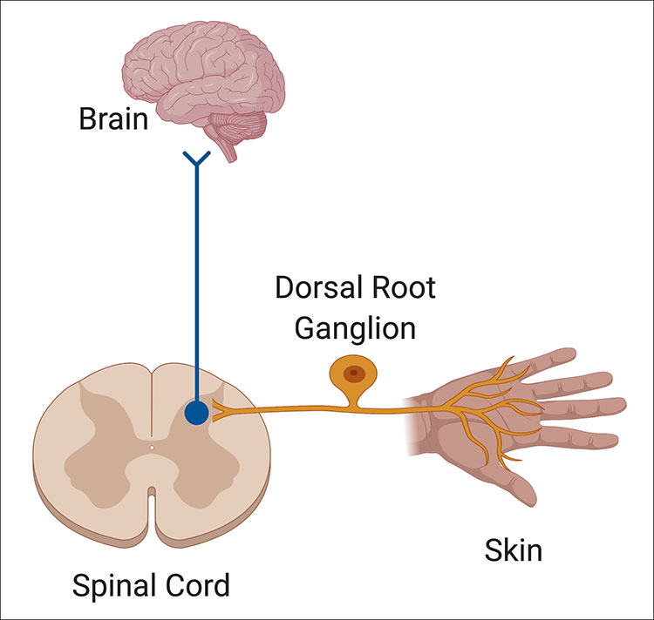
How touch and pain signals travel to the brain
Notes:
https://www.brainfacts.org/thinking-sensing-and-behaving/touch/2021/the-neurons-responsible-for-making-a-touch-feel-pleasant-111021

Slide 3
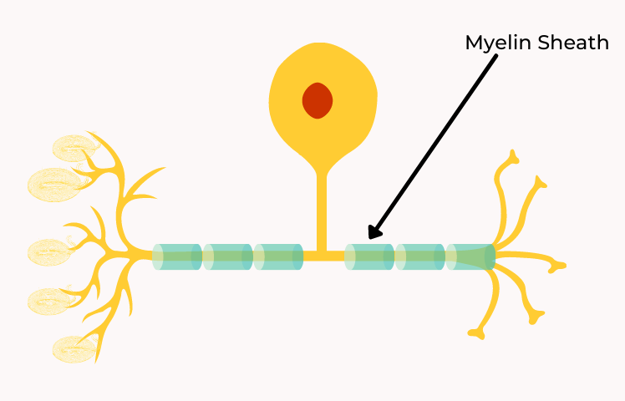
How touch and pain signals travel to the brain
Aβ – Fibers
Touch
Notes:
https://www.brainfacts.org/thinking-sensing-and-behaving/touch/2021/the-neurons-responsible-for-making-a-touch-feel-pleasant-111021

Slide 4
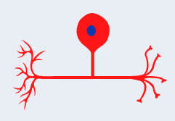
How touch and pain signals travel to the brain
Aβ – Fibers
Touch
C – Fibers
Pain
Notes:
https://www.brainfacts.org/thinking-sensing-and-behaving/touch/2021/the-neurons-responsible-for-making-a-touch-feel-pleasant-111021

Slide 5
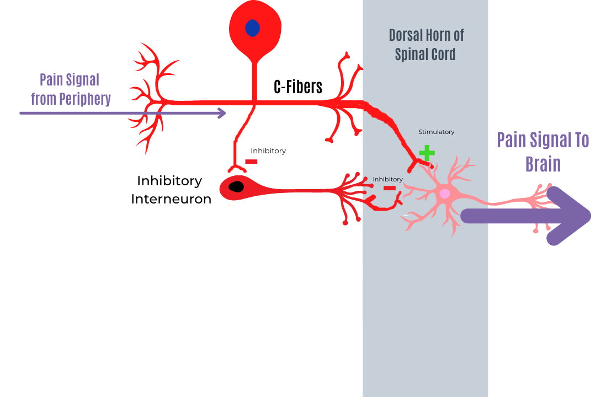
How touch and pain signals travel to the brain
Notes:
https://www.simplypsychedu.com/community/public/posts/492101-an-introduction-to-pain

Slide 6
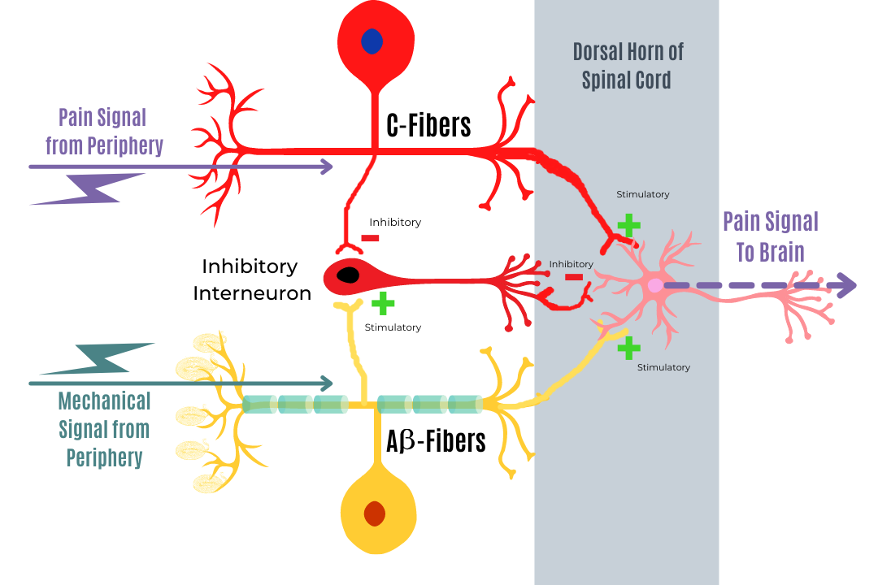
How touch and pain signals travel to the brain
Notes:
https://www.simplypsychedu.com/community/public/posts/492101-an-introduction-to-pain

Slide 7
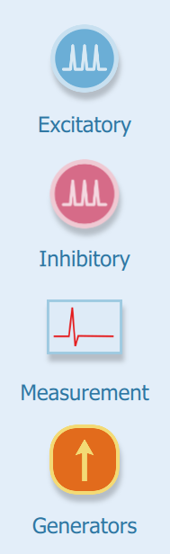

Neuronify

Slide 8
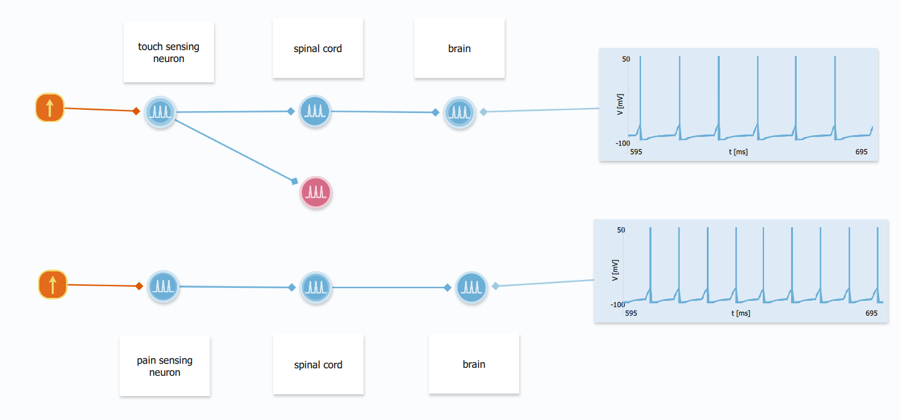
Low input -> touch & high input -> pain
Notes:
For touch: current output to be 0.4 nA
For pain: current output to be 0.6 nA

Slide 9
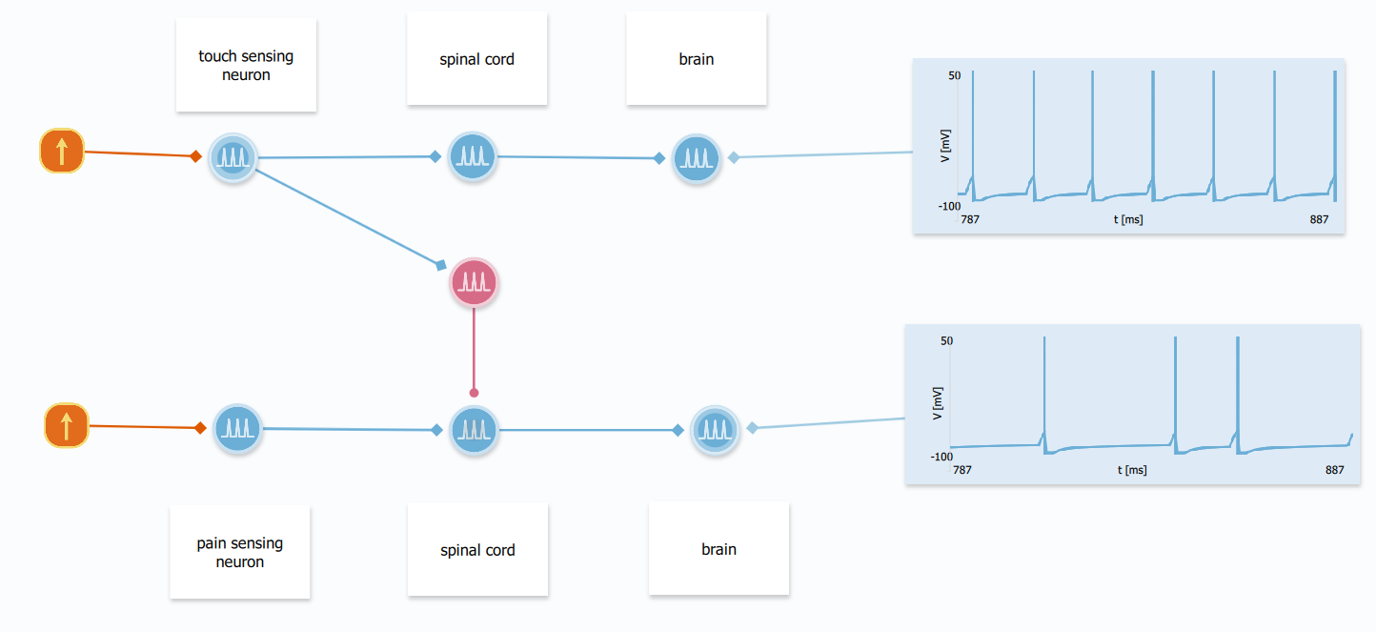
Touch relief pain

Slide 10
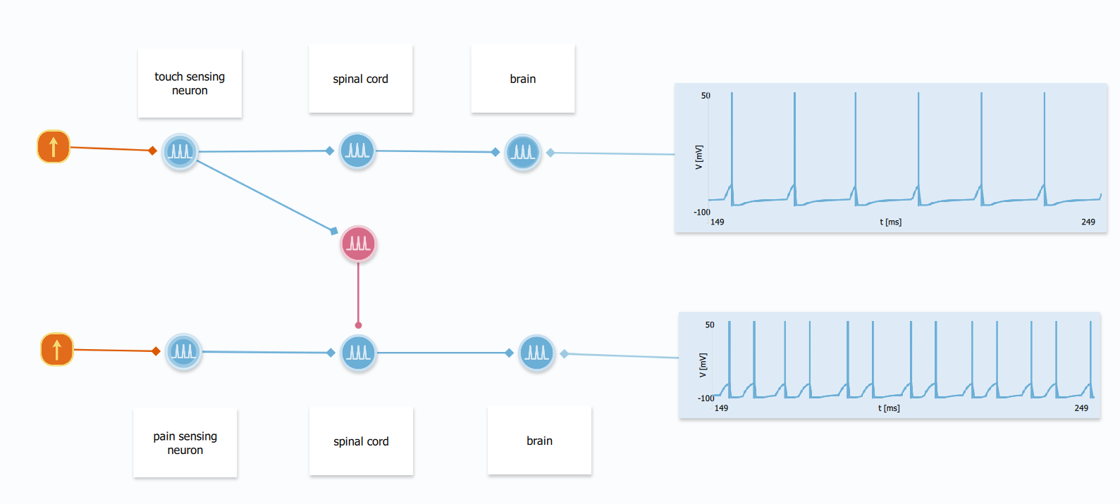
Chronic pain: pain threshold decreases
Notes:
Set the pain sensing neuron threshold below -70, around -72

Slide 11
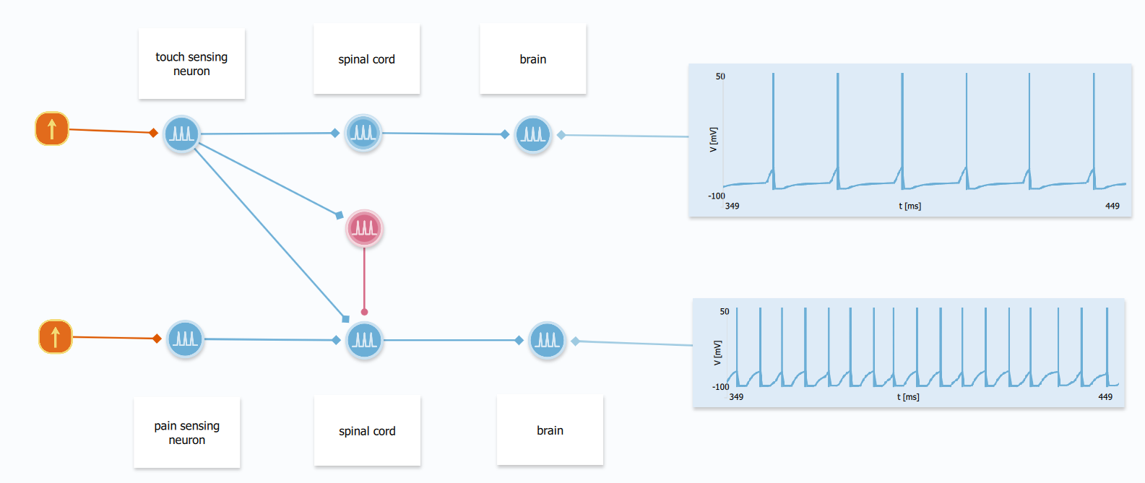
Chronic pain: touch evokes pain
Notes:
Set the maximum current from touch sensing neuron to be 5 nA and time constant to be 6 ms

