Slide 1
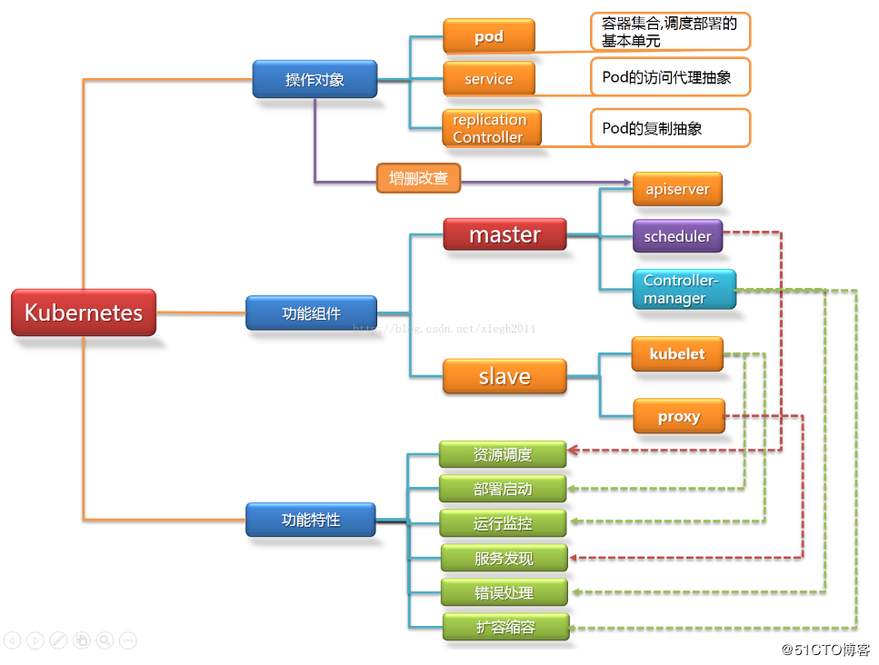

Slide 2
Etcd 节点
etcdIp
172.28.80.211
172.28.80.205
172.28.80.207
etcd
etcd
etcd
守护进程配置:/usr/lib/systemd/system/etcd.service
配置文件 /K8S/etcd/cfg/etcd.conf
安装路径 /k8s/etcd

Slide 3
flanneld 节点
flannedIp
172.28.80.211
172.28.80.205
172.28.80.207
172.28.47.240
flanneld
flanneld
flanneld
flanneld
Etcd cluster
/coreos.com/network/config '{ "Network": "10.18.0.0/16", "Backend": {"Type": "vxlan"}}'
守护进程配置:/usr/lib/systemd/system/flanneld.service
配置文件 /k8s/kubernetes/cfg/flannel
安装路径 /k8s/kubernetes/bin

Slide 4
Master 节点
masterIP 172.28.80.207
Kube-apiserver
安装路径: /k8s/kubernetes/server/bin/
配置路径:/k8s/kubernetes/cfg/kube-apiserver
守护进程:/usr/lib/systemd/system/kube-apiserver.service
kube-scheduler
安装路径: /k8s/kubernetes/server/bin/
配置路径: /k8s/kubernetes/cfg/kube-scheduler
守护进程: /usr/lib/systemd/system/kube-apiserver.service
kube-controller-manager
/k8s/kubernetes/server/bin/
/k8s/kubernetes/cfg/kube-controller-manager
/usr/lib/systemd/system/kube-controller-manager.serivce

Slide 5
Node 节点
nodeIp 172.28.47.240
Kubelet
安装路径: /k8s/kubernetes/bin
配置路径:/k8s/kubernetes/cfg/
守护进程:/usr/lib/systemd/system/kubelet.service
kube-proxy
安装路径: /k8s/kubernetes/bin/
配置路径: /k8s/kubernetes/cfg/
守护进程: /usr/lib/systemd/system/kube-proxy.service

Slide 6
证书
ETCD
ca.pem
ca_key.pem
ca-csr.json
cfssl
server_key.pem
server.pem
ca-config.json
server-csr.json
cfssl
Kubernets
ca.pem ca-key.pem
ca-csr.json
cfssl
Server-key.pem
server.pem
ca-config.json
server-csr.json
cfssl
kube-proxy-key.pem
kube-proxy.pem
ca-config.json
kube-proxy-csr.json
cfssl
ca-config.json: 其他证书配置信息，包括的有效期、类型
server-csr.json:包含CN="etcd",服务器IP地址列表，算法，名称等信息

