Slide 1
Week 4 Milestone

Slide 2
Motivation
With global warming, extreme heat events are becoming more common.
Beijing has developed and expanded rapidly over the past 30 years. As a large and densely populated city, it is also strongly affected by the urban heat island effect.
In recent years, extreme summer heat has affected people's daily lives and health. By studying how urban heat changes over time and space, this project may provide useful information for understanding and reducing heat risks.
Research Question
How have urban heat hotspots in Beijing changed over space and time during the past 30 years, and how are these changes related to land-cover change?

Slide 3
Data
I plan to use Landsat data from 1995 to 2025, mainly from summer (June–August).
I will use the data to study changes in Land Surface Temperature (LST).
I will use Copernicus land cover dataset to study the land cover change from 1995-2020.
Methods
Hotspot Detection：
Calculate the summer median LST for each year from 1995 to 2025.
Use the pooled 95th percentile (P95) across the entire study period as a consistent threshold to identify hotspot candidate pixels.
Apply 8-neighbor connectivity to group adjacent candidate pixels into hotspot clusters.
Expected Output
An animation showing the annual changes in hotspot distribution in Beijing from 1995 to 2025

Slide 4
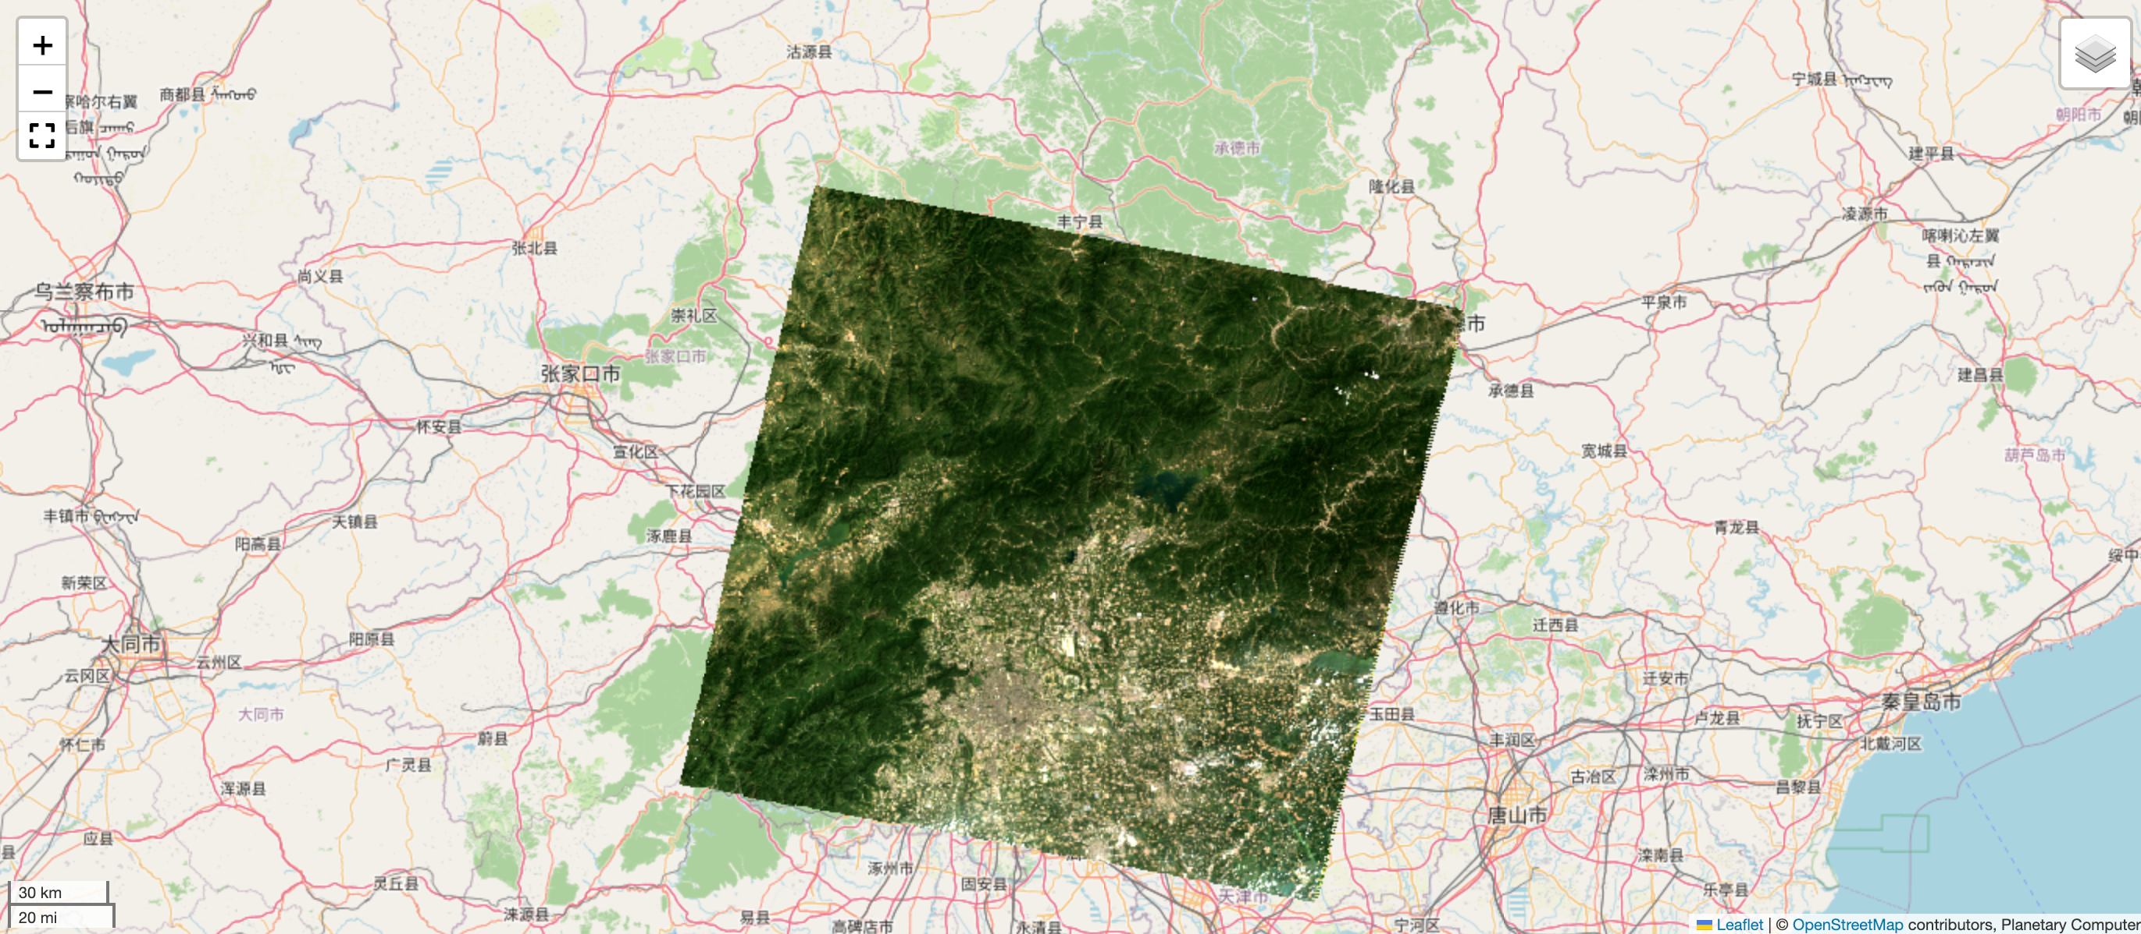
Evidence(1)
Access to Landsat data

Slide 5
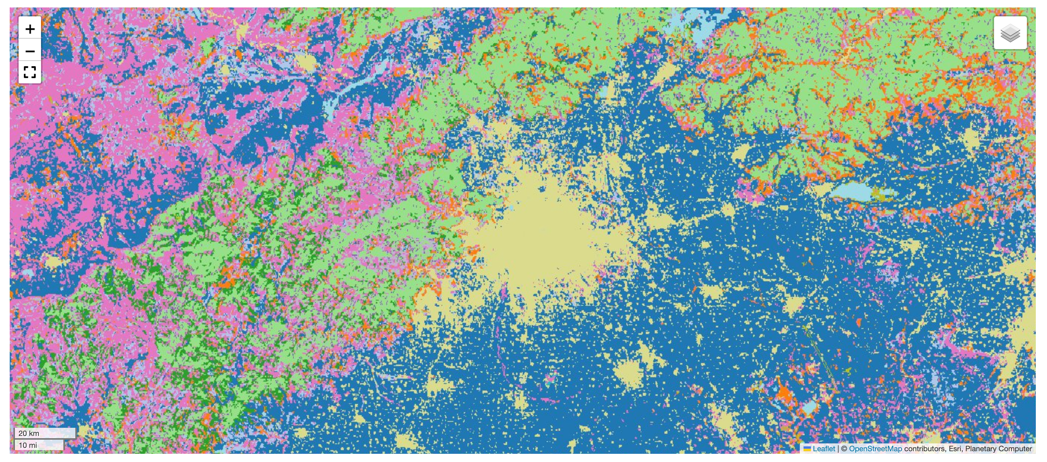
Evidence(2)
Access to land-cover data

Slide 6
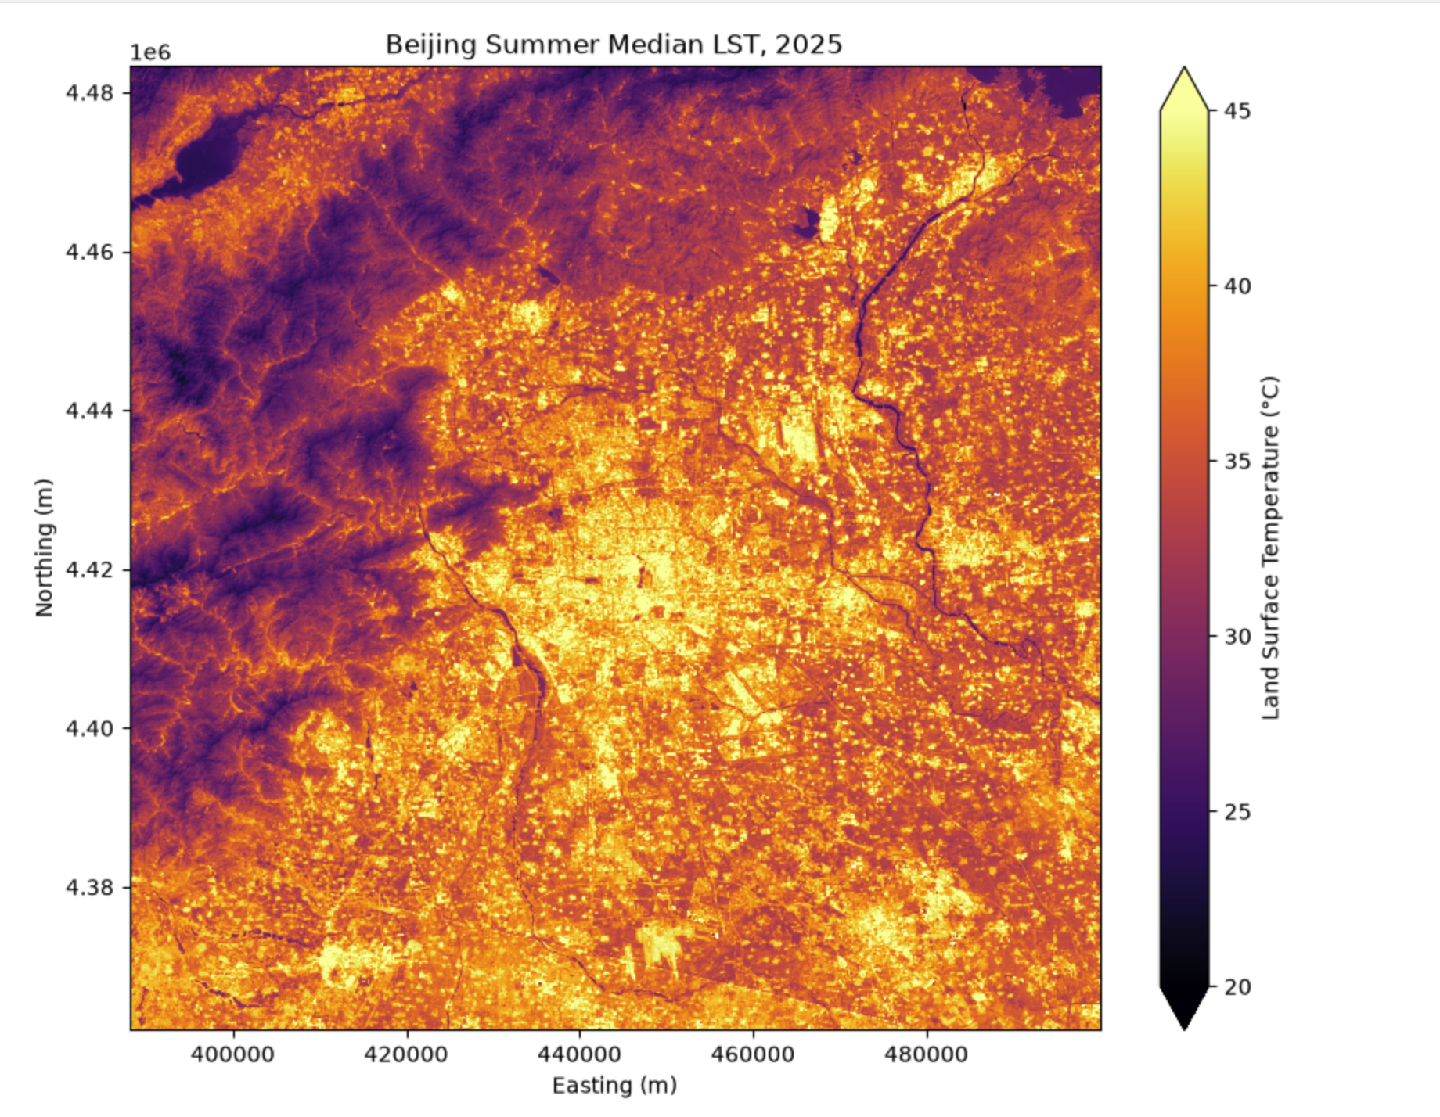
Evidence(3)
Sample workflow for summer median LST in 2025

Slide 7
Method Status
1. Method Candidates + Why They Fit
Hotspot detection: Calculate annual summer median LST (1995–2025), using a pooled P95 threshold and 8-neighbor connectivity to identify hotspot clusters. (Patch size has not decided yet)
Why: A consistent threshold allows comparison of hotspot distribution, size, and persistence over time.
Land-cover analysis: Compare hotspot patterns with land-cover types and transitions at five-year intervals.
2. Relevant Jupyter Book Sections Reviewed
Data acquisition and processing.
GeoAI package, including semantic segmentation and other machine learning applications.

Slide 8
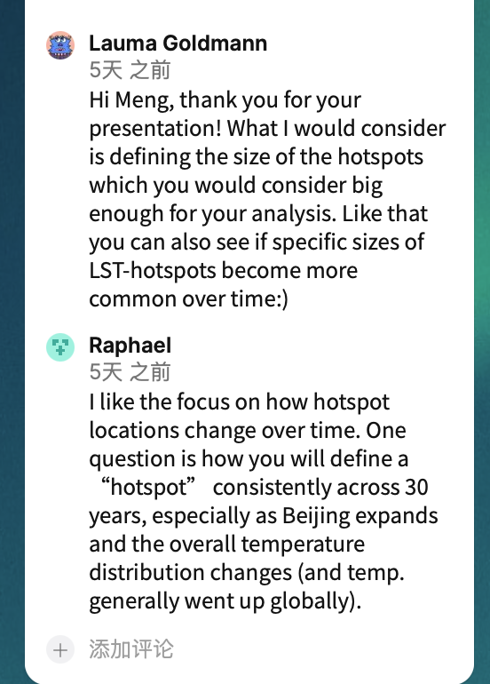
Feedback
Thanks for the feedback!
Based on the feedback, I plan to use a consistent P95 threshold across the entire study period to make hotspots comparable over time. I will also consider setting a minimum patch size and analyzing whether the size distribution of hotspots changes over the past 30 years.

Slide 9
Next Step
Data preprocessing: Align the Landsat data from 1995 to 2025 to ensure consistency across different sensors and years.
Threshold sensitivity analysis: Compare different thresholds to examine how they affect hotspot identification and spatial distribution.
Minimum patch size: Examine the initial hotspot patch size distribution and test different minimum patch sizes to select a suitable threshold.

Slide 10
Week 2 Milestone

Slide 11
Current Status
I am currently more interested in the urban heat topic because it seems more feasible and easier to manage. There are also more related studies, so I can learn from their methods.
Motivation
With global warming, extreme heat events are becoming more common.
Beijing has developed and expanded rapidly over the past 30 years. As a large and densely populated city, it is also strongly affected by the urban heat island effect.
In recent years, extreme summer heat has affected people's daily lives and health. By studying how urban heat changes over time and space, this project may provide useful information for understanding and reducing heat risks.
Research Question
How have urban heat hotspots in Beijing changed over space and time during the past 30 years, and how are these changes related to land-cover change?

Slide 12
ALIGNMENT STATE
Data
I plan to use Landsat data from 1995 to 2025, mainly from summer (June–August).
I will use the data to study changes in Land Surface Temperature (LST).
I will use Copernicus land cover dataset 1992 to study the land cover change.
How to define hotspots
My current idea is to use Landsat data from June to August each year and calculate the median LST for each pixel to create an annual summer LST map. Then, I plan to select the top 5% hottest pixels as hotspot candidates and cluster these pixels. (threshold selection???)
However, I found that some studies use Getis–Ord Gi* to detect hotspots. I still need to learn more about this method and decide which method is more suitable for my project. (neighborhood distance???)
Expected Output
Maps showing how urban heat hotspots have changed over the past 30 years.
Compare the hotspot changes with land-cover changes to see if there is a relationship between them.

Slide 13
Uncertainty
Data
How to ensure cross-sensor consistency among different generations of Landsat data over the 30-year study period.
How to deal with differences in spatial resolution and maintain a consistent analysis scale.
How cloud cover and missing observations may affect annual LST estimates.
Methods
Should hotspot detection be based on a fixed percentile threshold?
How can persistent hotspots be defined across multiple years?
Given the existing literature on urban heat hotspots, how can the project provide a distinct contribution?
Next Step
Review relevant literature and compare methods used for urban heat hotspot detection and long-term LST analysis.
Finalize the definition of hotspots and hotspot persistence.
Identify the required datasets and test their availability and preprocessing workflow.

