Slide 1
Monte Carlo (MC) method and its application in quantum physics
Mengzhi Chen
Department of Physics and Astronomy,
Michigan State University
PHY 905 Final Presentation
May 3rd, 2018

Slide 2
Content
Monte Carlo Method
Metropolis algorithm
Application in quantum physics
Result and discussion
Conclusion

Slide 3
Monte Carlo Method
Solving problems using randomness
Named by a city
Problem solving strategy
Gives appropriate solutions, getting close to real situation as increasing samplings
Complex for simple problems, effective for complex problems
…

Slide 4
Monte Carlo Method
Numerical integral
Randomness
Large number of sampling
Effective for nonanalytic or high dimensional integrals

Slide 5
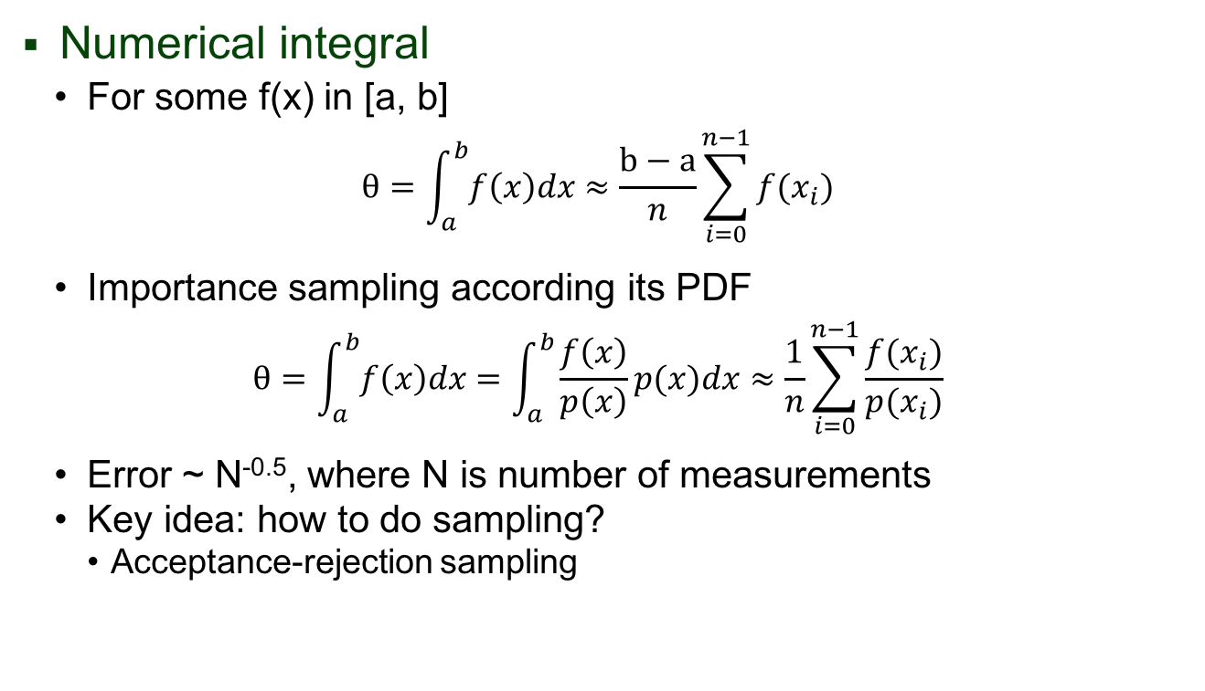
Monte Carlo Method
Numerical integral
For some f(x) in [a, b]
$$θ=\int_{a}^{b}{f\left(x\right)dx}≈\frac{b−a}{n}\sum_{i=0}^{n−1}{f(x_{i})}$$
Importance sampling according its PDF
$$θ=\int_{a}^{b}{f\left(x\right)dx}=\int_{a}^{b}{\frac{f\left(x\right)}{p\left(x\right)}p(x)dx}≈\frac{1}{n}\sum_{i=0}^{n−1}{\frac{f(x_{i})}{p(x_{i})}}$$
Error ~ N^{-0.5}, where N is number of measurements
Key idea: how to do sampling?
Acceptance-rejection sampling

Slide 6
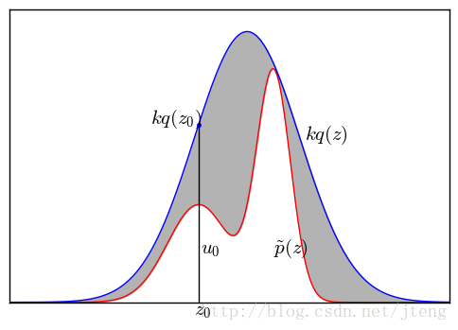
Monte Carlo Method
Acceptance-rejection sampling:
Sample from unknown PDF according to usual PDFs

Slide 7
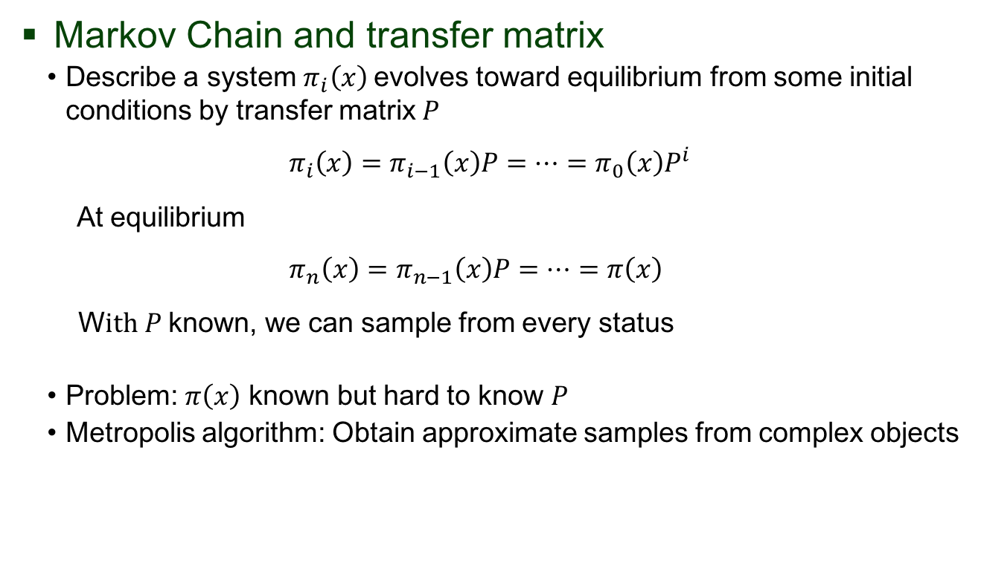
Markov Chain & Metropolis algorithm
Markov Chain and transfer matrix
Describe a system $π_{i}\left(x\right)$evolves toward equilibrium from some initial conditions by transfer matrix $P$
$$π_{i}\left(x\right)=π_{i−1}\left(x\right)P=…=π_{0}\left(x\right)P^{i}$$
At equilibrium
$$π_{n}\left(x\right)=π_{n−1}\left(x\right)P=…=π\left(x\right)$$
W$ith P$ known, we can sample from every status
Problem: $π\left(x\right)$ known but hard to know $P$
Metropolis algorithm: Obtain approximate samples from complex objects

Slide 8
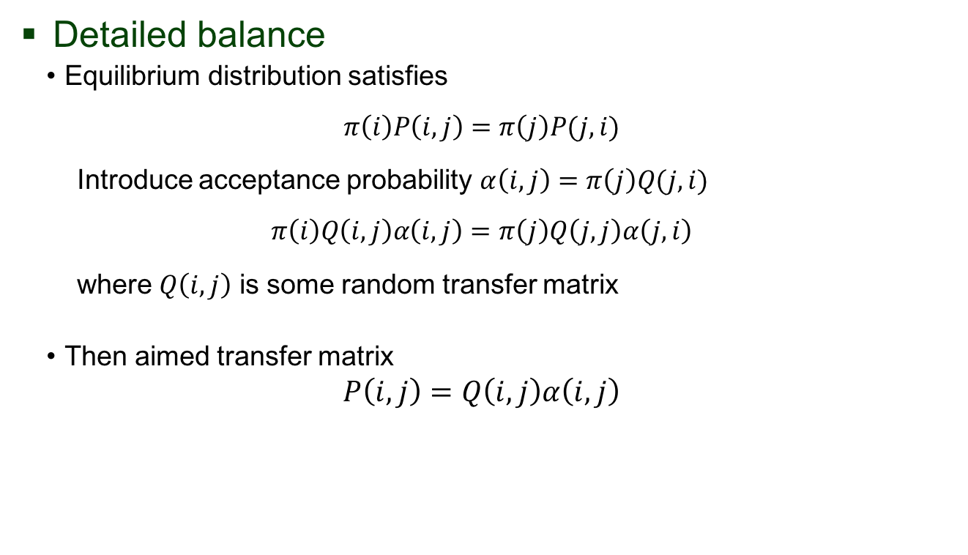
Metropolis algorithm
Detailed balance
Equilibrium distribution satisfies
$$π\left(i\right)P\left(i,j\right)=π\left(j\right)P(j,i)$$
Introduce acceptance probability $α\left(i,j\right)=π\left(j\right)Q(j,i)$
$$π\left(i\right)Q\left(i,j\right)α\left(i,j\right)=π\left(j\right)Q\left(j,j\right)α\left(j,i\right)$$
where $Q\left(i,j\right)$ is some random transfer matrix
Then aimed transfer matrix
$$P\left(i,j\right)=Q\left(i,j\right)α\left(i,j\right)$$

Slide 9
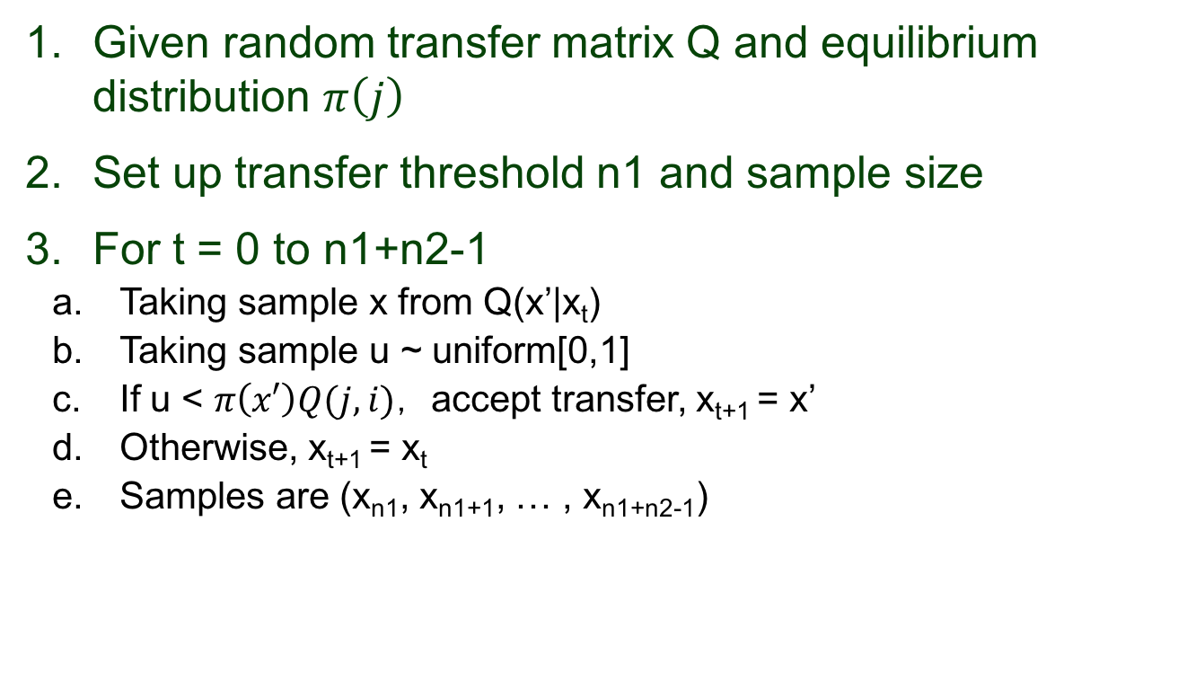
Metropolis algorithm
Given random transfer matrix Q and equilibrium distribution $π\left(j\right)$
Set up transfer threshold n1 and sample size
For t = 0 to n1+n2-1
Taking sample x from Q(x’|x_{t})
Taking sample u ~ uniform[0,1]
If u < $π\left(x′\right)Q(j,i)$， accept transfer, x_{t+1} = x’
Otherwise, x_{t+1} = x_{t}
Samples are (x_{n1}, x_{n1+1}, … , x_{n1+n2-1})

Slide 10
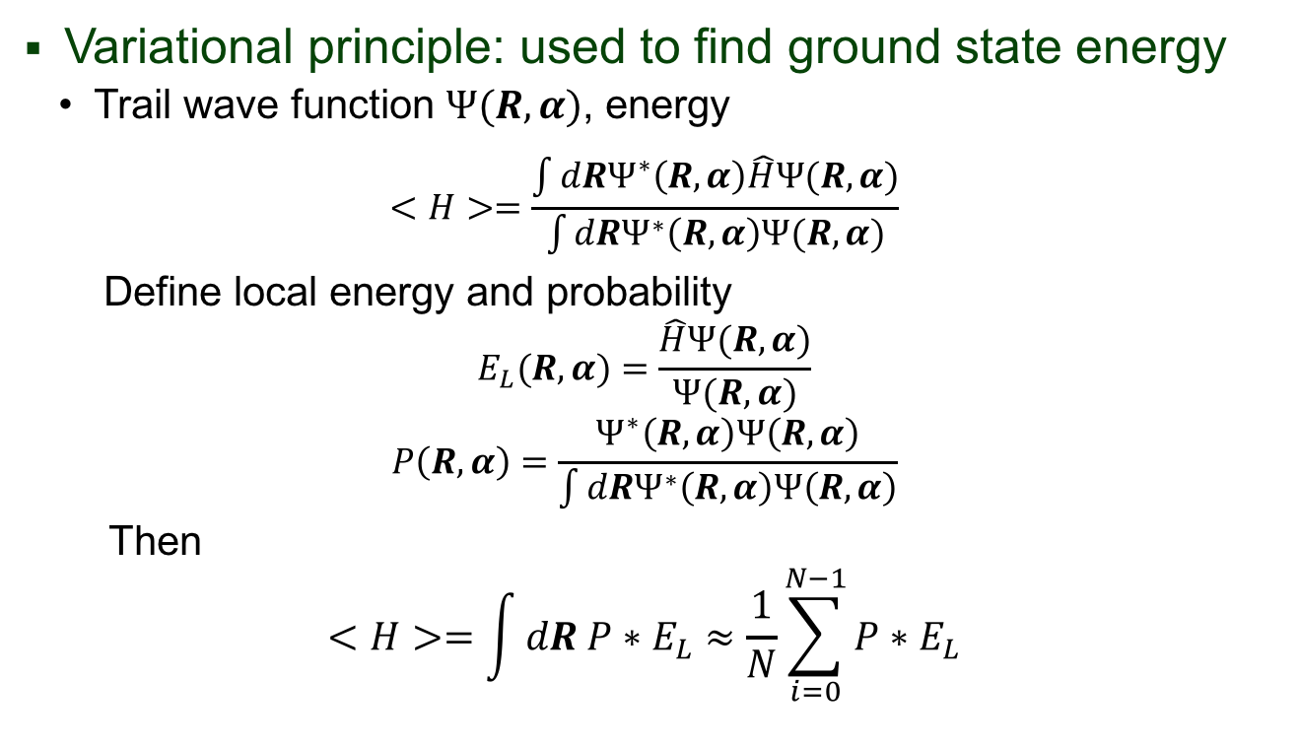
Variational Monte Carlo
Variational principle: used to find ground state energy
Trail wave function $Ψ(R,α)$, energy
$$<H>=\frac{\int{dRΨ^{∗}\left(R,α\right)\hat{H}Ψ(R,α)}}{\int{dRΨ^{∗}\left(R,α\right)Ψ(R,α)}}$$
Define local energy and probability
$$E_{L}(R,α)=\frac{\hat{H}Ψ(R,α)}{Ψ(R,α)}$$
$$P\left(R,α\right)=\frac{Ψ^{∗}\left(R,α\right)Ψ\left(R,α\right)}{\int{dRΨ^{∗}\left(R,α\right)Ψ\left(R,α\right)}}$$
Then
$$<H>=\int{dR P∗E_{L}}≈\frac{1}{N}\sum_{i=0}^{N−1}{P∗E_{L}}$$

Slide 11

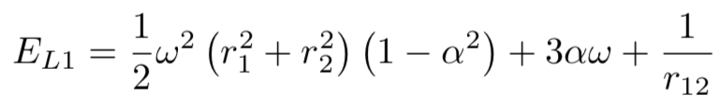

Physical system
Two electrons in Harmonic Oscillator potential
Hamiltonian
$$H=\frac{1}{2}\left(−∇_{1}−∇_{2}+ω^{2}r_{1}^{2}{+ω}^{2}r_{2}^{2}\right)+\frac{1}{r_{12}}$$
First trail wave function
with local energy

Slide 12
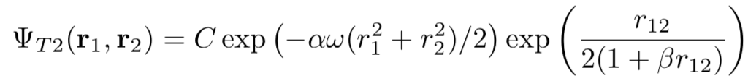
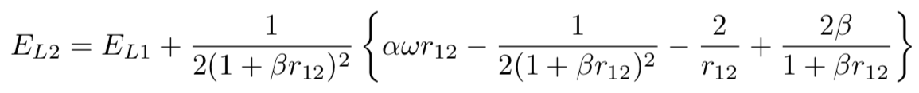

Physical system
Two electrons in Harmonic Oscillator potential
Hamiltonian
$$H=\frac{1}{2}\left(−∇_{1}−∇_{2}+ω^{2}r_{1}^{2}{+ω}^{2}r_{2}^{2}\right)+\frac{1}{r_{12}}$$
Second trail wave function
with local energy
Jastrow factor

Slide 13
Algorithm
Starting from random r₁ and r₂, set number of MC steps and variational parameters α
Trail move: r_{i}’ = r_{i} + s*dr where dr ~ uniform[0,1]; calculate E_{L}(r_{i}) and E_{L}(r_{i}’)
Metropolis algorithm to accept move is u < P(r_{i}’)/ P(r_{i})
Accepted: r_{i} = r_{i}’
<H> = SUM(E_{L}(r_{i}) )/# MC steps

Slide 14
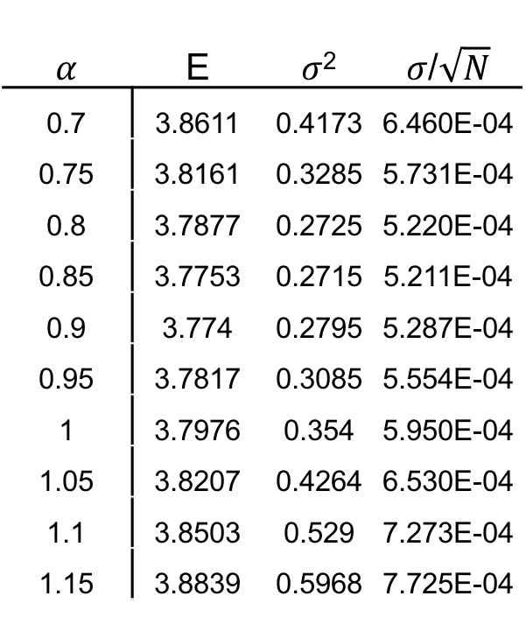
Results and discussion
𝛼 | E | 𝜎² | 𝜎/$\sqrt{N}$
0.7 | 3.8611 | 0.4173 | 6.460E-04
0.75 | 3.8161 | 0.3285 | 5.731E-04
0.8 | 3.7877 | 0.2725 | 5.220E-04
0.85 | 3.7753 | 0.2715 | 5.211E-04
0.9 | 3.774 | 0.2795 | 5.287E-04
0.95 | 3.7817 | 0.3085 | 5.554E-04
1 | 3.7976 | 0.354 | 5.950E-04
1.05 | 3.8207 | 0.4264 | 6.530E-04
1.1 | 3.8503 | 0.529 | 7.273E-04
1.15 | 3.8839 | 0.5968 | 7.725E-04
Variational MC method used for different 𝛼 values
N = 10⁷ and step size is adjusted for ~ 50% acceptance
Energies and variances are calculated
Table 1. Energies and variances for different parameter 𝛼. (𝜔=1)

Slide 15
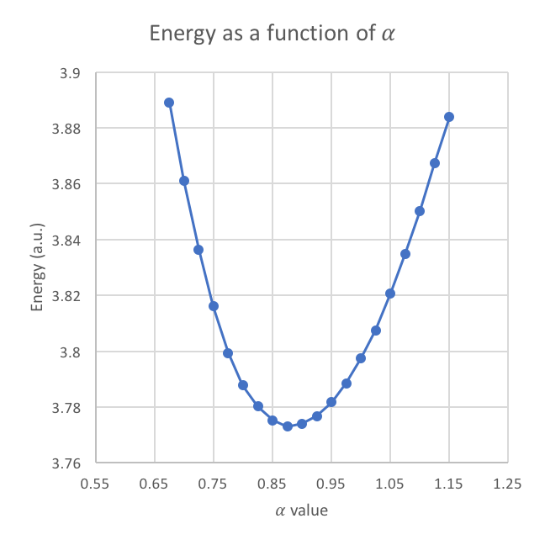
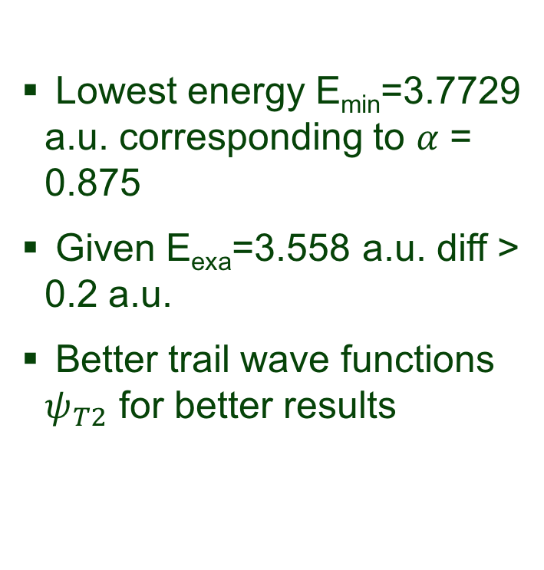
Results and discussion
Lowest energy E_{min}=3.7729 a.u. corresponding to 𝛼 = 0.875
Given E_{exa}=3.558 a.u. diff > 0.2 a.u.
Better trail wave functions $ψ_{T2}$ for better results
Figure 1. Energies as a function of parameter 𝛼. (𝜔=1)

Slide 16
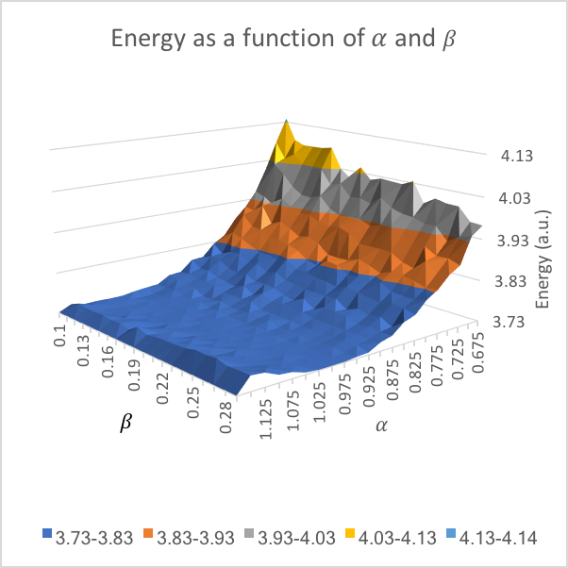
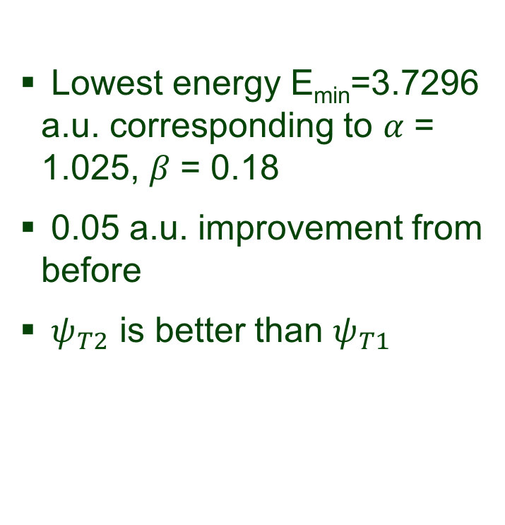
Results and discussion
Lowest energy E_{min}=3.7296 a.u. corresponding to 𝛼 = 1.025, 𝛽 = 0.18
0.05 a.u. improvement from before
$ψ_{T2}$ is better than $ψ_{T1}$
Figure 2. Energies as a function of parameters 𝛼 and 𝛽. (𝜔=1)

Slide 17
Remaining works and improvments
Calculations energies for different 𝜔
How 𝜔 relates with energy and variational parameters
Compare with results obtained in Project 2 (diagonalization method used)
Test of virial theorem
H.O. potential: <T> = <V>
Coulomb interaction: <T> = 0.5*<V>
Relative strength of Coulomb interaction compared with H.O. potential
Automatic search for variational parameters’ intervals and suitable step size

Slide 18
Summary and Outlook
Numerical integral using MC method
Nonanalytic or high dimensional integrals
Metropolis algorithm: sampling strategy
Solving two-electron in H.O potential
Variational principle Numerical integral
Two trail wave functions used in calculations
Outlook
Extension to atom systems and many body system
Combined with machine learning

