Slide 2
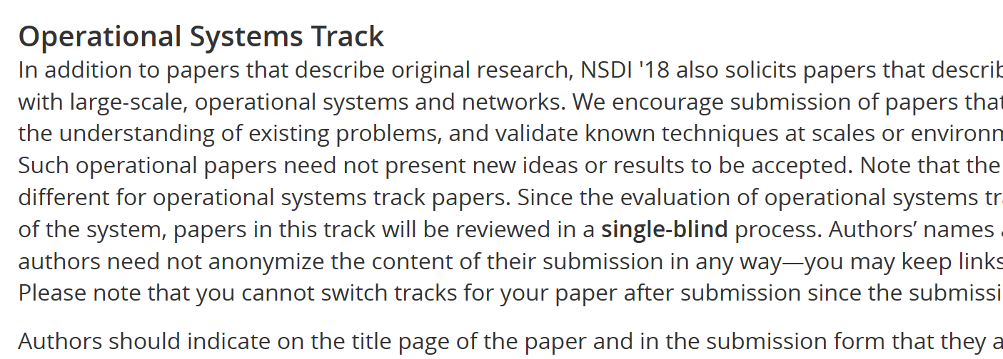
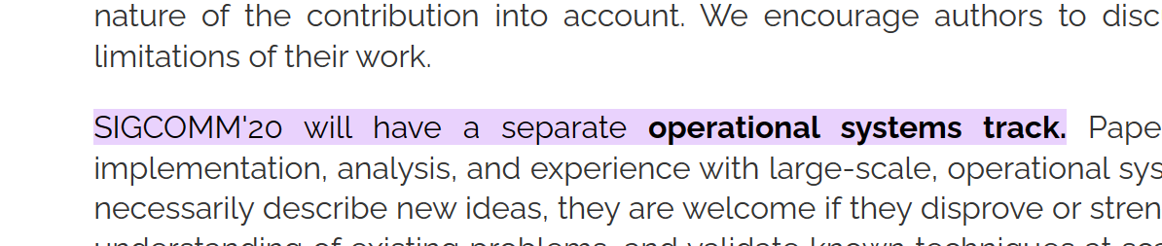
Background Industry Papers in Academic Conferences
Research conferences encourage submissions from the industry
Operational System Track/Experience Track:
SIGCOMM, since 2020.
NSDI, since 2015 (single-blind) and become double-blind in 2019.

Slide 3
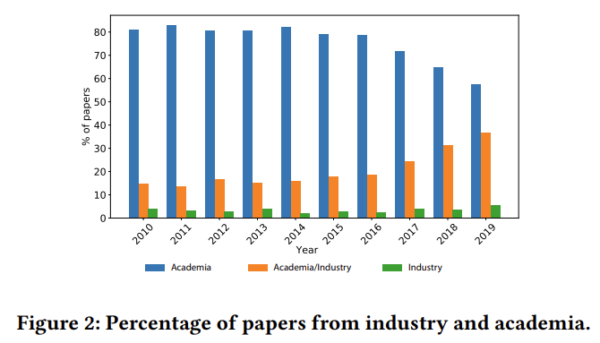
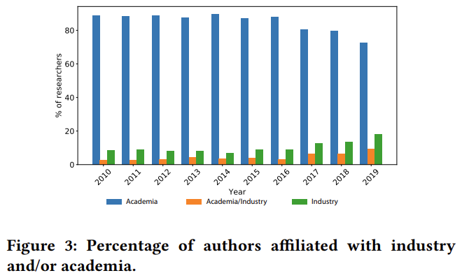
More Industry Papers!
This is common in other communities as well…
In CVPR:
*[2107.04902] Industry and Academic Research in Computer Vision
https://arxiv.org/abs/2107.04902

Slide 4
Stats in SIGCOMM’24
62 accepted papers
Academia only: 22 (35%)
Industry only: 4 (6%)
Academia + Industry: 36 (58%)
13 experience track papers:
Academia only: 0 (0%)
Industry only: 3 (23%)
Academia + Industry: 10 (77%)
49 research track papers:
Academia only: 22 (45%)
Industry only: 1 (2%)
Academia + Industry: 26 (53%)

Slide 5
It keeps increasing

Slide 6
Pros and Cons
On one side, networking research values large-scale deployments, and they do advance the community a lot! (think of BBR, DCTCP, …)
On the other side, the roles of the participating students/profs and companies are unclear in some collaborations.
What can academia bring to the industry and vice versa?

Slide 7
Questions
What can academia bring to the industry and vice versa?
How does the collaboration form?
What are the roles of industry/academia?
How does a typical collaboration look like?
…

Slide 8
Program rundown
Opening (6 min)
Zili Meng, Hong Kong University of Science and Technology
Sharings (24 min)
Ammar Tahir, University of Illinois Urbana-Champaign
James Larisch, Harvard University and Cloudflare
Ye Yang, Alibaba Cloud and Xiaochong Jiang, Zhejiang University
Zahaib Akhtar, Amazon Prime Video
Discussions & open-mic (15 min)

