Slide 1

Tarjan Algorithm
Computing biconnected components in O(m)
Matteo Menicacci

Slide 2
What is a biconnected component?

Slide 3
What is a biconnected component?

Slide 4
What is a biconnected component?

Slide 5
What is a biconnected component?
It’s a maximal biconnected subgraph.

Slide 6
What is a biconnected component?
It’s a maximal biconnected subgraph.
In this subgraph, if any one vertex were to be removed, it will remain connected.

Slide 7
What is a biconnected component?
A cut vertex of a connected graph is a node that, if removed, increases the number of connected components of the graph

Slide 8
What is a biconnected component?
A cut vertex of a connected graph is a node that, if removed, increases the number of connected components of the graph

Slide 9
What is a biconnected component?
A cut vertex of a connected graph is a node that, if removed, increases the number of connected components of the graph
Biconnected components are covering and overlapping communities

Slide 10
Algorithm implementation

Slide 11
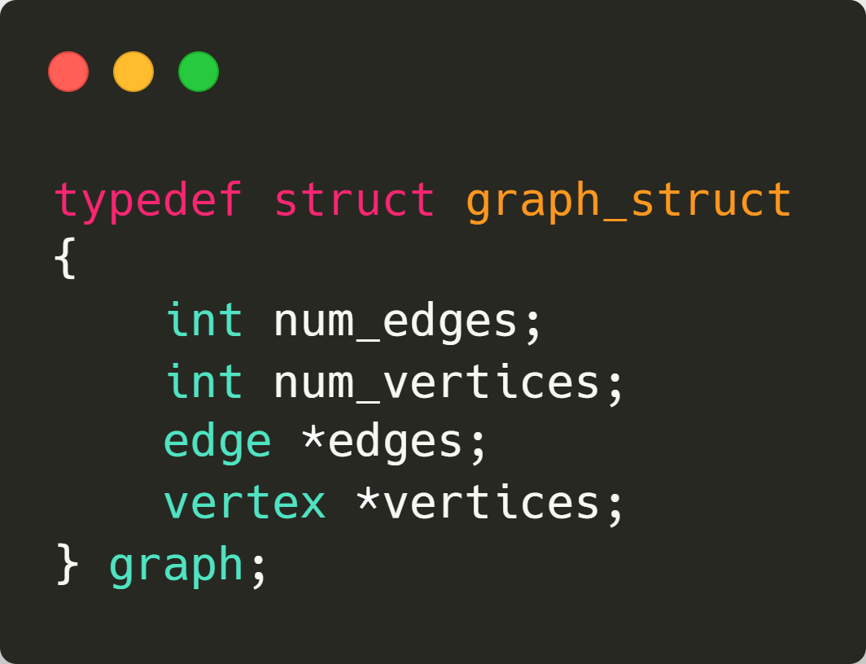
Algorithm implementation

Slide 12
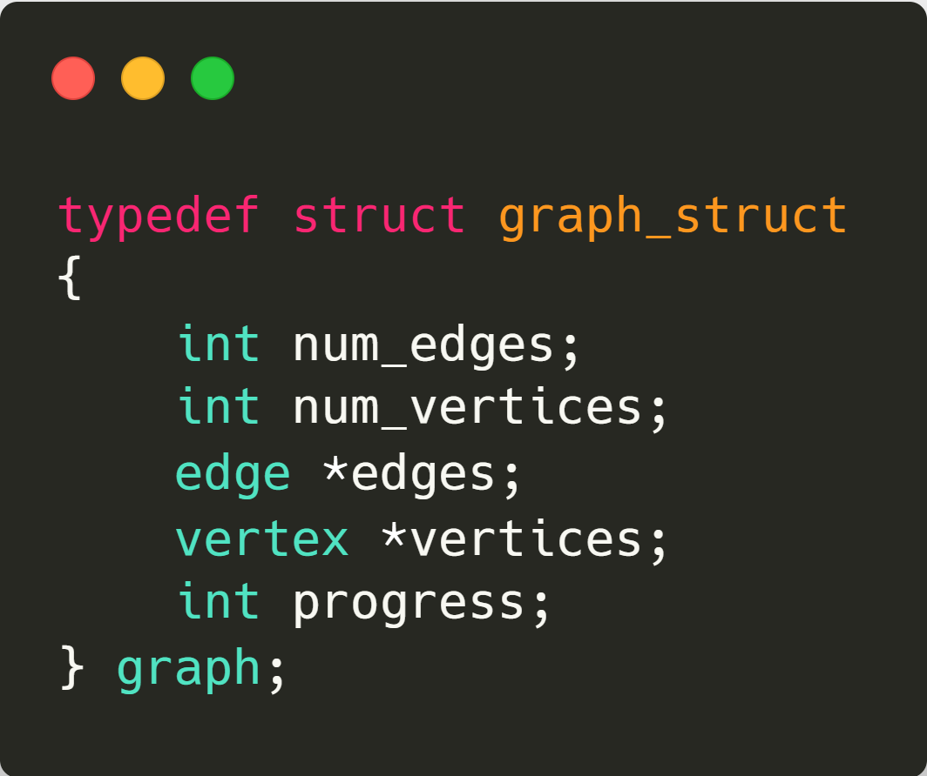
Algorithm implementation

Slide 13
Algorithm implementation

Slide 14
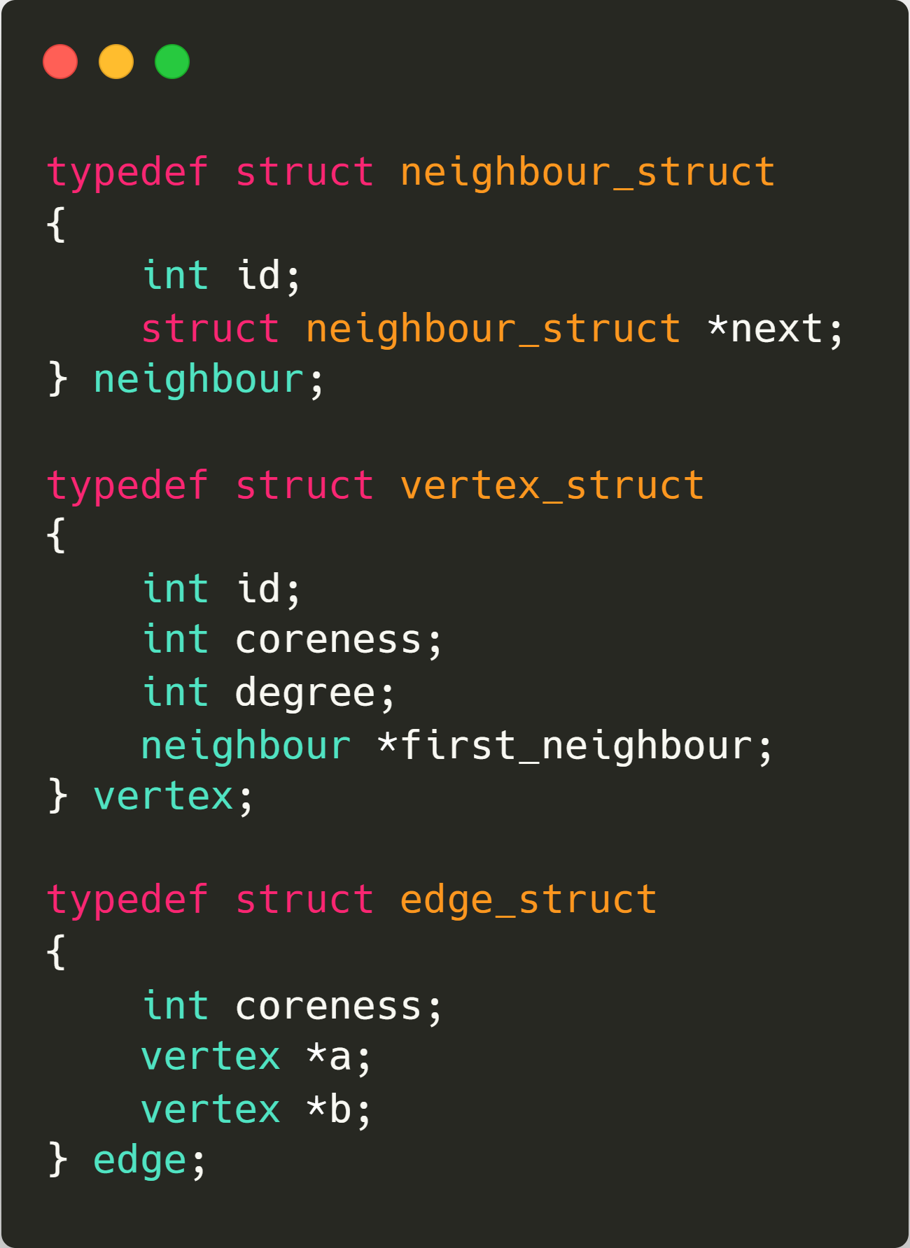
Algorithm implementation

Slide 15
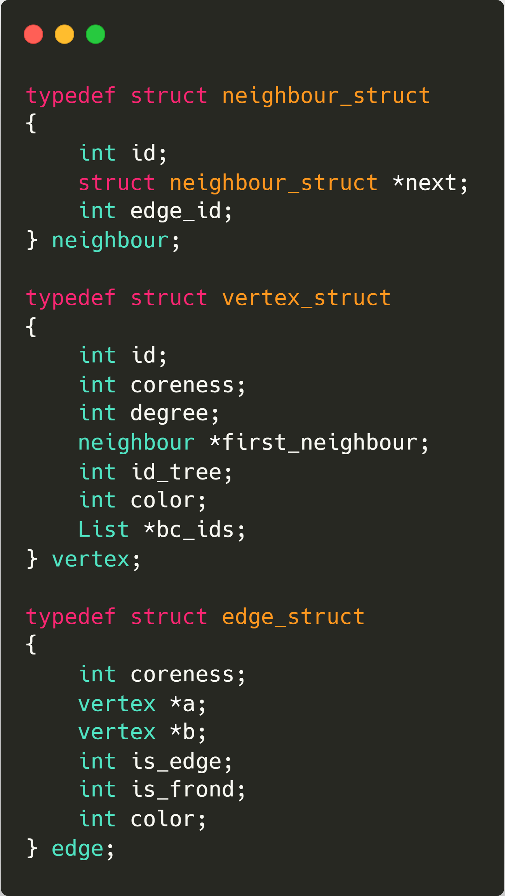
Algorithm implementation

Slide 16
Algorithm implementation

Slide 17
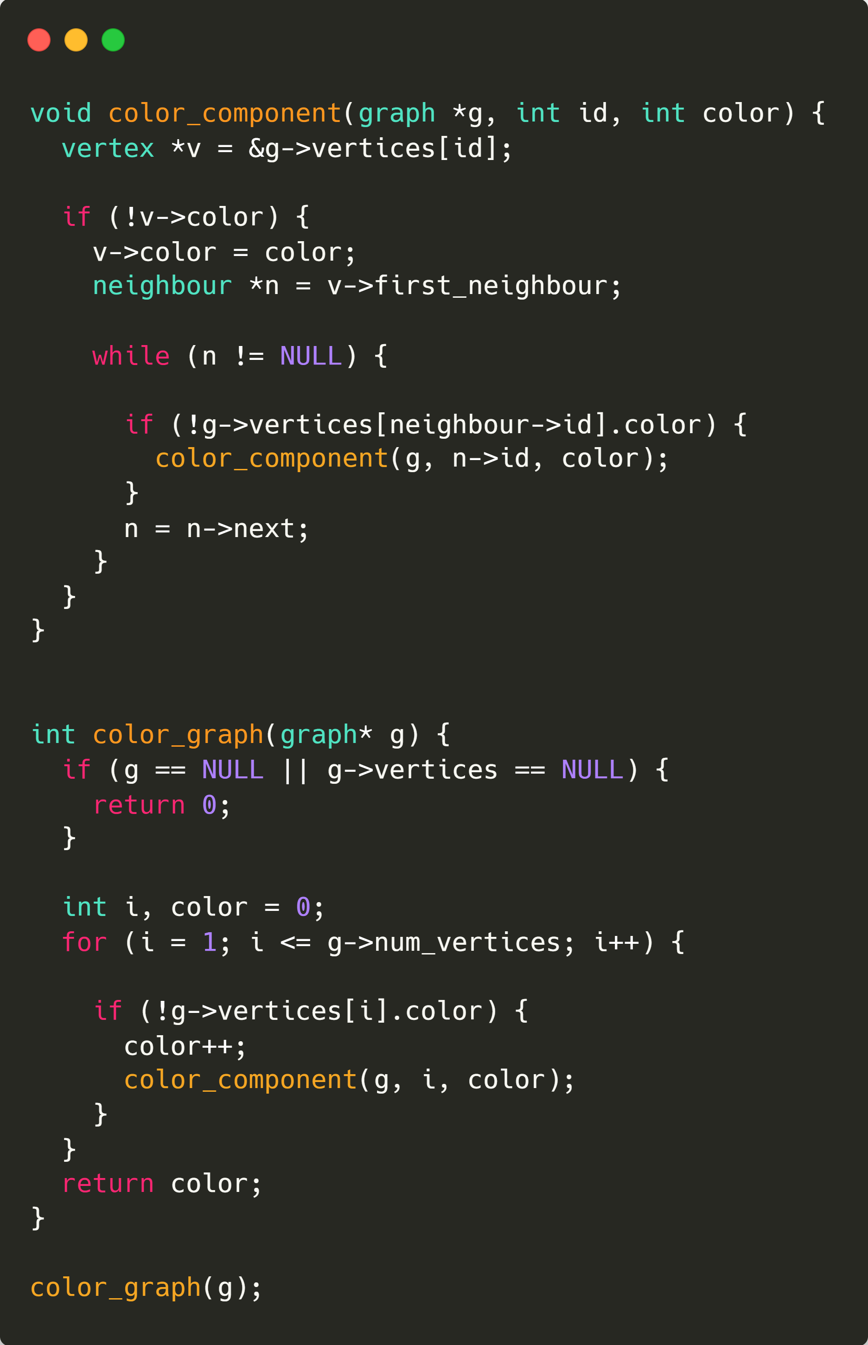
Algorithm implementation

Slide 18
Algorithm implementation

Slide 19
Algorithm implementation

Slide 20
Algorithm implementation
Performed in: O(n + m)

Slide 21
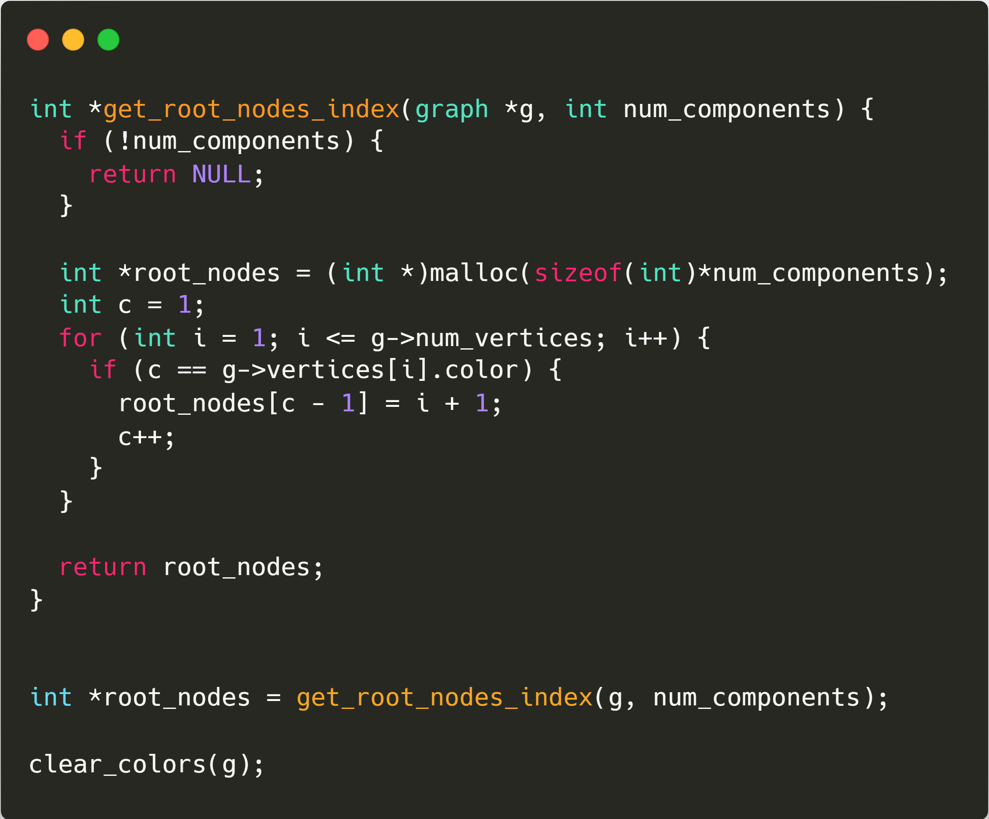
Algorithm implementation

Slide 22
Algorithm implementation

Slide 23
Algorithm implementation

Slide 24
Algorithm implementation
Performed in: O(n)

Slide 25
Algorithm implementation

Slide 26
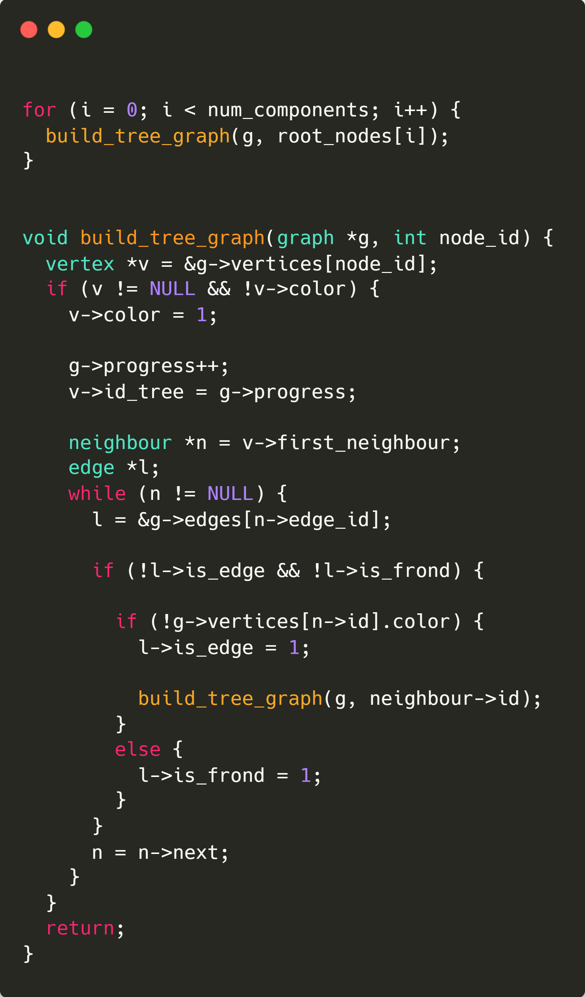
Algorithm implementation

Slide 27
Algorithm implementation

Slide 28
Algorithm implementation

Slide 29
Algorithm implementation

Slide 30
Algorithm implementation
1

Slide 31
Algorithm implementation
1

Slide 32
Algorithm implementation
1

Slide 33
Algorithm implementation
1

Slide 34
Algorithm implementation
1

Slide 35
Algorithm implementation
1

Slide 36
Algorithm implementation
2
1

Slide 37
Algorithm implementation
2
1

Slide 38
Algorithm implementation
3
2
1

Slide 39
Algorithm implementation
4
3
2
1

Slide 40
Algorithm implementation
5
4
3
2
1

Slide 41
Algorithm implementation
6
5
4
3
2
1

Slide 42
Algorithm implementation
7
6
5
4
3
2
1

Slide 43
Algorithm implementation
8
7
6
5
4
3
2
1

Slide 44
Algorithm implementation
8
9
7
6
5
4
3
2
1

Slide 45
Algorithm implementation
8
9
7
10
6
5
4
3
2
1

Slide 46
Algorithm implementation
8
9
7
10
6
5
4
3
2
1

Slide 47
Algorithm implementation
8
9
7
10
6
5
4
3
2
1

Slide 48
Algorithm implementation
8
9
7
10
6
5
4
3
2
1

Slide 49
Algorithm implementation
8
9
7
10
6
5
4
3
2
1

Slide 50
Algorithm implementation
14
8
15
17
13
9
7
22
16
12
10
6
21
11
5
23
20
18
4
26
19
3
2
25
27
1
24

Slide 51
Algorithm implementation
Performed in: O(m)
14
8
15
17
13
9
7
22
16
12
10
6
21
11
5
23
20
18
4
26
19
3
2
25
27
1
24

Slide 52
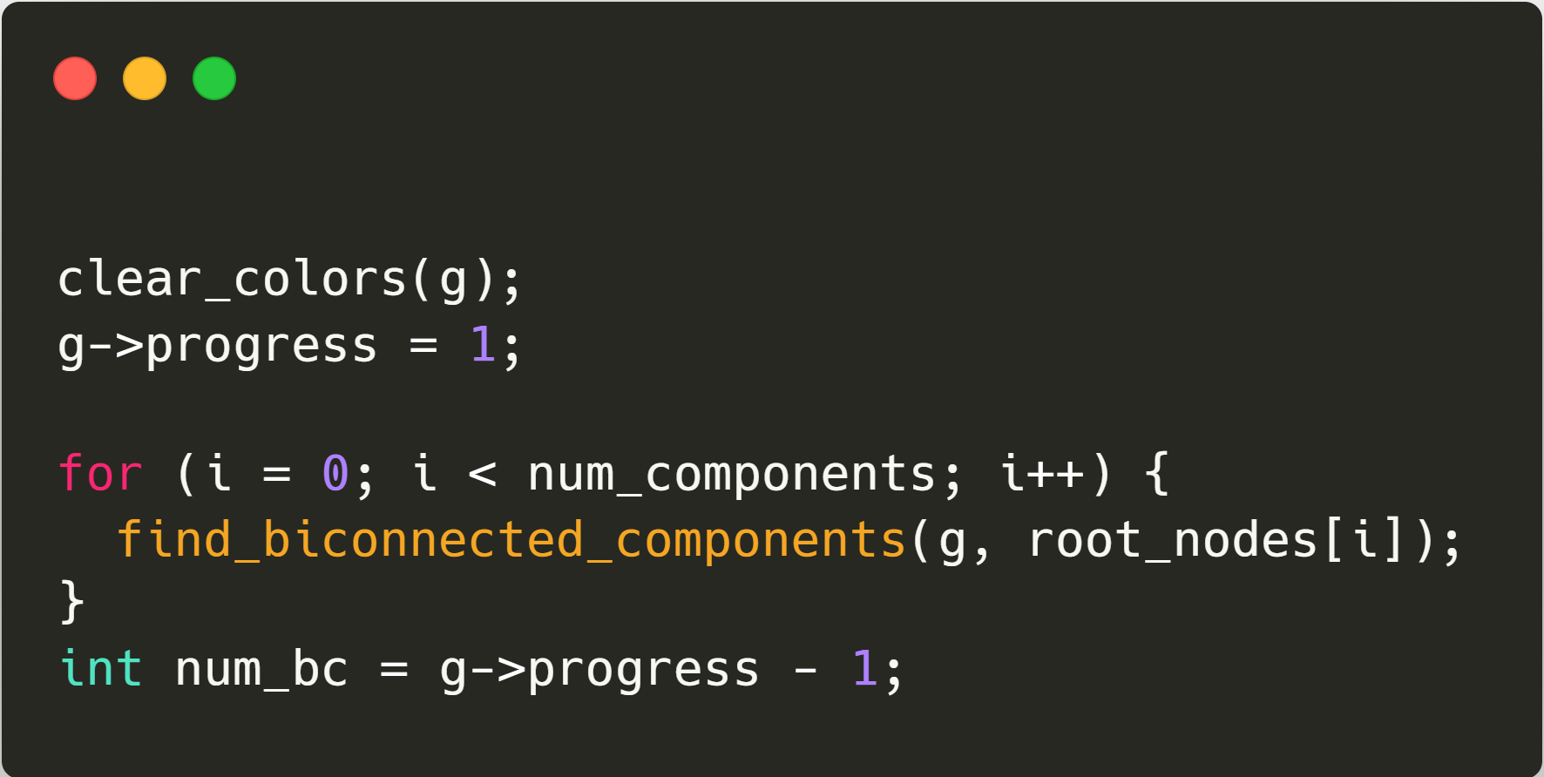
Algorithm implementation
14
8
15
17
13
9
7
22
16
12
10
6
21
11
5
23
20
18
4
26
19
3
2
25
27
1
24

Slide 53
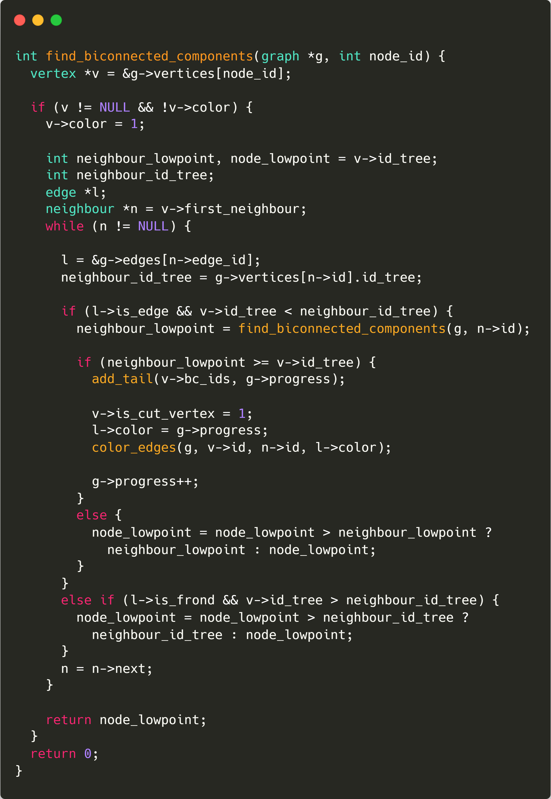
Algorithm implementation
14
8
15
17
13
9
7
22
16
12
10
6
21
11
5
23
20
18
4
26
19
3
2
25
27
1
24

Slide 54
Algorithm implementation
14
8
15
17
13
9
7
22
16
12
10
6
21
11
5
23
20
18
4
26
19
3
2
25
27
1
24

Slide 55
Algorithm implementation
14
8
15
17
13
9
7
22
16
12
10
6
21
11
5
23
20
18
4
26
19
3
2
25
27
1
24

Slide 56
Algorithm implementation
14
8
15
17
13
9
7
22
16
12
10
6
21
11
5
23
20
18
4
26
19
3
2
25
27
1
24

Slide 57
Algorithm implementation
14
8
15
17
13
9
7
22
16
12
10
6
21
11
5
23
20
18
4
26
19
3
2
25
27
1
24

Slide 58
Algorithm implementation
14
8
15
17
13
9
7
22
16
12
10
6
21
11
5
23
20
18
4
26
19
3
2
25
27
1
24

Slide 59
Algorithm implementation
14
8
15
17
13
9
7
22
16
12
10
6
21
11
5
23
20
18
4
26
19
3
2
25
27
1
24

Slide 60
Algorithm implementation
14
8
15
17
13
9
7
22
16
12
10
6
21
11
5
23
20
18
4
26
19
3
2
25
27
1
24

Slide 61
Algorithm implementation
14
8
15
17
13
9
7
22
16
12
10
6
21
11
5
23
20
18
4
26
19
3
2
25
27
1
24

Slide 62
Algorithm implementation
14
8
15
17
13
9
7
22
16
12
10
6
21
11
5
23
20
18
4
26
19
3
2
25
27
1
24

Slide 63
Algorithm implementation
14
8
15
17
13
9
7
22
16
12
10
6
21
11
5
23
20
18
4
26
19
3
2
25
27
1
24

Slide 64
Algorithm implementation
14
8
15
17
13
9
7
22
16
12
10
6
21
11
5
23
20
18
4
26
19
3
2
25
27
1
24
2

Slide 65
Algorithm implementation
14
8
15
17
13
9
7
22
16
12
10
6
21
11
5
23
20
18
4
26
19
3
2
25
27
1
2
24

Slide 66
Algorithm implementation
14
8
15
17
13
9
7
22
16
12
10
6
2
1
21
11
5
23
20
18
4
26
19
3
2
25
27
1
24

Slide 67
Algorithm implementation
14
8
15
17
13
9
7
22
16
12
10
6
2
1
New BC found
21
11
5
23
20
18
4
26
19
3
2
25
27
1
24

Slide 68
Algorithm implementation
14
8
15
17
13
9
7
22
16
12
10
6
21
11
5
23
20
18
4
26
19
3
2
25
27
1
24

Slide 69
Algorithm implementation
14
8
15
17
13
9
7
22
16
12
10
6
21
11
5
23
20
18
4
26
19
3
2
25
27
1
24

Slide 70
Algorithm implementation
14
8
15
17
13
9
7
22
16
12
10
6
21
11
5
23
20
18
4
26
19
3
2
25
27
1
24

Slide 71
Algorithm implementation
14
8
15
17
13
9
7
22
16
12
10
6
21
11
5
23
20
18
4
26
19
3
2
25
27
1
24

Slide 72
Algorithm implementation
14
8
15
17
13
9
7
22
16
12
10
6
21
11
5
23
20
18
4
26
19
3
2
25
27
1
24

Slide 73
Algorithm implementation
14
8
15
17
13
9
7
22
16
12
10
6
21
11
5
23
20
18
4
26
19
3
2
25
27
1
24

Slide 74
Algorithm implementation
8
9
7
10
6
5
4

Slide 75
Algorithm implementation
8
9
7
10
6
5
4

Slide 76
Algorithm implementation
8
9
7
10
6
5
4

Slide 77
Algorithm implementation
8
9
7
10
6
5
4

Slide 78
Algorithm implementation
8
9
7
10
6
5
4

Slide 79
Algorithm implementation
8
9
7
10
6
5
4

Slide 80
Algorithm implementation
8
9
7
10
6
5
4

Slide 81
Algorithm implementation
8
9
7
10
6
5
4

Slide 82
Algorithm implementation
8
9
7
10
6
5
10
5
4

Slide 83
Algorithm implementation
8
9
7
LP: 5
10
6
5
10
5
4

Slide 84
Algorithm implementation
8
9
7
LP: 5
10
6
7
5
5
4

Slide 85
Algorithm implementation
8
9
7
5
10
6
5
4

Slide 86
Algorithm implementation
8
9
7
10
6
5
9
5
4

Slide 87
Algorithm implementation
8
LP: 5
9
7
10
6
5
4

Slide 88
Algorithm implementation
8
LP: 5
9
7
10
6
5
5
4

Slide 89
Algorithm implementation
8
5
9
7
10
6
5
4

Slide 90
Algorithm implementation
8
LP: 5
9
7
10
6
5
4

Slide 91
Algorithm implementation
8
LP: 5
9
7
10
6
5
4

Slide 92
Algorithm implementation
8
LP: 5
9
7
10
6
5
5
4

Slide 93
Algorithm implementation
8
5
9
7
10
6
5
4

Slide 94
Algorithm implementation
8
9
7
LP: 5
10
6
5
4

Slide 95
Algorithm implementation
8
9
7
LP: 5
10
6
5
4

Slide 96
Algorithm implementation
8
9
7
LP: 5
10
6
5
5
4

Slide 97
Algorithm implementation
8
9
7
5
10
6
5
4

Slide 98
Algorithm implementation
8
9
7
10
6
LP: 5
5
4

Slide 99
Algorithm implementation
8
9
7
10
6
LP: 5
5
5
4

Slide 100
Algorithm implementation
8
9
7
10
6
5
5

Slide 101
Algorithm implementation
8
9
7
5
5
10
6
5

Slide 102
Algorithm implementation
8
9
7
10
6
5

Slide 103
Algorithm implementation
8
9
7
10
6
5

Slide 104
Algorithm implementation
8
9
7
10
6
5

Slide 105
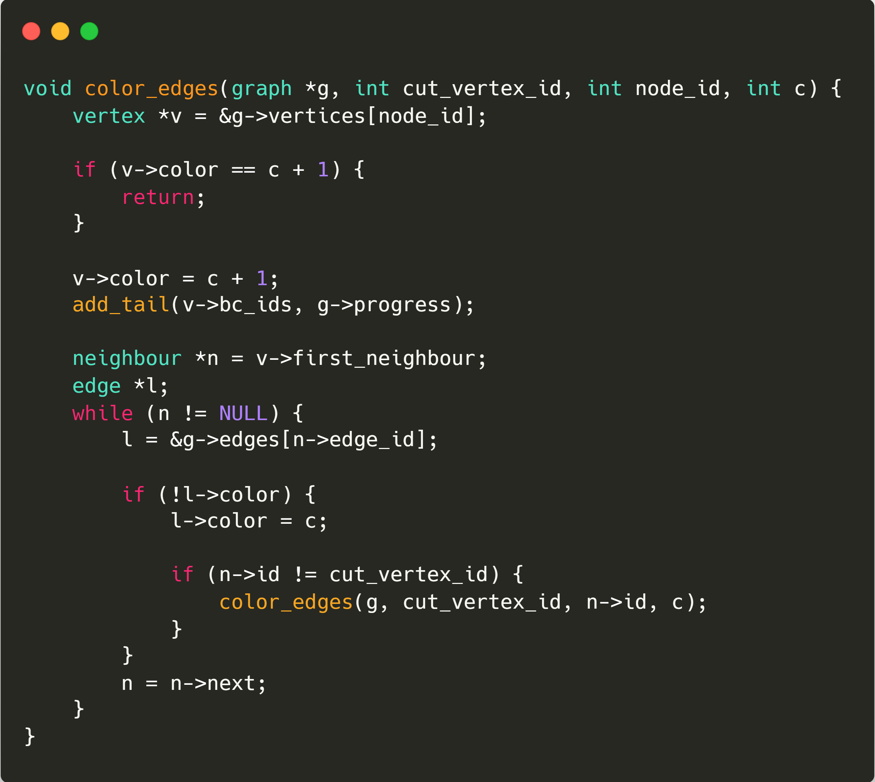
Algorithm implementation
8
9
7
10
6
5

Slide 106
Algorithm implementation
8
9
7
10
6
5

Slide 107
Algorithm implementation
8
9
7
10
6
5

Slide 108
Algorithm implementation
8
9
7
10
6
5

Slide 109
Algorithm implementation
8
9
7
10
6
5

Slide 110
Algorithm implementation
8
9
7
10
6
5

Slide 111
Algorithm implementation
8
9
7
10
6
5

Slide 112
Algorithm implementation
8
9
7
10
6
5

Slide 113
Algorithm implementation
8
9
7
10
6
5

Slide 114
Algorithm implementation
8
9
7
10
6
5

Slide 115
Algorithm implementation
8
9
7
10
6
5

Slide 116
Algorithm implementation
8
9
7
10
6
5

Slide 117
Algorithm implementation
8
9
7
10
6
5

Slide 118
Algorithm implementation
14
8
15
17
13
9
7
22
16
12
10
6
21
11
5
23
20
18
4
26
19
3
2
25
27
1
24

Slide 119
Algorithm implementation
14
8
15
17
13
9
7
22
16
12
10
6
21
11
5
23
20
18
4
26
19
3
2
25
27
1
24

Slide 120
Algorithm implementation
14
8
15
17
13
9
7
22
16
12
10
6
21
11
5
23
20
18
4
26
19
3
2
25
27
1
24

Slide 121
Algorithm implementation
14
8
15
17
13
9
7
22
16
12
10
6
21
11
5
23
20
18
4
26
19
3
2
25
27
1
24

Slide 122
Algorithm implementation
14
8
15
17
13
9
7
22
16
12
10
6
Cost analysis:
21
11
5
23
20
18
4
26
19
3
2
25
27
1
24

Slide 123
Algorithm implementation
14
8
15
17
13
9
7
22
16
12
10
6
Cost analysis:
There is just one difference between the classic Tarjan algorithm and this implementation.
21
11
5
23
20
18
4
26
19
3
2
25
27
1
24

Slide 124
Algorithm implementation
14
8
15
17
13
9
7
22
16
12
10
6
Cost analysis:
There is just one difference between the classic Tarjan algorithm and this implementation.
The main function returns just the lowpoint without the list of edges. So the cost must be O(m) still.
21
11
5
23
20
18
4
26
19
3
2
25
27
1
24

Slide 125
Algorithm implementation
14
8
15
17
13
9
7
22
16
12
10
6
Cost analysis:
There is just one difference between the classic Tarjan algorithm and this implementation.
The main function returns just the lowpoint without the list of edges. So the cost must be O(m) still.
When we found a new biconnected component, we visit all its internal nodes and all their edges. We don’t exit from the biconnected component and we don’t visit an internal node twice.
21
11
5
23
20
18
4
26
19
3
2
25
27
1
24

Slide 126
Algorithm implementation
14
8
15
17
13
9
7
22
16
12
10
6
Cost analysis:
A node can be an internal node just for one biconnected component, so the cost is still O(m).
There is just one difference between the classic Tarjan algorithm and this implementation.
The main function returns just the lowpoint without the list of edges. So the cost must be O(m) still.
When we found a new biconnected component, we visit all its internal nodes and all their edges. We don’t exit from the biconnected component and we don’t visit an internal node twice.
21
11
5
23
20
18
4
26
19
3
2
25
27
1
24

Slide 127
Algorithm implementation
A node can be an internal node just for one biconnected component, so the cost is still O(m).
4
Why is this true?
5
7
3
11
6
2
8
10
1
9

Slide 128
Algorithm implementation
A node can be an internal node just for one biconnected component, so the cost is still O(m).
4
Why is this true?
If we remove a non-cut-vertex node, there will still exist a path between every node of the biconnected component it belongs.
5
3
11
6
2
8
10
1
9

Slide 129
Algorithm implementation
A node can be an internal node just for one biconnected component, so the cost is still O(m).
4
Why is this true?
If we remove a non-cut-vertex node, there will still exist a path between every node of the biconnected component it belongs.
If a non-cut-vertex node belongs to multiple biconnected components we reach a paradox.
5
7
3
11
6
2
8
10
1
9

Slide 130
Algorithm implementation
A node can be an internal node just for one biconnected component, so the cost is still O(m).
4
Why is this true?
If we remove a non-cut-vertex node, there will still exist a path between every node of the biconnected component it belongs.
If a non-cut-vertex node belongs to multiple biconnected components we reach a paradox.
Only a cut-vertex node can belong to more than one biconnected component.
5
7
3
11
6
2
8
10
1
9

Slide 131
Algorithm implementation
A node can be an internal node just for one biconnected component, so the cost is still O(m).
4
Why is this true?
If we remove a non-cut-vertex node, there will still exist a path between every node of the biconnected component it belongs.
If a non-cut-vertex node belongs to multiple biconnected components we reach a paradox.
Only a cut-vertex node can belong to more than one biconnected component.
If we just visit the internal nodes of each biconnected component, we don’t visit a node twice.
5
7
3
11
6
2
8
10
1
9

Slide 132
Algorithm implementation
14
8
15
17
13
9
7
Overall analysis:
22
16
12
10
6
All this operations, from finding the connected components and their root nodes to building a tree inside the graph and finding the biconnected components, have been made in sequence.
So the overall cost its O(n + m)
21
11
5
23
20
18
4
26
19
3
2
25
27
1
24

Slide 133
Algorithm output
18
4
26
19
3
2
25
27
1
24

Slide 134
Algorithm output
For each edge, the biconnected component it belongs to
18
4
26
ID: 6
ID: 4
ID: 9
ID: 9
ID: 6
19
3
2
25
27
ID: 6
ID: 1
ID: 9
ID: 9
ID: 6
1
24

Slide 135
Algorithm output
For each edge, the biconnected component it belongs to
For each node, the list of biconnected components it belongs to
ID: 6
18
ID: 4
4
26
ID: 9
ID: 4, 6
ID: 6
19
3
2
ID: 1
ID: 9
25
27
ID: 9
1
ID: 1, 6
24
ID: 9

Slide 136
Algorithm output
Plus, each node’s neighbourhood is ordered based on its BC component ID
Ordering is performed in O(n + m) thanks to bucket-sort
ID: 6
18
ID: 4
4
26
ID: 9
ID: 4, 6
ID: 6
19
3
2
ID: 1
ID: 9
25
27
ID: 9
1
ID: 1, 6
24
ID: 9

Slide 137
Algorithm output
Plus, each node’s neighbourhood is ordered based on its BC component ID
Ordering is performed in O(n + m) thanks to bucket-sort
18
ID: 6
ID: 4,
6
3
4
ID: 4
1
ID: 6

Slide 138
Algorithm output
Plus, each node’s neighbourhood is ordered based on its BC component ID
Ordering is performed in O(n + m) thanks to bucket-sort
18
ID: 6
ID: 4,
6
next
3
first_neighbour
4
ID: 4
next
1
ID: 6

Slide 139
Algorithm output
Plus, each node’s neighbourhood is ordered based on its BC component ID
Ordering is performed in O(n + m) thanks to bucket-sort
4
ID: 4
ID: 4,
6
next
3
first_neighbour
18
ID: 6
next
1
ID: 6

Slide 140
Algorithm output
Plus, each node’s neighbourhood is ordered based on its BC component ID
Ordering is performed in O(n + m) thanks to bucket-sort
4
ID: 4
first_bc
ID: 4,
6
next
first_bc
3
18
ID: 6
next
1
ID: 6

Slide 141

Thank you

