Slide 1

FULLY AUTOMATED FLOOD DETECTION: HARNESSING THE POWER OF DEEP LEARNING AND SENTINEL FOR PROCESSING LARGE AMOUNTS OF DATA
Bruno Menini Matosak, Merve Keskin, Eva-Maria Steinbacher,
Leizel de la Cruz, Isabella Tkalec
ACKNOWLEDGEMENT:
Content partially created with open-source data and code provided by GEOHUM. https://github.com/GEOHUM-PLUS

Slide 2
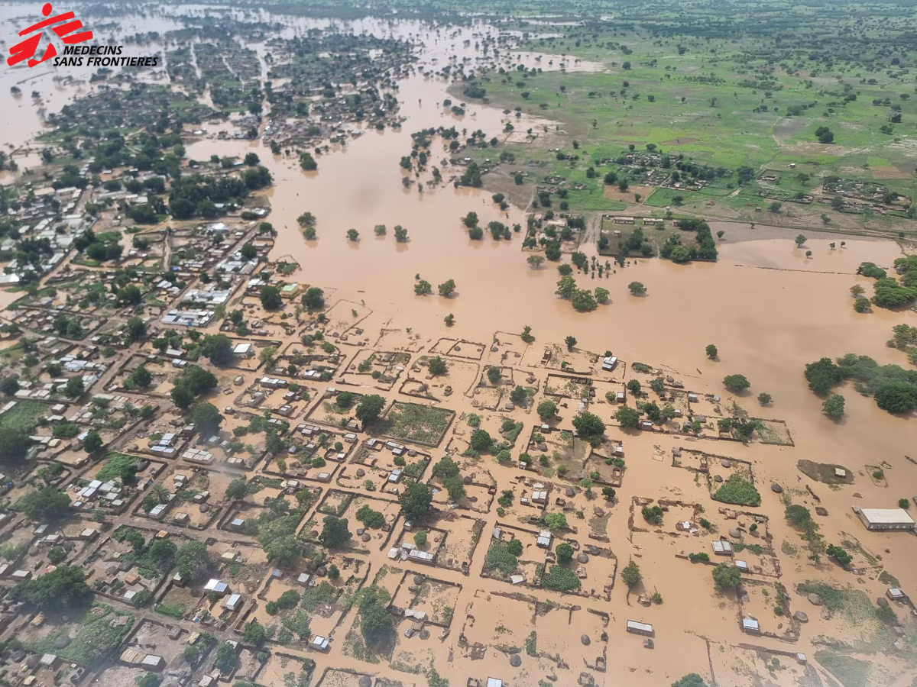
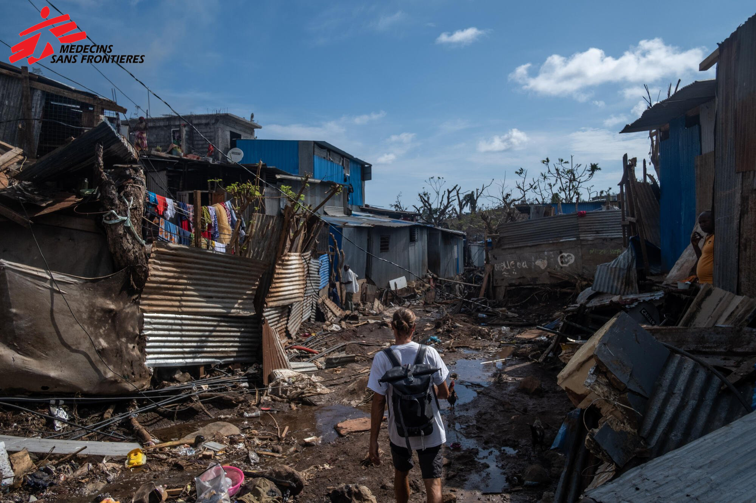
Motivation
Floods can be very dangerous
  Human displacement
  Loss of life
  Damage properties
Due to climate change floods are becoming…
  … more frequent
  … harder to predict
Approximately 1.47 billion people are at high risk of severe flooding¹
  89% live in low- and middle-income countries
¹Rentschler and Salhab. People in Harm’s Way : Flood Exposure and Poverty in 189 Countries. 2020.
Images Source: Doctors Without Borders (MSF)

Slide 3
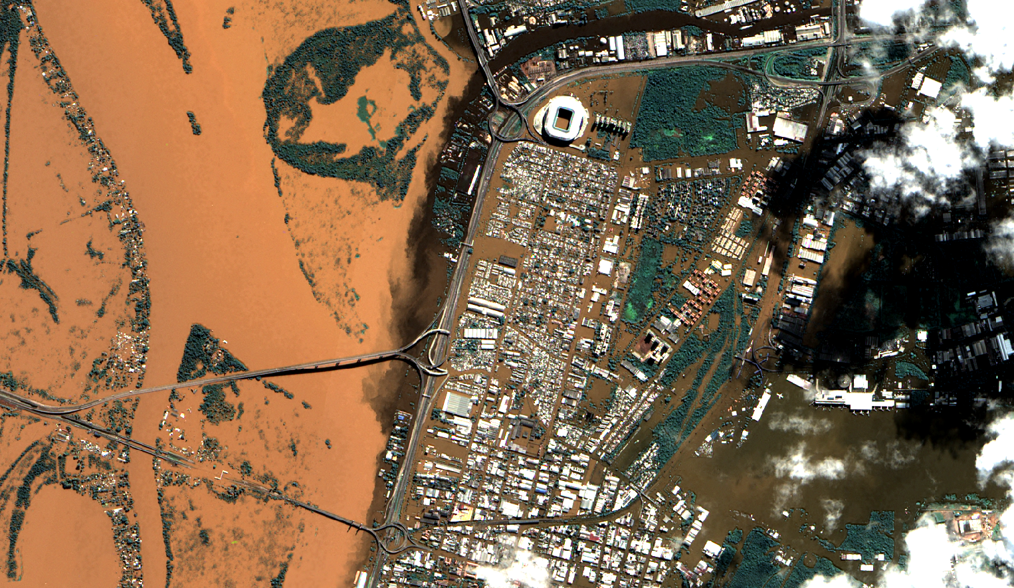
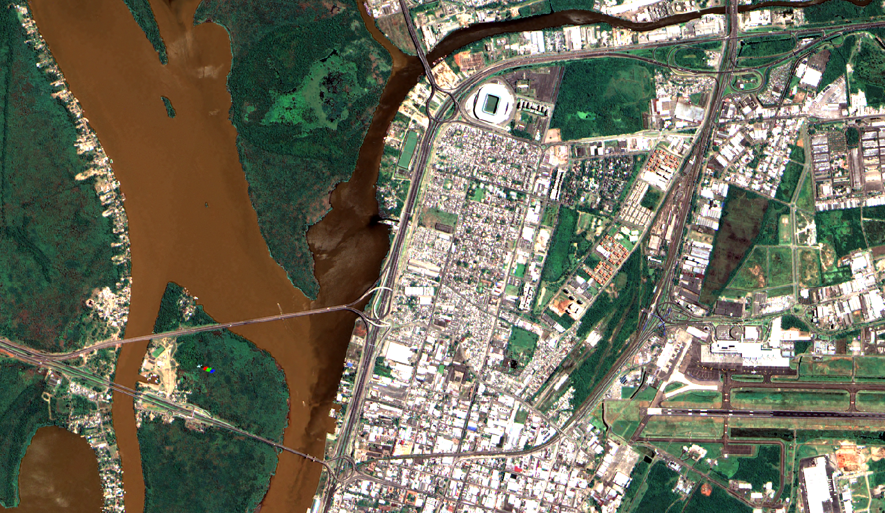
Source: INPE
Notes:
In this slide, I want to showcase how dangerous and devastating floods can be.
– This is a scene before and after flood for the urban center of Porto Alegre, in southern Brazil. It is a major city in the country, with over 1.4 million people.
– The city center was heavily affected, leaving more than 200,000 people displaced.
To connect this slide with the next one, it should be highlighted that in such situations, it is of utmost importance to swiftly and precisely map the flood, so we know what are the most affected areas so we know how many people we expect to be affected and need help.

Slide 4
LEARNING OBJECTIVES
Today we are going to use Google Colab to…
Learn how to use STAC to automatically retrieve satellite data
Apply a Deep Learning model to Map Floods

Slide 5
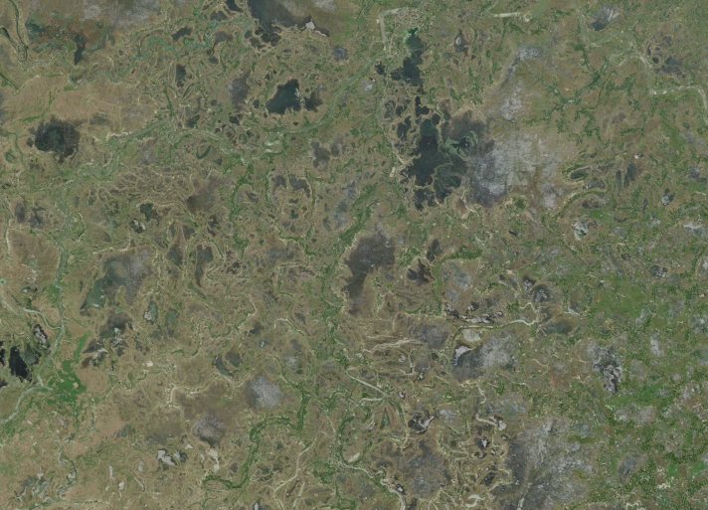
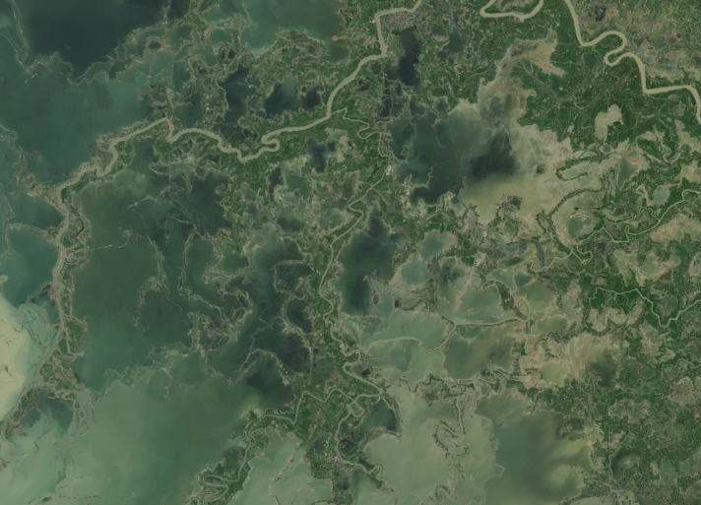
Why automating is necessary?
Each Sentinel-2 tile is commonly more than 5GB
AOIs in borders need multiple tiles
  But we don’t need everything, only our AOI…
Manually downloading data may be doable for one flood event, but what about 2, 4, 25 flood events?
  And for longer term flood risk estimation?
  Continuous monitoring?
Images Source: Copernicus.

Slide 6





What is the STAC API?
STAC is a standard and a community of collaborators working to enable increased access to information about our planet.
Focus on making it as easy as possible for data providers to expose their data to the world.
Great applications for geospatial raster data.

Slide 7
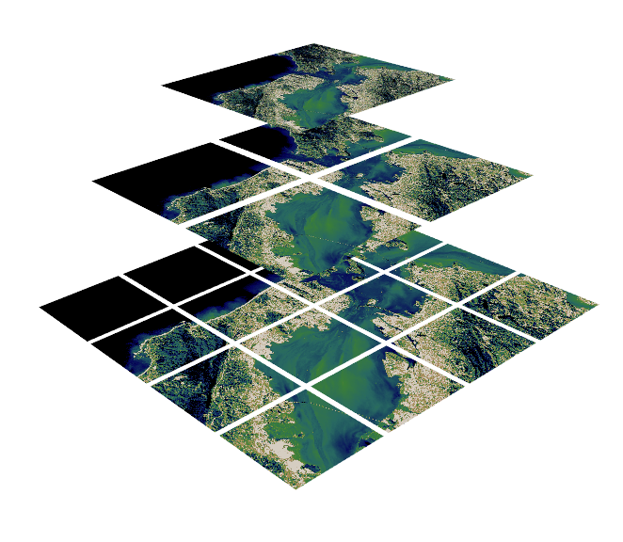
Optimizing the Data Access
What is COG GeoTIFF?
  A Cloud Optimized GeoTIFF (COG) is a regular GeoTIFF file, aimed at being hosted on a HTTP file server, with an internal organization that enables more efficient workflows on the cloud.
Source: https://www.kitware.com/deciphering-cloud-optimized-geotiffs/

Slide 8
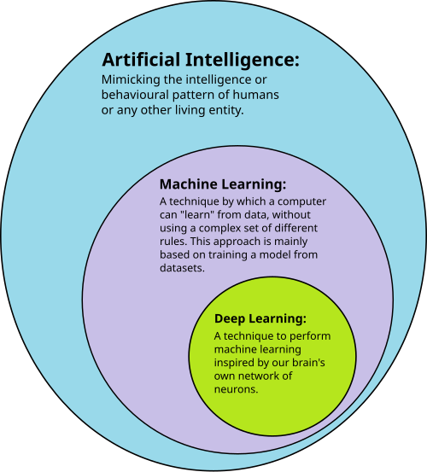
Deep Learning
Automatically find necessary representations to perform a task
Commonly perform better than classical approaches
Requires a lot of data for training
Was made feasible by GPU processing
Source: Shinde, Pramila P., and Seema Shah. "A review of machine learning and deep learning applications." 2018; Wikipedia.

Slide 9
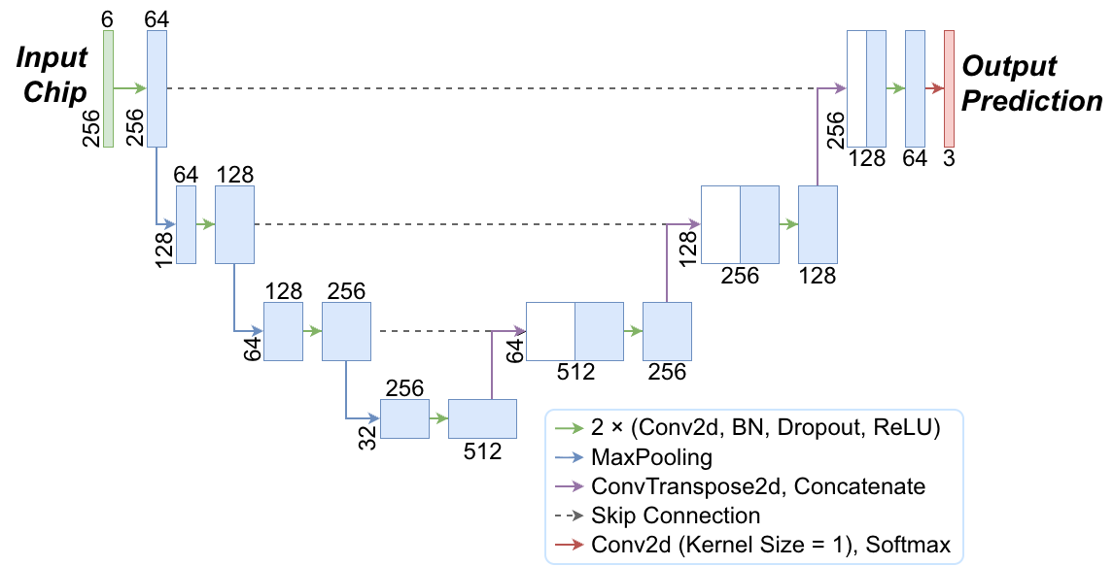
The U-Net
The model we are going to use
Convolutional Neural Network (CNN)
  Encoder – decoder architecture with skip connections
One of the most used architectures
  Nowadays is considered a baseline model

Slide 10
The Structure of the Google Colab Notebook
1
2
3
Preparing Environment
Setting AOI and Date
Finding Satellite Data
4
Preparing the Model
5
6
Displaying and Saving Results
Prediction

Slide 11

Google Colab Notebook
https://shorturl.at/EVmzw
Or
https://colab.research.google.com/drive/1Qht-fGL6Qrzt6jNsYCyP79TMS6cfH8_i?usp=sharing

Slide 12
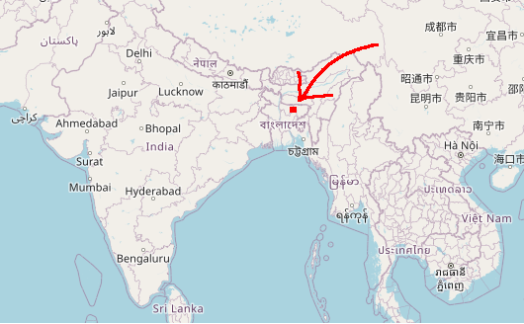
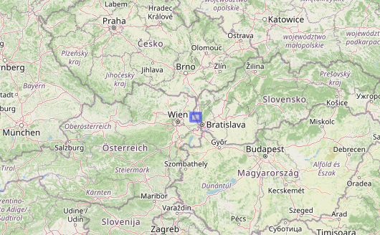
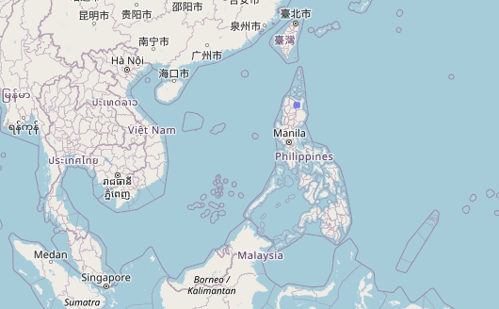
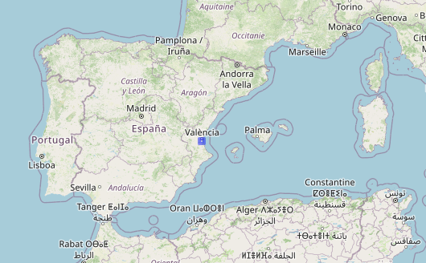
Some AOI Suggestions
22 October 2024
20 September 2024
1
2
12 November 2025
20 November 2024
3
4

Slide 13

Before we Finish, Some Quick Feedback
https://forms.gle/MS1roJndNC4qTQvB7

Slide 14
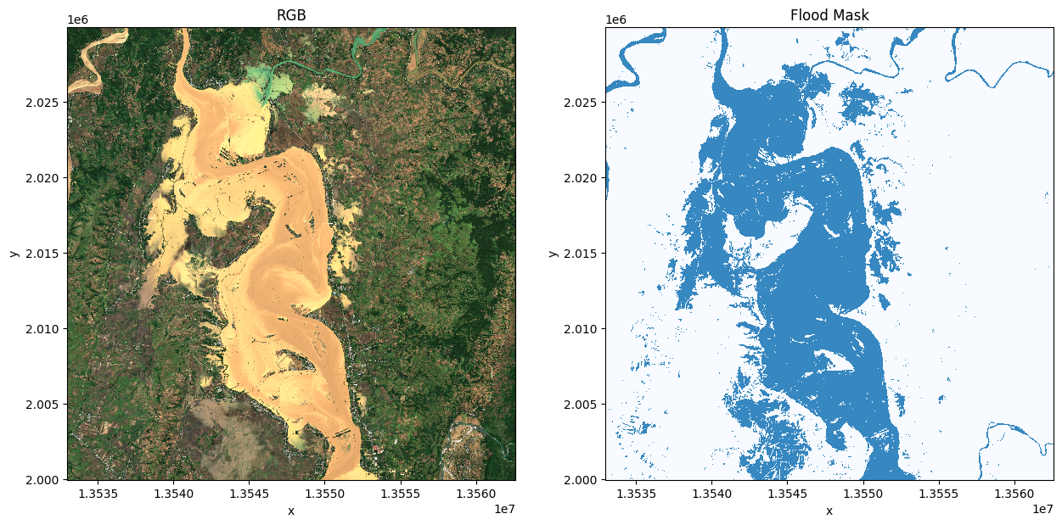
Take Aways
Today we:
  Used STAC to automatically retrieve images
  Applied a deep learning model to map floods
The script is now yours to use and improve, you can:
  Map other floods
  Use data from other STAC servers
  Automate mapping of multiple flood events

