Slide 1

Chat App
Project Presentation CS744 Autumn 2024
Team Name: Titans
Members: Nishant
Github

Slide 2
Context
Domain of Project: Real Time communication systems and networking applications.
Why this domain: The aim is to build a practical, real-time chat application that facilitates user-to-user and group communication, focusing on functionality like user management, group administration, and offline message handling, addressing real-world communication needs.

Slide 3
Problem Description
Statement: The project addresses the challenge of creating a real-time chat application that supports user-to-user and group communication with essential features like user authentication, group management, and offline message handling. The focus is on designing a lightweight, functional, and scalable system to cater to real-world communication needs.

Slide 4
Scope/Goals:
Enable secure and reliable messaging between users.
Provide group communication with administrative controls.
Handle offline message storage and delivery seamlessly.
Ensure scalability to handle multiple users concurrently.

Slide 5
Deliverables
A working client-server chat application.
Key features
Registration and Login.
User-to-user chat.
Group chat with admin privileges.
Offline message handling.
Blocking/unblocking users.

Slide 6
Components of Project
Client Module: Handles user input, sends command to server and displays responses.
Server Module: Multi-threaded server that processes commands from multiple clients simultaneously.
Authentication Module: Handles user registration and login.
Group Management Module: Allows users to create, join, and leave groups.
Message Handling Module: Manages direct user-to-user messaging and group chats.
Blocking Mechanism: Allows users to block/unblock specific users.

Slide 7
Design
Components
Client: User interface for messaging.
Server: Handles client requests, message routing, and group management.
Database (File System): Stores user, group, and message data.

Slide 8
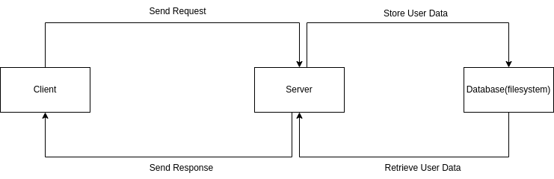
Client-Server Interaction
Actions
Client: Sends commands like login, send message, create group.
Server: Processes the commands and sends responses back.
State
Client: Idle, Logged In.
Server: Waiting for connections, Handling Requests.

Slide 9
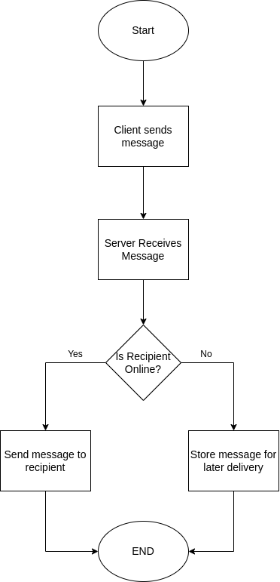
Message Handling Flow (Direct Chat)
Actions:
Client sends a message.
Server checks if the recipient is online.
Decisions:
If Online: Message is sent directly.
If Offline: Store the message for later delivery.

Slide 10
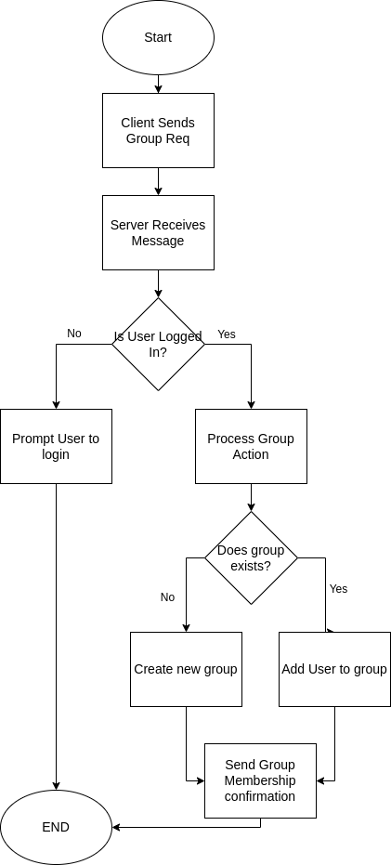
Group Management Flow
Actions:
Create/Join/Leave Group: Client sends requests to manage groups.
Server: Processes requests and updates group data in the database.
Decision:
Is User Logged In? → If yes, allow group management; if no, prompt login.
Does Group Exist?

Slide 11
Implementation Details
Server Implementation
Multi-threaded architecture: Each client connection is handled by a separate thread, created using std::thread.
Modules Implemented:
Authentication Module: Register and verifies users.
Message Handling Module: Manages direct and group messages, including offline storage.
Group Management Module: Provides features like group creation, joining, and admin controls.
Synchronization: Used std::mutex to ensure thread safety for shared resources like group data and offline messages.

Slide 12
Client Implementation
Command Parsing: A command parser converts user input into server-recognizable commands.
Response Handling: A dedicated thread listens for responses from the server, enabling real-time communication.

Slide 13
Challenges Overcome
Managing thread synchronization using mutexes and condition variables
Handling offline messages and ensuring they are delivered correctly upon user reconnection.

Slide 14
Code Integration Highlights
Networking: Socket programming for client-server communication.
Message Flow: Commands like CHAT, GROUP_CHAT, and BLOCK processed seamlessly.

Slide 15
Evaluation
Questions of Evaluation
What is the latency of a message sent between two clients for varying client counts?
How does the latency change as the number of clients increases?
At what client count does the server start to experience performance degradation in terms of latency?
What is the throughput (messages per second) for direct chat with varying client counts?
How does throughput scale as the number of clients increases?
At what client count does throughput begin to drop or plateau?

Slide 16
Setup
Hardware/Environment
Server: Multi-core machine with sufficient memory (e.g., 4-core CPU, 16 GB RAM).
Clients: Simulated using multiple threads/processes.
Network: Local area network for baseline tests.

Slide 17
Software
Server Application: Multi-threaded server running your chat application.
Client Simulation: Custom scripts to simulate user activity (e.g., LOGIN, CHAT, REGISTER).

Slide 18
Workloads
Direct Chat Load
Simulate 10, 50, 100, and 200 users sending direct messages to each other.
Each user sends a fixed number of messages (e.g., 1 messages/user).

Slide 19
Parameters/Configuration (Independent Variables)
Number of Users: Test with 10, 50, 100, and 200 users.
Message Rate: Vary the rate of messages sent (e.g., 1 message/second, 5 messages/second).

Slide 20
Metrics (Dependent Variables)
Latency: Time taken to deliver a message (measured in milliseconds).
Throughput: Number of messages processed per second by the server.

Slide 21
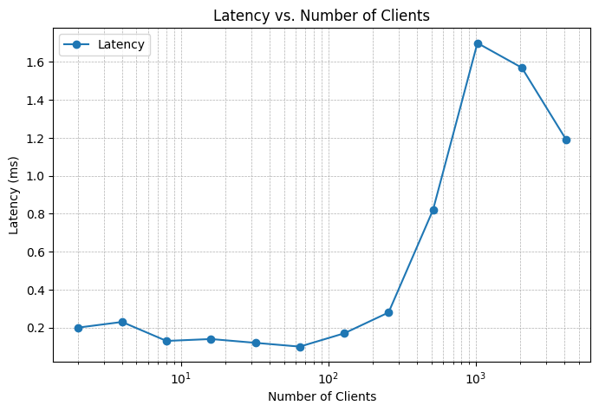
Direct Chat Latency Test

Slide 22
Clients | Latency(ms)
2 | 0.20
4 | 0.23
8 | 0.13
16 | 0.14
32 | 0.12
64 | 0.10
128 | 0.17
256 | 0.28
512 | 0.82
1024 | 1.70
2048 | 1.57
4096 | 1.19

Slide 23
Observations
Latency remains stable and low (<0.2 ms) for up to 256 clients, showing the server handles light to moderate loads efficiently.
Latency increases significantly beyond 512 clients, reaching 1.7 ms at 1024 clients and fluctuating afterward.
At 2048 and 4096 clients, latency decreases to 1.57 ms and 1.19 ms, suggesting possible anomalies in the test or reduced load due to dropped messages.

Slide 24
Inferences
The server is optimized for up to 256 clients, where latency remains low and stable.
Beyond 256 clients, resource contention (e.g., thread management, I/O bandwidth) likely causes queuing delays, leading to higher latency.
The decrease in latency for 2048 and 4096 clients may indicate that not all messages are being processed, requiring further validation.

Slide 25
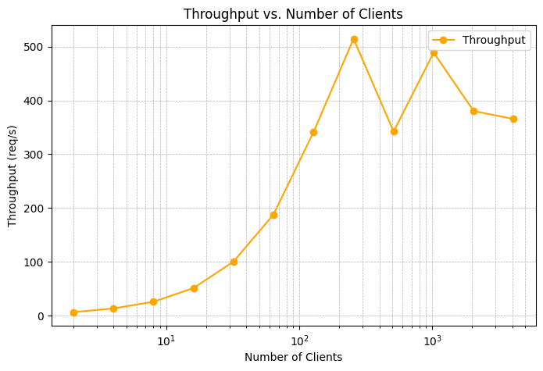
Direct Chat Throughput Test

Slide 26
Clients | Throughput (requests/sec)
2 | 6.61
4 | 13.51
8 | 25.91
16 | 51.25
32 | 100.45
64 | 188.01
128 | 341.13
256 | 514.60
512 | 342.14
1024 | 488.90
2048 | 380.28
4096 | 365.49

Slide 27
Observations
Throughput increases steadily from 6.61 requests/sec (2 clients) to 514.6 requests/sec (256 clients), indicating efficient scaling for moderate loads.
Throughput decreases at 512 clients (342.14 requests/sec) and fluctuates at 1024 clients (488.9 requests/sec) and beyond.
Throughput stabilizes around 365 requests/sec at 4096 clients, showing the server has reached its resource limit.

Slide 28
Inferences
The server performs optimally up to 256 clients, where throughput increases linearly. Beyond this point, the server encounters resource saturation, reducing its ability to scale further.
The decrease in throughput suggests the server's CPU, memory, or I/O bandwidth becomes a limiting factor at higher loads.

Slide 29
Summary of Results
System Sweet Spot: The server performs best for up to 256 clients, maintaining low latency and high throughput.
Performance Bottlenecks: Increased latency and decreased throughput at higher loads indicate server-side resource constraints (e.g., CPU, memory, or I/O bandwidth).
Future Improvements:
Optimize server threading and message handling.
Introduce horizontal scaling or load balancing to handle higher client loads efficiently.

Slide 30
Unfinished Scope
Implement end-to-end encryption (e.g., AES, RSA) to ensure message confidentiality between users, even if the server is compromised.
Add two-factor authentication (e.g., OTP or email verification).
Introduce message expiry for older messages to save storage.
Add feature to send file as well.
Add a feature to search for old messages using keywords.
Replaced file-based storage with a NoSQL database to improve data management and scalability.

Slide 31
Challenges
Writing a robust offline message storage mechanism was challenging, especially ensuring that messages were correctly queued and delivered when the recipient came online.
Creating a flexible structure to allow easy addition of new features while avoiding excessive code coupling.
Handling multiple concurrent client connections and avoiding race conditions was a significant challenge, especially with features like group chat and offline messaging.
Balancing a user-friendly interface with feature-rich functionality was challenging, particularly when implementing commands like JOIN_GROUP, BLOCK_USER, and GROUP_CHAT.

Slide 32
Reflection
Implementing group chat functionality, including creating groups, managing membership, and handling admin privileges (e.g., adding/removing members, promoting/demoting admins), was a highlight of the project. It required careful consideration of how group data is stored and accessed.
If I had the chance to redo the project, I would replace the file-based storage with a NoSQL database. File-based storage worked for the project but has limitations in terms of scalability, performance, and ease of data retrieval.

Slide 33
Conclusions
The project successfully implemented a real-time chat application with features like direct messaging, group chat, offline message storage, and user management. While the use of file-based storage provided a functional solution, transitioning to a database would significantly enhance scalability and performance. The challenges of managing concurrency and designing an extensible structure made the project both rewarding and insightful. This project lays a strong foundation for further enhancements, including improved scalability, advanced security, and a more seamless user experience.

Slide 34
References
Google Search: Used for researching specific technical issues and finding relevant documentation for Python socket programming, multithreading, and encryption.
Stack Overflow: Utilized for troubleshooting specific coding problems, receiving solutions from the developer community, and understanding common issues related to concurrency, file handling, and server-client communication.
ChatGPT (OpenAI): Used for assistance with problem-solving, code generation, and clarifying concepts related to networking, threading, encryption, and performance optimization

