Slide 1
atoms Measuring Thiele / Small Loudspeaker Parameters

Slide 4
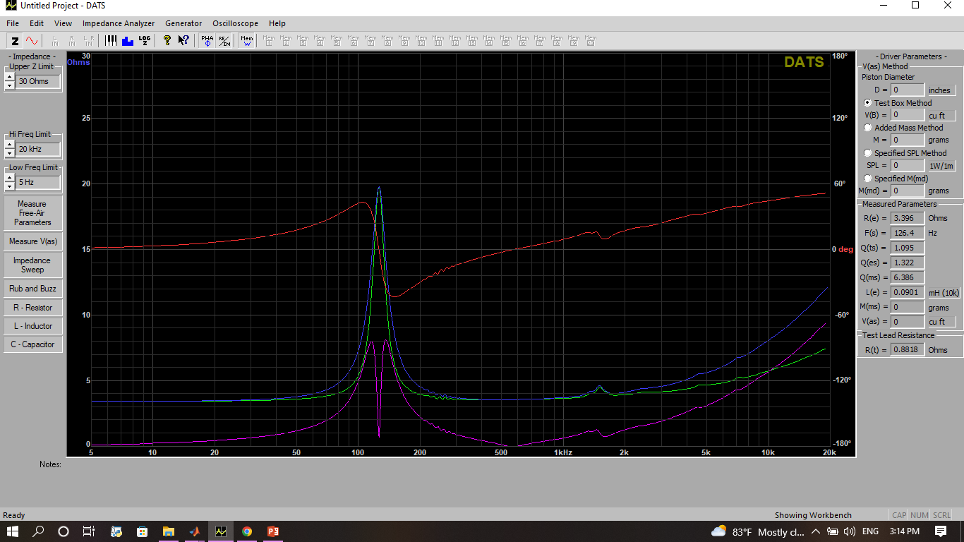

Slide 5
ფოტო დინამიკის ან გამზომვის

Slide 6
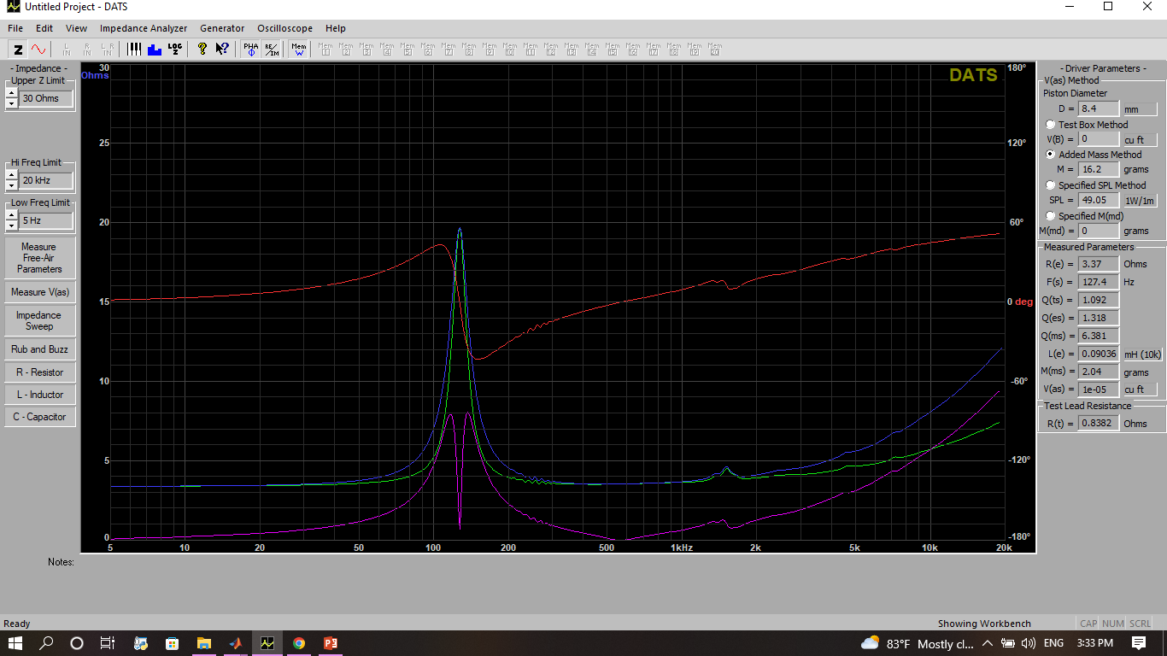
Vas -ს გაზომვა

Slide 7
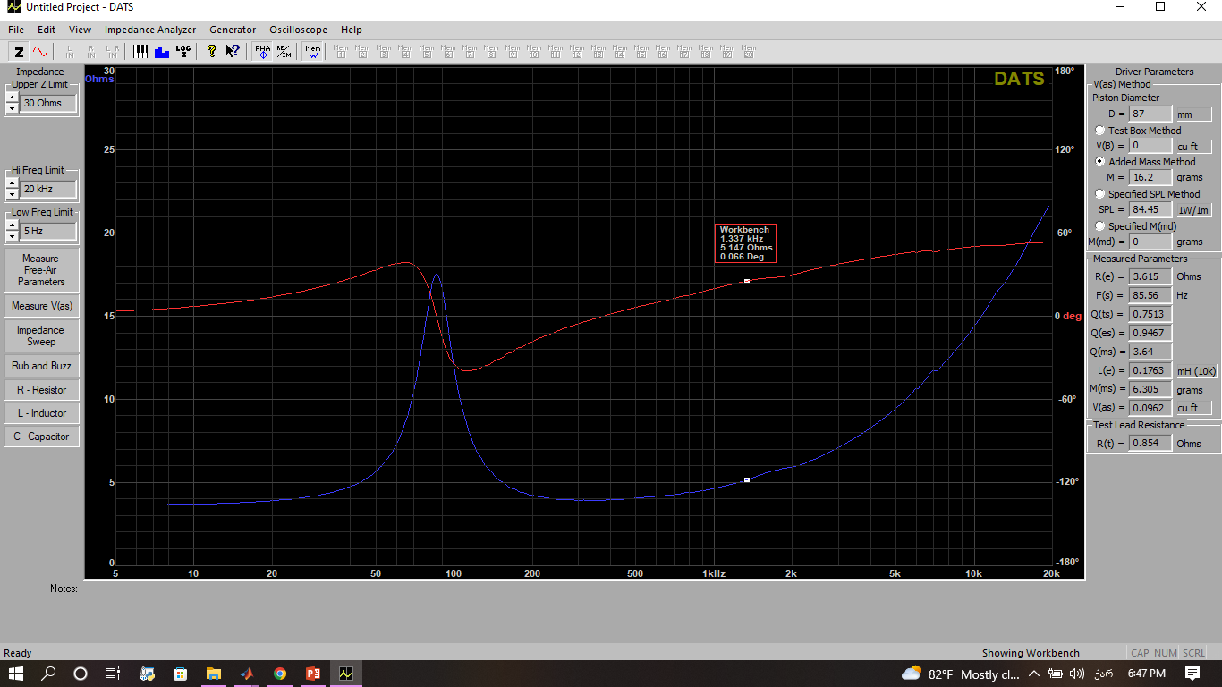
Vas -ს გაზომვა მეორე დინამიკი (მოდელებია მისაწერი)

Slide 8
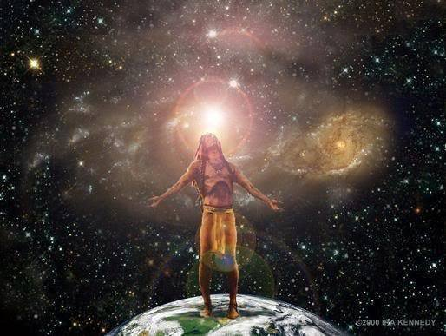
The human brain contains one hundred billion neurons, each neuron is as powerful as a large computer, and each neuron has around ten thousand connections with other neurons. Within our foreheads there is a chaos, inside our brains there is a galaxy of information, which is incomprehensible to our linear minds.
But chaos is basically good. Relax. Surf the waves of chaos and learn how to redesign your own realities. Sit back. Flow. Open your eyes. Turn off your minds. Unfocus, and let the waves of chaos roll over your brain. Float. Drift, Zoom. Design. Create new order, your order, your style from chaos.

Slide 9
