Slide 1

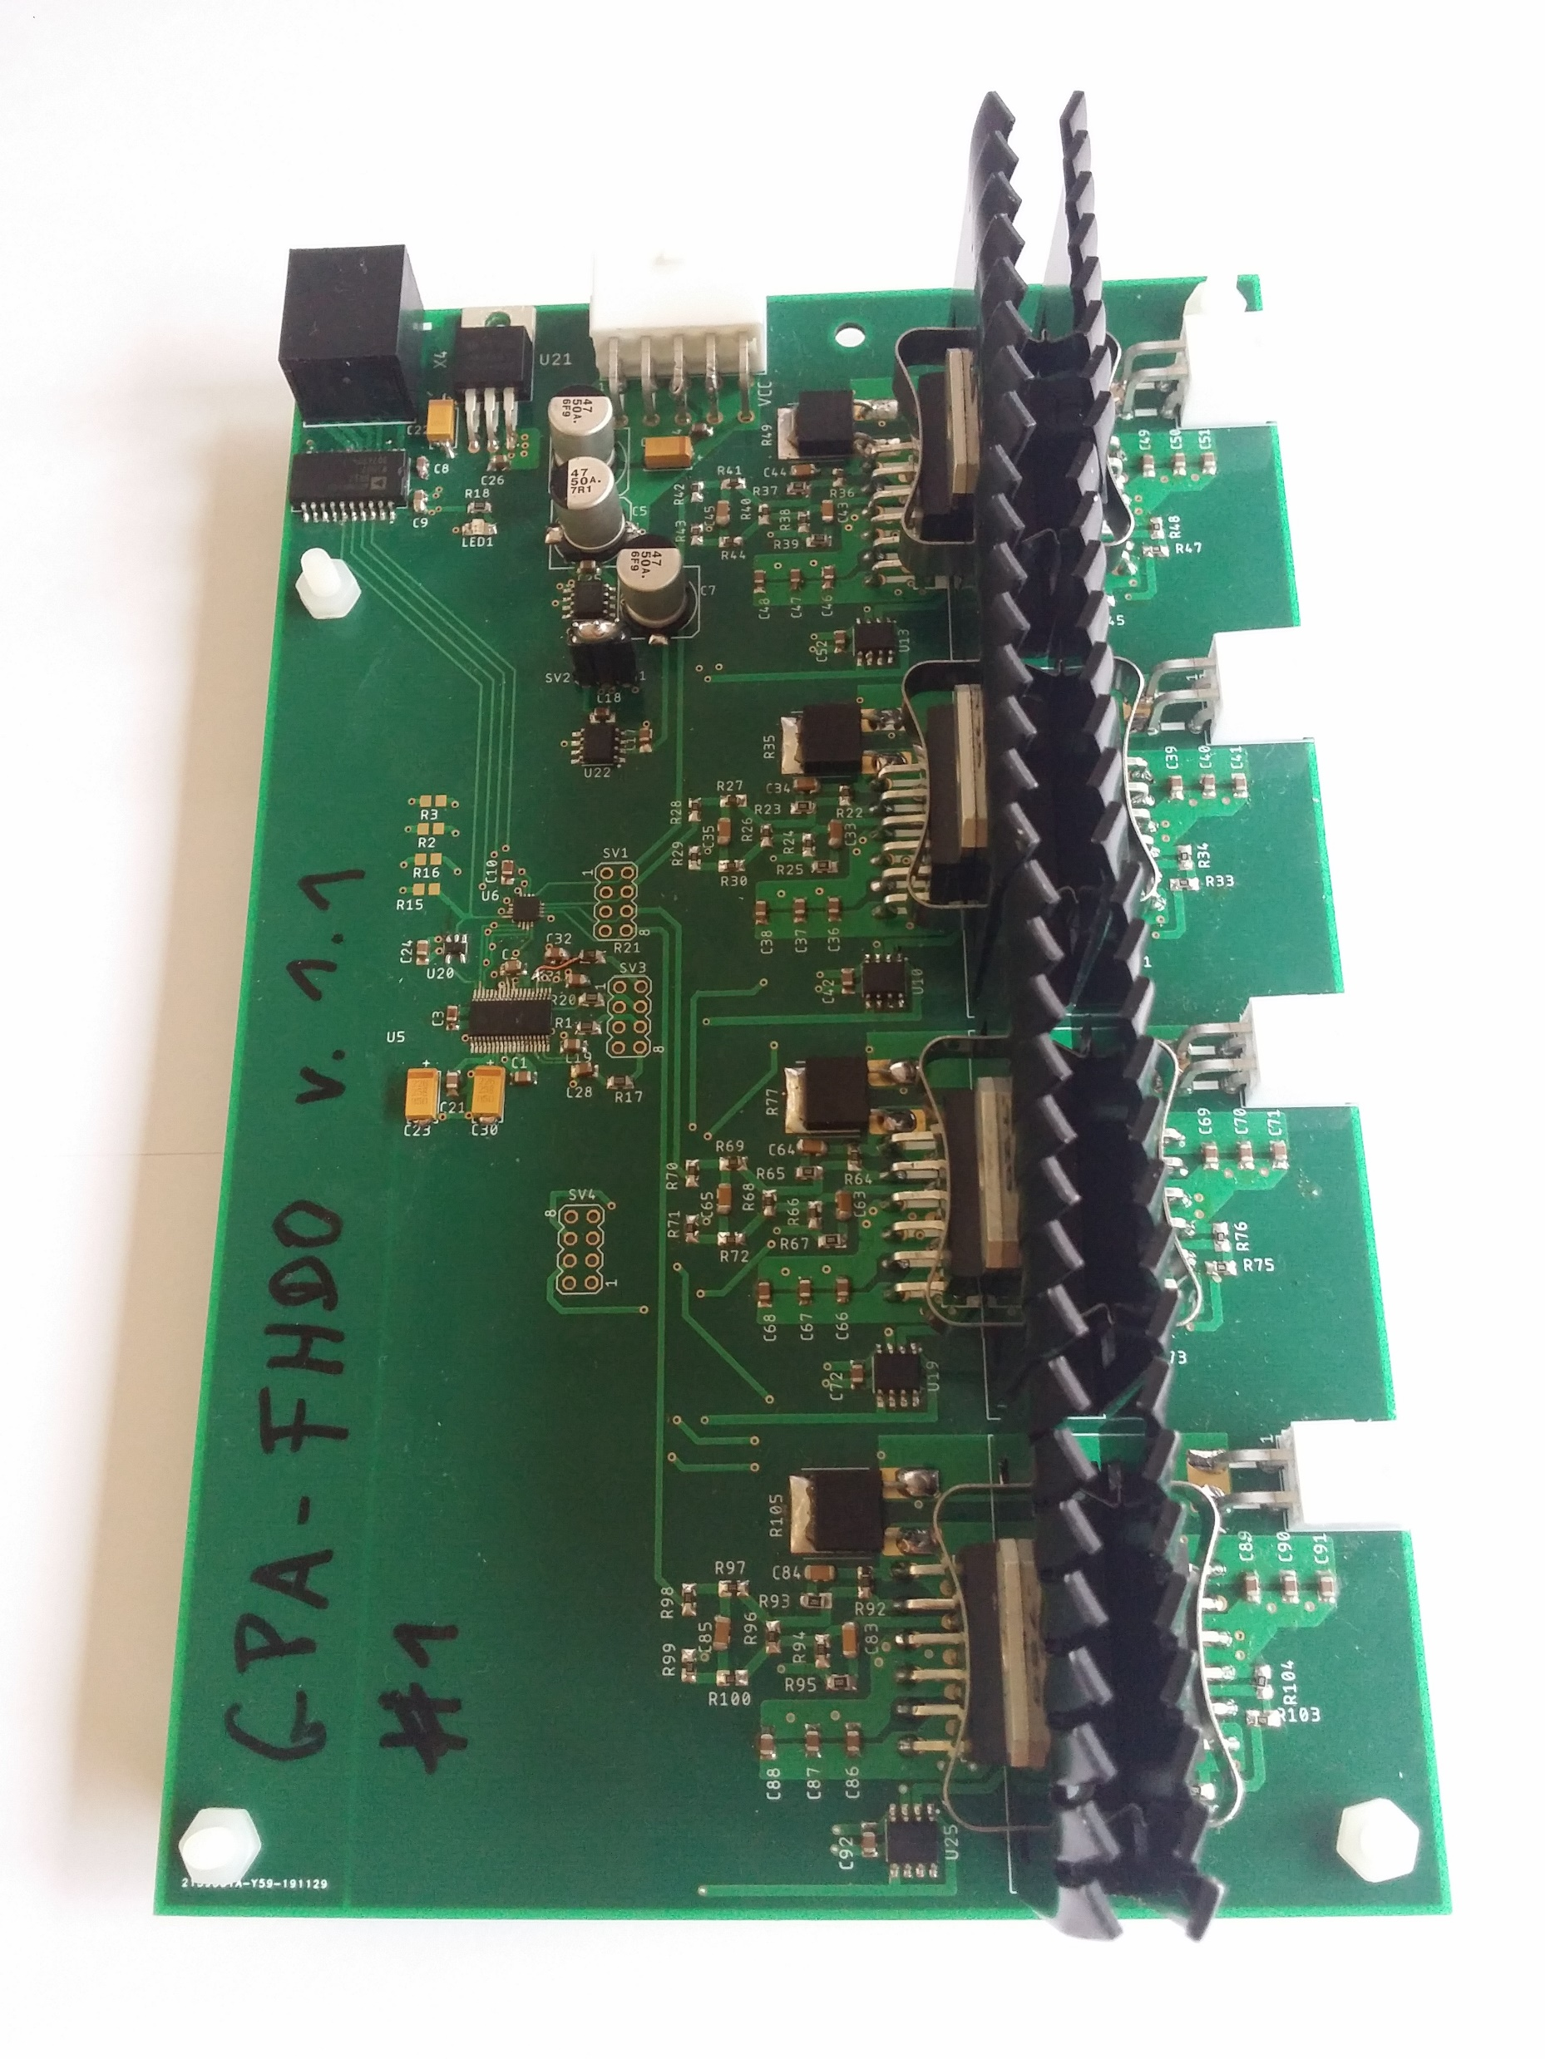
GPA-FHDO
4 channels with +-10A each
single SPI Interface
single supply (13-60V input)
current monitor
digital calibration
open source: https://github.com/menkueclab/GPA-FHDO
Contributors: Benjamin Menküc, Jason Stockmann, Nicolas Arango, Odin Holmes

Slide 2
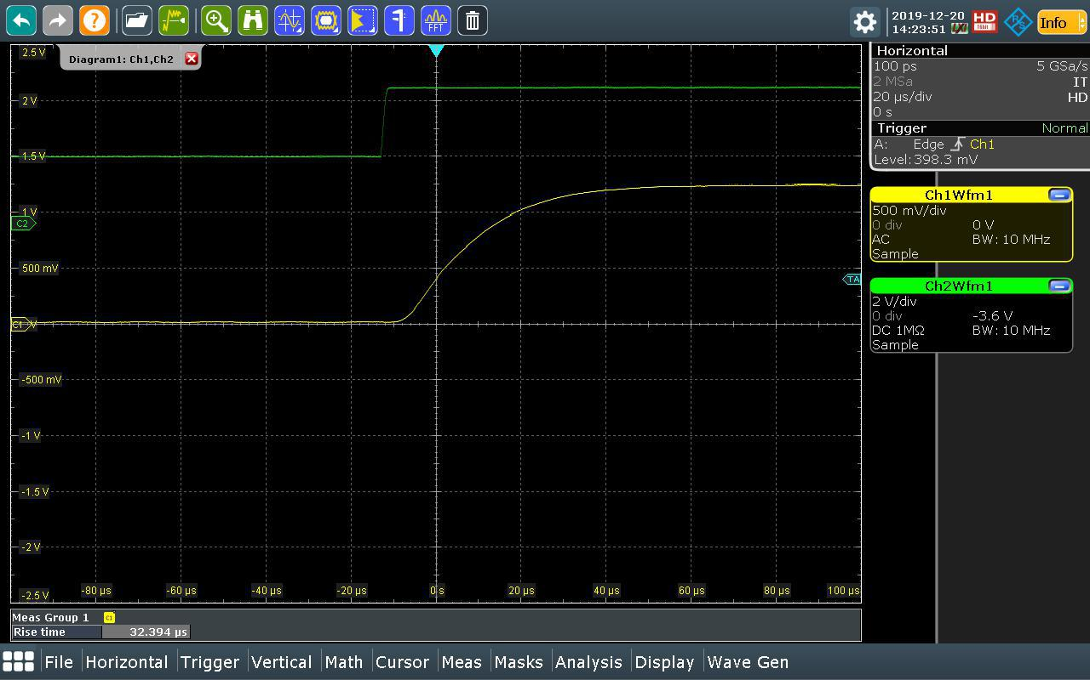
Rise-Time = 32 us
Conditions VCC = 15V I_step = 2A Coil: L=10 uH, ESR=50 mOhms
Can be further improved by tuning the feedback capacitor

Slide 3
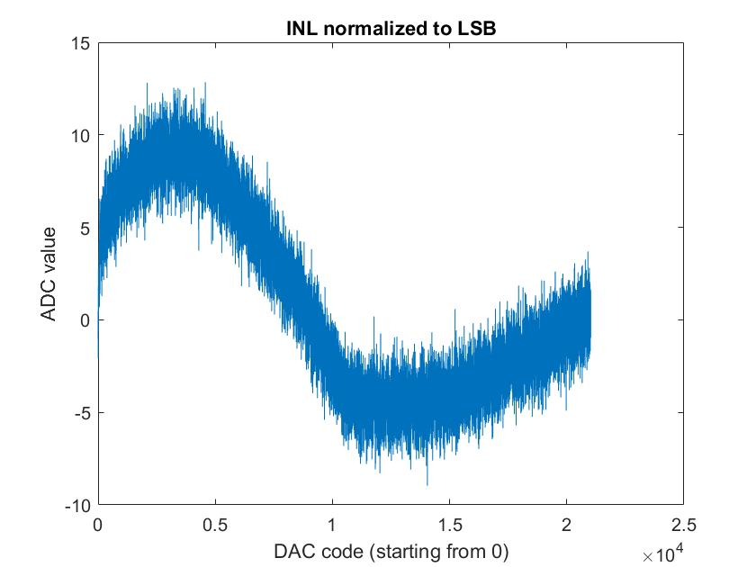
INL = 0.075%
Conditions I_max = 2A VCC = 15V (after digital calibration)

Slide 4
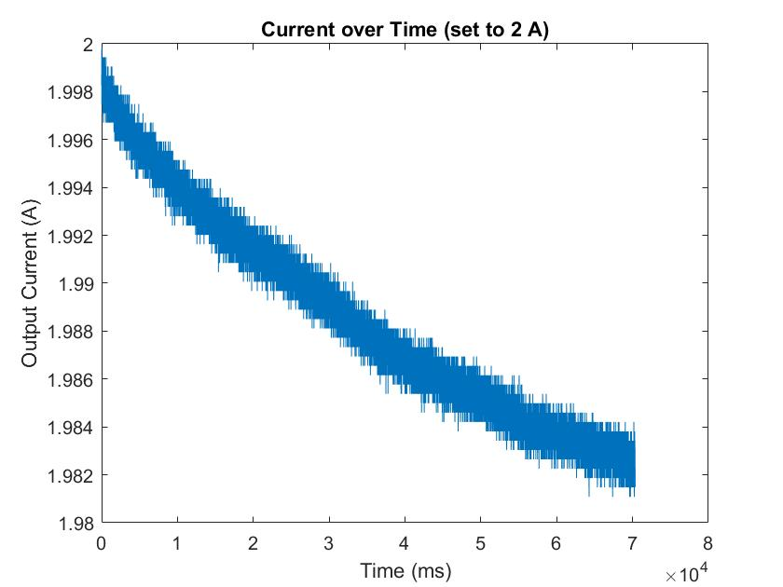
Temperature Offset Error = 1%
Conditions start temp. 20 °C end temp 160 °C VCC = 15V I = 2A (after digital calibration)

Slide 5
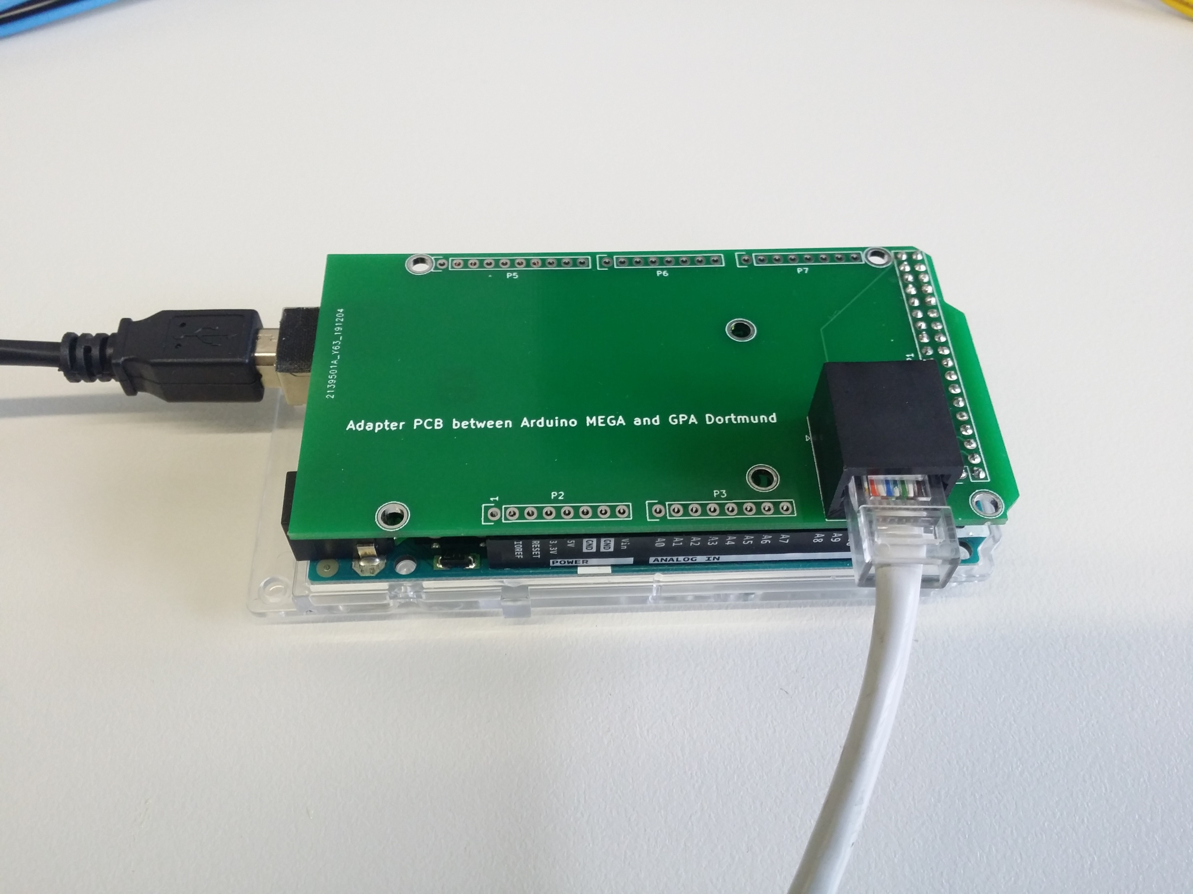
Digital Calibration
Integrated current monitor allows digital calibration
Sample source code for Arduino is available
Arduino shield makes first experiments very easy

