Slide 1

Sorting Algorithm Visualizer
CSCI208 — Data Structures & Algorithms
Salma Abuhagar
Maria Adel
MennatAllah Hussien
Habiba Hesham
Marvey Adel

Slide 2

Why Did We Build This?
Sorting algorithms are usually taught with code and theory alone.
Students struggle to see the operational difference between O(n²) and O(n log n) from text.
There is no easy way to observe what an algorithm "thinks"
step by step.

Slide 3
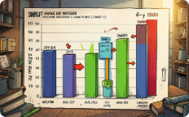



Our Solution
Interactive Visuals
Code Explorer
Race Mode
Audio + Live Graphs
Line-by-line highlighting with plain-English explanations — step forward/backward to inspect execution.
All five algorithms run simultaneously on the same input so performance differences are visible instantly.
Animated bar charts reveal comparisons and swaps in real time so students can watch algorithms operate.
Sound effects and live complexity graphs map comparisons and swaps to auditory and visual signals for multisensory learning.

Slide 4
The 5 Algorithms
Algorithm | Best Case | Average | Worst Case | Stable
Bubble Sort | O(n) | O(n²) | O(n²) | Yes ✅
Selection Sort | O(n²) | O(n²) | O(n²) | No ❌
Insertion Sort | O(n) | O(n²) | O(n²) | Yes ✅
Merge Sort | O(n log n) | O(n log n) | O(n log n) | Yes ✅
Quick Sort | O(n log n) | O(n log n) | O(n²) | No ❌

Slide 5

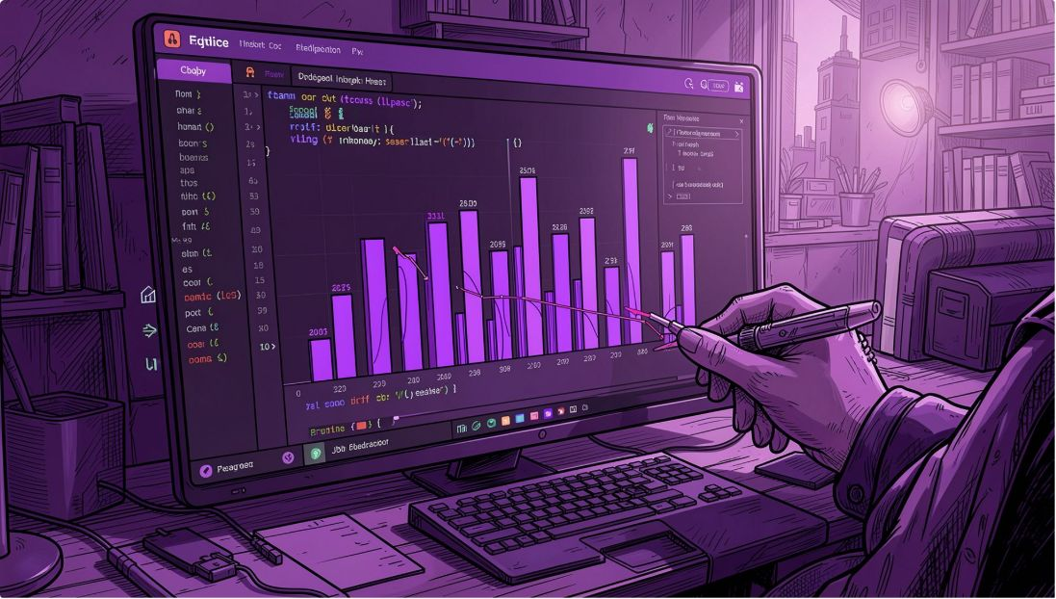

How We Built It
Backend — Python + Flask
All 5 algorithms implemented from scratch in Python.
Each comparison and swap recorded as an explicit "step" object.
No use of built-in sort() — every operation is instrumented for teaching.
Frontend — HTML + CSS + JavaScript
Animations render each step as colored bar chart transitions.
Sound effects produced with Web Audio API to mark swaps/comparisons.
Live complexity graphs drawn on HTML5 Canvas; responsive UI for demos.
User clicks Sort ↓ Python runs algorithm → records every step ↓ Sends steps as JSON to the browser ↓ JavaScript animates each step with color + sound

Slide 6
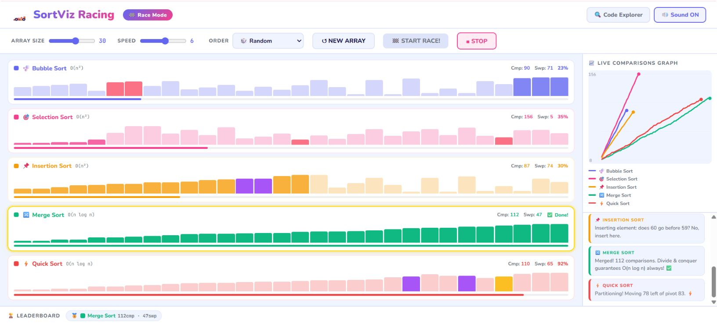
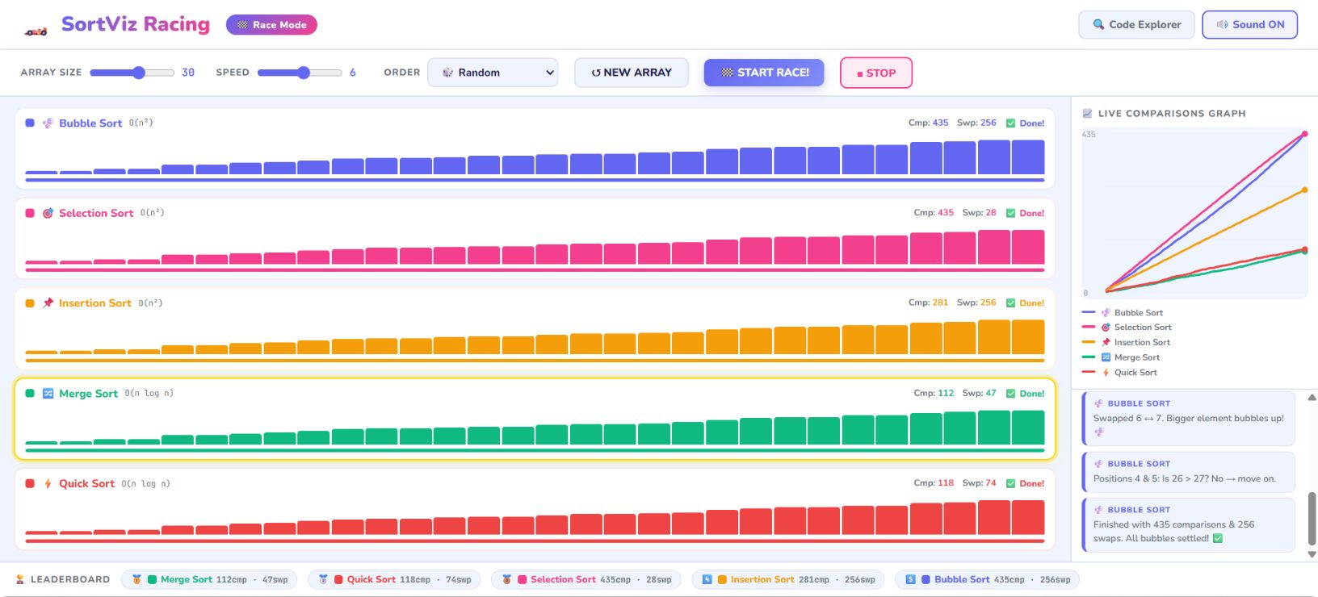
Live Demo — Race Mode
How the race works in real time
All five algorithms race on the same array simultaneously.
Merge Sort and Quick Sort finish far ahead while Bubble and Selection struggle.
A live graph tracks comparison counts.
The winner receives a gold glow and leaderboard position.

Slide 7
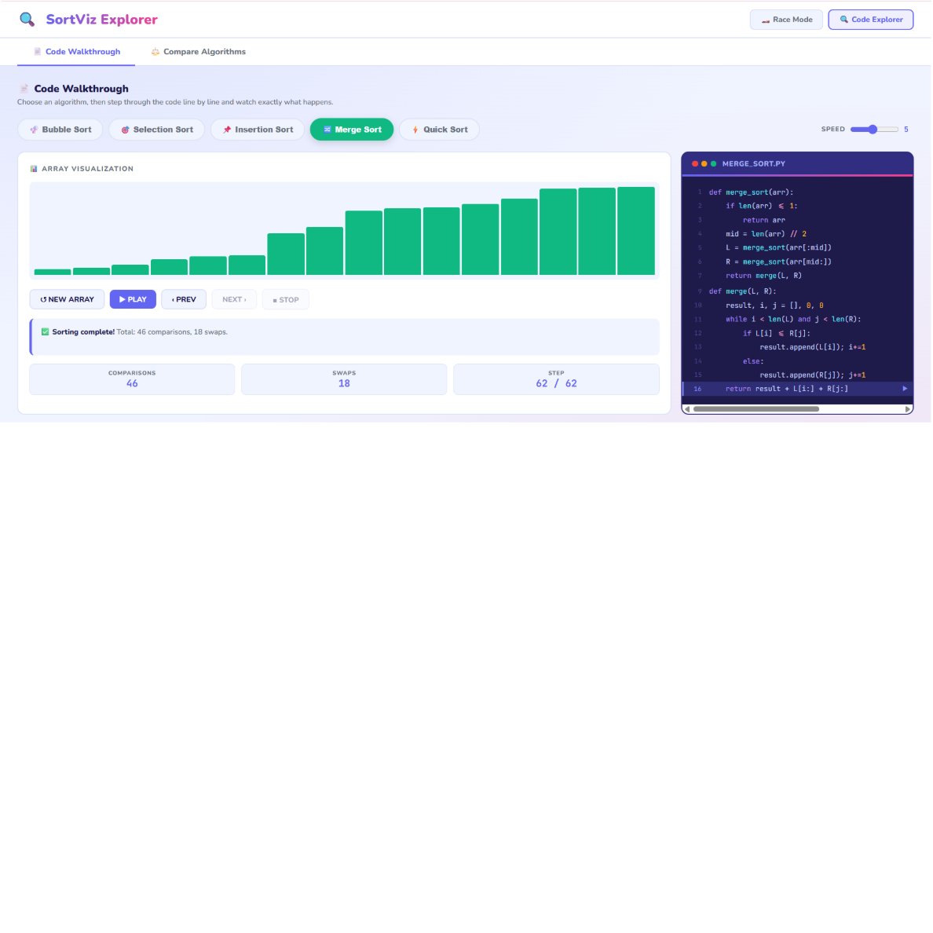
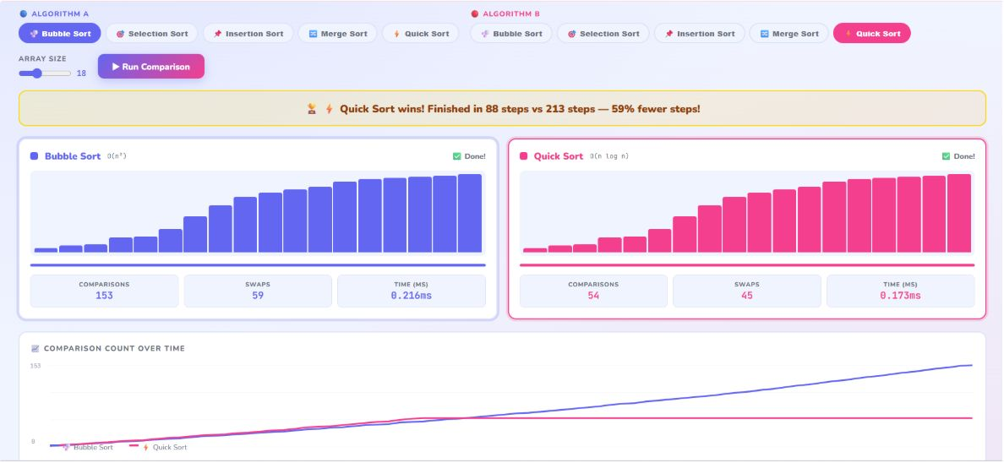
Live Demo — Code Explorer
Tab 1 — Code Walkthrough
Select an algorithm and press Play. The currently executing line highlights in purple while a plain-English explanation updates every step. Navigate with Previous / Next buttons to inspect state changes.
Tab 2 — Compare Two Algorithms
Run two different algorithms side-by-side on the same input. Track comparisons, swaps, runtime, and see a live chart plus a winner banner showing which finished faster and by how much.

Slide 8
Empirical Results — Comparisons Count
Array Size | Bubble Sort | Selection Sort | Insertion Sort | Merge Sort | Quick Sort
10 | 45 | 45 | 22 | 22 | 20
25 | 300 | 300 | 148 | 83 | 71
50 | 1,225 | 1,225 | 612 | 221 | 186
100 | 4,950 | 4,950 | 2,475 | 528 | 447
As array size doubles → Bubble Sort and Selection Sort comparisons increase quadratically; Merge Sort and Quick Sort grow much slower (near n log n).

Slide 9

What We Learned
No single algorithm is best for every input — choose by context.
Insertion Sort excels on nearly-sorted arrays; its overhead is low.
Quick Sort is fastest on average for random data but degrades on sorted input without safeguards.
Merge Sort is consistent — true O(n log n) in all cases.
Bubble Sort is the simplest conceptually but the slowest in practice.
Running algorithms visually made complexity differences obvious immediately — an effective teaching tool.

Slide 10
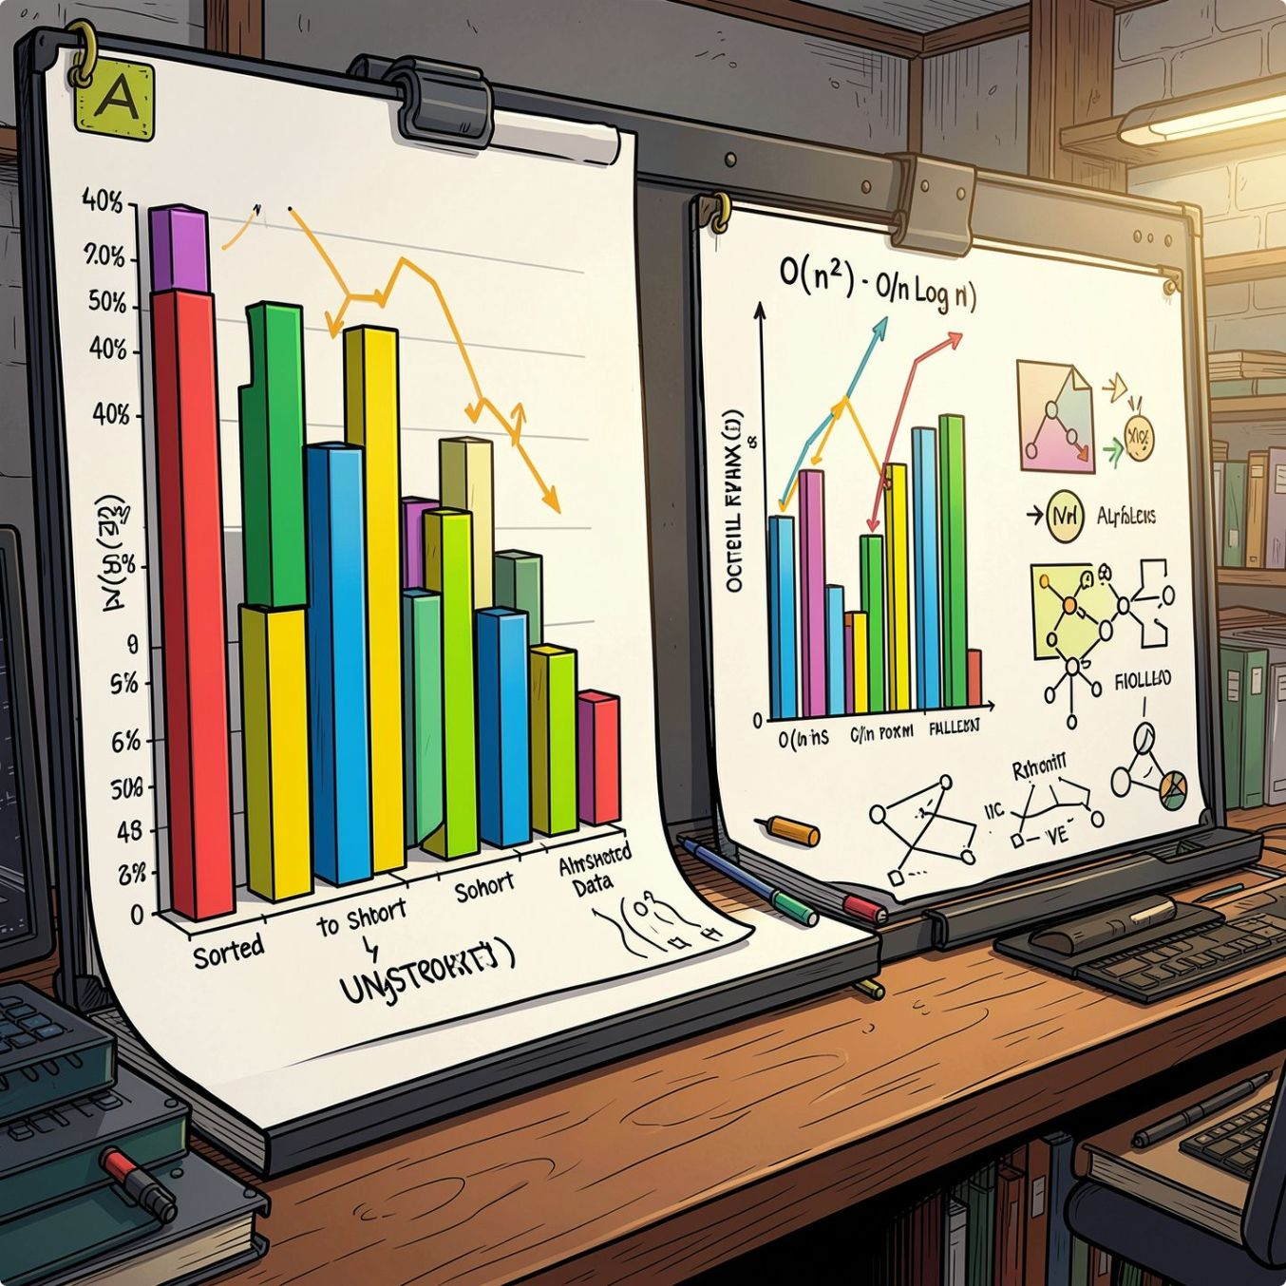
Thank You!
Any Questions?

