Slide 1

Project _ Call Center
Prepared by: Menna Taha Farag

Slide 2





Company Overview: Concentrix Egypt
Corporate Profile
Context & Challenges
•
Company Name: Concentrix Egypt
Due to the fast-paced call center environment, rotational shifts, and high work pressure, the company experiences high employee turnover.
•
Industry: IT Services & IT Consulting
•
Headquarters: Newark, California, USA
•
Company Type: Public Company
Key Business Impacts:
•
Increased employee stress & burnout
•
Global Reach: Leaders in CX & BPO serving 70+ countries
•
Reduced individual & team operational performance
•
Continuous, urgent recruitment needs
90 Employees
Current Operational Workforce in Egypt Branch
Core Services Offered:

Slide 3
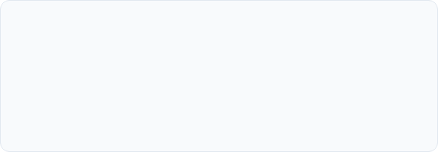


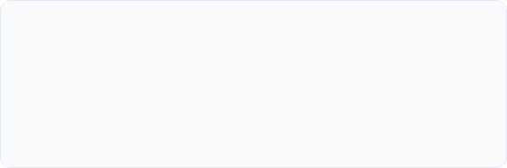
Recruitment Plan: Basic Information
Position Specifications
•
Position Title: Customer Service Representative (Call Center Agent)
•
Department: Operations _ Call Center
•
Vacancies:
•
Hiring Reason: Replace turnover departures & sustain operations
Budget & Channels
•
Budget Range: 8,000 – 10,000 EGP / month
•
Deadline to Hire:
•
Recruitment Sources: Company Website, LinkedIn, Facebook, Employee Referrals, Job Fairs

Slide 4


Target Candidate Profile
Qualifications & Skills
•
Experience: 0-2 years in customer service / call center (Fresh graduates welcome)
•
Education: Bachelor's Degree (Any Discipline)
•
Required Skills: Excellent communication, English (B1–B2), Customer Service, Pressure tolerance
•
Preferred Skills: Previous call center exp, CRM system knowledge
Traits & Responsibilities
Traits: Patient, Positive attitude, Team player, Adaptable, Responsible
Key Duties: Handle inquiries, resolve complaints, record customer info accurately, meet daily/monthly KPIs, escalate complex issues.

Slide 5
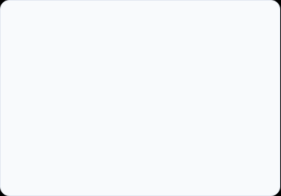







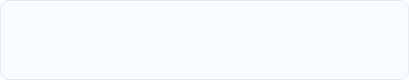
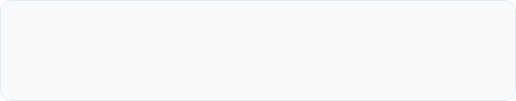
Sourcing Strategy & 2-Week Timeline
Primary Channels
Secondary Channels
Selection Stages
•
Concentrix Official Website
•
Wuzzuf Job Portal
1.
CV Screening
•
LinkedIn Corporate Page
•
University & Job Fairs
2.
HR Interview
•
Facebook Recruitment Groups
3.
English & Communication Evaluation
4.
Job Offer Issuance
•
Internal Employee Referrals
Week 1: Sourcing & Screening
Week 2: Interviewing & Hiring
Publish job advertisements across channels, collect incoming applications, and perform CV screening & shortlisting.
Conduct structured HR interviews, complete English & Communication assessments, and send job offers.

Slide 6






Evaluation & Screening Criteria
Evaluation Weighting System
Detailed Screening Requirements
Criteria | Weight
Communication Skills | 30%
English Language Proficiency | 30%
Customer Service Skills | 20%
Problem-Solving Ability | 10%
Culture Fit & Traits | 10%
Criteria | Requirement | Weight
Education | Bachelor's Degree | 10%
Experience | 0-2 yrs Call Center | 15%
English Level | B1 - B2 or above | 30%
Communication | Good verbal & written | 25%
Personality | Positive, Adaptable | 10%
Computer Skills | Basic MS Office & Typing | 5%
Availability | Rotational shifts | 5%
Pass / Fail Benchmark:
Score ≥ 60% proceeds to interview.
Score < 60% automatically rejected.
14 Days
90%
≥ 50
3 : 1
900 EGP
Time to Hire Target
Offer Acceptance Rate
Qualified Applicants
Interview-to-Hire Ratio
Cost Per Hire Target

Slide 7





Resume Screening & Interview Setup
Screening Indicators
Structured Interview Process
•
Interview Format: Structured & Behavioral Interview
Red Flags:
•
•
Poor English language level
Panel Members: HR Specialist, Operations Manager, Team Leader
•
Unprofessional or incomplete CV
•
Duration: 30 – 45 Minutes per candidate
•
Frequent job changes without clear reasons
•
Missing contact details
Interview Stages:
1. Introduction
2. Background Check
3. Behavioral Questions
4. Tech/Comm Test
Strong Indicators:
5. Candidate Q&A
6. Closing
•
Clear and well-organized resume format
•
Relevant customer service experience
•
High English proficiency & highlighted skills

Slide 8

Interview Question Framework
Category | Interview Question | Assessment Purpose
General | Please introduce yourself in English and describe your educational background. | Evaluate English proficiency, communication skills, and confidence.
Motivation | Why do you want to work at Concentrix? | Assess motivation and corporate awareness.
Retention | Why did you leave your previous job? / Why start in customer service? | Assess turnover risk, career motivation, and long-term commitment.
Behavioral (STAR) | Tell me about a time you dealt with a difficult or angry customer. | Evaluate problem-solving, conflict resolution, and customer care.
Prioritization | How would you prioritize multiple simultaneous customer requests? | Assess time management and decision-making under pressure.
Job Fit | Are you comfortable working under pressure and rotational shifts? | Evaluate operational flexibility and adaptability.
Closing | Do you have any questions for us? | Measure genuine interest in the role and company.

Slide 9
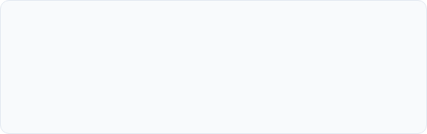

Training Plan: 2-Day Intensive Workshop
Needs & Objectives
Addressed Needs: Weak customer communication, inquiry handling issues, telephone etiquette gaps, active listening needs.
Target Audience: 10 Newly hired Customer Service Representatives.
Format & Duration: 2 Days (4 hrs/day) | Interactive Workshop, Role Play, Mock Calls.
Expected Training Results

Slide 10


KPI Design & Performance Evaluation
CSR KPI Weighting Table
Performance Rating Scale
KPI Description | Target | Weight
Customer Satisfaction (CSAT) | ≥ 90% | 30%
First Call Resolution (FCR) | ≥ 85% | 25%
Attendance & Punctuality | ≥ 95% | 15%
Schedule Adherence | ≥ 95% | 15%
Average Handling Time (AHT) | ≤ 6 min | 15%
Rating Level | Total Score Range | Action Path
Excellent | 90 – 100 | Reward & Promotion
Very Good | 80 – 89 | Retain & Develop
Good | 70 – 79 | Maintain Performance
Needs Improvement | 60 – 69 | Coaching Support
Unsatisfactory | Below 60 | 60-Day PIP Plan
PIP Policy:

Slide 11

9-Box Talent Matrix & Action Plan
Employee | Performance | Potential | 9-Box Position | HR Decision & Development Action
Agent A | High | High | Top Talent | Promotion & Leadership Development Program
Agent B | High | Medium | High Performer | Reward & Advance Customer Service Training
Agent C | Medium | High | Future Leader | Leadership Development Program
Agent D | Medium | Medium | Core Employee | Maintain Performance & Quarterly Development Training
Agent E | Low | Low | Performance Improvement | 60-Day PIP, Weekly Coaching, Communication Re-evaluation
* Note: Sample evaluation of 5 employees. The complete methodology applies across all 80 operational call center agents.

Slide 12






Employee Relations & Engagement Strategy
Key Activities
Recognition Program
Conflict Resolution
•
Monthly 1-on-1 meetings
•
Employee of the Month
1.
Report issue (1 Day)
•
Quarterly feedback surveys
•
Performance Certifications
2.
HR Investigation (48 hrs)
•
Monthly rewards & recognition
•
Gift Cards & Bonuses
3.
Joint Meeting (3 Days)
4.
Solution Agreement (5 Days)
•
Bi-monthly team building
•
Public Team Appreciation
5.
Follow-up (1 Week)
•
Open-door management policy
≥ 85%
< 10%
≥ 80%
≥ 90%
Satisfaction Target
Turnover Rate Target
Engagement Index
Conflict Resolution Rate

Slide 13




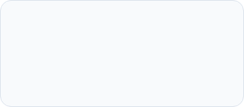
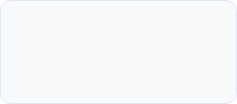
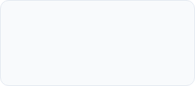

Employee Onboarding Roadmap
Pre-Onboarding
First Day
First Week
First Month
Send offer contract (HR), prepare workstation/laptop & headset (IT/Admin), create CRM account.
Welcome session, company overview, team introduction, office tour, system access validation.
Communication & CRM training, first live calls under supervisor coaching, daily follow-up.
Performance review, feedback session, addressing challenges, confirming full onboarding success.
100%
≤ 30 Days
≥ 95%
≥ 80%
Training Completion
Time to Productivity
3-Month Retention Rate
Month 1 Score

