Slide 1
Uber Fare Prediction
Task 1 — Exploratory Data Analysis
Exploring the data before modeling: questions, the right plot for each, and the insight it reveals.
ML Internship Program • Cellula Technologies

Slide 2
OBJECTIVE & DATA PREPARATION
Understanding the Data Before Modeling
Objective: explore Uber ride records from NYC, choose the right plot for each question, and turn that into insight that will shape feature choices in Task 2 (modeling).
Rows Removed in Cleaning
No missing values or duplicate rows were found — but coordinate and fare outliers needed targeted removal.
Key cleaning steps applied:
Removed negative fares & zero-passenger trips
Converted coordinates from radians to degrees
Removed invalid GPS points & out-of-NYC coordinates
Capped extreme distances (>100km) and fares (>$180)
Data-quality issues (bad coordinates, unrealistic fares) were real and had to be fixed before any plotting or modeling.
From here, every plot in this deck uses the cleaned dataset only.

Slide 3
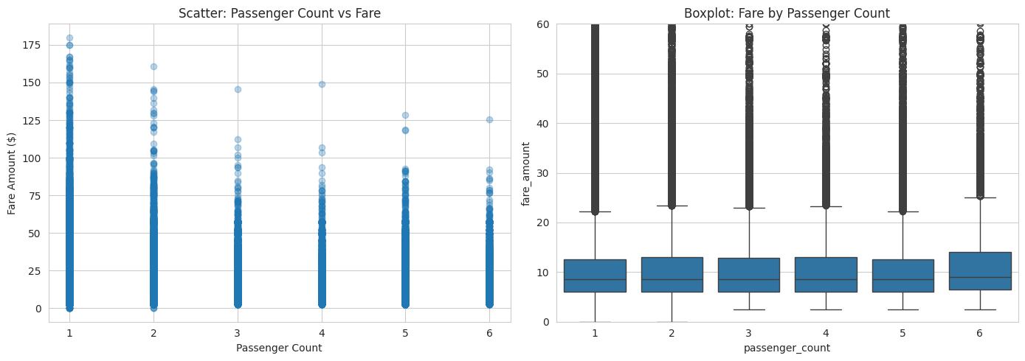
Q1 · PASSENGER COUNT vs FARE
Does a Higher Passenger Count Mean a Higher Fare?
Scatter + Boxplot | passenger_count (numerical, 1–6) vs fare_amount
Insight: Average fare is nearly flat across passenger-count groups — passenger count is not a meaningful driver of fare. Pricing depends on distance and time, not headcount.

Slide 4
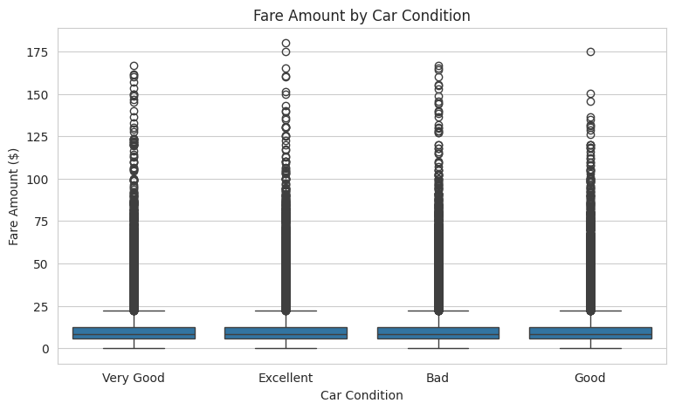
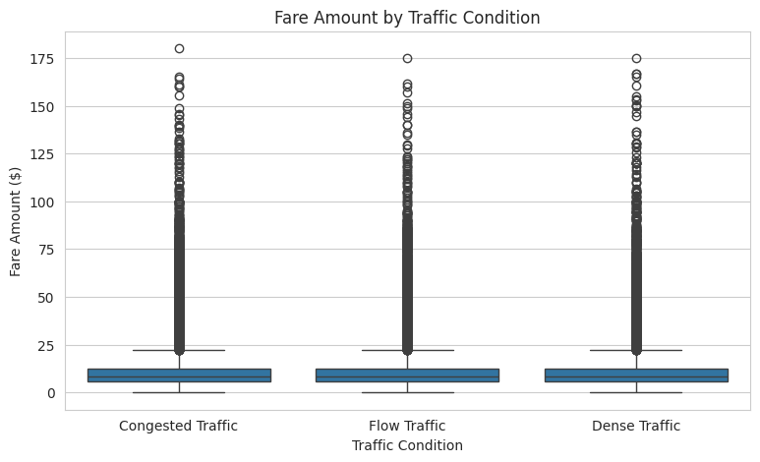
Q2 & Q4 · CAR CONDITION AND TRAFFIC vs FARE
Do Vehicle Condition or Traffic Level Change the Fare?
Boxplot | categorical vs fare_amount
Insight: Fares are very close across both car condition and traffic level — neither shows a clear effect in this dataset, suggesting price is set mainly by a fixed distance/time model rather than trip conditions.

Slide 5
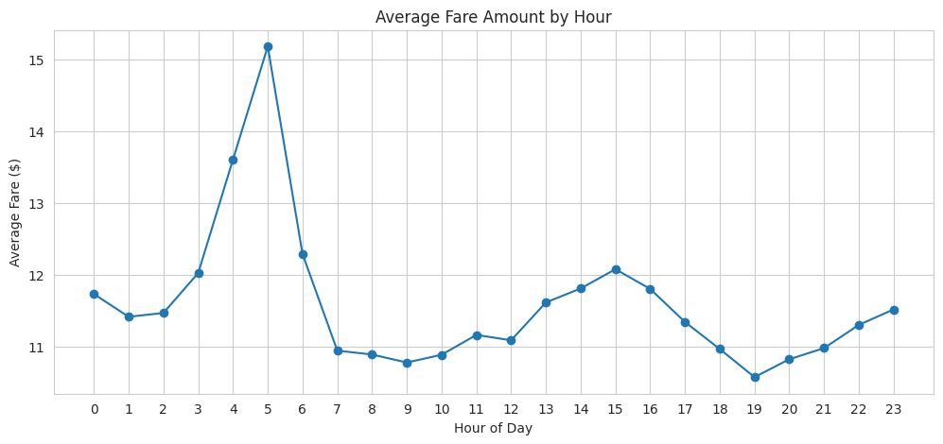
Q3 · FARE BY HOUR OF DAY
At What Hour Are Fares Typically Highest?
Line Chart | hour (ordered, 0–23) vs average fare_amount
Insight: Average fare rises slightly in the early morning and evening rush hours, likely reflecting longer trips such as airport runs during those windows.

Slide 6
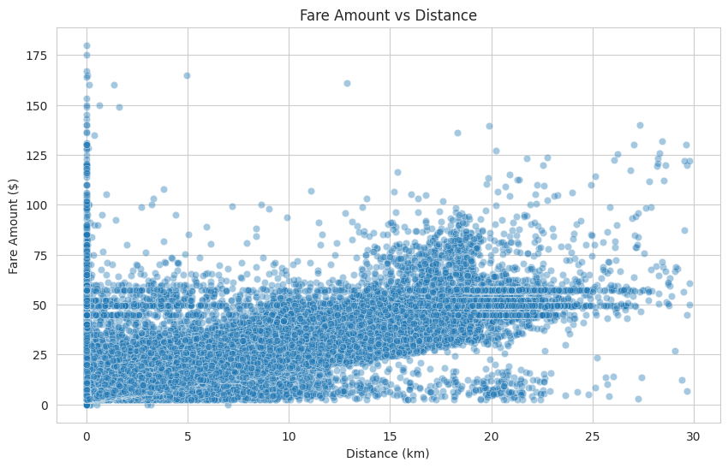
Q5 · DISTANCE vs FARE
Is Distance the Strongest Predictor of Fare?
Correlation
Strong &
Linear
Insight: Fare rises steadily and consistently as distance increases. Distance is confirmed as the single strongest predictor of fare among all features examined.

Slide 7
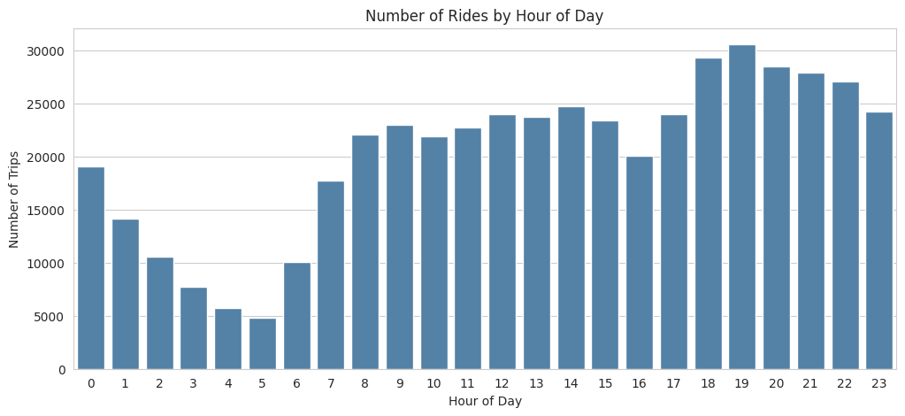
Q6 · RIDE DEMAND BY HOUR
At What Time of Day Are Ride Requests Most Frequent?
Count Plot | hour (discrete) vs number of trips — demand, not price
Insight: Ride demand peaks in the evening (post-work / dinner hours) and drops sharply overnight — a typical daily mobility pattern, distinct from the fare-by-hour trend in Q3.

Slide 8
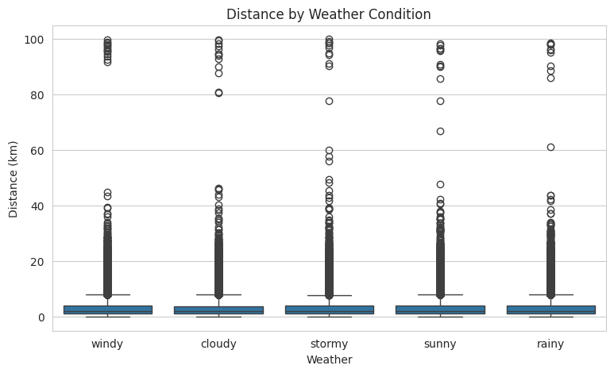
Q7 · WEATHER vs TRIP DISTANCE
Does Weather Influence How Far People Travel?
Boxplot | Weather (categorical) vs distance
Insight
Distance distributions look similar across all weather conditions. Weather doesn't meaningfully change how far people choose to travel in this dataset.

Slide 9
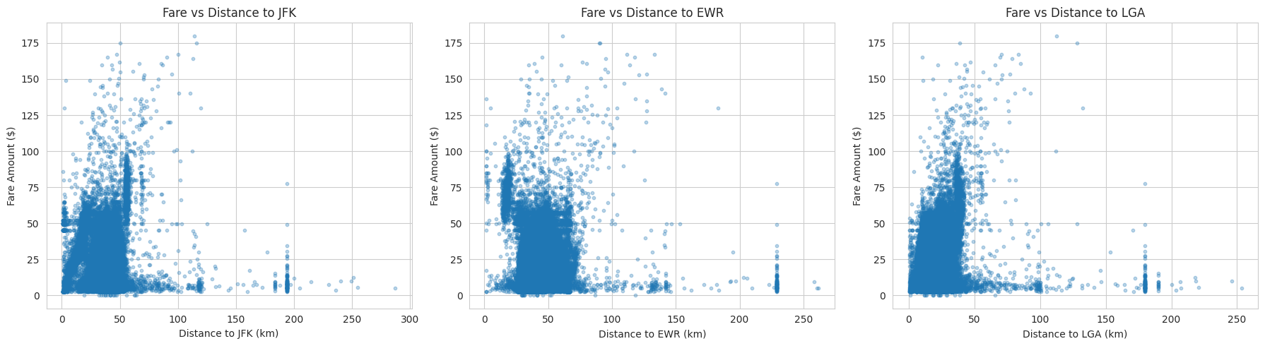
Q8 · AIRPORT PROXIMITY vs FARE
Are Rides Closer to Airports Generally More Expensive?
Scatter Plot | distance to JFK / EWR / LGA vs fare_amount
Insight: No clear linear relationship between airport distance and fare — correlation is weak. This likely reflects flat-rate airport pricing rather than the usual distance-based model, worth investigating further in Task 2.

Slide 10
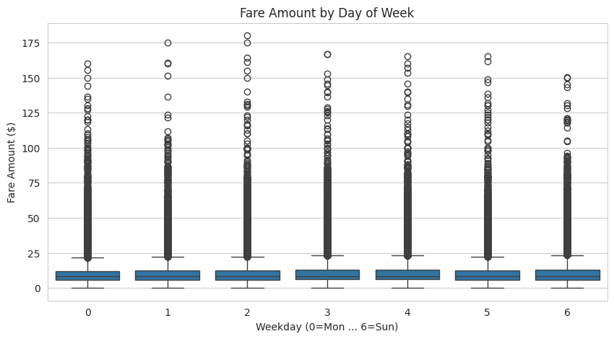
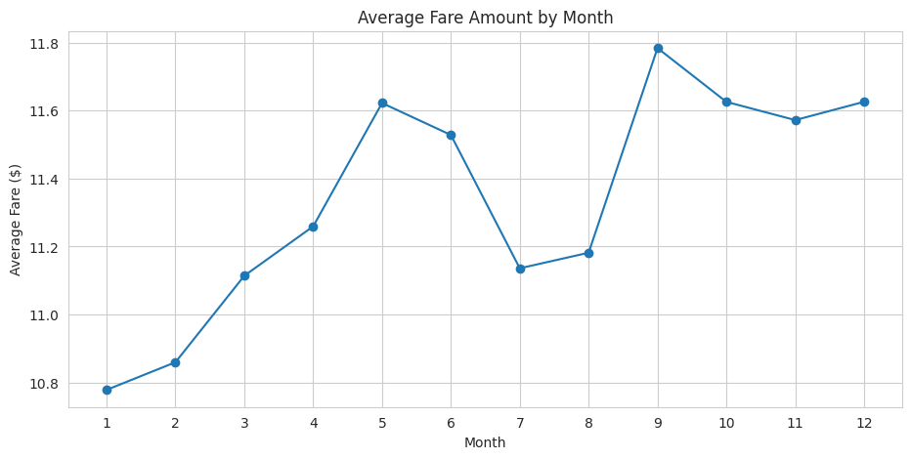
Q9 & Q10 · EXTRA QUESTIONS (OUR OWN)
Do Weekday or Month Affect the Fare?
Boxplot (weekday) & Line Chart (month) vs fare_amount
Insight: No major difference across weekdays, and average fare stays fairly stable across months — neither day-of-week nor season shows a strong seasonal pattern in this dataset.

Slide 11
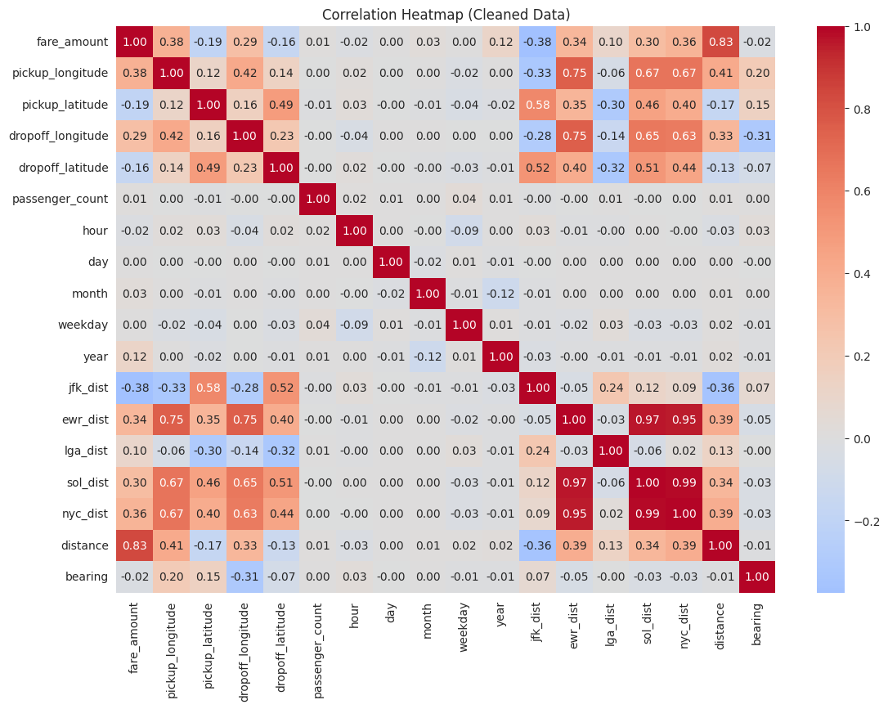
OVERALL VIEW · CORRELATION HEATMAP
Which Features Relate Most to Fare?
Insight
distance is by far the strongest driver of fare_amount, confirming Q5. Airport distances, hour, and month all show weak individual correlation with fare on their own.

Slide 12
KEY TAKEAWAYS
EDA Summary & What It Means for Task 2
Strongest predictor: Distance — a clear, strong, linear relationship with fare.
Weak individual effects: Passenger count, car condition, traffic, weather, weekday, month.
Hour matters differently: Mild effect on average fare, but a much clearer effect on ride demand.
Airport trips are different: Weak correlation with distance — likely flat-rate pricing, worth deeper modeling.
Next step: distance will be the core feature for Task 2, with added engineering for airport trips and rush-hour periods.

