Slide 1






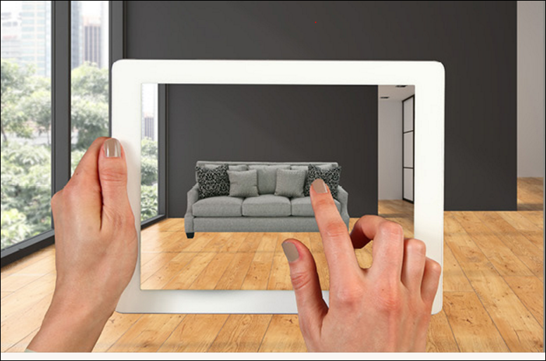
Augmented Reality in lifestyle ‘ARea’
Mohamed Essam El-Deen , Mohamed Saeed , MennaAllah Magdy
IT Department , Faculty of computers and Information
ABSTRACT
Technologies
CONCLUSIONS
Augmented reality technology is becoming much more of mainstream among retail businesses. Consumers are increasingly tech savvy who tend to make their purchasing decision from home or on a mobile device. Augmented reality is the Segway for retailers to create more meaningful, memorable shopping experiences for customers while leveraging your digital audience in the process.
We know that our customers are increasingly using their smartphones as a shopping companion and we want to continue to find ways to inspire them and facilitate a better shopping experience
Unity is the ultimate game development platform ,You can create any 2D or 3D game with Unity. You can make it with ease, you can make it highly-optimized and beautiful, and you can deploy it with a click to more platforms than you have fingers and toes.
It uses Computer Vision technology to recognize and track planar images (Image Targets) and simple 3D objects, such as boxes, in real-time. This image registration capability enables developers to position and orient virtual objects, such as 3D models and other media
Android is a mobile operating system developed by Google, based on the Linux kernel and designed primarily for touchscreen mobile devices such as smartphones and tablets.
Firebase is a Google platform for creating and marketing and monitoring mobile apps , Firebase is a cloud database for mobile apps.
Augmented reality technology is becoming much more of mainstream among retail businesses. Consumers are increasingly tech savvy who tend to make their purchasing decision from home or on a mobile device. Augmented reality is the Segway for retailers to create more meaningful, memorable shopping experiences for customers while leveraging your digital audience in the process.
Augmented reality technology and AR apps have limitless marketing potential for retailers. In order to stay competitive and relevant in your industry, consider embracing and integrating AR into your business.
In the end, every business will eventually need to develop a mobile app to allow customers to reach them from wherever they are. It’s surprising how tapping into some of your phone’s lesser known features can facilitate an engaging connection with your customers.
OBJECTIVES
Buying new furniture can be time-consuming and overwhelming as it’s the considered the hardest part about buying furniture is not constructing it. It’s making sure it’s going to look good in your home.to bypass the feeling of buying regrettable purchases.
Furniture shopping and visualizing pieces in your home is difficult, which is why we saw the need to create a way for our customers to envision a piece in their home with their existing flooring, wall colors and decor, make it their own, and trust in their investment. Imagine exactly how that stunning new sofa will look in your living room is not an easy task. It will therefore come as no surprise that customers end up taking home furniture which turns out to be the wrong size for its intended location. But now our new app is here to help you avoid mistakes and make furniture buying easier than ever! Thanks to augmented reality, customers can now try out select products in their homes with the help of a printed catalog, a mobile app and a smartphone or tablet.
We created an AR catalog app to help customers visualize how certain pieces of furniture would fit and look in their very own homes. Customers simply launch the app on their smartphone or tablet, and use the camera function to capture an image of a room in their home. The customer can then select different items from the catalog to see how the finished, assembled piece of furniture will look in their home before they purchase.
How the application works ?!
Simply place the Target in the spot where you're considering adding a new piece of furniture, scan the Target with the augmented reality app on your mobile device and select the desired item. As shown on figure 1.1
The augmented reality feature then projects the item into your home by layering it over a real-time view of your room captured through your device's camera. The app also lets you experience the scale of the objects in relation to your living space
Figure 1.1
REFERNCES
https://firebase.google.com
https://en.wikipedia.org/wiki/Android
https://en.wikipedia.org/wiki/Augmented_reality
https://developer.android.com
http://www.digitaltrends.com/mobile/best-augmented-reality-apps/
http://mashable.com/category/augmented-reality/
http://computer.howstuffworks.com/augmented-reality.html
https://www.theguardian.com/technology/augmented-reality
https://appreal-vr.com/blog/markerless-vs-marker-based-augmented-reality/
CONTACT
mohamedessam.2017@gmail.com
m7md.fci@gmail.com
menna.magdy182@gmail.com

