Slide 1

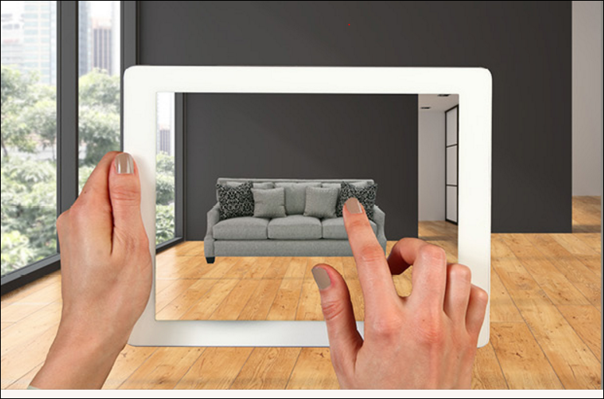
Augmented Reality in lifestyle
Mohamed Essam , Mohamed Saeed , MennaAllah Magdy
IT Department
Augmented reality technology is becoming much more of mainstream among retail businesses. Consumers are increasingly tech savvy who tend to make their purchasing decision from home or on a mobile device. Augmented reality is the Segway for retailers to create more meaningful, memorable shopping experiences for customers while leveraging your digital audience in the process.
We know that our customers are increasingly using their smartphones as a shopping companion and we want to continue to find ways to inspire them and facilitate a better shopping experience
1-Unity
Unity is the ultimate game development platform ,You can create any 2D or 3D game with Unity. You can make it with ease, you can make it highly-optimized and beautiful, and you can deploy it with a click to more platforms than you have fingers and toes.
2-Vuforia
It uses Computer Vision technology to recognize and track planar images (Image Targets) and simple 3D objects, such as boxes, in real-time. This image registration capability enables developers to position and orient virtual objects, such as 3D models and other media
3-Firebase
Firebase is a Google platform for creating and marketing and monitoring mobile apps , Firebase is a cloud database for mobile apps.
4-Android
Android is a mobile operating system developed by Google, based on the Linux kernel and designed primarily for touchscreen mobile devices such as smartphones and tablets.
Augmented reality technology is becoming much more of mainstream among retail businesses. Consumers are increasingly tech savvy who tend to make their purchasing decision from home or on a mobile device. Augmented reality is the Segway for retailers to create more meaningful, memorable shopping experiences for customers while leveraging your digital audience in the process.
In the end, every business will eventually need to develop a mobile app to allow customers to reach them from wherever they are. It’s surprising how tapping into some of your phone’s lesser known features can facilitate an engaging connection with your customers.
Furniture shopping and visualizing pieces in your home is difficult, which is why we saw the need to create a way for our customers to envision a piece in their home with their existing flooring, wall colors and decor, make it their own, and trust in their investment.
We created an AR catalog app to help customers visualize how certain pieces of furniture would fit and look in their very own homes. Customers simply launch the app on their smartphone or tablet, and use the camera function to capture an image of a room in their home. The customer can then select different items from the catalog to see how the finished, assembled piece of furniture will look in their home before they purchase.
https://firebase.google.com/features
https://en.wikipedia.org/wiki/Android_(operating_system)
https://en.wikipedia.org/wiki/Augmented_reality
https://developer.android.com/index.html
http://www.digitaltrends.com/mobile/best-augmented-reality-apps/
http://mashable.com/category/augmented-reality/
http://computer.howstuffworks.com/augmented-reality.htm
https://www.theguardian.com/technology/augmented-reality
https://www.youtube.com/watch?v=09vxKN1zLNI
https://appreal-vr.com/blog/markerless-vs-marker-based-augmented-reality/
Mohamedessam.2017@gmail.com
m7md.fci@gmail.com
Menna.magdy182@gmail.com

