Slide 1
STEGOSHIELD
AI-Driven Secure Steganography & Steganalysis System
Secure message hiding • encrypted payloads • AI-based stego detection
AES-256-CBC
JUNIWARD
DWT + STC
CNN + ONNX
React + FastAPI
Project Identity
React Frontend
FastAPI
Services
Modular platform combining standards-based encryption, adaptive steganographic embedding, and production-ready ML inference for forensic detection.
Upload • Encode • Detect
Orchestration
Crypto • Stego • ML
Academic / Technical Documentation • Version 4.0 • May 2026
StegoShield v4.0 | AI-Driven Secure Steganography & Steganalysis
01
Notes:
Opening: introduce StegoShield as a secure pipeline for hiding and detecting information in images. Emphasize that the project combines cryptography, steganography, ML steganalysis, backend orchestration, and a React user interface.

Slide 2
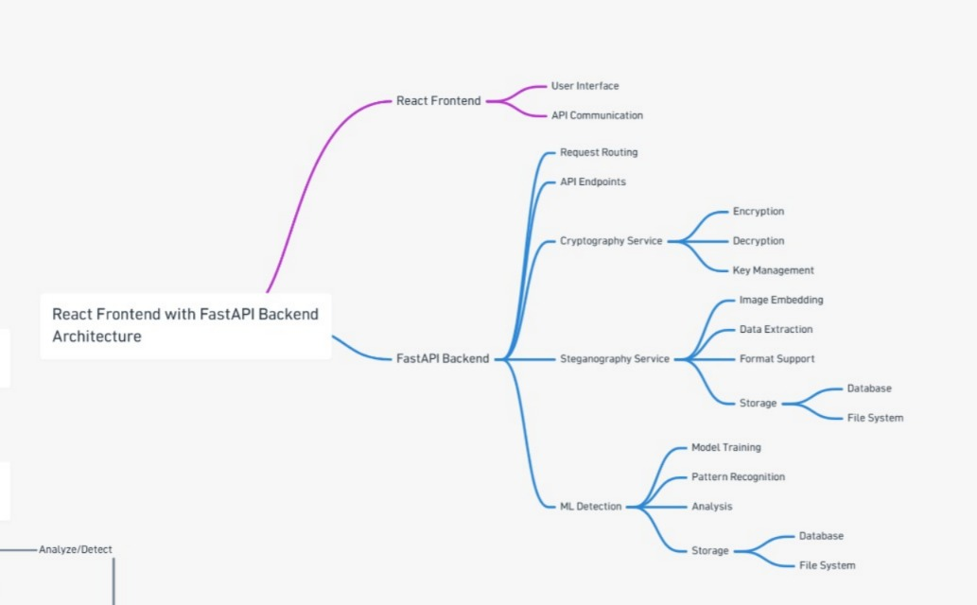
Executive Summary
A modular system that separates security, embedding, detection, API, and UI responsibilities.
Cryptography
Steganography
AES-256-CBC
Message confidentiality
JUNIWARD
Adaptive image hiding
ML Detection
Backend
CNN + ONNX
CLEAN / STEGO classification
FastAPI + Uvicorn
Routing and orchestration
Frontend
Reference overview image included and aligned to StegoShield modules
React 18 + Axios
User workflows and API calls
3
4
>40 dB
<50 ms
Core domains
API endpoints
Target PSNR
ONNX target
StegoShield v4.0 | AI-Driven Secure Steganography & Steganalysis
02
Notes:
This slide summarizes the system. The key review point is separation: encryption is not embedding, steganography is not ML, and the backend only orchestrates calls across services.

Slide 3
Problem Statement
Modern steganography pipelines face confidentiality, detectability, and robustness challenges.
01
Security Gap
02
Detection Gap
03
Robustness Gap
Hidden data is often embedded directly without a strong encryption layer. If extracted, the payload may be readable.
Forensic analysis needs reliable tools that classify whether an image is CLEAN or STEGO under modern embedding pipelines.
Basic methods are fragile under compression, resizing, noise, and brightness/contrast adjustments.
StegoShield addresses these gaps by combining AES encryption, JUNIWARD adaptive embedding, and ML-based steganalysis in one cohesive workflow.
StegoShield v4.0 | AI-Driven Secure Steganography & Steganalysis
03
Notes:
State the core problem: steganography alone is not enough. We also need encrypted payloads, detection capability, and measurable robustness against common image transformations.

Slide 4
Project Objectives & Scope
Clearly scoped deliverables across crypto, steganography, detection, API, and frontend.
ID
Objective
Priority
O1
AES-256 encryption / decryption
Critical
O2
JUNIWARD embed / extract
Critical
O3
CNN training for detection
High
O4
Optuna hyperparameter tuning
High
O5
ONNX export & inference
Medium
O6
React frontend interface
High
O7
RESTful API orchestration
High
Scope note
Each module is independently developable, testable, and deployable; interfaces are defined through REST and service contracts.
04
StegoShield v4.0 | AI-Driven Secure Steganography & Steganalysis
Notes:
Highlight that the project is ambitious but bounded. The deliverables are not vague; they map to specific services, APIs, models, and frontend workflows.

Slide 5
Threat Model & Security Goals
Defense mapping against passive monitoring, image manipulation, and forensic analysis.
Adversary Capabilities
Security Goals
System Defense
• Intercepts stego images
• Applies JPEG compression
• Resizes images
• Adds noise or brightness changes
• Performs statistical steganalysis
G1 Preserve confidentiality
G2 Maintain statistical stealth
G3 Detect stego images
G4 Test robustness
G5 Provide usable UI
• AES-256-CBC encryption
• JUNIWARD adaptive costs
• CNN-based detector
• Attack testing endpoint
• React workflow UI
Key assumption: the attacker does not have AES keys and does not know JUNIWARD parameters a priori.
StegoShield v4.0 | AI-Driven Secure Steganography & Steganalysis
05
Notes:
Explain the adversary model. The system is designed for confidentiality and stealth, while also providing a detector to support forensic analysis.

Slide 6
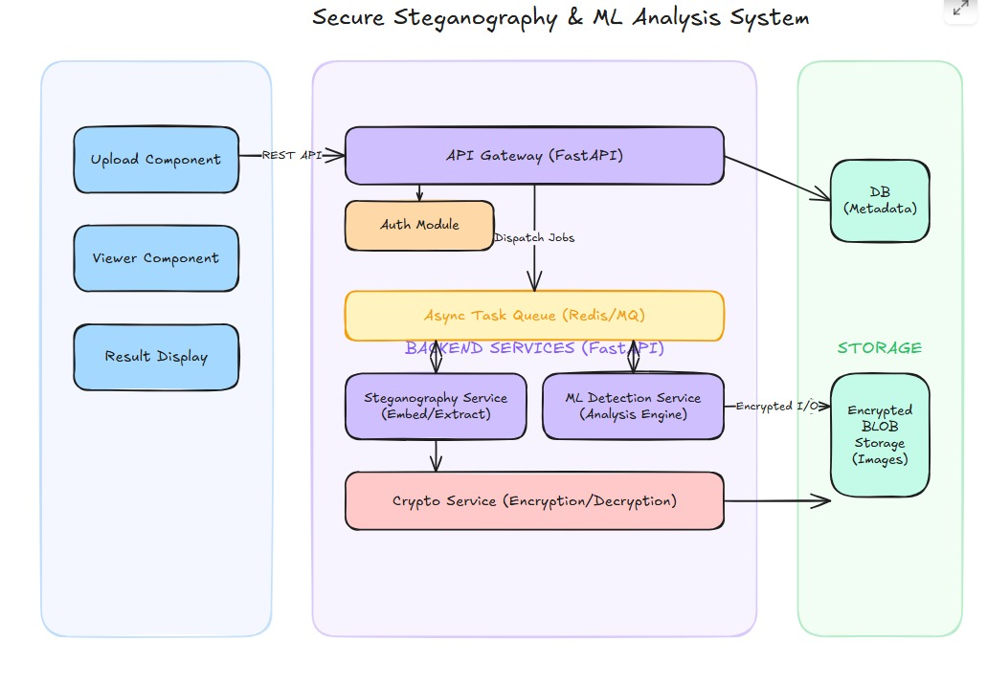
High-Level System Architecture
React UI, FastAPI orchestration, independent services, and image/model/log storage.
Crypto
AES-256-CBC
Encrypt / Decrypt
React Frontend
FastAPI Backend
Port 3000
Upload • Encode • Decode • Detect
Port 8000
Orchestration only
JUNIWARD
DWT + STC
Embed / Extract
ML Detection
CNN + ONNX
CLEAN / STEGO
Storage
Attached reference image: service-oriented architecture
Images • Models • Logs
Architecture rule
Backend coordinates services but does not contain core crypto implementation or ML model logic.
StegoShield v4.0 | AI-Driven Secure Steganography & Steganalysis
06
Notes:
Walk through the request path: frontend sends REST calls to FastAPI, which routes to independent modules. This separation makes testing, replacement, and deployment cleaner.

Slide 7
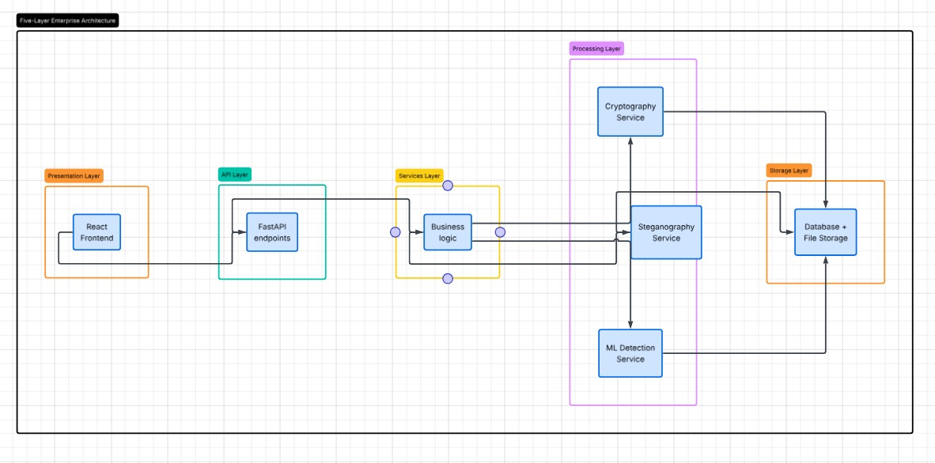
Five-Layer Architecture & Module Boundaries
A defense-ready explanation of what each layer is—and what it is not.
Frontend
React 18 + Axios
UI and REST API communication only
Backend
FastAPI + Uvicorn
Routing, validation, orchestration only
Cryptography
AES-256-CBC
Message encryption and decryption
Steganography
JUNIWARD
Adaptive image embed/extract using DWT + STC
Attached reference image: layered architecture
Critical clarification
ML Detection
PyTorch → ONNX
Binary classification: CLEAN or STEGO
JUNIWARD is not pure Machine Learning. It is heuristic optimization-based steganography using signal processing and cost-based embedding.
StegoShield v4.0 | AI-Driven Secure Steganography & Steganalysis
07
Notes:
This slide prevents conceptual confusion. JUNIWARD belongs to steganography, not ML. The ML component performs detection only.

Slide 8
Encoding Workflow
From user input to encrypted stego image with measurable quality metadata.
1
2
3
4
5
Upload
Validate
Encrypt
Embed
Return
Cover image + message + key + payload
Format, payload range, capacity
AES-256-CBC + random IV
JUNIWARD DWT + STC
Stego image + PSNR + timing
Input contract
Output contract
image, message, optional 32-byte base64 key, payload float default 0.2 bpp.
base64 stego image with encryption metadata, payload_bpp, PSNR, file sizes, and encoding_time_ms.
StegoShield v4.0 | AI-Driven Secure Steganography & Steganalysis
08
Notes:
Describe the complete encoding path. The message is encrypted first, then the encrypted bytes are embedded. The frontend receives the result and quality metrics.

Slide 9
Decoding Workflow
Extract the hidden encrypted payload, then decrypt it using the provided key.
Stego Image + Key
JUNIWARD Extraction
AES Decryption
Original Message
User upload through React
Recover encrypted bytes
AES-256-CBC + PKCS7
Recovered plaintext
Failure Case 01
Failure Case 02
Failure Case 03
DECRYPTION_FAILED
Incorrect key or corrupted data.
NO_DATA_FOUND
No hidden payload was detected.
CORRUPTED_STEGO
Image modified after embedding.
StegoShield v4.0 | AI-Driven Secure Steganography & Steganalysis
09
Notes:
Clarify that extraction and decryption are separate stages. A successful extraction can still fail decryption if the wrong key is supplied or the stego image was modified.

Slide 10
Detection Workflow
Fast binary steganalysis: is the uploaded image CLEAN or STEGO?
Image Upload
Preprocess
ONNX Inference
Prediction
Any supported image format
RGB, resize 256×256, normalize
Production model runtime
CLEAN / STEGO + confidence
256×256
2 classes
90%
<50 ms
Input Size
Output
Target Accuracy
CPU Inference
Boundary condition
The ML model detects stego likelihood only; it does not encrypt, embed, extract, or decode hidden messages.
StegoShield v4.0 | AI-Driven Secure Steganography & Steganalysis
10
Notes:
Stress the ML boundary. Detection is a classification task. It does not perform cryptography or steganographic embedding.

Slide 11
JUNIWARD Steganography Algorithm
A deterministic heuristic optimization method using wavelet-domain embedding.
RGB → YUV
4-Level DWT
Cost ρ[i]
STC Encoding
Inverse DWT
Embed only in luminance channel
Daubechies-8 wavelet
High cost in smooth regions; low cost in textured regions
Near-optimal constrained embedding
Reconstruct stego image
Cost Function
Classification
rho[i] = 1 / ( |c[i]|^1.0 + 1e-10 )
LL subband is left untouched; detail subbands LH, HL, HH are used.
JUNIWARD is not pure ML: no neural networks, no training data, deterministic for fixed inputs.
StegoShield v4.0 | AI-Driven Secure Steganography & Steganalysis
11
Notes:
Explain why JUNIWARD improves stealth: it avoids embedding in statistically sensitive areas and prefers textured wavelet coefficients with lower embedding cost.

Slide 12
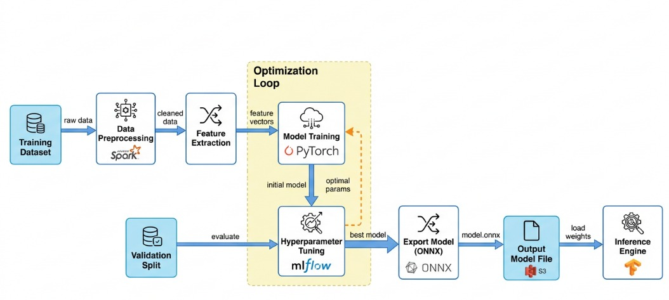
ML Pipeline for Steganalysis
Dataset generation, training optimization, ONNX export, and production inference.
Dataset Preparation
ALASKA2 clean images + synthetically generated JUNIWARD stego samples across payloads 0.1–0.4 bpp.
Training & Optimization
CNN in PyTorch with Optuna search: learning rate, batch size, layers, dropout, optimizer.
Attached reference image: ML training and inference pipeline
Production Inference
Export best model to ONNX and serve through ONNX Runtime for low-latency classification.
90%
0.95
0.92
Target Accuracy
AUC-ROC
F1-score
35–50 ms
70/15/15
ONNX CPU
Split
StegoShield v4.0 | AI-Driven Secure Steganography & Steganalysis
12
Notes:
This slide shows the ML lifecycle. The dataset is balanced, the model is tuned with Optuna, and ONNX is used for production inference.

Slide 13
API Design & Specifications
Four REST endpoints serve the complete secure-stego and detection workflows.
POST /encode
POST /decode
Input: image, message, key, payload
Output: stego_image, metadata, PSNR, timing
Input: stego image, key
Output: recovered original message, decoding time
POST /detect
POST /attack
Input: image, confidence_threshold
Output: CLEAN/STEG, confidence, probabilities
Input: image, attack_type, attack_params
Output: BER, character accuracy, PSNR, SSIM
Base URL
http://localhost:8000/api/v1 • JSON responses • multipart/form-data for uploads • CORS enabled for React localhost:3000
StegoShield v4.0 | AI-Driven Secure Steganography & Steganalysis
13
Notes:
Mention that API contracts make integration explicit. Each endpoint has defined inputs, outputs, and known error codes.

Slide 14
Frontend Design: React 18
A clear component structure maps directly to user-facing workflows.
src/components
Navigation / Navbar
Encode: Form, Uploader, Result
Decode: Form, Message Display
Detect: Form, Prediction Card
Attack: Form, Metrics Display
Common: Spinner, Alert, Confidence Bar
Axios API Service
FastAPI Backend
baseURL: /api/v1
encodeAPI • decodeAPI • detectAPI • attackAPI
Orchestration and response handling
User experience
The UI exposes encode, decode, detect, and attack testing without exposing internal service complexity.
StegoShield v4.0 | AI-Driven Secure Steganography & Steganalysis
14
Notes:
Explain that frontend is intentionally thin. It handles file uploads, form input, preview, error states, and confidence visualization while delegating logic to APIs.

Slide 15
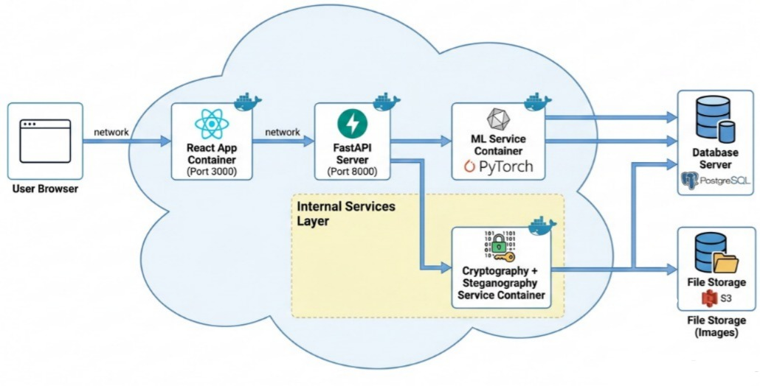
Testing, Performance & Deployment
Quality gates across unit, integration, E2E, performance, and containerized deployment.
Unit Tests
Integration
Pytest / Jest
Target: 90–100%
Pytest / Postman
Target: 90%
E2E
Performance
Cypress / Selenium
Target: Key flows
Locust / k6
Target: SLA targets
Attached reference image: deployment/container architecture
<5 sec
<3 sec
<50 ms
>40 dB
>0.95
>10 rps
Encoding
Decoding
Inference
PSNR
SSIM
Throughput
Deployment
Local development uses uvicorn for FastAPI and npm start for React; Docker Compose runs backend and frontend independently.
StegoShield v4.0 | AI-Driven Secure Steganography & Steganalysis
15
Notes:
Summarize testing strategy and performance targets. The deployment model is simple enough for local demos and structured enough for containerized environments.

Slide 16
Risks, Limitations & Conclusion
Transparent limitations strengthen the credibility of the system design.
Known Limitations
Mitigation Strategy
Final Value
• ALASKA2 is not originally JUNIWARD-based
• Stego labels are synthetic
• Payloads are controlled: 0.1–0.4 bpp
• Unknown real-world algorithms may differ
• Train across multiple payloads
• Document distribution shift
• Use robustness testing
• Keep modules replaceable
• Improve dataset realism later
StegoShield delivers a complete secure pipeline: encrypt → embed → detect → test → deploy.
Confidentiality
Stealth
Detection
Deployment
StegoShield: a modular, secure, AI-assisted steganography and steganalysis platform.
StegoShield v4.0 | AI-Driven Secure Steganography & Steganalysis
16
Notes:
Close by acknowledging limitations honestly, then restate the engineering value: modular design, secure payloads, adaptive embedding, ML-based detection, and deployable UI/API architecture.

