Slide 1

A
Project Review Meeting
on
Explainable AI Framework for Employee AttritionPrediction
by
P.SREE BHUVANESWARI - 2420030519
M.WITTY-2420030759
P.GURU PRASAD – 2420090089
Team Number: 1
Under the guidance of
Dr. KATANGURI SWANTHANA
Department of Computer Science and Engineering
Koneru Lakshmaiah Education Foundation
(Deemed to be University estd. u/s. 3 of the UGC Act, 1956)
Off-Campus: Bachupally-Gandimaisamma Road, Bowrampet, Hyderabad, Telangana - 500 043.
Phone No: 7815926816, www.klh.edu.in

Slide 2
Introduction:
Employee attrition refers to employees leaving an organization. High attrition can lead to loss of experienced employees, additional recruitment costs and reduced productivity.
Machine Learning can help predict employees who are more likely to leave. However, prediction alone is not enough for HR. The organization also needs to understand why the model gives that prediction.
Our project therefore combines Machine Learning with Explainable AI to make employee attrition predictions more understandable and useful for HR decision-making.

Slide 3
Problem Statement:
Organizations have large amounts of employee data.
Identifying employees who may leave is difficult.
Employee attrition depends on multiple factors.
ML models may provide predictions without understandable reasons.
HR requires clear information about the factors influencing attrition.
Employee attrition data is imbalanced.

Slide 4
Objectives:
Predict employee attrition using Machine Learning.
Identify important factors influencing employee attrition.
Use SHAP and LIME for explainability.
Provide both overall and individual-level explanations.
Evaluate models using Accuracy, Precision, Recall, F1-Score and ROC-AUC.
Provide understandable information for HR decision support.

Slide 5
Literature Survey:
YEAR | RESEARCH | TECHNIQUE | PURPOSE | LIMITATION/GAP
2022 | Interpreting the Factors of Employee Attrition using Explainable AI | SHAP + LIME | Explains factors influencing employee attrition | Mainly focuses on interpreting attrition factors
2023 | Analyzing Employee Attrition Using Explainable AI for Strategic HR Decision-Making | LIME + SHAP + ELI5 | Explains ML predictions for HR decisions | Mainly focuses on prediction and explanation
2023 | Retention Is All You Need | ML + SHAP | HR decision-support for attrition | Shows that XAI can support HR decisions
2026 | Employee Attrition Prediction: An Explanatory and Statistically Robust Ensemble Learning Model | XGBoost + SHAP + LIME + Optuna | Improves prediction and interpretability | More complex pipeline
2026 | Explainable AI for Employee Turnover Prediction | SHAP + fairness + calibration | Adds subgroup fairness and validation | Shows that responsible deployment needs more than feature importance

Slide 6
Research Gap
Existing research focuses on employee attrition prediction.
SHAP is used for model explanations.
LIME is used for individual explanations.
Ensemble models are used for prediction.
Risk scoring is used in some approaches.
Fairness analysis is considered in some research.
An integrated prediction + explanation + HR decision-support framework is still needed.

Slide 7
Innovation, Creativity & Novelty
Employee Attrition Risk Profile
Our system provides:
Attrition prediction
Attrition probability
Important contributing factors
SHAP explanation
Individual employee explanation
Simple HR-oriented output

Slide 8
Methodology
IBM HR Dataset
↓
Data Preprocessing
Missing-value check
Duplicate check
Remove unnecessary columns
Categorical encoding
↓
Data Balancing
SMOTE
↓
Machine Learning
Logistic Regression
Random Forest
XGBoost
↓
Model Evaluation
Accuracy
Precision
Recall
F1-Score
ROC-AUC
↓
Explainable AI
SHAP
LIME
↓
Prediction + Explanation
This is your methodology.

Slide 9
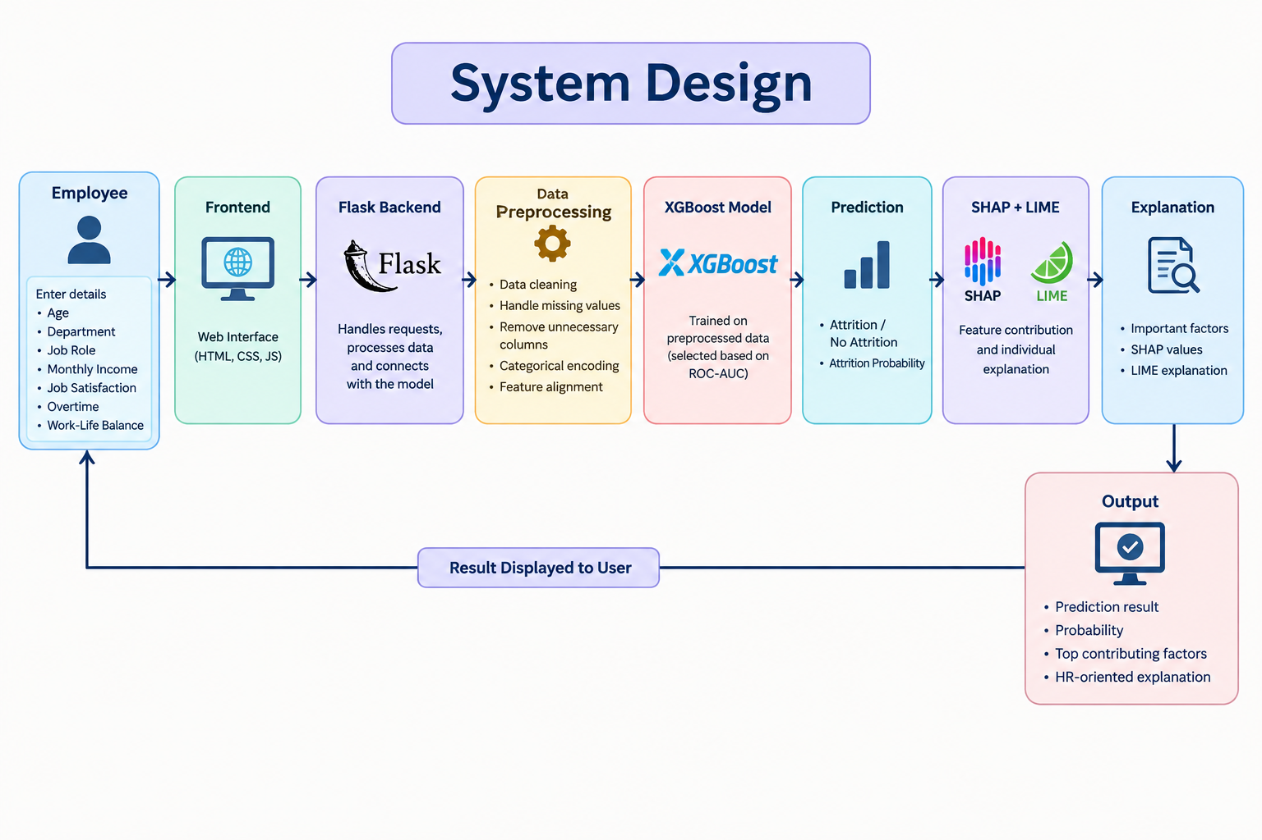
System Design

Slide 10
Modern Tools and Technologies
Category | Technology
Programming | Python
Data Processing | Pandas, NumPy
Machine Learning | Scikit-learn, XGBoost
Data Balancing | SMOTE
Explainable AI | SHAP, LIME
Backend | Flask, Flask-CORS
Frontend | HTML, CSS, JavaScript
Dataset | IBM HR Employee Attrition Dataset
Model Saving | Joblib
Development | VS Code, Git/GitHub

Slide 11
Implementation
Dataset
IBM HR Employee Attrition Dataset
1,470 employees
35 original features
Preprocessing
Removed unnecessary columns
One-hot encoded categorical features
Final model features: 44
Applied SMOTE to training data
Models
Logistic Regression
Random Forest
XGBoost
Explainability
SHAP
LIME
Application
Flask backend
HTML/CSS/JavaScript frontend
Output
Attrition / No Attrition
Attrition probability
Top contributing factors

Slide 12
Results
Model | Accuracy | Precision | Recall | F1 | ROC-AUC
Logistic Regression | 85.71% | 57.14% | 42.55% | 48.78% | 72.08%
Random Forest | 81.97% | 39.29% | 23.40% | 29.33% | 74.48%
XGBoost | 85.71% | 58.62% | 36.17% | 44.74% | 76.17%

Slide 13
Performance Evaluation
Performance Evaluation
Accuracy: Measures overall correct predictions.
Precision: Measures how many predicted attrition cases were actually attrition cases.
Recall: Measures how many actual attrition cases were identified.
F1-Score: Balances Precision and Recall.
ROC-AUC: Measures the model's ability to distinguish between attrition and non-attrition cases.
Observed Results
XGBoost achieved 85.71% Accuracy.
XGBoost achieved the highest ROC-AUC of 76.17% among the three models.
Logistic Regression achieved 42.55% Recall and 48.78% F1-Score.
The results show that model performance differs depending on the evaluation metric.

Slide 14
Explainability Results
SHAP Results
Identifies features contributing to the prediction.
Positive SHAP values increase the predicted attrition risk.
Negative SHAP values decrease the predicted attrition risk.
LIME Results
Provides an individual prediction explanation.
Shows which input factors influenced a particular employee prediction.
Put your generated:
shap_summary.png
shap_feature_importance.png
LIME explanation

Slide 15
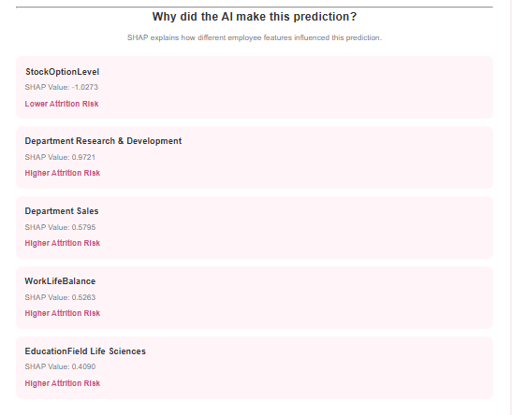
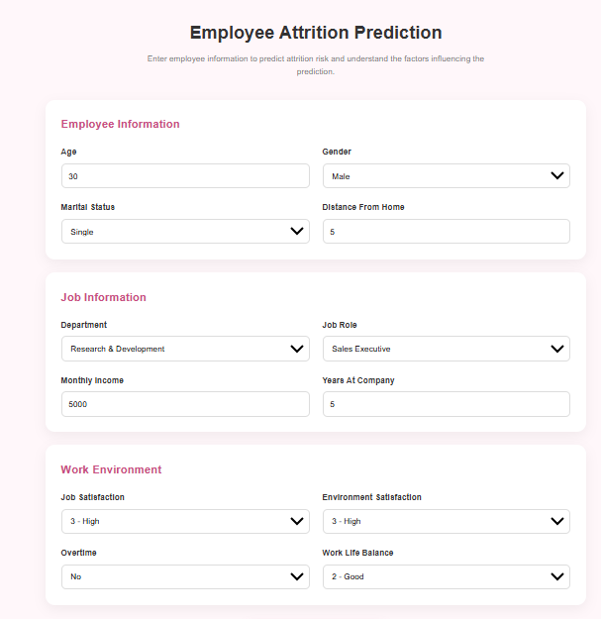

Working / Application Output

Slide 16
Conclusion
The project successfully implements an Explainable AI framework for employee attrition prediction using the IBM HR dataset. Multiple Machine Learning models were trained and evaluated, with XGBoost selected based on ROC-AUC. SHAP and LIME were integrated to explain individual predictions. The developed web application provides an understandable prediction, probability and contributing factors for HR analysis.

