Slide 1
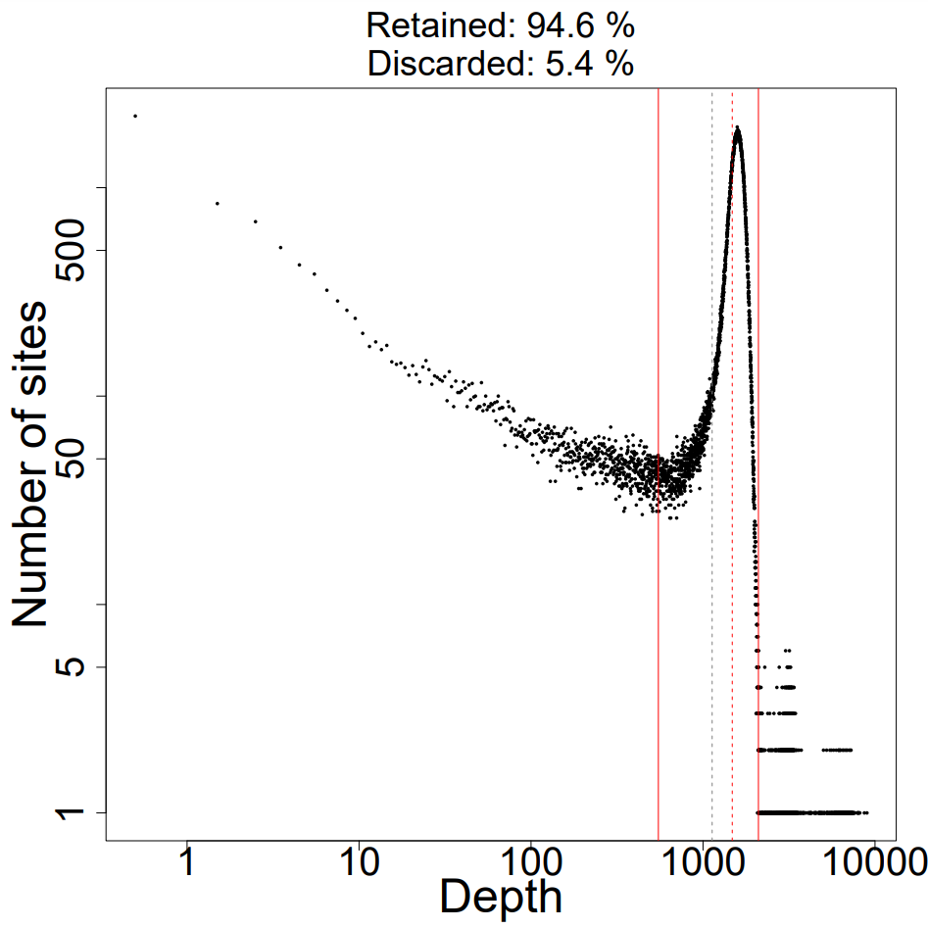
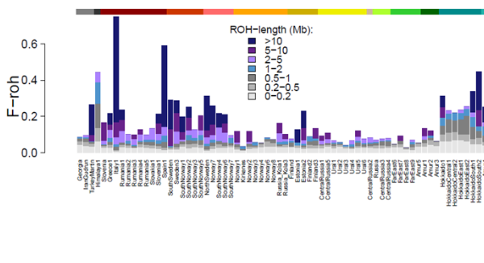
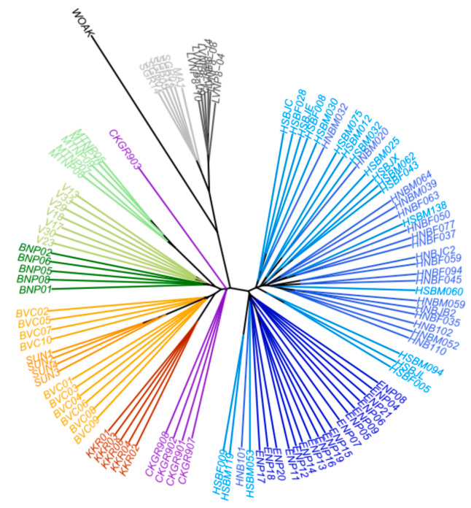
ROUTE MAP FOR GENOTYPE CALLING
using BAM2VCF script
bam-files
runpipeline (maskdepth=?)
PREFIX.masked.vcf.gz
combinevcf
masked_PREFIX.mybed1.txt.vcf.gz
calcdepth
INPUT FOR BAM2VCF_plotdepth
sampleinfo.DP.txt
globalfilter (min_alleles=?, snp_quality=?, removeindels=TRUE, mindepth=?,maxdepth=?)
PREFIX.globalfilter.thin0.mybed1.txt.vcf.gz
combinevcf2
INPUT FOR DARWINDOW
PREFIX.globalfilter.thin0.vcf.gz
thinallsites (thinallbp=??)
PREFIX.globalfilter.thin??.mybed1.txt.vcf.gz
combinethin
PREFIX.globalfilter.thin100.vcf.gz
selectvariants(biallelic=TRUE)
selectvariants(biallelic=FALSE)
PREFIX.mysnps.thin??.mybed1.txt.vcf.gz
PREFIX.mysnps.thin??.mybed1.txt.vcf.gz
combinevcf3
INPUT FOR VCF_CALCDIST.SH
PREFIX.mysnps.thin??.vcf.gz
missfilter (minalleles)
PREFIX.mysnps.thin??.missfilter.mybed1.txt.vcf.gz
add2inds
combinevcf4
allvcfdist.txt
PREFIX.mysnps.thin??.missfilter.vcf.gz
INPUT FOR SAMBAR
thinsnps (thinsnpbp=?????)
convert2ped
PREFIX.mysnps.ped
PREFIX.mysnps.thin??_?????.missfilter.vcf.gz

