Slide 1
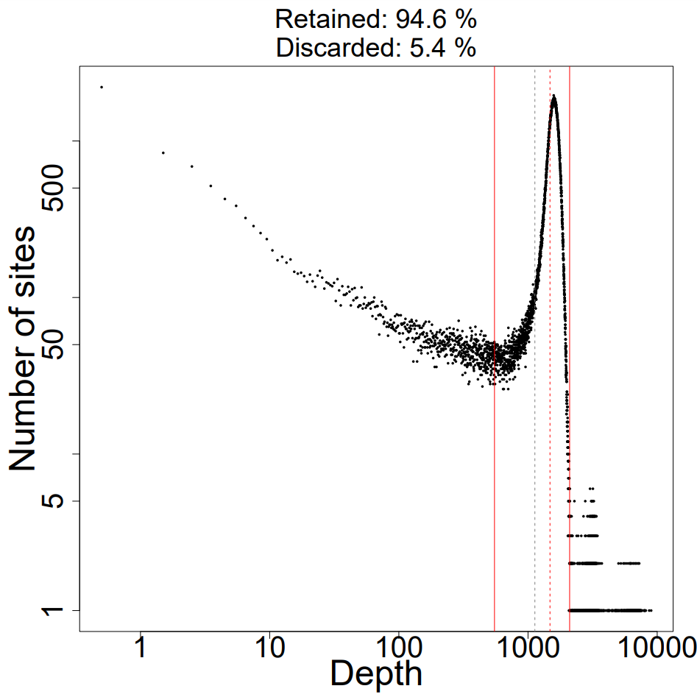
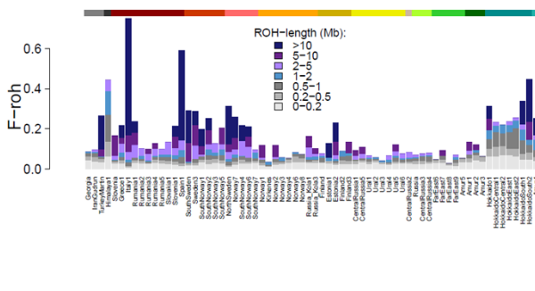
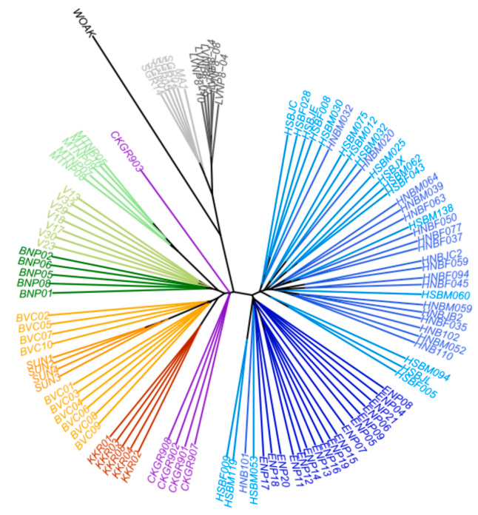
ROUTE MAP FOR GENOTYPE CALLING AND POPULATION-GENOMIC ANALYSES
https://github.com/mennodejong1986/WGS_data_analyses
sample1_1..fq.gz + sample1_2.fq.gz
sample2_1.fq.gz + sample2_2.fq.gz
FASTQ_filter_fastp.sh
sample1.QC.1..fq.gz + sample1.QC_2.fq.gz
include all sites (polymorphic AND monomorphic)
sample2.QC._1.fq.gz + sample2.QC_2.fq.gz
include all polymorphic sites (biallelic AND multiallelic)
FASTQ2BAM_bwa_HIGHWAY.sh
sample1.sorted.RG.dupremoved.filtered.bam
include only biallelic polymorphic sites
sample2.sorted.RG.dupremoved.filtered.bam
depreciated/redundant
BAM_extractregion.sh
sample1.xchrom.bam
sample2.xchrom.bam
UNTIL HERE, OUTPUT FILES ARE PER INDIVIDUAL
STARTING POINT WHEN REDOING ANALYSES
BAM2VCF_plotdepth.inR.txt
BAM2VCF_bcftools_HIGHWAY.sh
runpipeline (maskdepth=?)
calcdepth
PREFIX.masked.vcf.gz
combinevcf
masked_PREFIX.mybed1.txt.vcf.gz
sampleinfo.DP.txt
globalfilter (min_alleles=?, snp_quality=?,
removeindels=TRUE, mindepth=?,maxdepth=?)
VCF_darwindow.sh
VCF_darwindow.plotinR.txt
PREFIX.globalfilter.thin0.mybed1.txt.vcf.gz
combinevcf2
PREFIX.globalfilter.thin0.vcf.gz
mywindow.20000.he.allsites.roh.txt
thinallsites (thinallbp=??)
CONVERT_VCF2phylip.sh
Create input for ML tree building
PREFIX.globalfilter.thin??.vcf.gz
combinethin
PREFIX.globalfilter.thin??.mybed1.txt.vcf.gz
PREFIX.mysnps.thin.phy
VCF_easySFS.sh
SFS-based analyses
selectvariants(biallelic=FALSE)
selectvariants(biallelic=TRUE)
combinevcf3
VCF_annotate_SNPs.sh
For McDonald-Kreitman test
PREFIX.mysnps.thin??.mybed1.txt.vcf.gz
PREFIX.mysnps.thin??.vcf.gz
missfilter (minalleles)
PREFIX.annotated.vcf.gz
PREFIX.mysnps.thin??.missfilter.mybed1.txt.vcf.gz
VCF_calcdist.sh
VCF_calcdist_parallel.sh
combinevcf4
allvcfdist.txt
PREFIX.mysnps.thin??.missfilter.vcf.gz
thinsnps (thinsnpbp=?????)
SAMBAR.txt
convert2ped
importdata()
add2inds2()
PREFIX.mysnps.thin??_?????.missfilter.vcf.gz
PREFIX.mysnps.ped
genlight, snps, inds, inds2
VCF_EEMS.sh
Migration patterns
VCF_Dsuite
ABBA-BABA analyses
VCF_slidingwindow.sh
Genomic landscape of Dxy, pi and Fst along chromosomes

