Slide 1
AI adoption survey: Example Org (fictional)
Synthetic data, n=200 · 2026-11-11

Slide 2
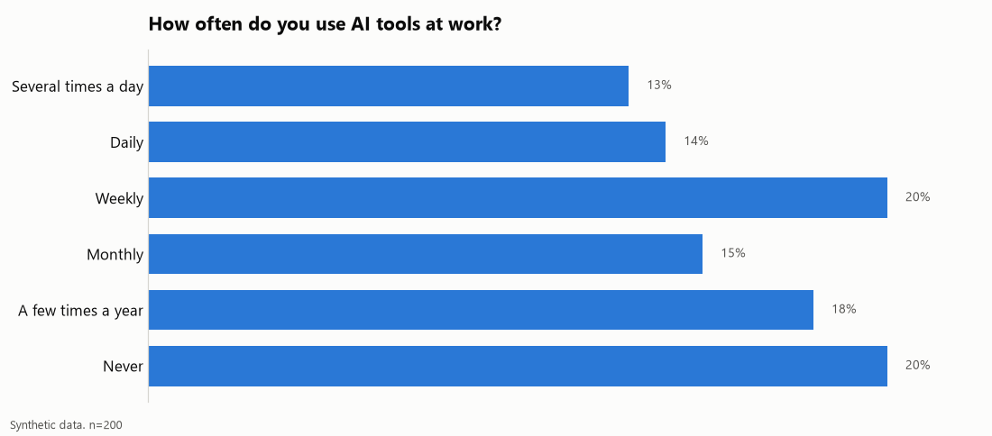
[Message] Use of AI at work
Notes:
Weekly or more: 47%

Slide 3
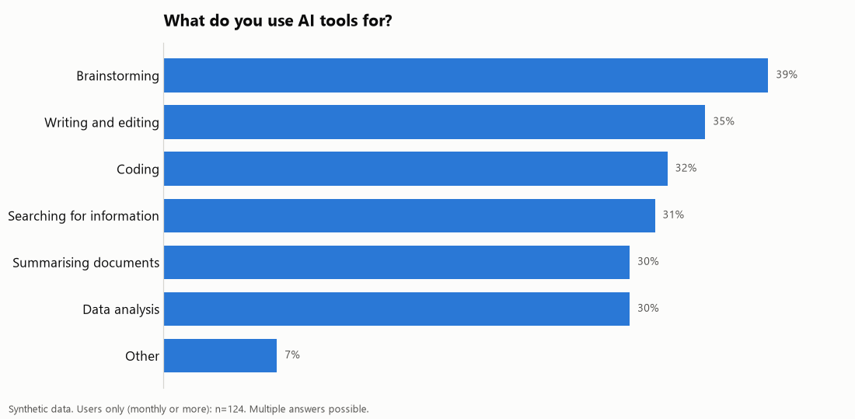
[Message] What people use AI for

Slide 4
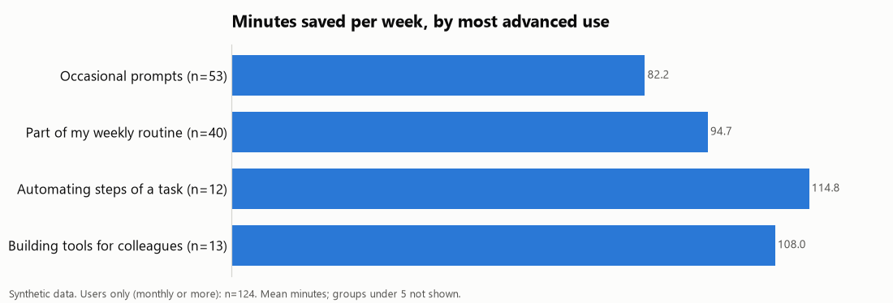
[Message] Time saved grows with depth of use

Slide 5
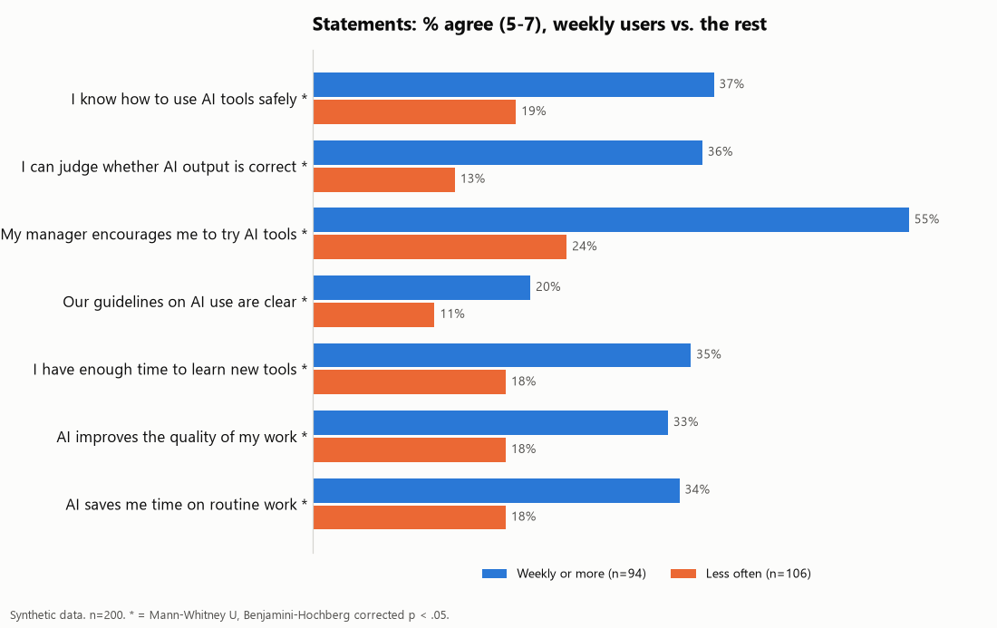
[Message] Weekly users see more value and support

Slide 6
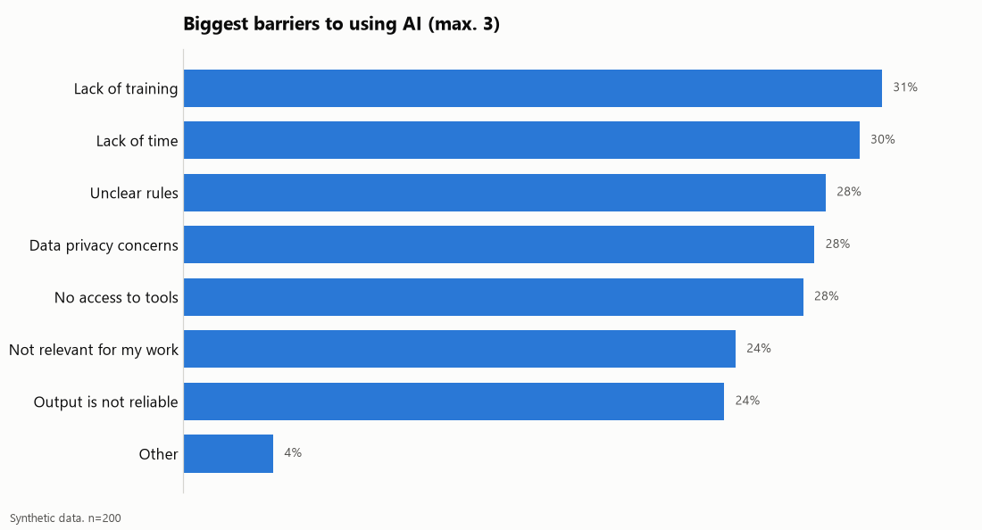
[Message] What holds people back

Slide 7
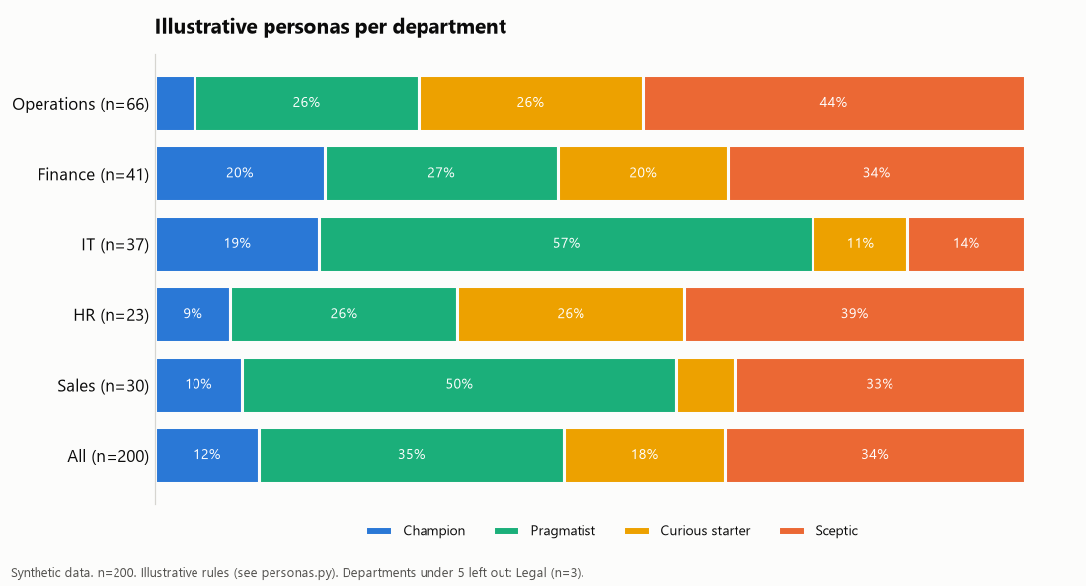
[Message] Personas per department
Notes:
Department x weekly use: chi2=23.0, df=4, p=0.000, Cramer's V=0.34

Slide 8
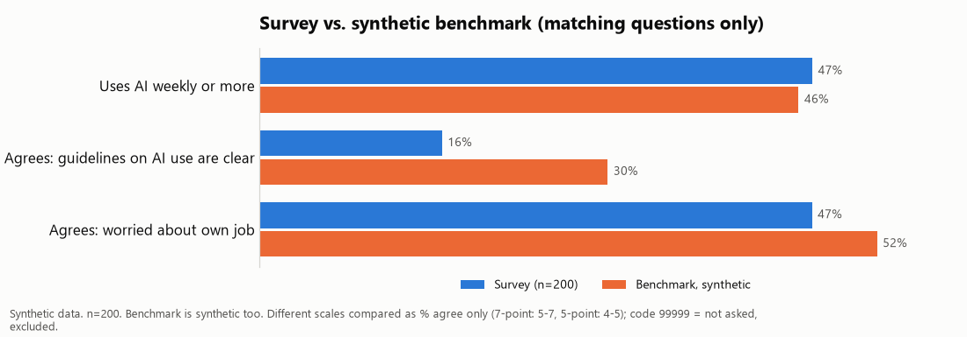
[Message] How we compare

