Slide 1


Done By:
Mennuli Kiran
Bala Krishna Yadam
K Sidda Chetan Reddy

Slide 2
Preface
INTRODUCTION
PROBLEM STATEMENT
OBJECTIVE
TOOLS USED
WEB SCRAPPING
DATA CLEANING STEPS
DATA VISUALIZATION
CONCLUSION

Slide 3

AmbitionBox Introduction
Ambition Box is a popular platform in India that provides company reviews, salary insights, interview experiences, and other career-related information.
It was founded in 2015 by two IIT Madras alumni
AmbitionBox's goal is to help job seekers prepare for interviews
It provides access to a resume database, job listings, and employer branding advertisement

Slide 4
Problem Statement
Despite the growing need for transparent and reliable information about companies and jobs, potential employees often lack access to accurate, up-to-date, and user-generated insights about workplace culture, salaries, and career progression, leaving them with limited ability to make informed career decisions.
Our goal is to compare companies, research career paths, and make informed decisions based on real employee experiences.

Slide 5
Objectives
Compare Companies: Analyze and compare companies based on employee reviews, ratings, and salary insights.
Research Career Paths: Explore career progression opportunities across different industries.
Make Informed Decisions: Provide job seekers with data-driven insights to make informed career decisions.
Leverage Real Employee Experiences: Utilize user-generated content (reviews, interviews, salaries) to offer transparent and reliable information.

Slide 6






Tools Used

Slide 7
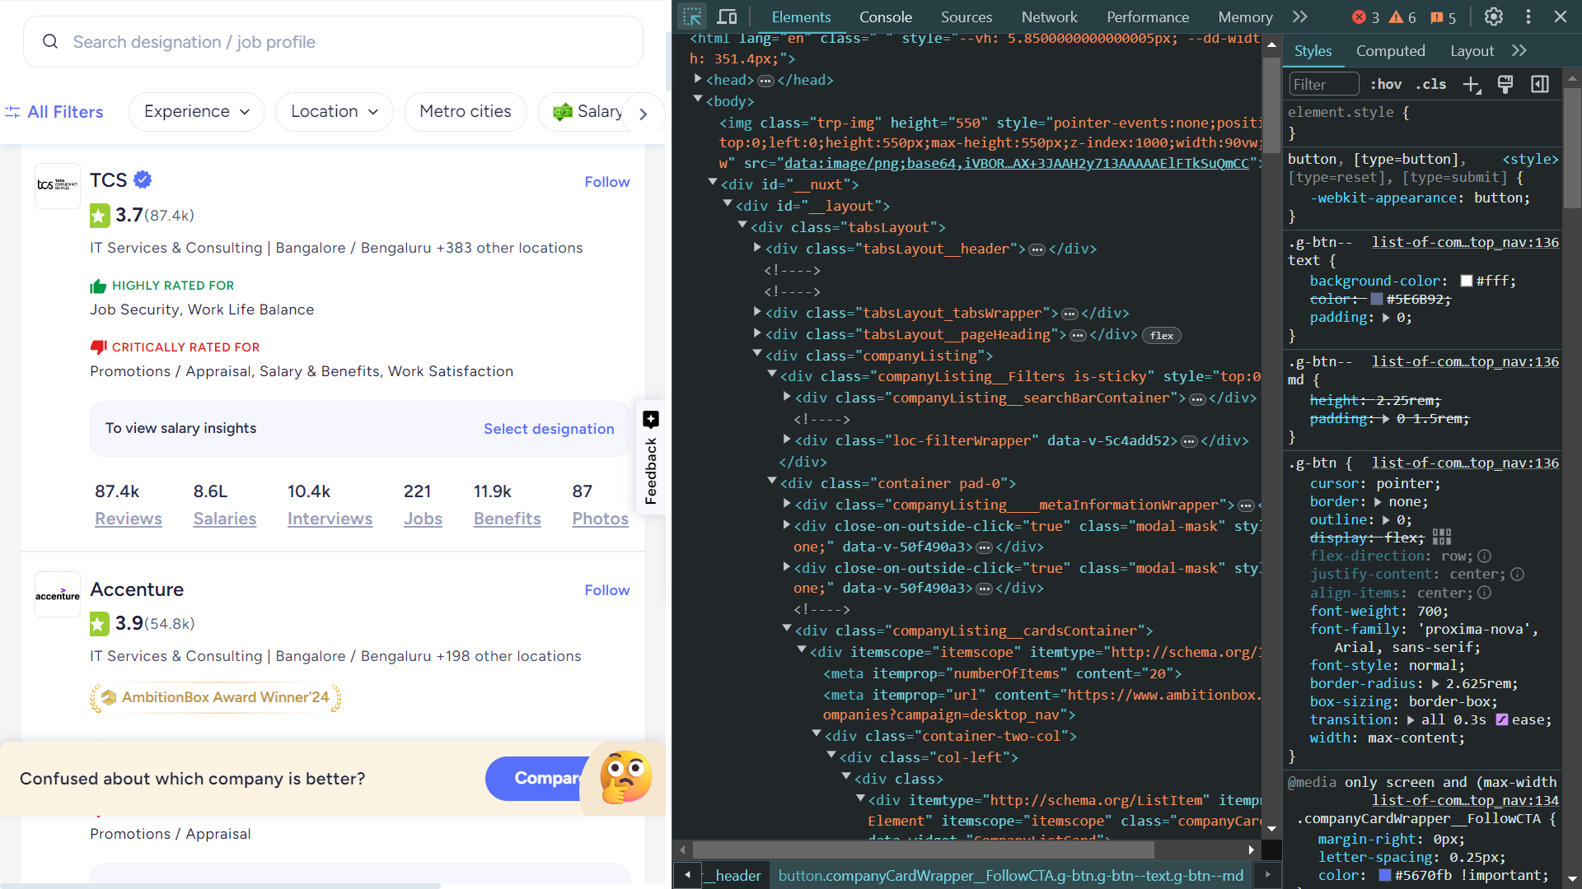
Web Scraping
Ambition box was selected as the data source
Used browser developer tools (Inspect Element) to locate relevant HTML tags Data (company name, rating, salaries,Reviews , etc.).
Using Header request 403 error was solved.
Used BeautifulSoup and Requests to extract data from Ambition box.
Sent HTTP requests to fetch web pages.
Parsed the HTML using BeautifulSoup to extract required information.
Stored the data in a structured format (CSV).
Performed Exploratory Data Analysis (EDA) to identify trends.

Slide 8
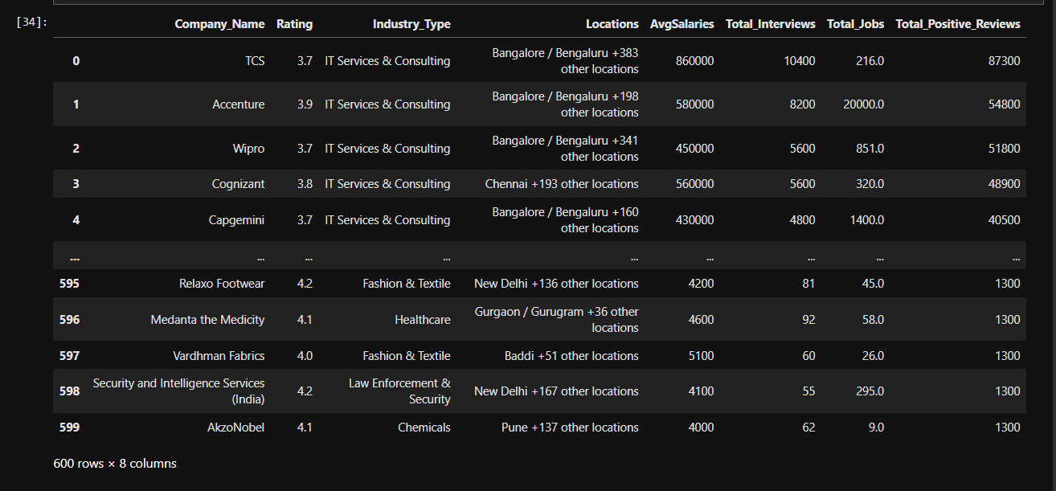
Data Cleaning Steps
Extracted data and named columns as Company Name, Industry_type, Rating, locations, Avg_Salaries , Total Interviews , Total_jobs , Total_Positive_Reviews .
Changed into numeric fields (Rating, Avg_Salaries ,Total_Interviews,Total_jobs,etc) to appropriate data types (integer/float) for analysis.
Identified and filled or removed missing values in columns like Totaljobs , Industry type.
Checked for duplicate entries to ensure data accuracy.
Cross-checked cleaned data for consistency and correctness before analysis.

Slide 9
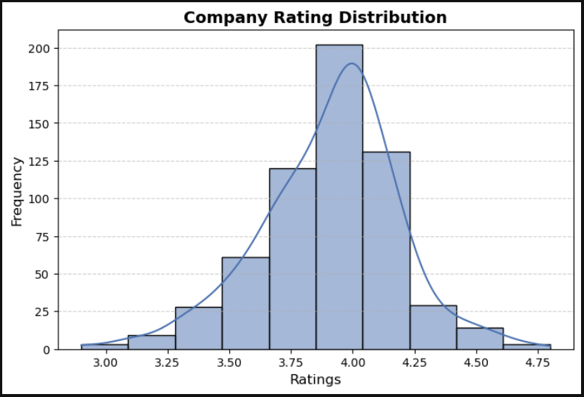
Data Visualization
Distribution of Company Ratings:
Visualization: Histogram with KDE Insight:
Most companies have ratings between 3.5 and 4.2, indicating generally positive reviews.
Few companies have very low (<3.0) or very high (>4.5) ratings.
Helps job seekers identify companies with outlier ratings (e.g., exceptionally good or poor).

Slide 10
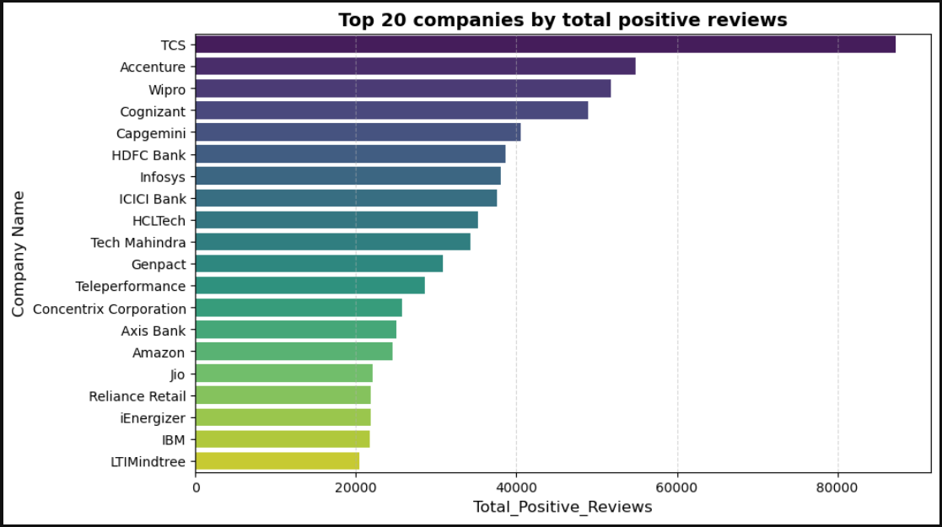
Top 20 Companies Based On Total Positive Reviews
Visualization: BarhPlot
Insight:
TCS, Accenture, and Wipro have the most reviews, implying higher transparency.
Companies with more reviews provide richer data for job seekers to evaluate.

Slide 11
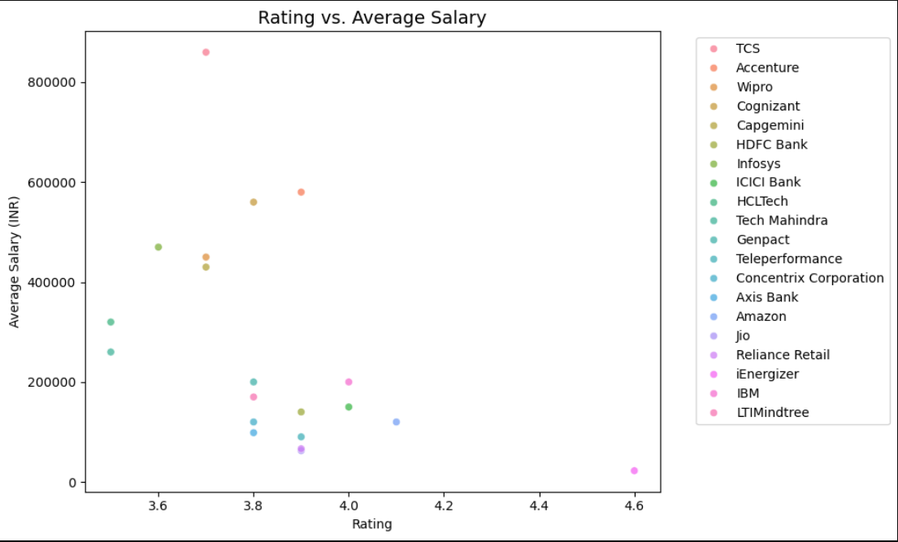
Rating vs. Avg Salary using Scatter plot
Visualization: Scatter Plot
Insight:
No strong correlation between ratings and salaries.
High salaries exist across all rating ranges (e.g., TCS has a moderate rating but high salary).
Job seekers must prioritize either salary or culture independently.

Slide 12
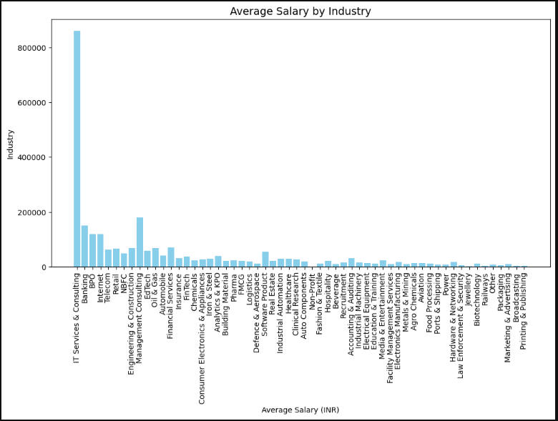
Average Salary by Industry
Visualization: Bar Chart
Insight:
IT Services & Consulting, Software Product, and Financial Services are top-paying industries.
Job seekers can target industries aligned with their salary expectations.

Slide 13
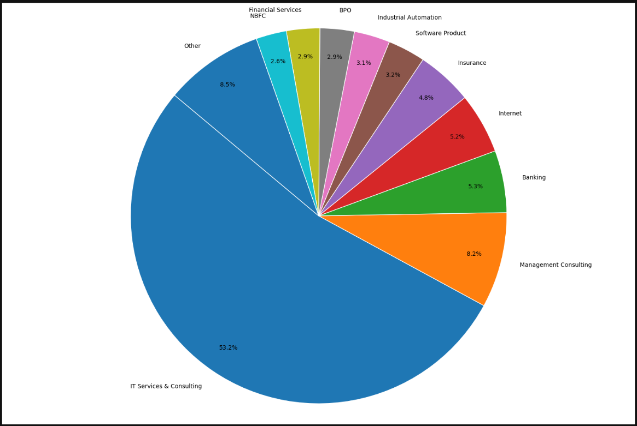
Key Insights:
IT Services & Consulting dominates with the largest share of jobs.
Banking and BPO follow as significant contributors.Smaller industries are grouped under "Other" for clarity.
This visualization highlights which industries offer the most job opportunities based on the dataset.

Slide 14
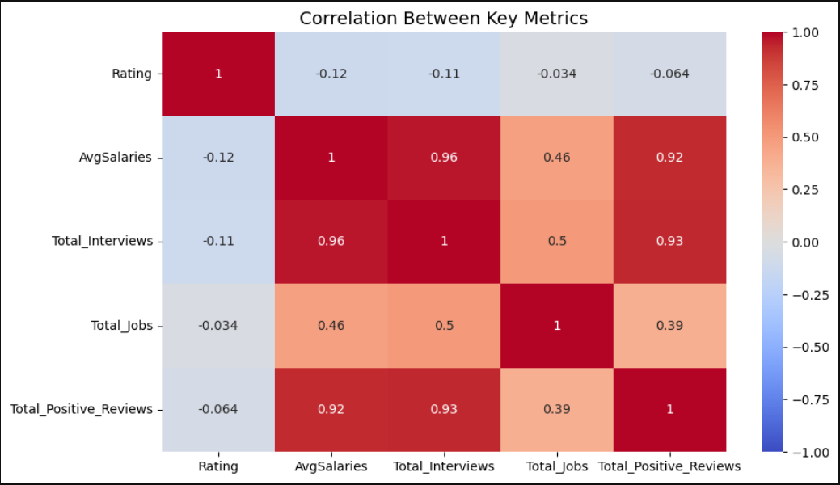
A correlation matrix visualizes the relationships between different numerical features in the dataset
Visualization: Heatmap
Total_Reviews strongly correlates with Total_Jobs (0.72), indicating companies with more jobs attract more reviews.
AvgSalaries has weak correlation with other metrics, reinforcing the need to analyze salaries separately.
Color-coded Heatmap Representation:
Values range from -1 to +1:
+1: Strong positive correlation (e.g., higher budget → higher collections).
0: No correlation.
-1: Strong negative correlation.

Slide 15
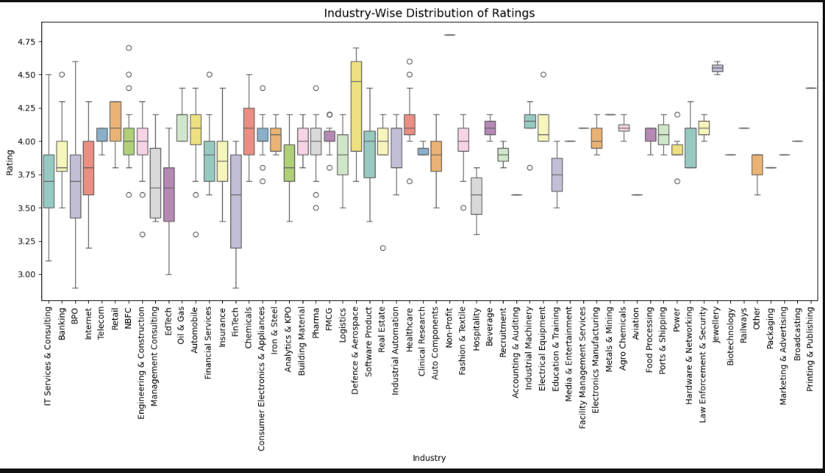
Industry-Wise Distribution of Ratings
Visualization: Boxplot
Insight:
Defence & Aerospace and Oil & Gas have consistently high ratings.
EdTech and BPO show wider rating variability, suggesting inconsistent workplace experiences.

Slide 16
Conclusion
Most companies have ratings between 3.5 and 4.2, indicating generally positive reviews.
IT Services & Consulting is the top-paying industry, followed by Software Product and Financial Services.
No strong correlation between company ratings and average salaries.
Companies like TCS, Accenture, and Wipro have the highest number of reviews, offering greater transparency.

Slide 17

THANK YOU

