Slide 1

Unreal
Game engine

Slide 2
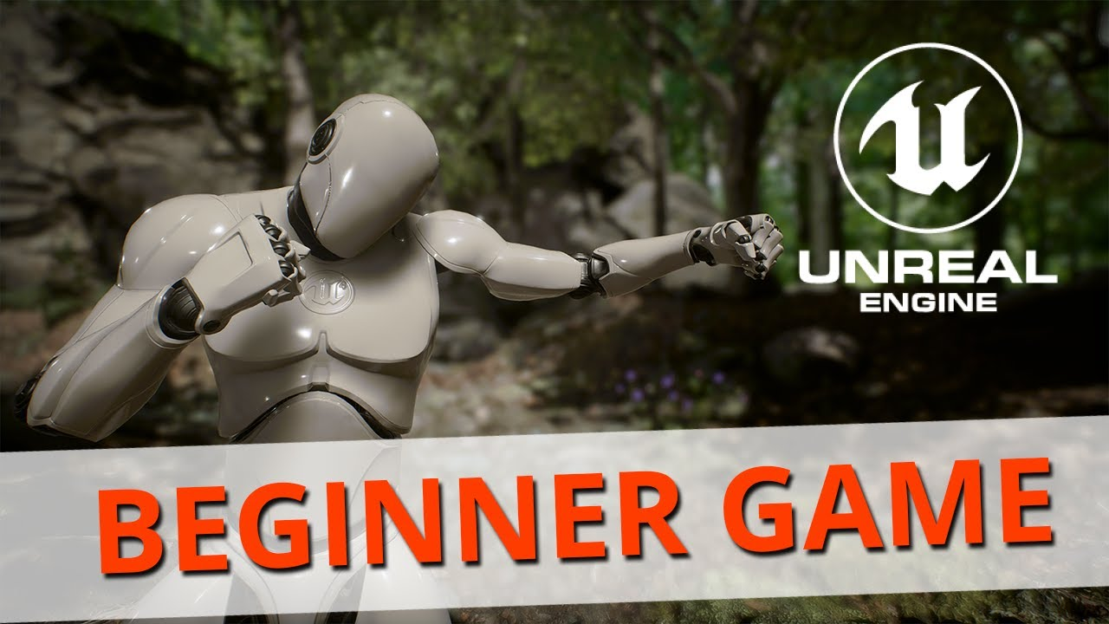

Slide 3

Tutorial:

Slide 4
Road to the engine: pros & cons
The website looks quite understable
Direction to download and navigation are pretty nice
Easy to install
Very large file
Takes a huge space in the computer C drive
Failed to install the engine version due to lack in space

Slide 5

Recommendation
Try a new thing can be interesting in the engine.
If anyone enjoy graphical work this is the engine.
Be aware of the disc space if trying to work on local computer
As Unreal Engine is a heavy, big, and expensive engine to make work, so that should be considered before starting.

Slide 6
Advantages
It has an easy interface
This game engine is well regarded for its ability to produce cutting-edge graphics
Unreal Engine is great for beginners

