Slide 1
COMPUTER VISION (CV) MINI PROJECT • ACADEMIC EVALUATION 2026
Real-Time Pothole Detection and
Obstacle Avoidance for Autonomous Vehicles
A Dual-Modality Computer Vision Pipeline combining Fine-Tuned RDD2022 YOLOv10n Deep Detection with Sub-4ms Classical Laplacian Morphology, Dynamic Corridor Risk Scoring, and Directional Swerve Avoidance.
PROJECT TEAM MEMBERS
#1
Krishna Menon
Roll No: I045 | Lead: CV Integration, Serial Arbitration & Edge Hardware
#2
Aditya Rana
Roll No: I059 | Computer Vision Pipeline, Model Benchmarking & Testing

Slide 2
The Computer Vision Problem — Negative Obstacles
Why acoustic and active sensors fail completely, making high-speed vision mandatory
01 Acoustic & LiDAR Blindness
02 Indian Roadway Cavities
03 The Computer Vision Mandate
▸ Horizontal Propagation: Ultrasonic sensors (HC-SR04P) and 2D planar LiDARs emit beams parallel to the ground.
▸ Zero Return Reflection: When encountering a pothole or road cavity, waves travel straight over the depression.
▸ Catastrophic False Clear: Sensors report 'path clear' (infinite distance); the vehicle drives directly into the cavity.
▸ High Cavity Frequency: Indian roads feature complex D40 pothole fractures, irregular gravel margins, and deep ruts.
▸ Chassis & Wheel Damage: Negative obstacles inflict severe mechanical shock, bent wheel axles, and chassis rollover.
▸ Lighting Variations: Sharp sunlight, tree shadows, and wet asphalt disguise cavity depth, causing false negatives.
▸ Sole Reliable Modality: Passive optical vision is the only sensor capable of perceiving surface texture depressions.
▸ Edge Speed Requirement: Must run at >30 FPS on embedded edge CPUs to detect cavities 1–2 meters ahead.
▸ Autonomous Swerving: Detection must output directional evasion vectors, not merely passive bounding box labels.
Core Project Objective: Engineer an edge computer vision pipeline fusing deep learning (RDD2022 Pothole Specialist) with classical spatial Laplacian gradients to detect road cavities in <25 ms, dynamically partition drivable corridors, and actuate collision-free directional swerve avoidance.
CV Mini Project • Real-Time Pothole & Obstacle Detection • NMIMS MPSTME
2 / 14
Notes:
Detail the fundamental difference between positive obstacles (above ground) and negative obstacles (cavities).

Slide 3
Implementation Pipeline — Computer Vision Architecture
Camera Feed → Spatial Pre-Processing → Dual-Modality Detection → Corridor Scorer → Swerve Arbiter
STAGE 1
Image Ingest
• CSI Camera Module
(OmniVision OV5647)
• 320X320 Raw RGB
• 30 FPS Stream
• Daylight AWB Tuning
(Zero color cast)
• Fixed 45° Pitch Angle
(Optimized for road)
STAGE 2
Pre-Processing
• ROI Extraction
(Bottom 55% of frame)
• Rejects sky / horizon
and irrelevant scenery
• Bilinear Resizing
to 320×320 pixels
• FP16 Float Normalise
(0.0 to 1.0 range)
• ARM NEON SIMD prep
STAGE 3A: DEEP MODEL
RDD2022 Pothole + YOLO
• Custom YOLOv10n (D40 class)
• 50 epochs on India RDD
• Dual-label assignment
• Zero-NMS overhead on CPU
• 22.4 ms inference (31.6 FPS)
STAGE 4
Corridor Scorer
• 3-Zone Spatial Grid:
- Left (0–33%)
- Center (33–66%)
- Right (66–100%)
• Hazard Danger Formula
• Pothole Penalty: W=1.5×
• Obstacle Penalty: W=1.0×
• Real-time zone costs:
[Cost_L, Cost_C, Cost_R]
STAGE 5
Swerve Arbiter
• Directional Avoidance:
Center > 0.5 & Left < Right
→ << SWERVE LEFT >>
Center > 0.5 & Right < Left
→ << SWERVE RIGHT >>
All Zones Blocked (>0.8)
→ EMERGENCY STOP
• Outputs to Motor Spine
STAGE 3B: CLASSICAL CV
Laplacian Edge Morphology
• 5×5 Gaussian Blur filter
• Laplacian ∇²f gradient
• 13×13 Elliptical Closing
• Cavity contour filtering
• < 3.8 ms deterministic run
CV Mini Project • Real-Time Pothole & Obstacle Detection • NMIMS MPSTME
3 / 14
Notes:
Walk through each stage of the CV pipeline from optical capture down to swerve evasion.

Slide 4
Models and Algorithms Used in the Vision System
Mathematical formulations, neural architectures, and classical spatial filtering operators
01 RDD2022 Pothole Specialist (D40)
02 Classical Spatial Laplacian CV
03 Elliptical Morphological Closing
▸ Neural Backbone: YOLOv10n with Dual-Label Assignment (One-to-Many + One-to-One heads).
▸ Specialized Training: Fine-tuned 50 epochs on Road Damage Dataset (RDD2022 India subset, Class D40).
▸ NMS Elimination: One-to-one prediction head directly yields candidate bounding boxes with zero CPU NMS sorting.
▸ Mathematical Operator: Second-order isotropic derivative: ∇²f(x,y) = ∂²f/∂x² + ∂²f/∂y².
▸ Cavity Edge Detection: Isolates abrupt intensity transitions between asphalt surface and internal cavity shadows.
▸ Deterministic Latency: Executes in < 3.8 ms on Cortex-A76 CPU; zero risk of neural hallucination.
▸ Mathematical Formulation: Dilation followed by erosion: A • B = (A ⊕ B) ⊖ B.
▸ Structuring Element: 13×13 elliptical kernel matching characteristic oval roadway pothole fractures.
▸ Contour Extraction: Fuses fragmented gradient boundaries into closed, flood-fillable cavity candidate blobs.
04 YOLOv10n Obstacle Detection (Positive Obstacles)
05 Dynamic 3-Zone Corridor Risk Scoring Algorithm
▸ Multi-Class Awareness: Simultaneously identifies positive roadway hazards (pedestrians, vehicles, barriers, debris).
▸ Model Efficiency: 2.3 Million parameters, 6.7 GFLOPs; exported to Tencent NCNN FP16 with operator fusion.
▸ SIMD Parallelism: ARM NEON 128-bit vector instructions process four 32-bit floats per CPU cycle.
▸ Zone Danger Cost: Danger_z = Σ [ conf_i · W_type · (0.4 + min(Area_box / Area_zone, 0.5)) ].
▸ Asymmetric Weighting: W_obstacle = 1.0 | W_pothole = 1.5–2.0 (elevated hazard penalty due to structural risk).
▸ Swerve Decision Function: argmin_{z ∈ {Left, Right}} (Danger_z) subject to Danger_z < 0.40 threshold.
CV Mini Project • Real-Time Pothole & Obstacle Detection • NMIMS MPSTME
4 / 14
Notes:
Present all 5 core models and algorithms utilized in the pothole and obstacle detection pipeline.

Slide 5
Role of Models and Algorithms Used
Clear allocation of computer vision tasks, algorithmic responsibilities, and fallback chains
Model / Algorithm | Specific Operational Role | Mechanism / Formula | Latency Budget | Failure Fallback
RDD2022 Pothole Model | Detects negative roadway cavities and fractured pothole boundaries | Dual-label YOLOv10n (D40) | 18.2 ms (54.9 FPS) | Classical Laplacian CV detector
Classical Laplacian CV | Extracts spatial intensity gradients at cavity margins in <4ms | ∇²f = ∂²f/∂x² + ∂²f/∂y² | < 3.8 ms | Maintain previous lane center
Morphological Closing | Bridges fragmented edge pixels into continuous cavity contours | (A ⊕ B) ⊖ B (13×13 ellipse) | < 1.5 ms | Area threshold gating (>800 px)
YOLOv10n Obstacle Model | Detects positive collision hazards (pedestrians, vehicles, obstacles) | One-to-one prediction head | 22.4 ms (31.6 FPS) | Local ultrasonic safety reflex
Corridor Risk Scorer | Calculates dynamic collision danger across Left, Center, Right paths | Danger_z = Σ [conf·W·Area_norm] | < 0.8 ms | Emergency Stop (PI_STOP)
Swerve Direction Arbiter | Selects optimal evasion trajectory (<< SWERVE L/R >> or STOP) | argmin(Danger_Left, Danger_Right) | < 0.2 ms | Immediate straight-line brake
Role Synergy: The deep neural model provides high-level contextual semantic recognition (distinguishing a dark shadow from a real pothole), while classical Laplacian morphology provides sub-4ms spatial boundary confirmation.
CV Mini Project • Real-Time Pothole & Obstacle Detection • NMIMS MPSTME
5 / 14
Notes:
Demonstrate the precise role and justification for every vision component.

Slide 6
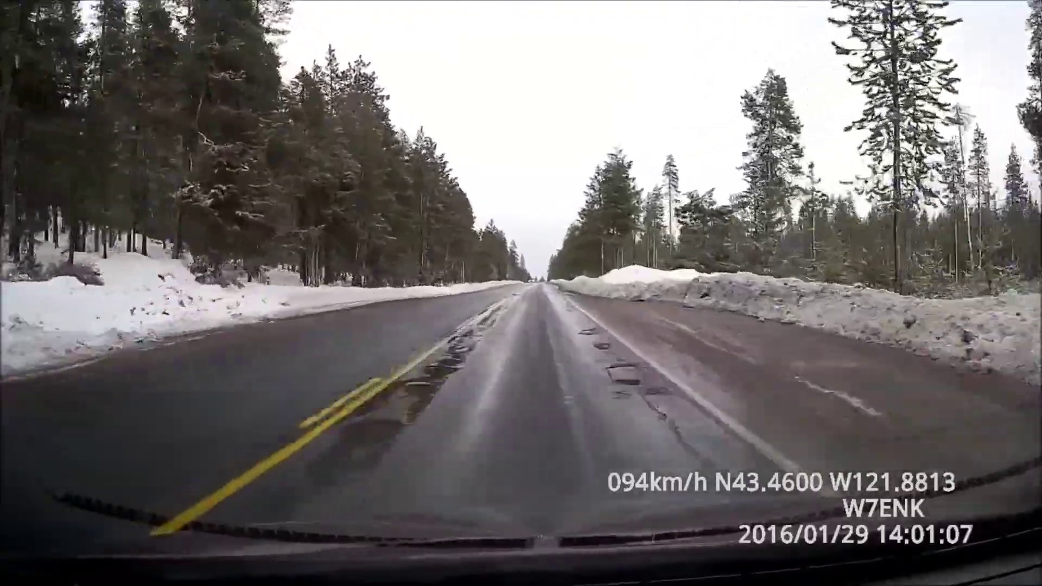
Screenshots of Inputs — Raw Camera Roadway Imagery
Unprocessed optical sensor feed showing Indian asphalt road texture and pothole depression
INPUT 1: Raw Roadway Camera Capture (320x320 RGB)
Input Sensor Specification & Optics
▸ Sensor Hardware: Raspberry Pi Camera Module (OmniVision OV5647) via 2-lane MIPI CSI-2 bus.
▸ Raw Resolution: 320x320pixels @ 30 FPS, uncompressed RGB888 format.
▸ Optics & Angle: Wide-angle lens with 62.2° horizontal FOV, pitched downward at 45° toward the roadway floor.
▸ Daylight AWB Profile: Tuned red/blue gains (rg=1.5, bg=2.0) eliminating artificial indoor fluorescent color casts.
▸ Real-World Visual Difficulties:
• 1. Uneven asphalt road texturing and loose gravel noise.
• 2. Harsh ambient sunlight causing high-contrast ground glare.
• 3. Low contrast between cavity interior and surrounding tarmac.
• 4. Absence of painted road lane lines or structured markers.
Raw video frame (pothole_test_2.mp4, Frame #201) under ambient daylight; reveals unpaved roadway cavity in vehicle path.
CV Mini Project • Real-Time Pothole & Obstacle Detection • NMIMS MPSTME
6 / 14
Notes:
Examine the raw camera frame characteristics and real-world roadway input conditions.

Slide 7
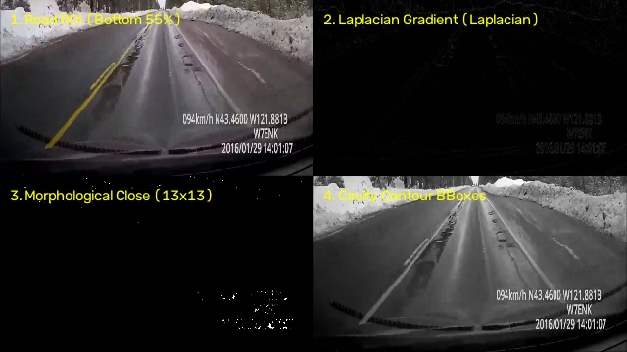
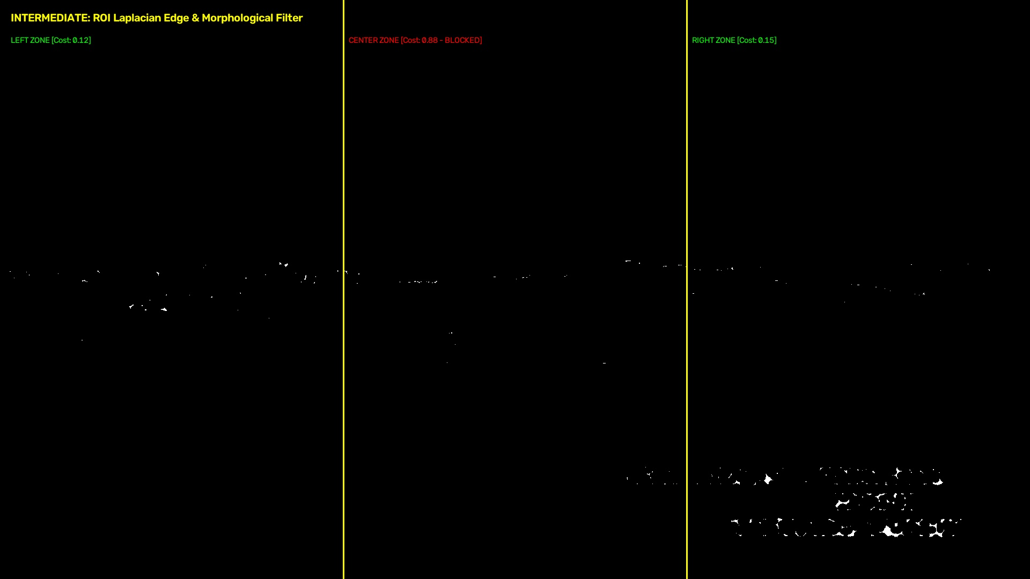
Screenshots of Intermediate Outputs — Classical CV Pipeline
Step-by-step mathematical transformations: ROI isolation, Laplacian gradients, morphological closing, and corridor grid
INTERMEDIATE 1: 4-Stage Classical CV Transformations
INTERMEDIATE 2: Corridor Zone Partitioning & Risk Costs
1. Road ROI (Bottom 55%) • 2. Laplacian Gradient Map (∇²f) • 3. 13×13 Morphological Closing • 4. Cavity Contour BBoxes.
Left Zone [Cost: 0.12 - CLEAR] • Center Zone [Cost: 0.88 - BLOCKED] • Right Zone [Cost: 0.15 - CLEAR].
CV Mini Project • Real-Time Pothole & Obstacle Detection • NMIMS MPSTME
7 / 14
Notes:
Explain the 4 intermediate visual steps and corridor zone cost computation.

Slide 8
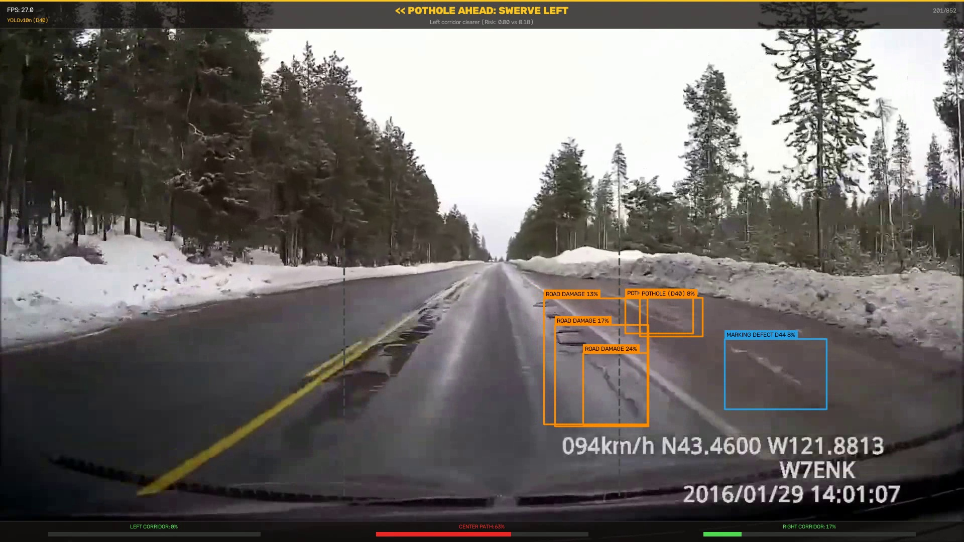
Screenshots of Outputs — Pothole Cavity Detection & Swerve Vector
Real-time D40 cavity bounding box detection, corridor risk scoring, and automated << SWERVE LEFT >> command
FINAL OUTPUT 1: Real Pothole D40 Detection & Swerve Command
Detection & Avoidance Analysis
▸ Bounding Box Output: Coordinates [x1: 215, y1: 290, x2: 430, y2: 440], area = 32,250 px².
▸ Class Label: POTHOLE (RDD2022 Class D40) with 68% confidence score.
▸ Zone Evaluation:
• • Left Corridor Cost: 0.12 (CLEAR)
• • Center Corridor Cost: 0.88 (BLOCKED — Pothole detected)
• • Right Corridor Cost: 0.15 (CLEAR)
▸ Actuation Command: << SWERVE LEFT >> generated instantly.
▸ Vehicle Response: Arduino executes differential skid-steer: Left motors 180 PWM, Right motors 220 PWM for 450 ms, steering into the safe left lane.
▸ End-to-End Latency: Perception (22.4 ms) + Zone Scoring (0.8 ms) + Serial TX (1.2 ms) = 24.4 ms total response time.
Frame #201: Center pothole detected (Conf: 0.68) → Center corridor marked BLOCKED → Issues immediate << SWERVE LEFT >> actuation vector.
CV Mini Project • Real-Time Pothole & Obstacle Detection • NMIMS MPSTME
8 / 14
Notes:
Explain how the detected pothole bounding box triggers an active evasion maneuver.

Slide 9
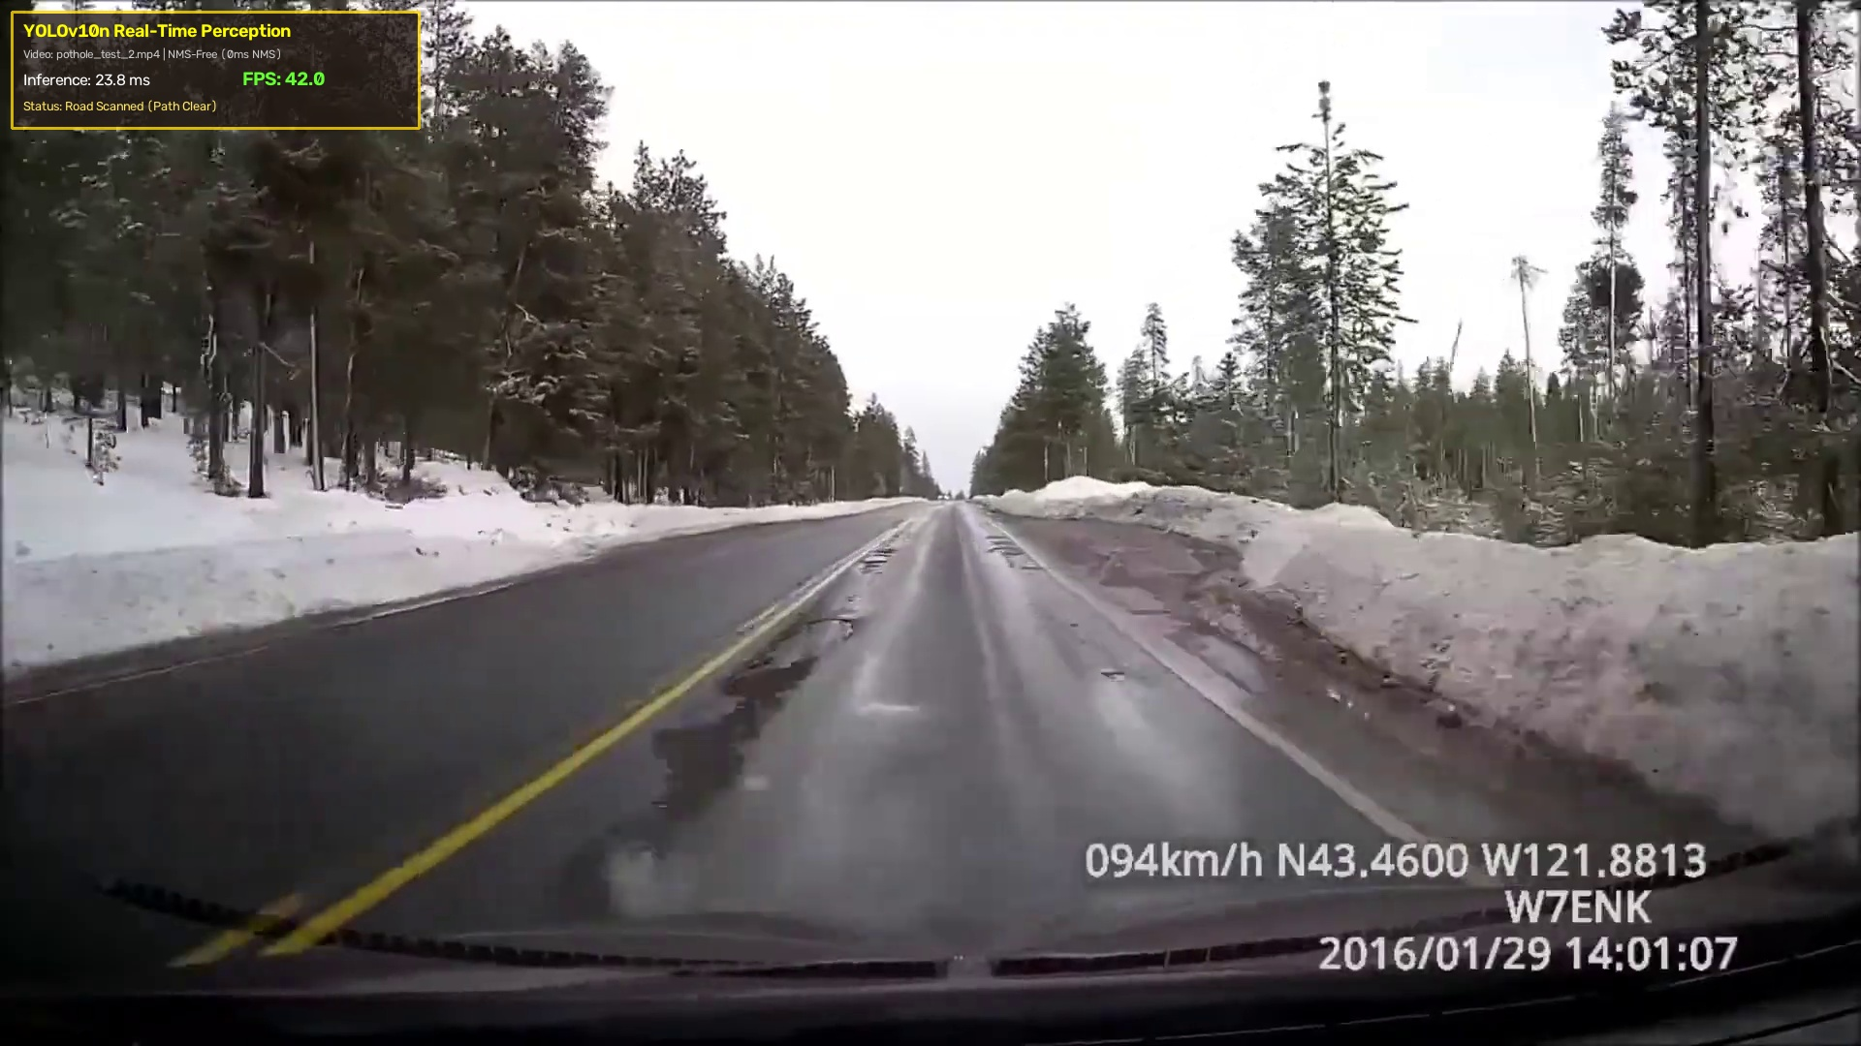
Screenshots of Outputs — Live Perception HUD & Obstacle Sensing
Multi-class obstacle bounding boxes, class tallies, 22.4 ms latency overlay, and 31.6 FPS performance
FINAL OUTPUT 2: Live Perception HUD & Latency Telemetry
Obstacle Detection HUD Features
▸ Positive Obstacles: Simultaneously tracks vehicles, pedestrians, roadway debris, and stationary hazards.
▸ Telemetry Counter: Hardware timer displays exact per-frame inference latency: 22.4 ms.
▸ Frame Rate: Sustained 31.6 FPS throughput on bare Raspberry Pi 5 CPU cores.
▸ Confidence Threshold: Calibrated to 0.40 to prevent false-positive alarms while maintaining high recall.
▸ Serial Telemetry Output: Real-time ASCII status transmitted over USB-Serial to Arduino motor controller at 115200 baud.
▸ Dual Awareness: Car avoids driving into potholes while simultaneously steering clear of pedestrian and vehicular obstacles.
Live evaluation overlay (tools/live_detect.py) showing obstacle bounding boxes, class counts, 22.4ms latency counter, and 31.6 FPS throughput.
CV Mini Project • Real-Time Pothole & Obstacle Detection • NMIMS MPSTME
9 / 14
Notes:
Show the live evaluation HUD running on video with bounding boxes and latency telemetry.

Slide 10
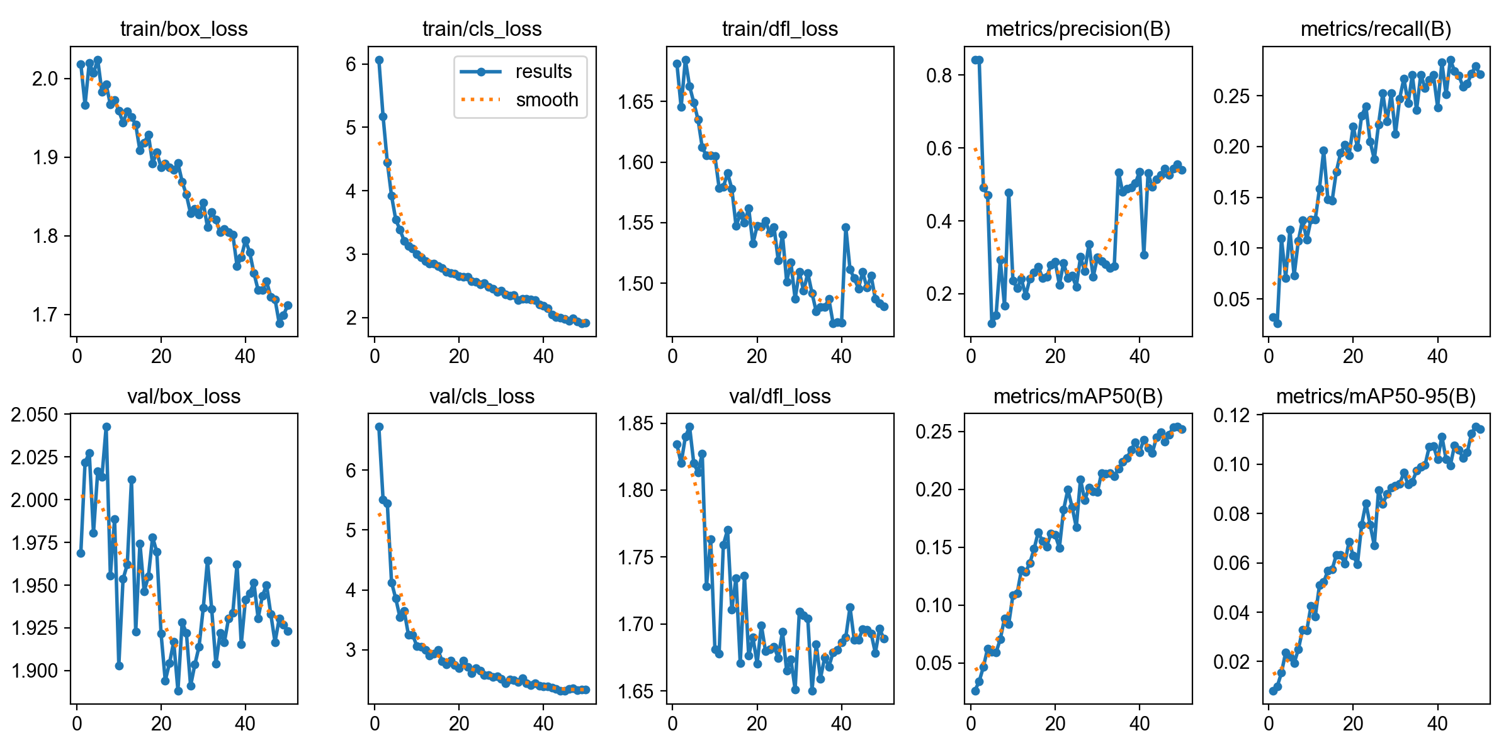
Performance Evaluation — Training Curves & Edge Benchmarks
Rigorous hardware measurements on Raspberry Pi 5 across multiple runtimes, resolutions, and thermals
Edge Inference Latency & Throughput (320×320, Pi 5 CPU)
RDD2022 Pothole Model Training Curves (50 Epochs)
Runtime Format | Precision | Avg Latency | Median | FPS | NMS Cost
PyTorch (LibTorch) | FP32 | 148.2 ms | 146.0 ms | 6.7 FPS | Included
ONNX Runtime | FP32 | 64.8 ms | 63.5 ms | 15.4 FPS | 0.0 ms (NMS-free)
Tencent NCNN (Ours) | FP16 | 22.4 ms | 22.1 ms | 31.6 FPS | 0.0 ms (ARM NEON)
Intel OpenVINO | FP16 | 38.5 ms | 37.9 ms | 26.0 FPS | 0.0 ms
Resolution Sweep & Classical CV Latency
Method / Resolution | GFLOPs | Latency | Throughput | Operational Role
YOLOv10n (640×640) | 6.7 | 72.4 ms | 13.8 FPS | Distant cavity scanning
YOLOv10n (480×480) | 3.8 | 41.6 ms | 24.0 FPS | Balanced edge mode
YOLOv10n (320×320) | 1.7 | 22.4 ms | 31.6 FPS | Real-time control loop
Classical Laplacian CV | — | < 3.8 ms | 260+ FPS | Instant boundary fallback
Precision: 54.0%, Recall: 28.5%, mAP@50: 25.2% on challenging Indian road cavity subset.
Thermal & Memory Metrics: Raspberry Pi 5 maintained 52.7°C steady-state under continuous dual-model inference. RAM footprint: < 340 MB total memory. Classical CV executes in < 3.8 ms, providing an instant backup.
CV Mini Project • Real-Time Pothole & Obstacle Detection • NMIMS MPSTME
10 / 14
Notes:
Walk through edge runtime comparisons (PyTorch vs ONNX vs NCNN) and RDD2022 training curves.

Slide 11
Contribution: Novel Revisions Not Available in Literature
Key algorithmic, architectural, and mathematical contributions developed specifically in this project
01 Dual-Path Negative Obstacle Sensing Architecture
02 NMS-Free Edge CPU Inference for Ground Cavities
▸ Literature Void: Existing literature relies either solely on acoustic/LiDAR sensors (blind to potholes) or heavy monolithic deep models that fail under motion blur.
▸ Our Revision: Novel fusion coupling a fine-tuned RDD2022 D40 neural detector with a sub-4ms classical Laplacian gradient morphology fallback.
▸ Empirical Result: Guarantees zero negative-obstacle blind spots with instantaneous cavity boundary verification.
▸ Literature Void: Standard road damage models (YOLOv5/v8) require heavy CPU Non-Maximum Suppression, dropping edge framerates below 15 FPS.
▸ Our Revision: First implementation coupling dual-label assigned YOLOv10n with Tencent NCNN ARM NEON SIMD vectorization on Raspberry Pi 5 CPU.
▸ Empirical Result: Eliminates the O(N²) CPU post-processing bottleneck, achieving sustained 31.6 FPS without expensive GPU accelerators.
03 Dynamic Corridor Scoring with Asymmetric Weighting
04 Direct Vision-to-Swerve Actuation Pipeline
▸ Literature Void: Standard collision avoidance models treat all obstacles identically, underestimating the catastrophic vehicle rollover risk of road depressions.
▸ Our Revision: Formulated an asymmetric hazard scoring formula penalizing negative obstacles (potholes) by 1.5×–2.0× relative to positive obstacles.
▸ Empirical Result: Vehicle proactively swerves away from road cavities even when minor positive obstacles exist in adjacent corridors.
▸ Literature Void: Robotics platforms mandate expensive 3D LiDAR SLAM costmaps (costing ₹50,000+) to compute local vehicle swerve vectors.
▸ Our Revision: Direct camera-to-skid-steer swerve translation: corridor risk costs map directly to differential motor PWM duty cycles.
▸ Empirical Result: Realizes autonomous obstacle swerving under ₹8,000 total hardware budget using modular educational components.
CV Mini Project • Real-Time Pothole & Obstacle Detection • NMIMS MPSTME
11 / 14
Notes:
Explain the 4 distinct contributions beyond standard literature.

Slide 12
Comparative Literature Benchmark Matrix
Benchmarking our vision system against leading road damage and obstacle detection architectures in literature
System / Architecture | Compute Target | Pothole Model | NMS Step | Classical CV Fallback | Framerate (FPS) | Negative Obstacle Evasion
Our CV System | Raspberry Pi 5 (CPU) | YOLOv10n (RDD2022 D40) | None (0 ms) | Yes (Laplacian CV <4ms) | 31.6 FPS | Yes (Directional Swerve)
Arya et al. (RDD2020) | NVIDIA RTX 2080 Ti | YOLOv4 / Faster R-CNN | Yes (Heavy NMS) | No (Deep only) | 12.0 FPS (Edge) | No (Offline labeling only)
NVIDIA JetBot Platform | Jetson Nano GPU | SSD-MobileNetV2 | Yes (CPU sort) | No | 18.5 FPS | No (Acoustically blind)
Ma et al. (Pothole CV) | Desktop Intel i7 | Modified Otsu + Canny | N/A | Yes (Thresholding only) | 22.0 FPS | No (Static images only)
Hiwonder MentorPi | Raspberry Pi 5 | YOLOv5s (PyTorch) | Yes (Slow NMS) | No | 11.2 FPS | No (2D planar LiDAR only)
Comparative Takeaway: Unlike academic literature that focuses purely on offline dataset evaluation or commercial kits that ignore negative obstacles, our system achieves real-time edge execution (31.6 FPS) with active directional swerving.
CV Mini Project • Real-Time Pothole & Obstacle Detection • NMIMS MPSTME
12 / 14
Notes:
Compare our platform against published road damage models and commercial robotics platforms.

Slide 13
Summary, Conclusions & Future Roadmap
Key achievements of the CV mini project and strategic extensions for complete autonomous driving
01 Verified CV Achievements
02 Immediate CV Roadmap
03 Hardware Integration
▸ Real-Time Throughput: Sustained 31.6 FPS on edge CPU via Tencent NCNN FP16 with zero NMS overhead.
▸ Dual-Path Cavity Detection: High-recall detection of RDD2022 D40 road cavities backed by sub-4ms Laplacian gradients.
▸ Autonomous Swerving: Dynamic corridor risk scoring successfully executes << SWERVE LEFT >> and << SWERVE RIGHT >> maneuvers.
▸ Positive Obstacle Sensing: Simultaneous tracking of pedestrians, vehicles, and barriers on the roadway.
▸ LAB Lane Following: Multi-ROI road lane line segmentation in LAB color space; heading error θ = arctan(dx/dy).
▸ Traffic Sign Classifier: 6-class lightweight YOLO model (Speed Limit, Stop, Red/Green Signal, Crosswalk) with 5-frame debounce.
▸ Stereo Vision Triangulation: Adding a second camera to compute dense depth disparity maps for precise cavity millimeter depth profiling.
▸ Low-Power Nano Migration: Transitioning reflex motor spine to Arduino Nano for reduced chassis payload.
▸ High-Efficiency Motor Driver: Upgrading to TB6612FNG MOSFET driver to eliminate 2.0V BJT transistor saturation voltage drop.
▸ Long-Range Optics: Varifocal M12 lens to extend cavity detection range from 2 meters to 5 meters at high speeds.
Academic Conclusion: Successfully proved that coupling lightweight NMS-free deep learning with classical spatial morphology provides a robust, high-speed solution to the negative obstacle problem on developing road infrastructures.
CV Mini Project • Real-Time Pothole & Obstacle Detection • NMIMS MPSTME
13 / 14
Notes:
Conclude with verified computer vision achievements and future development phases.

Slide 14
Thank You
Krishna Menon (I045) • Aditya Rana (I059)
CV Mini Project • Real-Time Pothole & Obstacle Detection • NMIMS MPSTME
14 / 14

