Slide 1
📦
Products
Full CRUD
📊
Inventory
Inventory & Product Management Application
Live tracking
Capstone Project | Software Engineering Program | April 2026
🏪
Suppliers
Contacts

Slide 2
The Problem & Our Solution
❌ The Problem
✅ JetStock Solution
Manual tracking via notebooks & spreadsheets
No real-time stock level visibility
Missing low-stock alerts until out of stock
No central system — disorganised records
Existing tools are too complex & expensive
Time wasted searching for product info
Central web app for all inventory data
Live stock quantity tracking
Low-stock & reorder level visibility
Organised by product, category & supplier
Simple, lightweight — built for small business
Fast search & filter for any product
→

Slide 3
Industry Domain & Stakeholders
Stakeholders
Primary Stakeholders (JetStock)
Small business owner
Staff
Secondary Stakeholders (JetStore)
Customers for business
Industry Domain (JetStock)
Small Retailers
Resellers
Home-based business

Slide 4
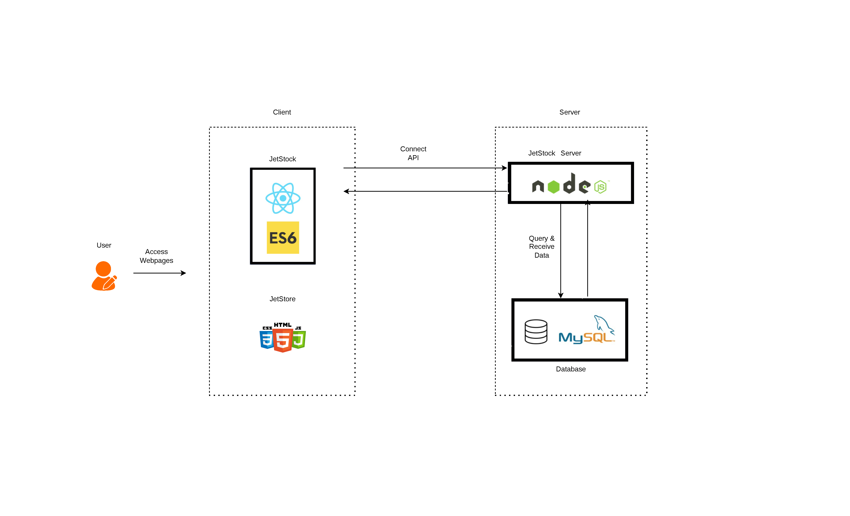
System Architecture & Tech Stack

Slide 5
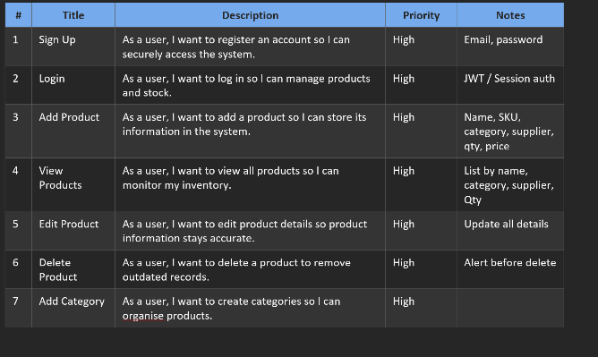
User Stories

Slide 6
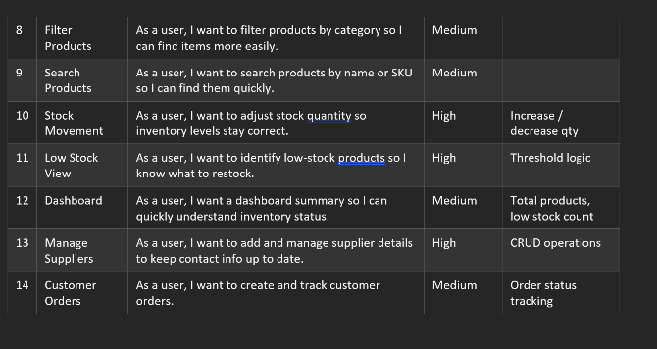
User Stories

Slide 7
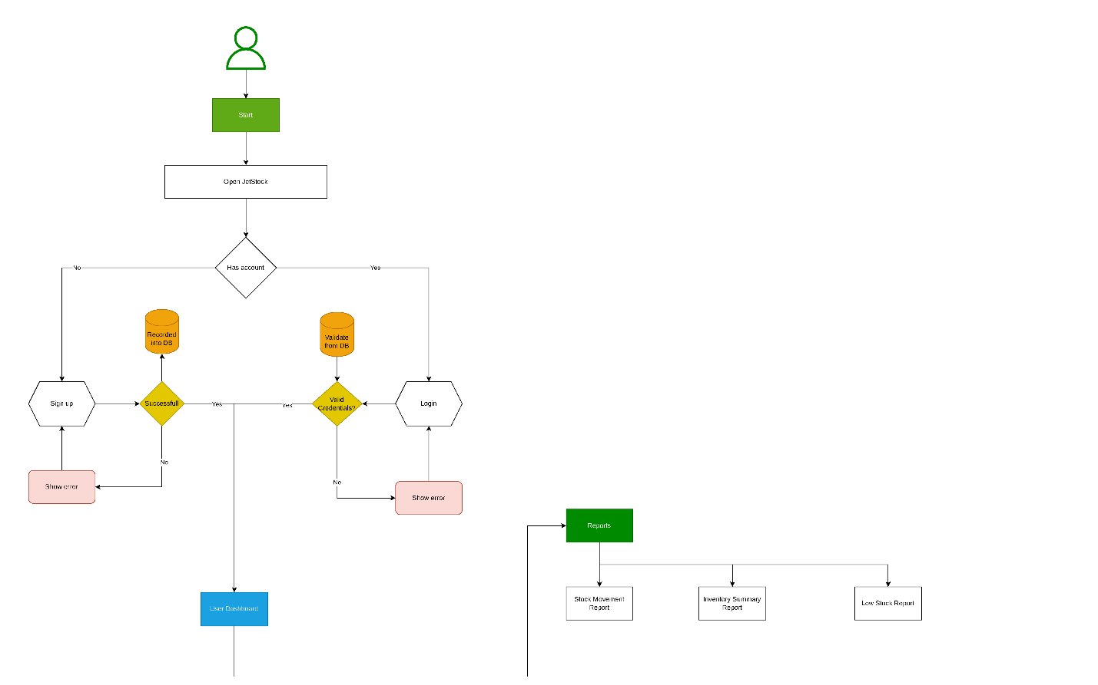
User Flow

Slide 8
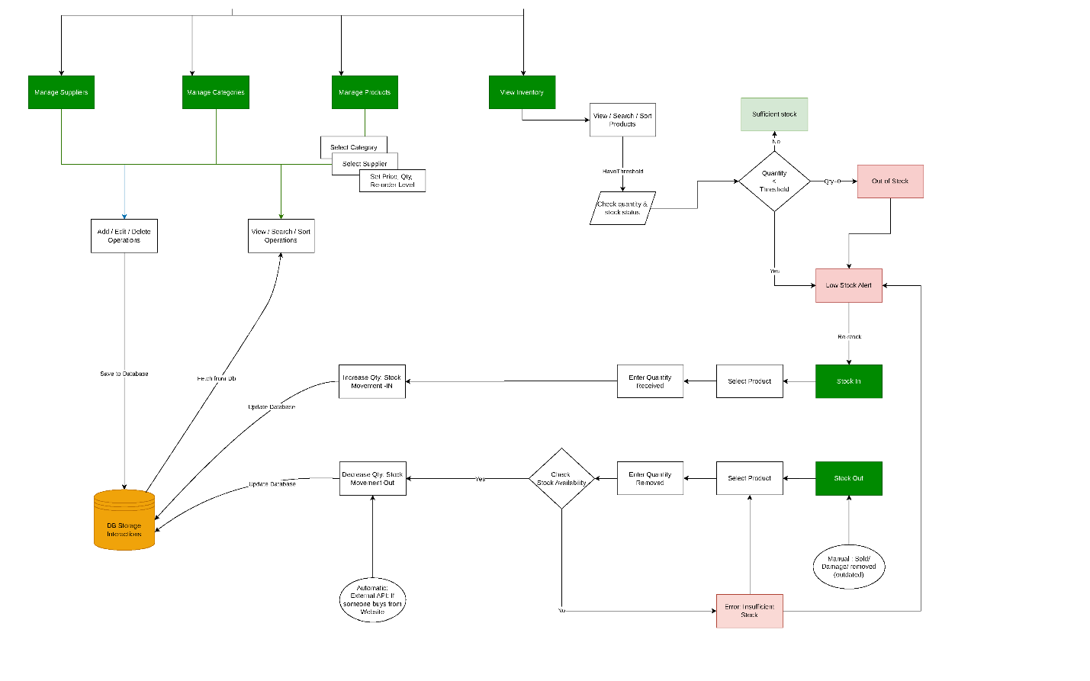
User Flow

Slide 9
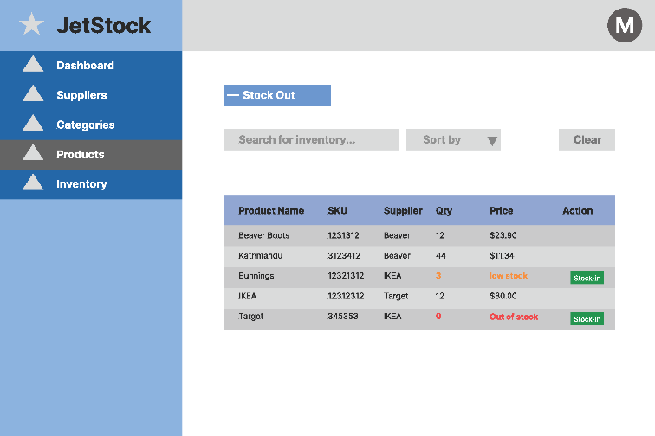
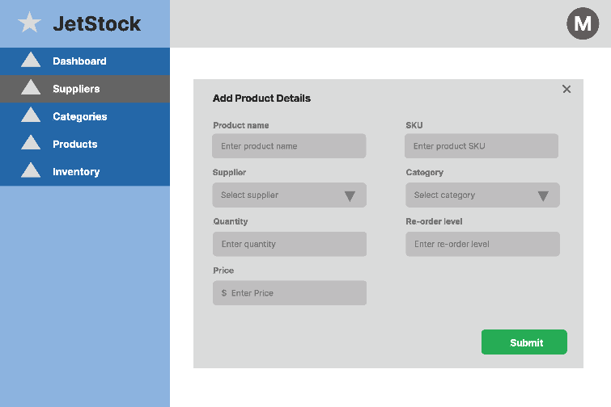
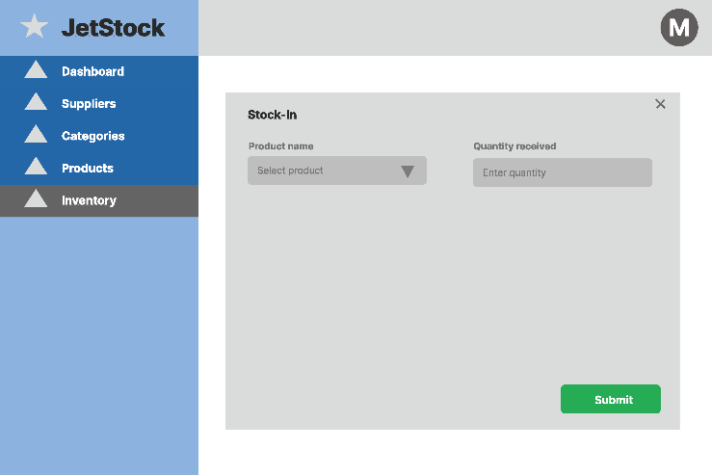
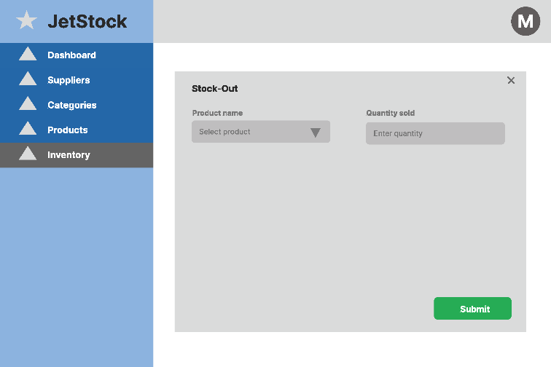
Wireframe Design

Slide 10
Key Features
🔐
📦
🏷️
🚚
Authentication
Product Management
Categories
Suppliers
JWT-based login & registration with role-based access
Full CRUD for products with SKU, price, category & supplier
Organise products into categories for easy filtering
Manage supplier contacts linked to your products
📊
↕️
📋
🎛️
Inventory Control
Stock Movements
Orders
Dashboard
Real-time quantity tracking with low-stock & out-of-stock alerts
Log stock IN/OUT with movement type: manual, online, return, damage
Create and track customer orders with full order item management
Summary view of total products, low-stock count and inventory stats

Slide 11
Non –functional & Extended Features
Exended Features
CSV export
Image upload
Theme modes
Role based access
Charts and analytics
Non-functional Features
Application is built in MUI
Interface is simple and easy
Backend MVC structure
API responses handle errors
Data persistents in MYSQL
Sensitive config in .env

Slide 12
Database Design (ERD)
Users
Products
Categories
id, first_name, last_name, email, role
id, sku, name, price, supplier_id, category_id
id, name, description, user_id
Stock_movements
Inventory
Suppliers
id, product_id, movement_type, source_type, qty
id, product_id, quantity_on_hand, reorder_level
id, name, contact_person, email, phone
Orders
Order_items
Customers
id, customer_id, status, total_amount
id, order_id, product_id, quantity, unit_price
id, full_name, email, phone, address

Slide 13
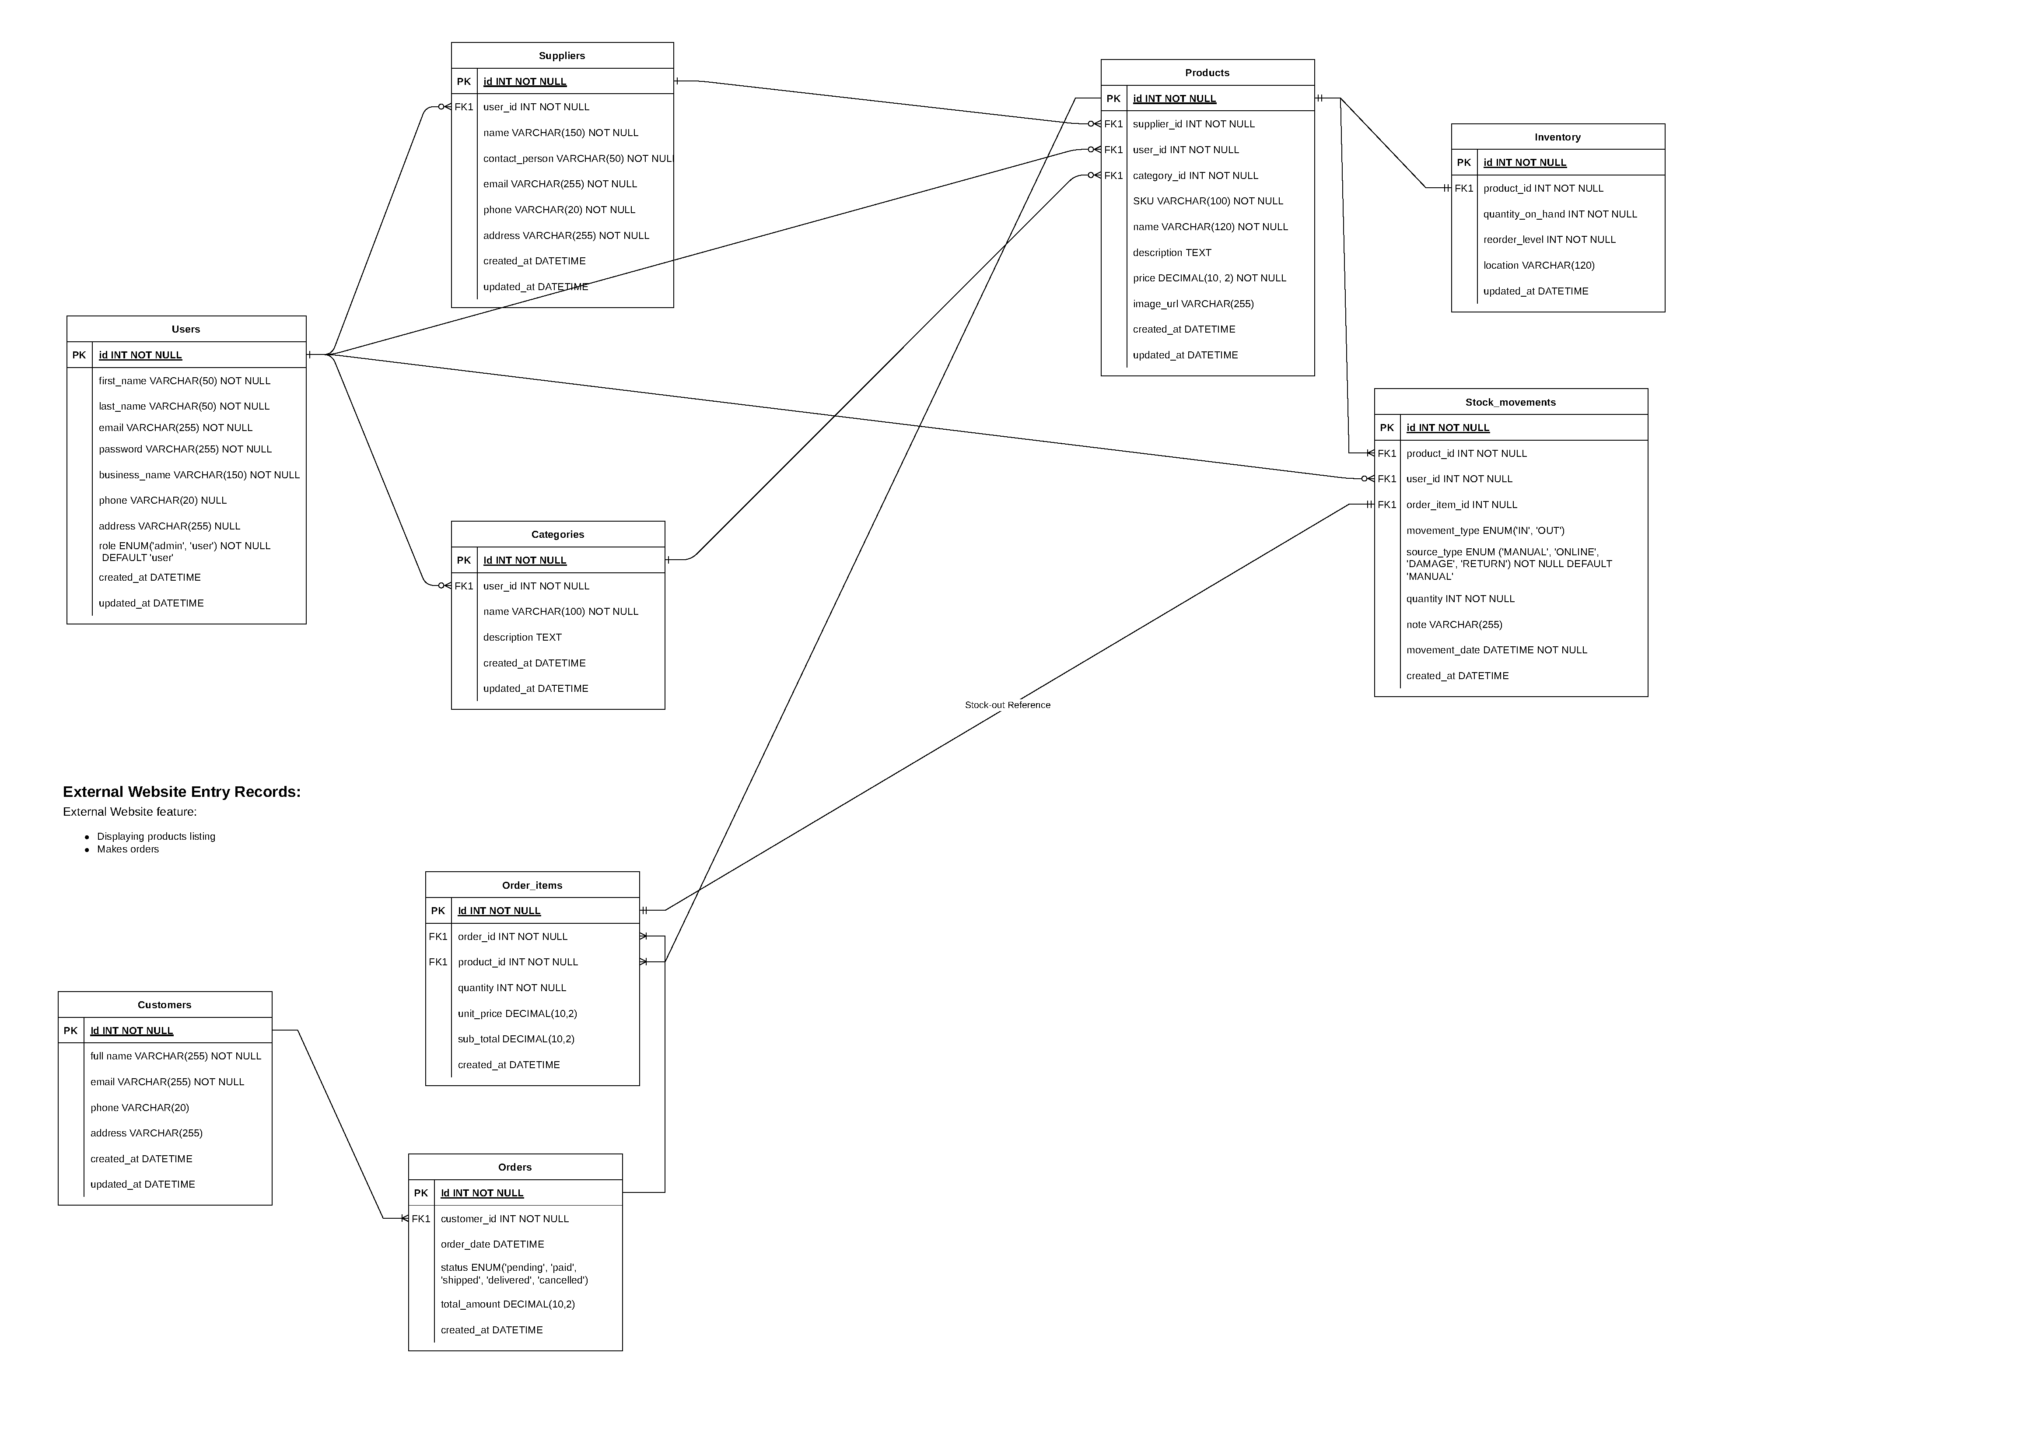

Slide 14
Project Planning & Timeline
Phase 1
Phase 2
Phase 3
Phase 4
Mar 13–15
Mar 16–24
Mar 24–28
Mar 28–31
Planning & Design
Backend Dev
Frontend Dev
Polish & Delivery
✓ Define project
✓ User stories
✓ Architecture diagram
✓ Lo-fi wireframes
✓ Models & DB setup
✓ CRUD APIs
✓ Auth / JWT
✓ Error handling
✓ Unit tests
✓ Login/Signup
✓ Dashboard
✓ All listing pages
✓ Forms & search
✓ Connect API
✓ UI polish
✓ Frontend tests
✓ Documentation
✓ PPT slides

Slide 15
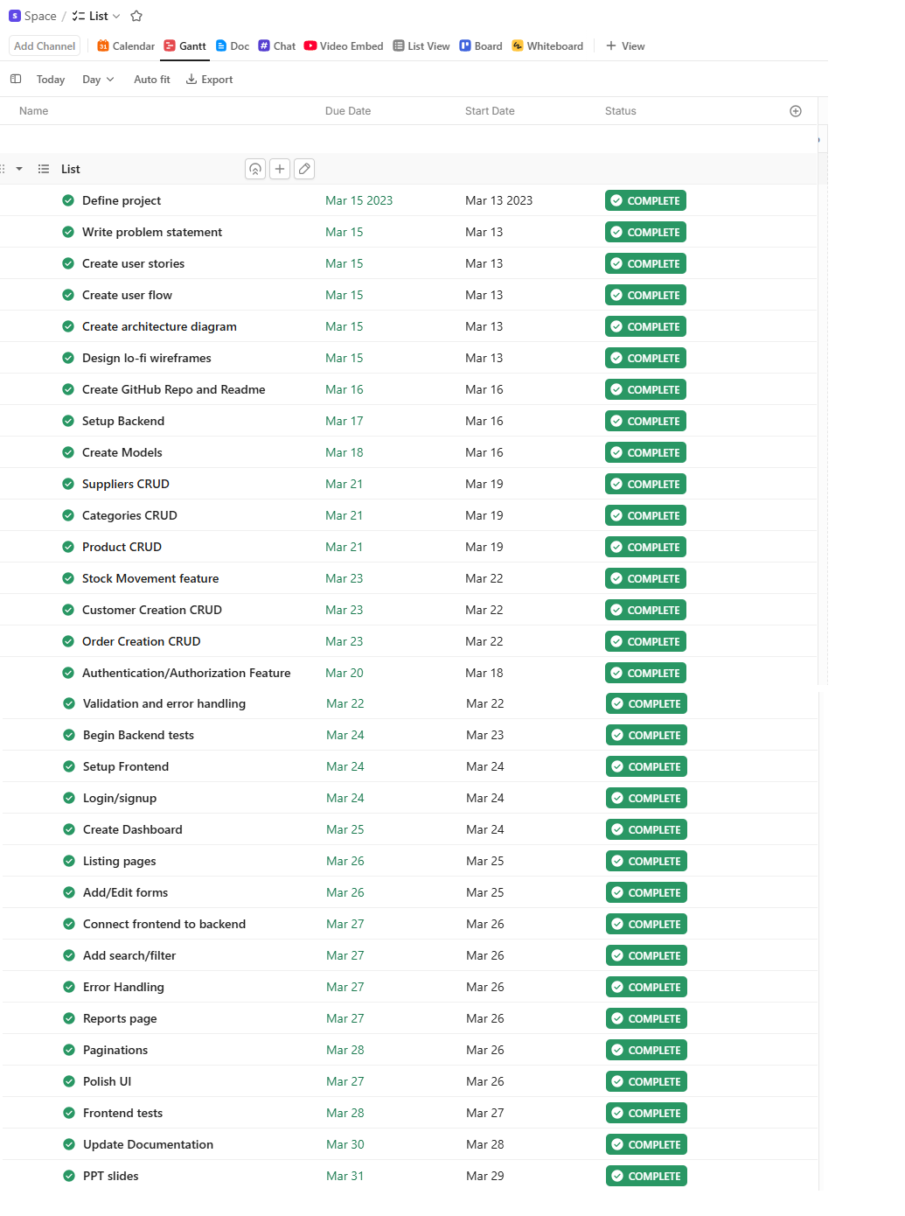

Slide 16
Testing Strategy
⚡ Unit Testing (Jest)
🔗 API Testing (Postman)
CRUD controller tests
Stock movement logic
Auth middleware validation
Error handling responses
All REST endpoints verified
Valid & invalid request bodies
Auth headers & protected routes
HTTP status code verification
👁️ Manual UI Testing
🛡️ Edge Cases Handled
Login/Registration flow
All CRUD form validation
Dashboard real-time data
Search, filter & pagination
Stock out > available qty
Duplicate SKU detection
Delete with linked records
Out-of-stock visual alerts

Slide 17
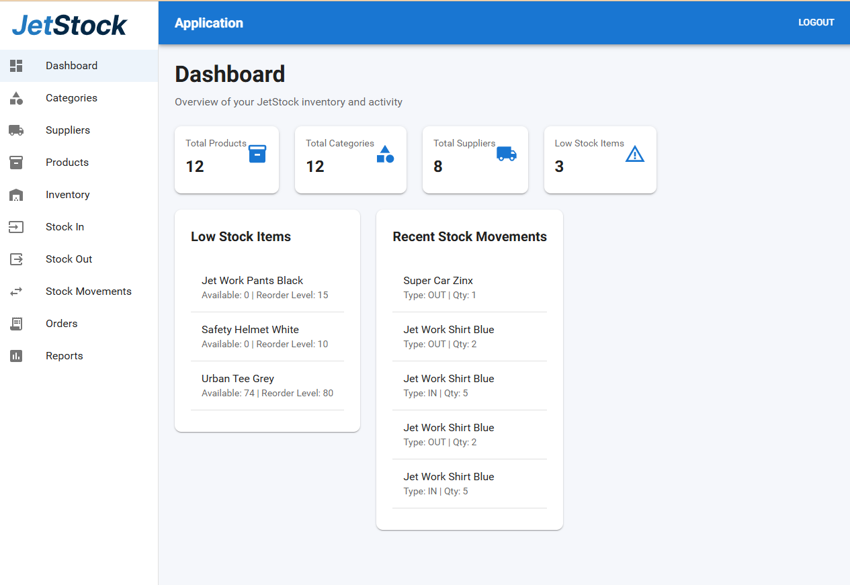
Application Walkthrough

Slide 18
Project Outcomes
What JetStock delivered
✅ Full-stack web app with React + Node.js + MySQL
✅ Complete CRUD for Products, Categories, Suppliers & Orders
✅ Real-time inventory tracking with low-stock alerts
✅ JWT authentication with protected routes
✅ External storefront (JetStore) connected via shared API
✅ Unit tests (Jest) + API tests (Postman)
https://github.com/mensonsundash/jetstock-capstone

